Slide 1
Chapter 11:
Human–Computer Interaction
Layer Design

Slide 2
Objectives
Understand several fundamental user interface (UI) design principles.
Understand the process of UI design.
Understand how to design the UI structure.
Understand how to design the UI standards.
Understand commonly used principles and techniques for navigation design.

Slide 3
Objectives (cont’d)
Understand commonly used principles and techniques for input design.
Understand commonly used principles and techniques for output design.
Be able to design a user interface.
Understand the affect of nonfunctional requirements on the human-computer interaction layer.

Slide 4
Overview
Interface Design formalizes the interaction of the system with external entities
  System Interfaces are machine-machine and are dealt with as part of systems integration
  User Interfaces are human-computer and are the focus of this chapter

Slide 5
PRINCIPLES OF USER INTERFACE DESIGN

Slide 6
Principles of User Interface Design
Layout
Content Awareness
Aesthetics
User Experience
Consistency
Minimal User Effort

Slide 7
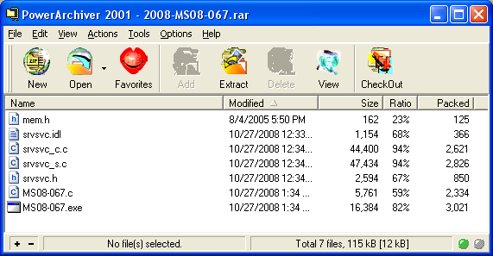
General Layout
Navigation Area
Reports & Forms Area
Status Area

Slide 8
Layout
Each area may be further subdivided
Each area is self-contained
Areas should have a natural intuitive flow
  Users from western nations tend to read from left to right and top to bottom
  Users from other regions may have different flows

Slide 9
Content Awareness
Intuitively answers the users’ questions:
  Where am I?
  What am I supposed to be doing here?
Content awareness applies to sub-areas within a form or window
  Related form fields (e.g. address information) are grouped together
  Related report information (e.g. records) are grouped together

Slide 10
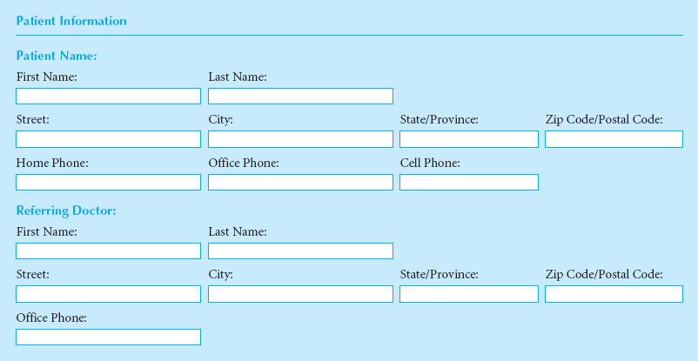
Form Content Awareness
Name Area
Phone Numbers Area

Slide 11
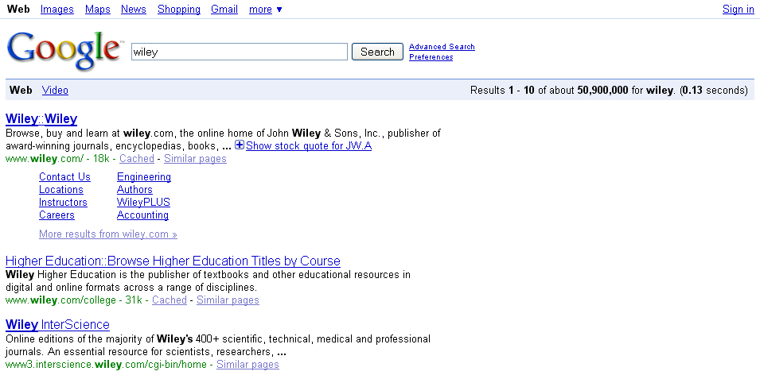
Report Content Awareness
First Record Area
Second Record Area

Slide 12
Aesthetics
Interfaces should be functional, inviting to use, and pleasing to the eye
In most cases, less is more (minimalist design)
White space is important
Acceptable information density is proportional to the user’s expertise
  Novice users prefer less than 50% density
  Expert users prefer more than 50% density

Slide 13
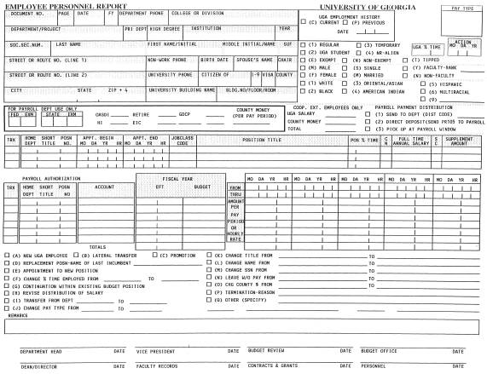
Bad Aesthetics

Slide 14
User Experience
Ease of learning
  Significant issue for inexperienced users
  Relevant to systems with a large user population
Ease of use
  Significant issue for expert users
  Most important in specialized systems
Sometimes ease of learning and use of use go hand in hand

Slide 15
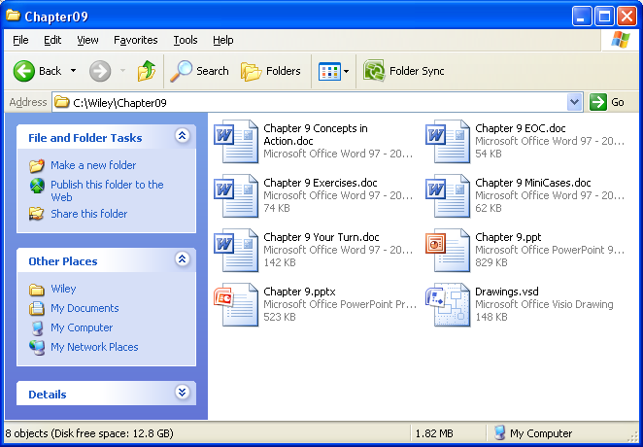
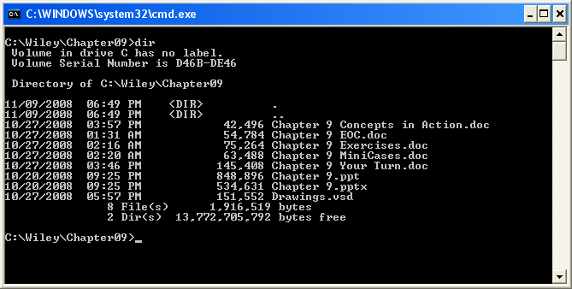
Multiple Interfaces
Microsoft Windows has multiple interfaces for the same functionality
Most users prefer to use Windows Explorer for handling files
Expert users sometimes prefer the command line interface

Slide 16
Consistency
All parts of the system work in the same way
Key areas of consistency are
  Navigation controls
  Terminology
Probably most important concept in making the system simple because it allows the users to predict what is going to happen

Slide 17




Minimal User Effort
Interfaces should be designed to minimize the effort needed to accomplish tasks
A common rule is the tree-clicks rule
  Users should be able to go from main menu of a system to the information they want in no more than three mouse clicks

Slide 18
USER INTERFACE DESIGN PROCESS

Slide 19
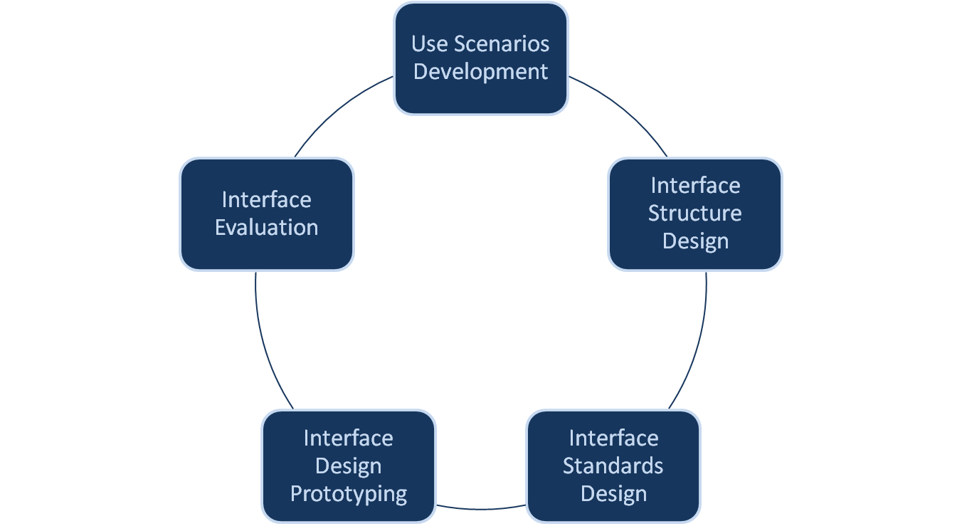
5-Step UI Design Process

Slide 20
Use Scenario Development
Use scenarios outline the steps performed by users to accomplish some part of their work
A use scenario is one path through an essential use case
Presented in a simple narrative description
Document the most common cases so interface designs will be easy to use for those situations

Slide 21
Interface Structure Design
The interface structure defines
  The basic components of the interface
  How they work together to provide functionality to users
Windows Navigation Diagrams (WND) show
  how all the screens, forms, and reports used by the system are related
  how the user moves from one to another

Slide 22
Windows Navigation Diagrams
Like a state diagram for the user interface
  Boxes represent components
    Window
    Form
    Report
    Button
  Arrows represent transitions
    Single arrow indicates no return to the calling state
    Double arrow represents a required return
  Stereotypes show interface type

Slide 23
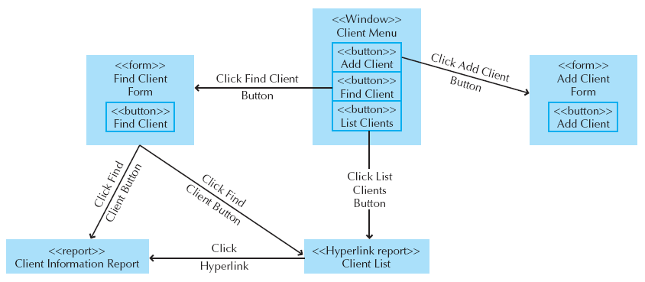
Sample WND

Slide 24
Interface Standards Design
Interface standards are basic design elements found across the system user interface
Standards are needed for:
  Interface metaphor
  Interface objects
  Interface actions
  Interface icons
  Interface templates

Slide 25
Interface Design Prototyping
Mock-ups or simulations of computer screens, forms, and reports
Four common approaches
  Storyboard
  Windows layout diagram
  HTML prototype
  Language prototype

Slide 26
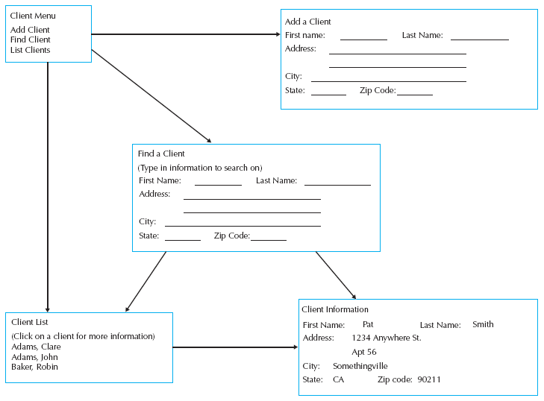
Sample Storyboard

Slide 27
Interface Evaluation
Goal is to understand how to improve the interface design before the system is complete
Have as many people as possible evaluate the interface
Ideally, interface evaluation is done while the system is being designed—before it is built

Slide 28
4 Approaches to UI Evaluation
Heuristic
Walkthrough
Interactive
Formal Usability Testing

Slide 29
NAVIGATION DESIGN

Slide 30
Navigation Design Basic Principles
Prevent mistakes
Simplify recovery from mistakes
Use consistent grammar order

Slide 31
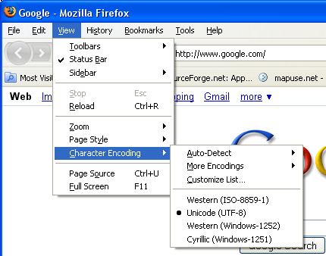
Common Navigation Menu
Drop-down menu
Menu bar
Grayed-out commands
Cascading menu

Slide 32
INPUT DESIGN

Slide 33
Input Design Basic Principles
Online versus Batch processing
Capture data at the source
Minimize keystrokes

Slide 34
Types of Inputs
Free form
  Text box
  Number box
Selection box
  Check box
  Radio button
  List box (on-screen, drop-down, or combo)
  Sliders

Slide 35
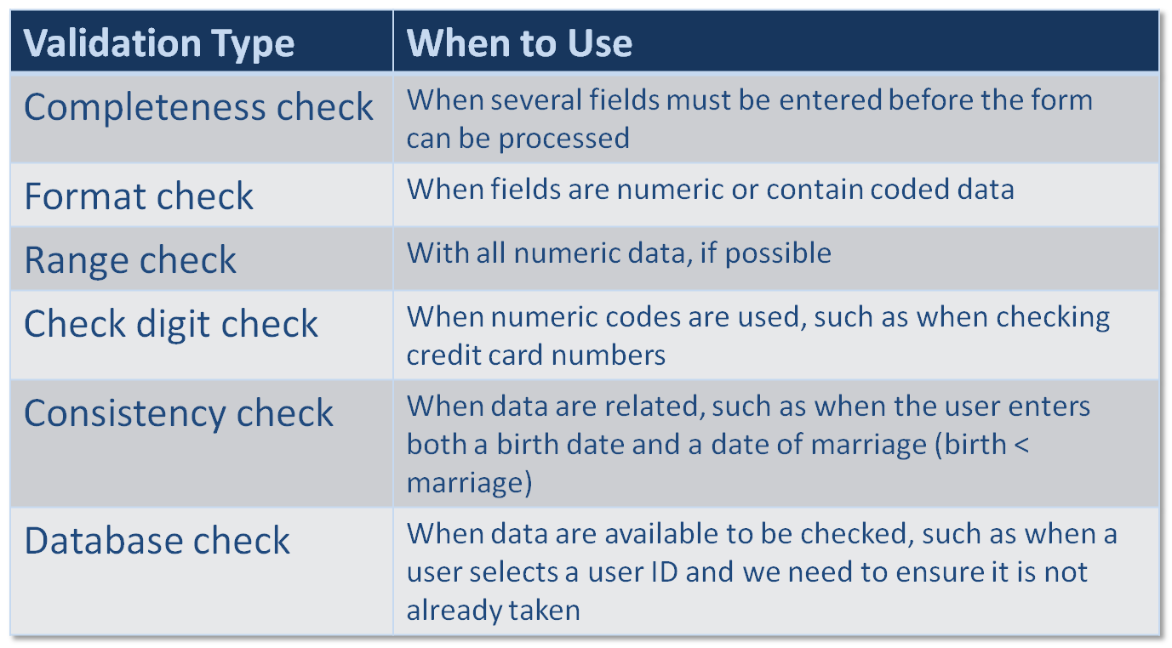
Input Validation Types

Slide 36
OUTPUT DESIGN

Slide 37
Output Design Basic Principles
Understand report usage
Manage information load
Minimize bias

Slide 38
Types of Outputs
Detail reports
Summary reports
Exception reports
Turnaround documents
Graphs

Slide 39
NONFUNCTIONAL REQUIREMENTS

Slide 40
Non-Functional Requirements
Operational Requirements
  Technologies that can be used (e.g. GUI, mouse)
Performance Requirements
  User interface took kit speed and capacity
Security Requirements
  Restricted user interface (e.g. an ATM machine)
Political & Cultural Requirements
  Date formats, colors and icons

Slide 41
Summary
Principles of User Interface Design
User Interface Design Process
Navigation Design
Input Design
Output Design
Nonfunctional Requirements

