Slide 1
Chapter 13:
Construction

Slide 2
Objectives
Be familiar with the system construction process.
Understand different types of tests and when to use them.
Understand how to develop documentation.

Slide 3
Introduction
Construction is the development of all parts of the system, documentation, and new operating procedures
Programming is the largest, but least risky part of systems development
A program is not considered finished until the test for that program is passed.

Slide 4
MANAGING PROGRAMMING

Slide 5
Assigning Programmers
First, group together related classes, then assign each group to a programmer
Time required is proportional to number of programmers
  The more programmers, the more coordination, which means less time is spent actually coding
  Best to use a small team of programmers
  Divide complex projects into autonomous parts

Slide 6
Coordinating Activities
Weekly project meetings
Create and enforce standards
Divide resources into three areas:
  Development
  Testing
  Production
Implement change control measures

Slide 7
Managing the Schedule
Time estimates must be revised as construction proceeds
  Build a 10% error margin into all schedules
Scope creep occurs when new requirements are added to the project after the system design was finalized
Risk assessments can help predict problems before they derail the project

Slide 8
DESIGNING TESTS

Slide 9
Testing
The purpose of testing is to uncover as many errors as feasible
  It is impossible to prove the system error-free
  It is too expensive to look for all possible bugs
Four stages of testing
  Unit tests
  Integration tests
  System tests
  Acceptance tests

Slide 10
Testing and Object Orientation
Encapsulation and Information-Hiding
Polymorphism and Dynamic-Binding
Inheritance
Reuse
Object-Oriented Development Process and Products

Slide 11
Test Planning
Testing takes place throughout the development of an object-oriented system
Test plans define a series of tests to be conducted
Each test has a specific objective and describes specific test cases to examine
Stubs are hard-coded placeholders that allow testing using unfinished classes

Slide 12
Unit Tests
Unit tests focus on a single class
Black box testing examines externally visible behaviors of a class
  Driven by CRC cards and method contracts
  Tester knows nothing of how the class was coded
White box testing examines the internals of a class
  Driven by method specifications for the class

Slide 13
Rules of Unit Testing
Write the test first
Define the expected output or result.
Don't test your own programs.
Test for invalid or unexpected conditions.
Use reproducible tests
Never write a test that succeeds the first time.
The probability of locating more errors in any one module is directly proportional to the number of errors already found in that module.

Slide 14
Integration Tests
Assess whether a set of classes that must work together do so without error
Four common approaches
  User interface testing
  Use case testing
  Interaction testing
  System interface testing
Most projects use all four approaches

Slide 15
Final Testing
System Testing determines
  How well the system meets business requirements
  Usability, security, & performance under load
  Adequacy of documentation
Acceptance Testing
  Primarily by users with support from project team
  Goals is to confirm that the system is complete and is acceptable to the users

Slide 16
DEVELOPING DOCUMENTATION

Slide 17
Developing Documentation
Documentation of the system must be done throughout system development
Two fundamentally different types
  System documentation is for those who install, maintain or build upon the system
  User documentation is for those who use it
    Assume the users will not read the manuals before starting to use the system!
Online documentation is the norm today

Slide 18
Types of Documentation
Reference Documents
  Tell users how to perform specific tasks
Procedure Manuals
  Describe how to perform business tasks
  Each procedure normally entails multiple tasks
Tutorials
  teach people how to use major components of a system

Slide 19
Designing Documentation Structure
Develop a set of documentation navigation controls that lead the user to documentation topics
Topics generally come from 3 sources
  Commands and menus in the user interface
  How to perform certain tasks
  Definitions of important terms

Slide 20
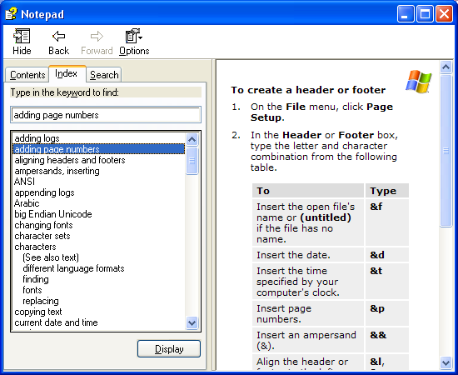
Online Help Example
Navigation buttons
Task title
Step-by-step instructions

Slide 21
Writing Documentation Topics
Use the active voice
Use e-prime style
Use consistent terms
Use simple language
Use friendly language
Use parallel grammatical structures
Use steps correctly
Use short paragraphs

Slide 22
Summary
Managing Programming
Designing Tests
Developing Documentation

