Slide 1
Chapter 14:
Installation and Operations

Slide 2
Objectives
Be familiar with the system installation process.
Understand different types of conversion strategies and when to use them.
Understand several techniques for managing change.
Be familiar with post-installation processes.

Slide 3
Installation & Operations
Managing the change to a new system is one of the most difficult tasks in any organization
Conversion planning normally begins while the programmers are still coding
Change management focuses on people
Maintenance can account for 80% of IS budget

Slide 4
Implementing Change
As-Is System
To-Be System
Transition
Unfreeze
Analysis & Design
Move
Technical Conversion
Change Management
Refreeze
Support & Maintenance

Slide 5
CULTURAL ISSUES AND INFORMATION TECHNOLOGY

Slide 6
Cultural Issues
Power distance
Uncertainty-avoidance
Individualism vs. collectivism
Masculinity vs. femininity
Long vs. short-term orientation

Slide 7
CONVERSION

Slide 8
Conversion
Conversion is the technical process by which a new system replaces an old system
Three major steps to a conversion plan
  Acquire and install needed hardware
  Install software
  Convert data
Three dimensions to a conversion plan
  Conversion style
  Conversion location
  Conversion modules

Slide 9
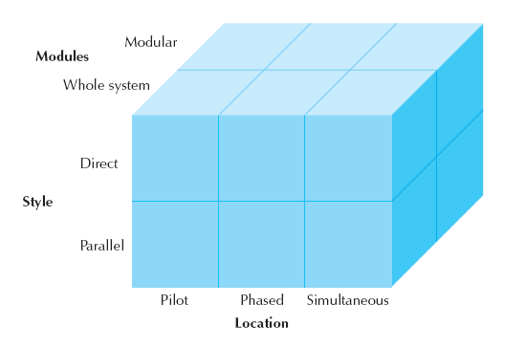
Conversion Strategies

Slide 10
Selecting Conversion Strategies
Risk, cost, and time: choose any two
Risk
  Even after testing, bugs may exist
Cost
  Redundant resources for transitions can be pricey
Time
  Slow and safe or fast and risky?

Slide 11
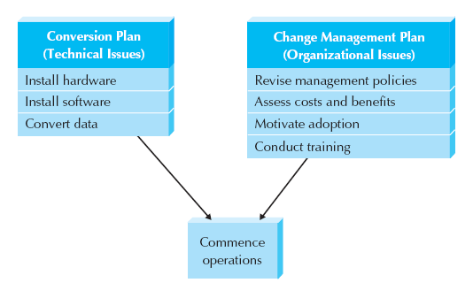
Elements of Migration Plans

Slide 12
CHANGE MANAGEMENT

Slide 13
Change Management
The process of helping people adopt & adapt to the to-be system and its accompanying work processes without undue stress
Key roles
  Sponsor
  Change agent
  Potential adopters
“Build it and they will come” doesn’t work!

Slide 14
Resistance to Change
What is good for the organization is often not good for the people in it
People perform their own personal cost-benefit analysis
  Most will overestimate costs and underestimate benefits
  Must take into account the transition process cost
  Perceived costs and benefits determine attitude

Slide 15
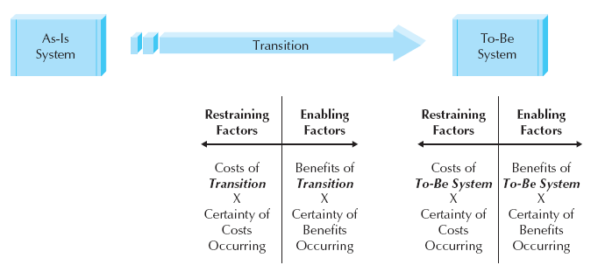
Costs & Benefits of Change

Slide 16
Revising Management Policies
Management policies
  Provide goals
  Define how work processes should be performed
  Determine how people are rewarded
No computer system will be successfully adopted unless management policies support its adoption

Slide 17
Work Process Structuring Tools
Standard Operating Procedures
  SOPs must be revised to match the to-be system
Measurements and Rewards
  Adapt to motivate desired (acceptance) behavior
Resource Allocation
  Direct effect is the actual reallocation of resources
  Symbolic effect shows that management is serious about the new system

Slide 18
Assessing Costs & Benefits
Two perspectives: organizational & adopters’
Consider the effects on both end-users, and their middle managers
Goal is to persuade opponents to go along
  Significant management changes may be required to prevent grassroots derailing efforts
The success of the organization may actually hinder willingness to adopt a new system
  “Why fix it if it ain’t broke?”

Slide 19
Motivating Adoption
Provide clear and convincing evidence of the need for change
Two basic strategies to motivate adoption
  Informational strategy
  Political strategy
Change management goal is to support and encourage the ready adopters and help them win over the reluctant adopters

Slide 20
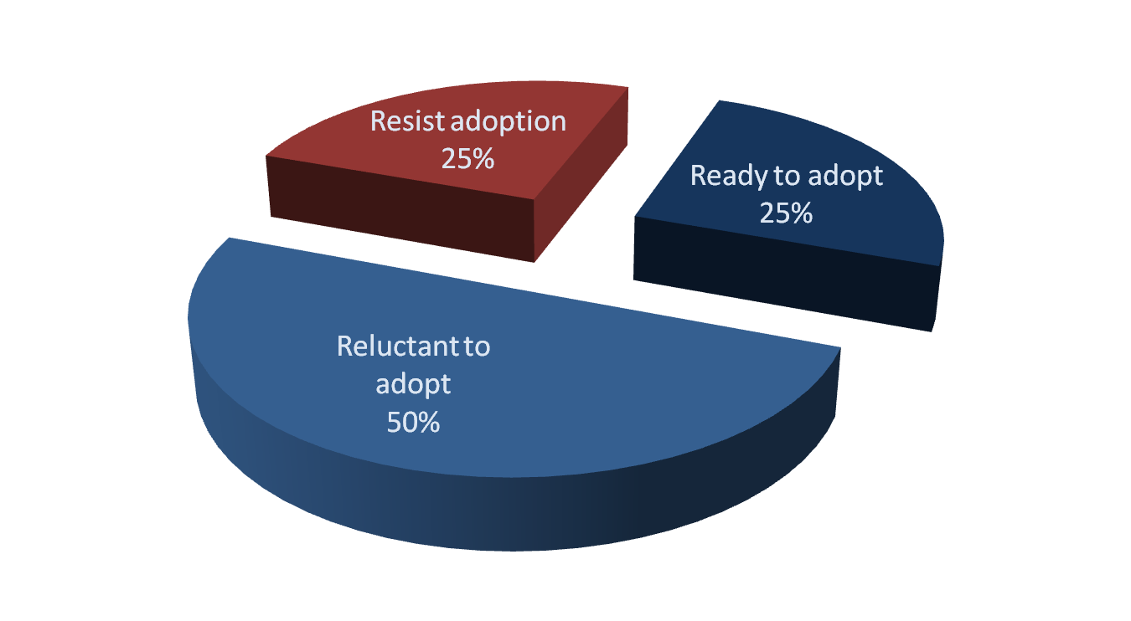
Organizational Attitudes

Slide 21
Training
Adoption is enabled by providing the skills needed to adopt the change
Training should not focus on using the system
Training should focus on helping the users accomplish their jobs
Classroom training is most common, but others are better for specific situations

Slide 22
Selecting Training Methods
 | Classroom Training | One-on-One Training | Computer Based Training
Cost to develop | Medium | Low-Medium | High
Cost to deliver | Medium | High | Low
Impact | Medium-High | High | Low-Medium
Reach | Medium | Low | High

Slide 23
POST-IMPLEMENTATION ACTIVITIES

Slide 24
System Support
The Operations Group is responsible for running the system post-installation
Types of system support
  On-demand training
  Online support
  Help desk
    Level I support should satisfy 80% of problems
    Level II support staff address the remaining problems after a Problem Report is filled out by level I

Slide 25
Elements of a Problem Report
Time and date of the report
Contact information for support person taking the report
Contact information of the person who reported the problem
Software and/or hardware causing problem
Location of the problem
Description of the problem
Action taken
Disposition (problem fixed or forwarded to system maintenance)

Slide 26
System Maintenance
The process of refining the system to make sure it continues to meet business needs
More expensive than initial development
Change requests are smaller versions of a system request

Slide 27
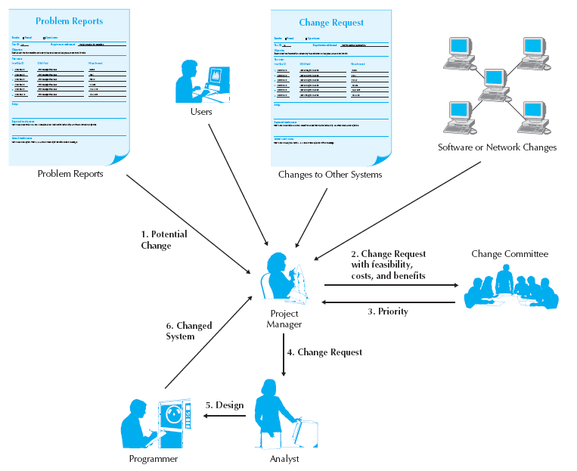
Processing a Change Request

Slide 28
Summary
Cultural Issues and Information Technology
Conversion
Change Management
Post-implementation Activities

