Slide 1
Systems Analysis & Design
CS183 Spring Semester 2008
Dr. Jonathan Y. Clark
Email: j.y.clark@surrey.ac.uk
Course Website: www.computing.surrey.ac.uk/personal
/st/J.Y.Clark/teaching/sad/cs183.html
Slide <number>

Slide 2
Course Textbook:
Systems Analysis and Design With UML 2.0
An Object-Oriented Approach, Second Edition
Chapter 2:
Introduction to Object-Oriented Systems Analysis & Design with the Unified Modeling Language
Slide <number>

Slide 3
Adapted from slides © 2005
John Wiley & Sons, Inc.
Slide <number>

Slide 4

Objectives
Understand the basic characteristics of object-oriented systems.
Be familiar with the Unified Modeling Language (UML),V.2.0.
Slide <number>

Slide 5


Non-Object-Oriented…
Process models
  Based on behaviour and actions
Data Models
  Based on static (fixed) representations of data
Slide <number>

Slide 6
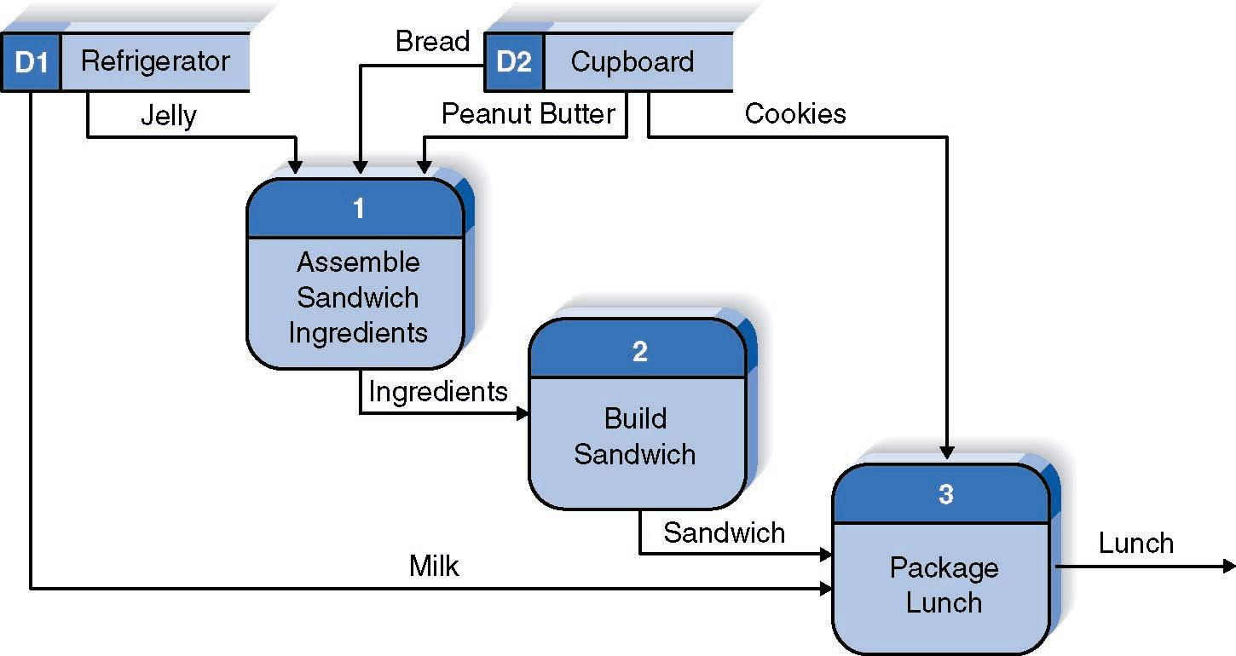
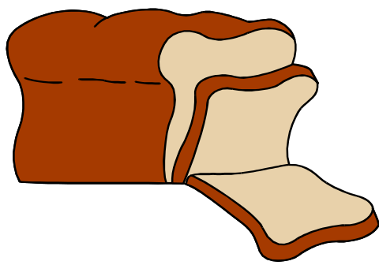
A “Simple” Process for Making Lunch
Slide <number>

Slide 7
Process Modelling:
Data Flow Diagrams
Slide <number>

Slide 8
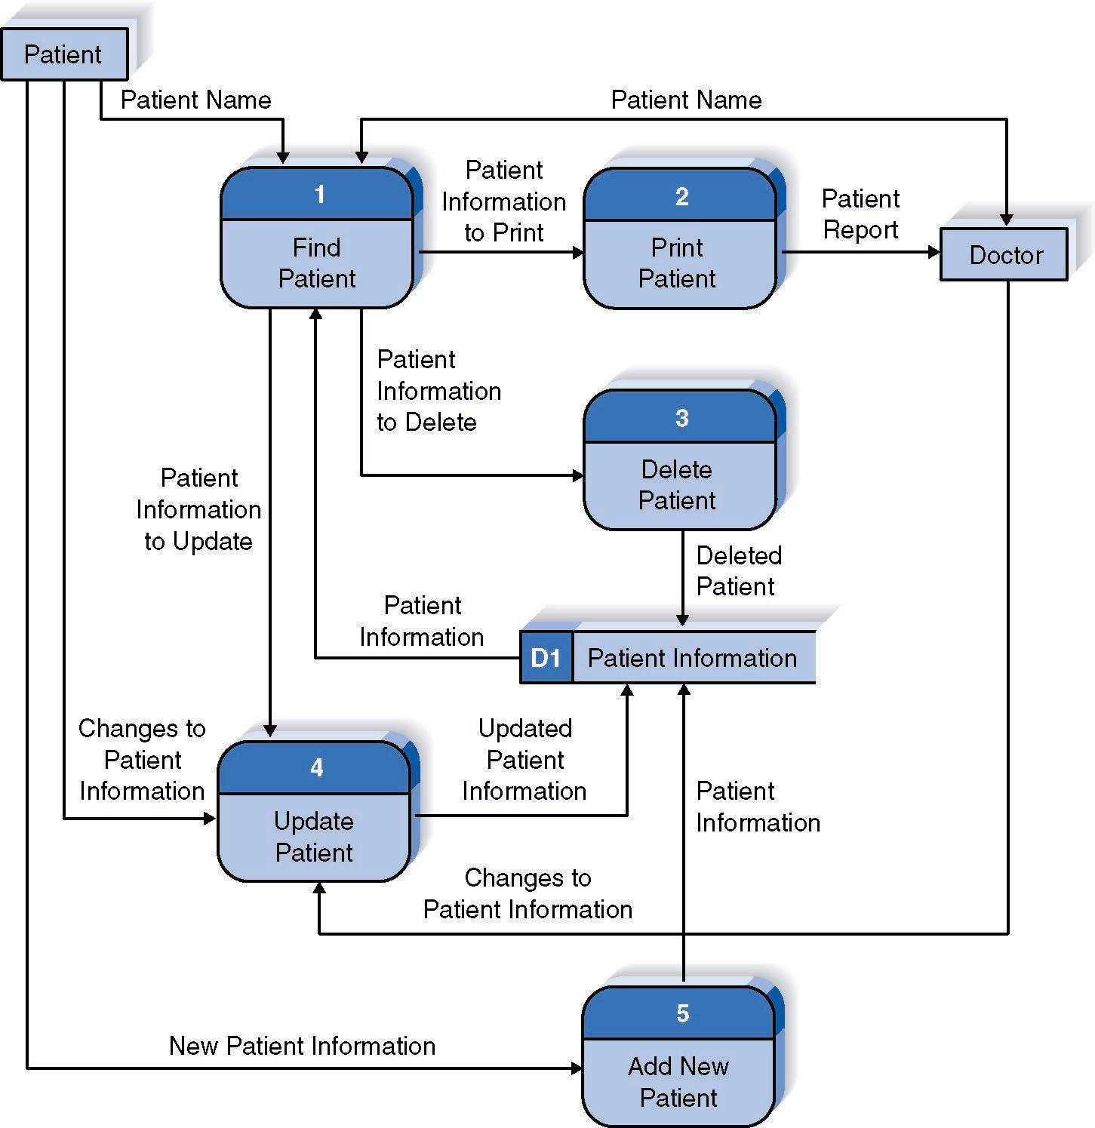
Reading a DFD
Slide <number>

Slide 9
Data Modelling:
Entity-Relationship Diagrams (ERDs)
Slide <number>

Slide 10
What Is an ERD?
A picture showing the information created, stored, and used by a business system.
Entities generally represent people, places, and things of interest to the organization.
Lines between entities show relationships between entities.
Slide <number>

Slide 11
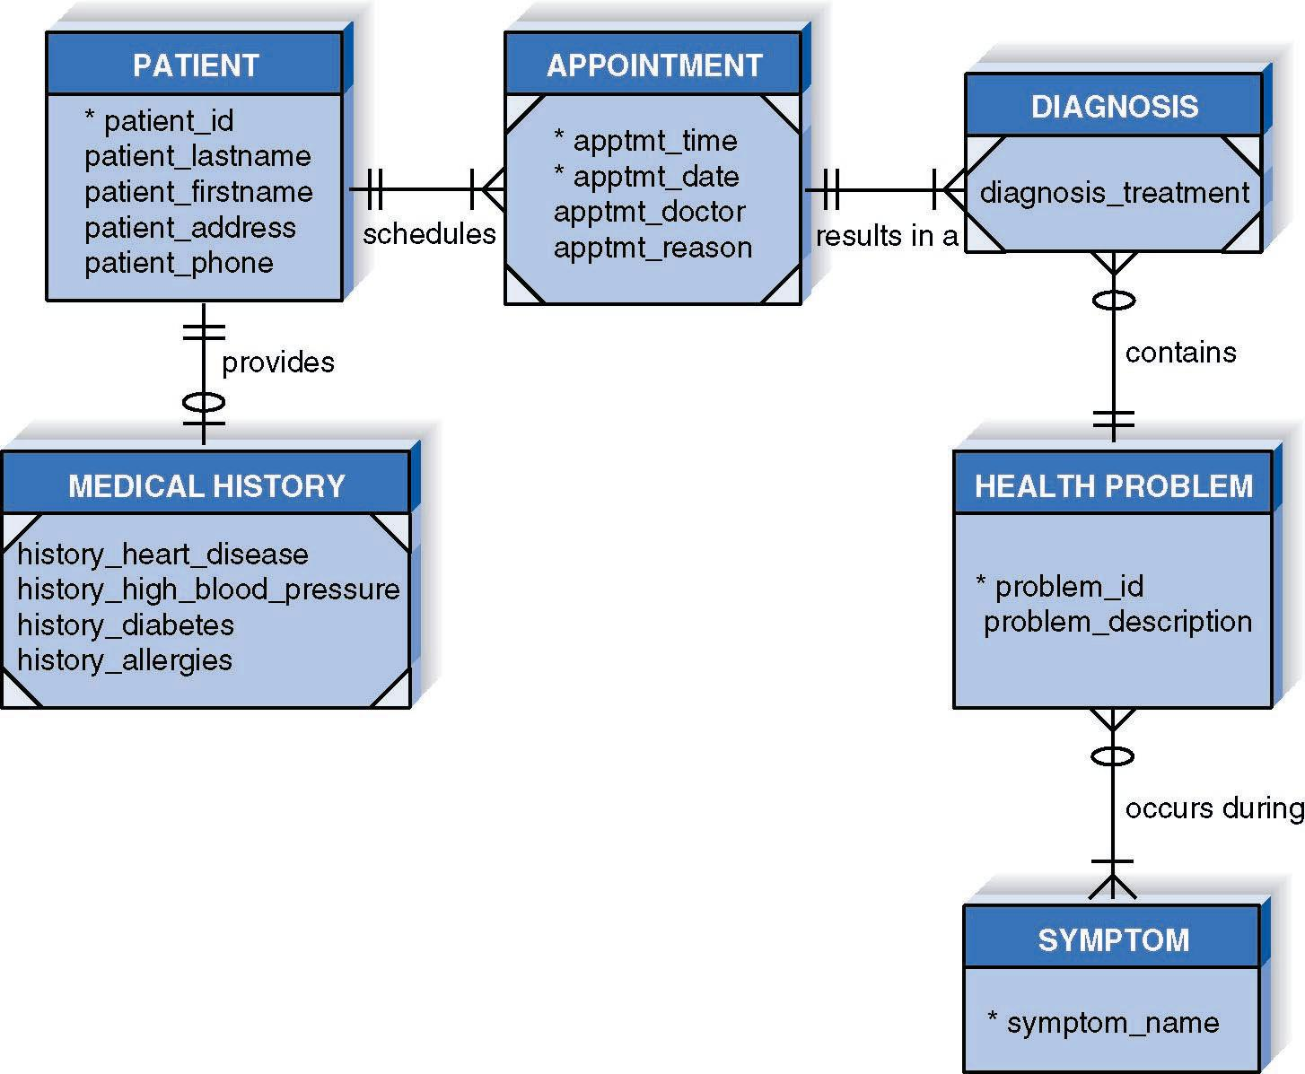
An ERD Example
PowerPoint Presentation for Dennis, Wixom & Tegardem Systems Analysis and Design
Copyright 2001 © John Wiley & Sons, Inc. All rights reserved.

Slide 12
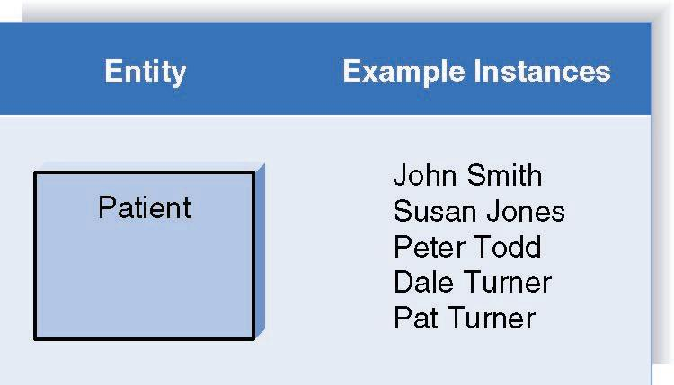
Entities and Instances
Slide <number>

Slide 13
Object-Oriented Approaches
Combine processes and data
Are more ‘natural’
Slide <number>

Slide 14
Basic Characteristics of Object Oriented Systems
Classes and Objects
Methods and Messages
Encapsulation and Information Hiding
Inheritance
Polymorphism
Slide <number>

Slide 15
Helpful Hint….’Compile’
C Classes
O Objects
M Methods and Messages
P Polymorphism
I Inheritance
(Last, but not least)
E Encapsulation
Slide <number>

Slide 16
Classes and Objects
Class – Template to define specific instances or objects
Object – Instantiation of a class
Attributes – Describes the object
Behaviours – specify what object can do
Slide <number>

Slide 17
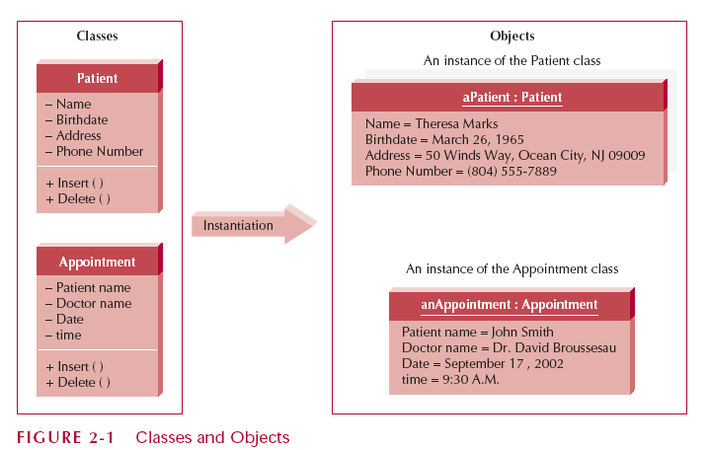
Classes and Objects
Slide <number>

Slide 18
Methods and Messages
Methods implement an object’s behaviour
  Analogous to a function or procedure
Messages are sent to trigger methods
  Procedure call from one object to the next
Slide <number>

Slide 19
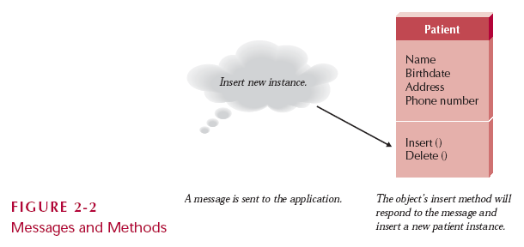
Messages and Methods
Slide <number>

Slide 20

Encapsulation and Information Hiding
Encapsulation
  combination of data and process into an entity
Information Hiding
  Only the information required to use a software module is published to the user
Reusability is the Key Point
  an object is used by calling methods
Slide <number>

Slide 21
Inheritance
Superclasses or general classes are at the top of a hierarchy of classes
Subclasses or specific classes are at the bottom
Subclasses inherit attributes and methods from classes higher in the hierarchy
Slide <number>

Slide 22
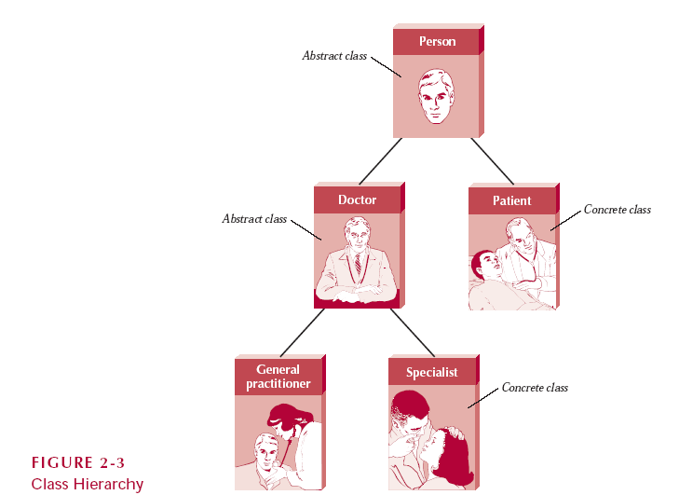
Class Hierarchy
Slide <number>

Slide 23
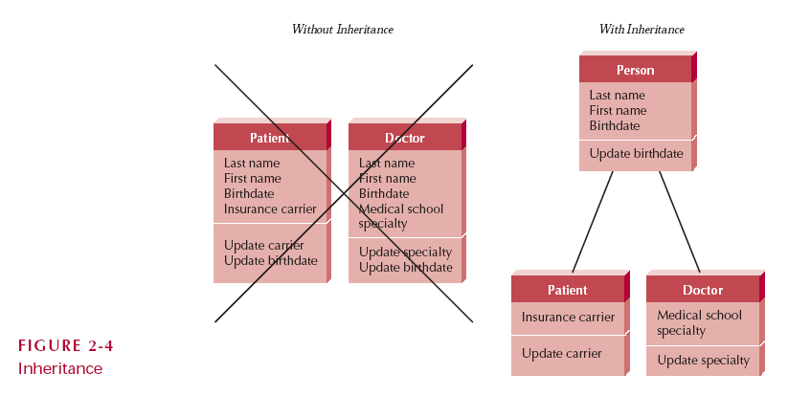
Inheritance
Slide <number>

Slide 24
Polymorphism
A message can be interpreted differently by different classes of objects
e.g. A ‘Create_Record’ message is essentially the same thing, but causes ‘Create_Patient_Record’ by a ‘Patient_Database’ object, or ‘Create_Doctor_Record’ by a ‘Healthcare_Staff_Database’ object
Slide <number>

Slide 25
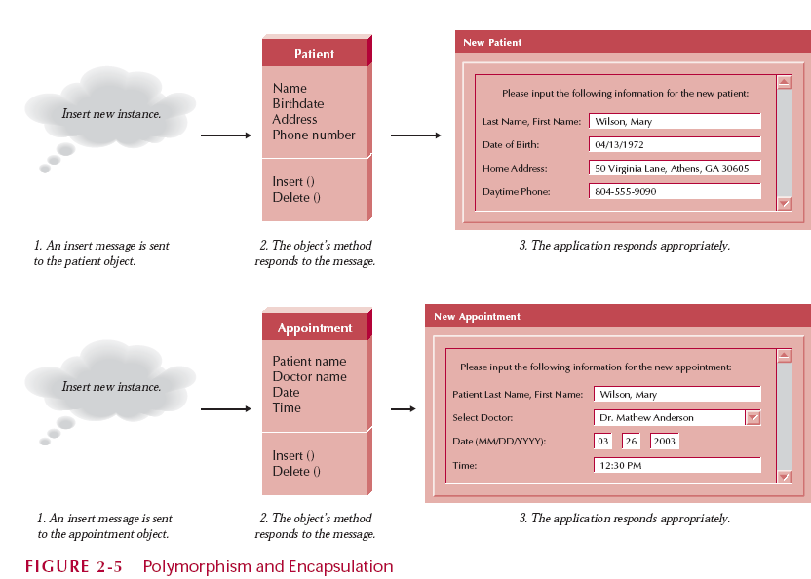
Polymorphism & Encapsulation
Slide <number>

Slide 26
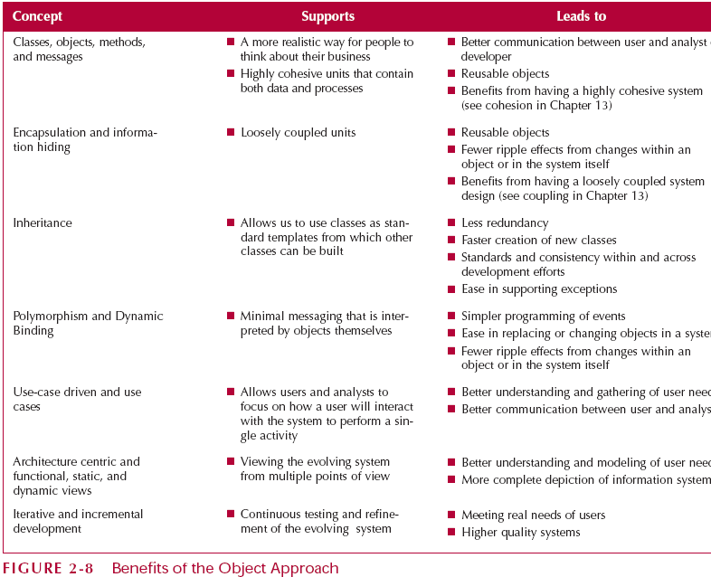
Benefits of the Object Approach
Slide <number>

Slide 27
The Unified Modelling Language, Version 2.0
Functional Diagrams
Structure Diagrams
Behaviour Diagrams
  Developers
    Grady Booch
    Ivar Jacobson
    James Rumbaugh
Slide <number>

Slide 28
Functional Diagrams
Activity Diagrams
  Illustrate business workflows
Use-Case Diagrams
  Capture business requirements
  Illustrates interaction between system and environment
Slide <number>

Slide 29
Structure Diagrams
Class diagrams
  relationship between classes
Object diagrams
  Relationships between objects
Slide <number>

Slide 30
Behaviour Diagrams
Interaction Diagrams ....
  Sequence diagrams
    Show Time-based ordering and behaviour of objects and their activities
State Machines ...
  Behavioural State Machines (Statechart diagrams)
    Examines behaviour of one class/object
Slide <number>

Slide 31
Object Oriented Systems Analysis and Design
Use-case driven
Iterative and Incremental
Often associated with PHASED Development (a RAD methodology)
Slide <number>

Slide 32

Basic Method for Development of Object Oriented Systems
Identifying business value
Analyze feasibility
Develop workplan
Staff the project
Control and direct project
Requirements determination
Functional modelling
Structural modelling
Behavioural modelling
Moving on to design
Slide <number>

Slide 33
Summary
Process oriented (Data flow diagrams) and Data oriented (Entity relationship diagrams)
Basic characteristics of Object Oriented Systems Analysis and Design
Introduction to Unified Modelling Language and the Unified Process
Slide <number>

