Slide 1
Systems Analysis & Design
CS183 Spring Semester 2008
Dr. Jonathan Y. Clark
Email: j.y.clark@surrey.ac.uk
Course Website: www.computing.surrey.ac.uk/personal
/st/J.Y.Clark/teaching/sad/cs183.html
Slide <number>

Slide 2
Course Textbook:
Systems Analysis and Design With UML 2.0
An Object-Oriented Approach, Second Edition
Chapter 5:
Requirements Determination
Slide <number>

Slide 3
Adapted from slides © 2005
John Wiley & Sons, Inc.
Slide <number>

Slide 4


SDLC PHASES
PLANNING PHASE
ANALYSIS PHASE
DESIGN PHASE
IMPLEMENTATION PHASE
Slide <number>

Slide 5

Analysis Phase: Key Ideas
The goal of the analysis phase is to truly understand the requirements of the new system and develop a system that addresses them.
The first challenge is finding the right people to participate.
The second challenge is collecting and integrating the information
Slide <number>

Slide 6
Requirements Gathering Methods
Interviews
JAD Sessions
Questionnaires
Document Analysis
Observation
Slide <number>

Slide 7
1. INTERVIEWS
Slide <number>

Slide 8
Interviews -- Five Basic Steps
Selecting interviewees
Designing interview questions
Preparing for the interview
Conducting the interview
Post-interview follow-up
Slide <number>

Slide 9

Selecting Interviewees
Based on information needed
Often good to get different perspectives
  Managers
  Users
  Ideally, all key stakeholders
Slide <number>

Slide 10
Types of Questions
Types of Questions
Examples
Closed-Ended Questions
* How many telephone
orders are received per day?
* How do customers place orders?
* What additional information
would you like the new system
to provide?
Open-Ended Questions
* What do you think about the
current system?
* What are some of the problems
you face on a daily basis?
* How do you decide what types of
marketing campaign to run?
Probing Questions
* Why?
* Can you give me an example?
* Can you explain that in a bit
more detail?
Slide <number>

Slide 11
Designing Interview Questions
Unstructured interview
  Broad, roughly defined information
Structured interview
  More specific information
Slide <number>

Slide 12
Questioning Strategies
EXAMPLES?
High Level
Very General
Medium-Level
Moderately
Specific
Low-Level
Very Specific
TOP DOWN
BOTTOM UP
Slide <number>

Slide 13


Interview Preparation Steps
Prepare general interview plan
  List of questions
  Anticipated answers and follow-ups
Confirm areas of knowledge
Set priorities in case of time shortage
Prepare the interviewee
  Inform them of the schedule
  Tell interviewees reason for interview
  Inform them of areas of discussion
Slide <number>

Slide 14

Conducting the Interview
Appear professional and unbiased
Record all information
Check on organizational policy regarding tape recording
Be sure you understand all issues and terms
Separate facts from opinions
Give interviewee time to ask questions
Be sure to thank the interviewee
End on time
Slide <number>

Slide 15
Conducting the Interview
Practical Tips
Don’t worry, be friendly
Pay attention
Summarize key points
Be succinct (concise)
Be honest
Watch body language
Slide <number>

Slide 16
Post-Interview Follow-Up
Prepare interview notes
Prepare interview report
Look for gaps and new questions
Slide <number>

Slide 17
Interview Report
INTERVIEW REPORT
Interview notes approved by: ____________
Person interviewed ______________
Interviewer _______________
Date _______________
Primary Purpose:
Summary of Interview:
Open Items:
Detailed Notes:
Slide <number>

Slide 18
2. JOINT APPLICATION DESIGN (JAD) SESSIONS
Slide <number>

Slide 19
JAD Key Ideas
Allows project managers, users, and developers to work together
May reduce scope creep by 50%
Avoids requirements being too specific or too vague
Slide <number>

Slide 20
Joint Application Design (JAD) Important Roles
Facilitator
  ensures sticking to agenda
  helps understanding of technical terms and jargon
  records group input on clearly-viewable display area
Scribe (or scribes)
  takes minutes and notes
  makes copies where necessary
Slide <number>

Slide 21
Joint Application Design (JAD) Setting
U-Shaped seating
Away from distractions
Whiteboard/flip chart
Prototyping tools
e-JAD
Slide <number>

Slide 22
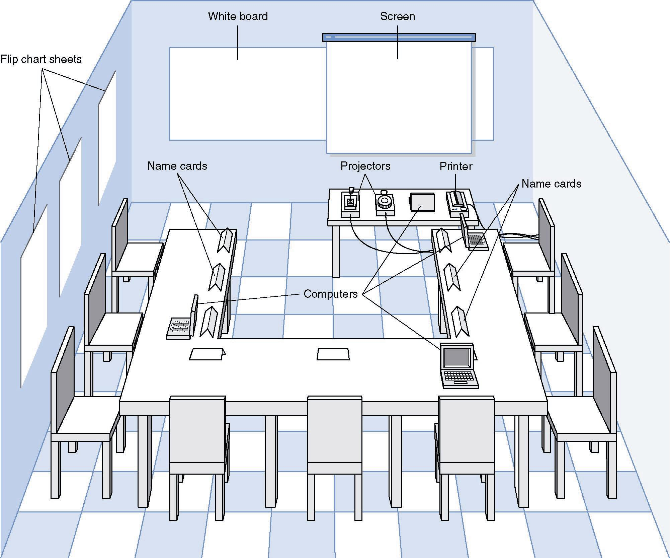
JAD Meeting Room
JPEG Figure 5-5 Goes Here
Slide <number>

Slide 23

The JAD Session
Tend to last 5 to 10 days over a three week period
Prepare questions as with interviews
Formal agenda and groundrules
Facilitator activities
  Keep session on track
  Help with technical terms and jargon
  Record group input
  Help resolve issues
Post-session follow-up
Slide <number>

Slide 24
JAD Sessions -- Five Basic Steps
Selecting participants
Designing the JAD Session
Preparing for the JAD Session
Conducting the JAD Session
Post-JAD follow-up
Slide <number>

Slide 25
Managing Problems in JAD Sessions
Reducing domination
Encouraging non-contributors
Side discussions
Agenda merry-go-round
Violent agreement
Unresolved conflict
True conflict
Use humour
Slide <number>

Slide 26
3. QUESTIONNAIRES
Slide <number>

Slide 27
Questionnaire Steps
Selecting participants
  Using samples of the population
Designing the questionnaire
  Careful question selection
Administering the questionnaire
  Working to get good response rate
Questionnaire follow-up
  Send results to participants
Slide <number>

Slide 28
Good Questionnaire Design
Begin with non-threatening and interesting questions
Group items into logically coherent sections
Do not put important items at the very end of the questionnaire
Do not crowd a page with too many items
Avoid abbreviations
Avoid biased or suggestive items or terms
Number questions to avoid confusion
Pretest the questionnaire to identify confusing questions
Provide anonymity to respondents
Slide <number>

Slide 29
4. DOCUMENT ANALYSIS
Slide <number>

Slide 30
Document Analysis
Provides clues about existing “as-is” system
Typical documents
  Forms
  Reports
  Policy manuals
Look for user additions to forms
Look for unused form elements
Slide <number>

Slide 31
5. OBSERVATION
Slide <number>

Slide 32
Observation
Checks validity of information gathered other ways
Users/managers often don’t remember everything they do !
Behaviours change when people are watched !
Careful not to ignore periodic activities
  Weekly … Monthly … Annual !
Slide <number>

Slide 33
Selecting the Appropriate Techniques
Interviews JAD Questionnaires Document Observation
Analysis
Type of As-Is As-Is As-Is As-Is As-Is
Information Improve. Improve. Improve.
To-Be To-Be
Depth of High High Medium Low Low
Information
Breadth of Low Medium High High Low
Information
Integration Low High Low Low Low
of Info.
User Medium High Low Low Low
Involvement
Cost Medium Low- Low Low Low-
Medium Medium
Slide <number>

Slide 34
Summary
There are five major information gathering techniques that all systems analysts must be able to use: Interviews, JAD, Questionnaires, Document Analysis, and Observation.
Systems analysts must also know how and when to use each as well as how to combine methods.
Slide <number>

