Slide 1
Systems Analysis & Design
CS183 Spring Semester 2008
Dr. Jonathan Y. Clark
Email: j.y.clark@surrey.ac.uk
Course Website: www.computing.surrey.ac.uk/personal
/st/J.Y.Clark/teaching/sad/cs183.html
Slide <number>

Slide 2
Course Textbook:
Systems Analysis and Design With UML 2.0
An Object-Oriented Approach, Second Edition
Chapter 7:
Structural Modelling
Slide <number>

Slide 3
Adapted from slides © 2005
John Wiley & Sons, Inc.
Slide <number>

Slide 4

Key Ideas
A structural or conceptual model describes the structure of the data that supports the business processes in an organization..
The structure of data used in the system is represented through CRC cards, class diagrams, and object diagrams.
Slide <number>

Slide 5
STRUCTURAL MODELS
Slide <number>

Slide 6
Purpose of Structural Models
Reduce the “semantic gap” between the real world and the world of software
Create a vocabulary for analysts and users
Represent things, ideas, and concepts of importance in the application domain
Slide <number>

Slide 7

Classes and Objects
Class – Template to define specific instances or objects
Object – Instantiation of a class
Attributes – Describes the object
Behaviours – specify what an object can do
Slide <number>

Slide 8
Basic Characteristics of Object Oriented Systems
Classes and Objects
Methods and Messages
Encapsulation and Information Hiding
Inheritance
Polymorphism
Slide <number>

Slide 9
Helpful Hint….’Compile’
C Classes
O Objects
M Methods and Messages
P Polymorphism
I Inheritance
(Last, but not least)
E Encapsulation
Slide <number>

Slide 10
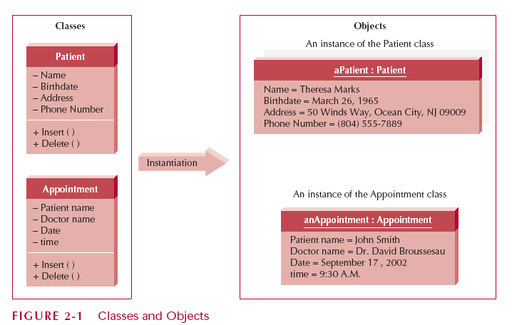
Classes and Objects
Slide <number>

Slide 11

Encapsulation and Information Hiding
Encapsulation
  combination of data and process into an entity
Information Hiding
  Only the information required to use a software module is published to the user
Reusability is the Key Point
  an object is used by calling methods
Slide <number>

Slide 12
Inheritance
Superclasses or general classes are at the top of a hierarchy of classes
Subclasses or specific classes are at the bottom
Subclasses inherit attributes and methods from classes higher in the hierarchy
Slide <number>

Slide 13
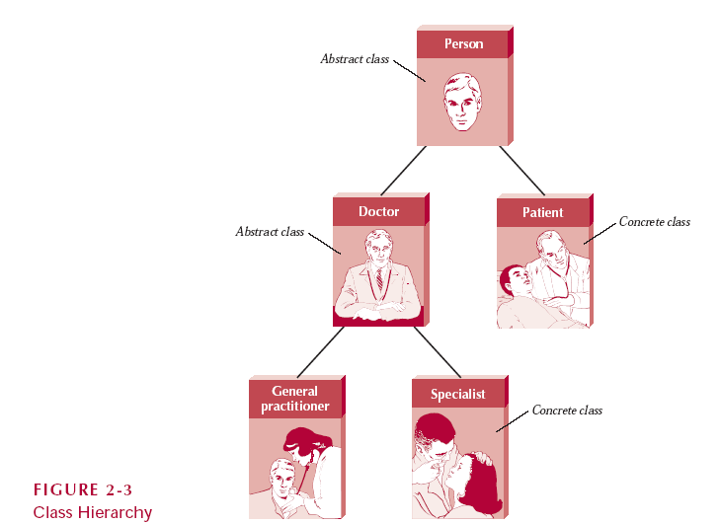
Class Hierarchy
Slide <number>

Slide 14
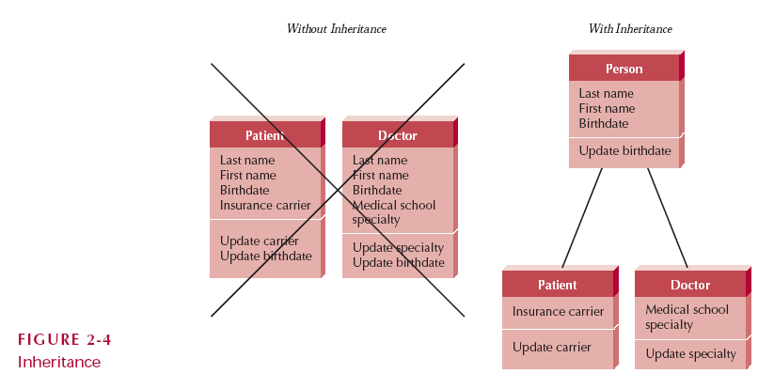
Inheritance
Slide <number>

Slide 15


Classes
Templates for creating instances or objects
  Concrete (can have real instances)
  Abstract (only exists to hold subclasses)
Typical examples:
  Application domain, user interface, data structure, file structure, operating environment, document, and multimedia classes
Slide <number>

Slide 16
Attributes
Units of information relevant to the description of the class
Only attributes important to the task should be included
Slide <number>

Slide 17
Operations (Methods)
Action that instances/objects can take
Focus on relevant problem-specific operations (at this point)
Slide <number>

Slide 18
Relationships
Generalization
  Enables inheritance of attributes and operations [...is a kind of...]
Aggregation
  Relates parts to the whole [..is a part of..]
Association
  Miscellaneous relationships between classes
Slide <number>

Slide 19
CLASS-RESPONSIBILITY-COLLABORATION CARDS
Slide <number>

Slide 20

Responsibilities and Collaborations
Responsibilities
  Knowing
  Doing
Collaboration
  Objects working together to service a request
Slide <number>

Slide 21
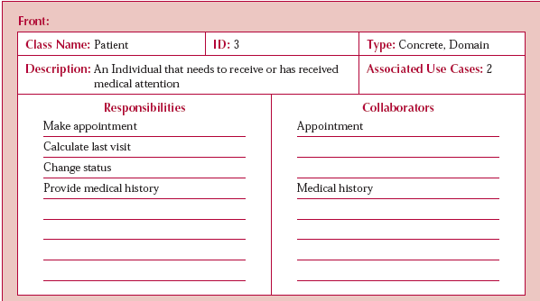
A CRC Card
Slide <number>

Slide 22
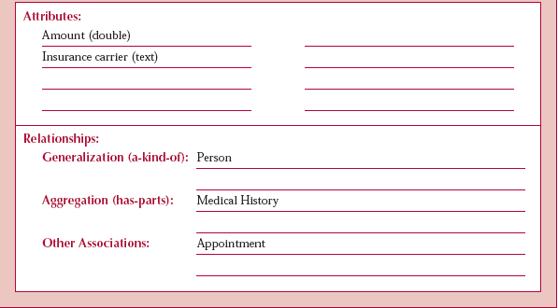
Back of CRC Card
Slide <number>

Slide 23
CLASS DIAGRAMS
Slide <number>

Slide 24
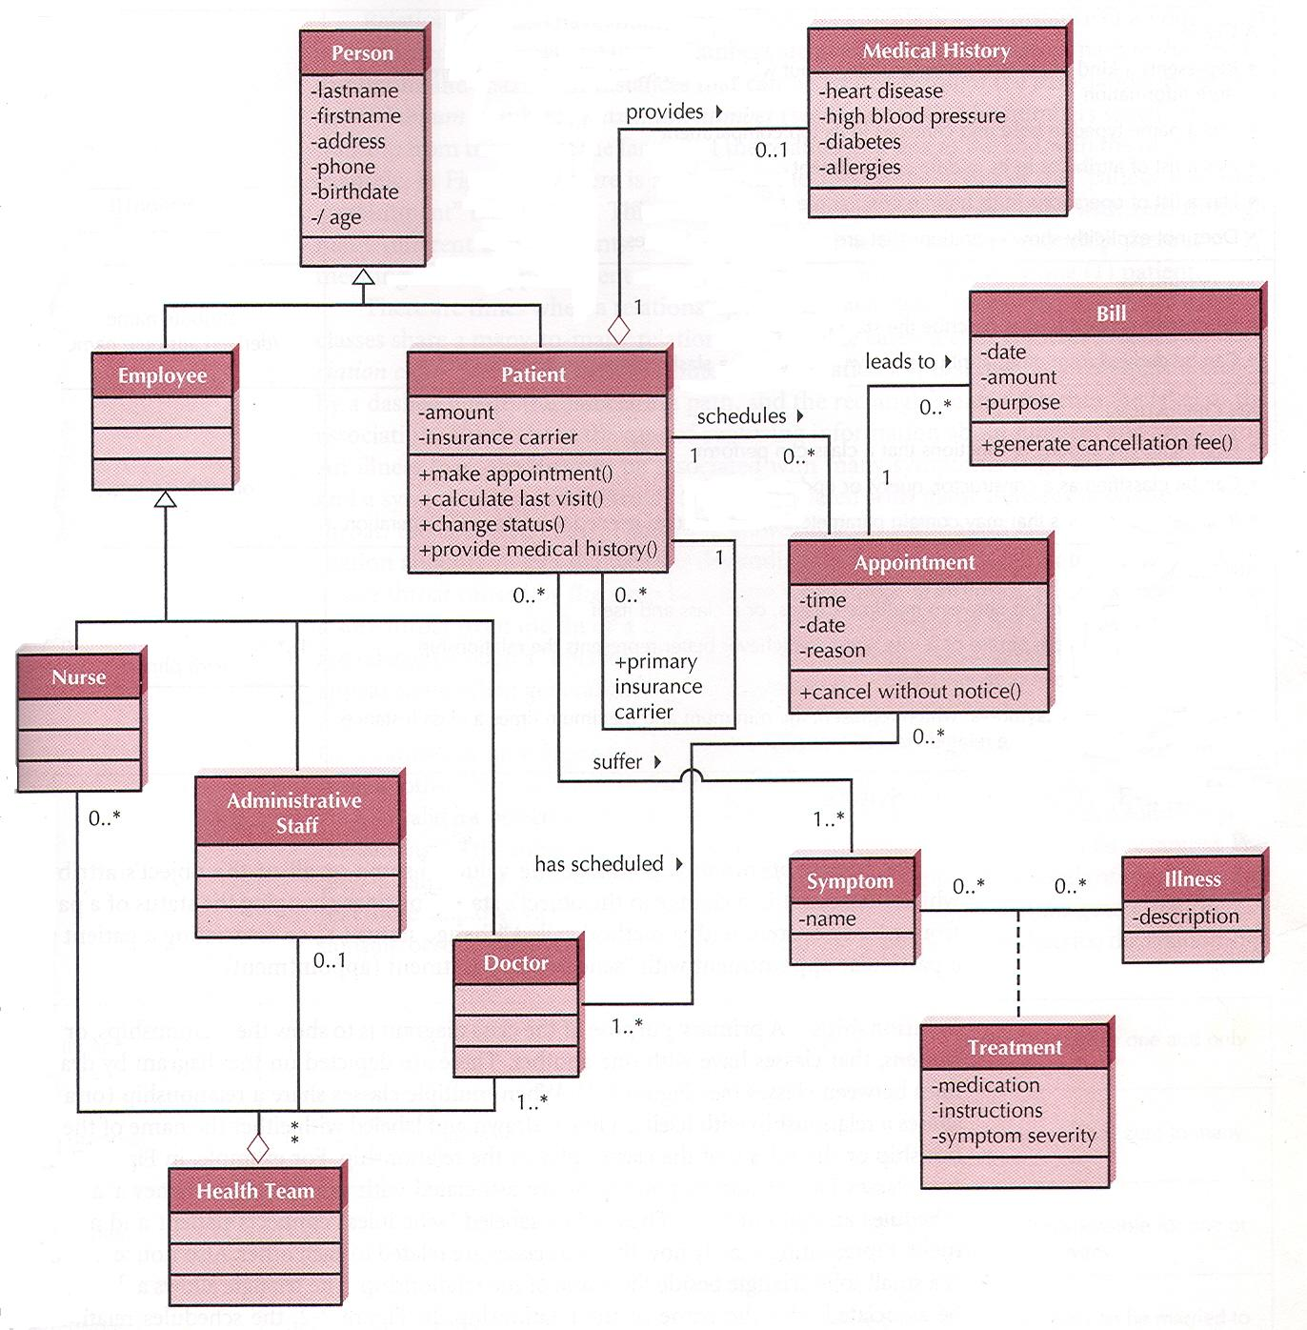
Example Class Diagram
Slide <number>

Slide 25
Class Diagram Syntax
A CLASS
AN ATTRIBUTE
AN OPERATION
AN ASSOCIATION
Class 1
-attribute
+operation ()
Attribute name/
derived attribute name
operation name ()
1..* 0..1
______verb phrase____
Slide <number>

Slide 26
More on Attributes
Derived attributes
  /age, for example can be calculated from birth date and current date
Visibility
  + Public (not hidden)
  # Protected (hidden from all except immediate subclasses)
  - Private (hidden from all other classes)
Slide <number>

Slide 27
More on Operations
Constructor
  Creates object (ie. creates instance)
Destructor
  Removes object (ie. removes instance)
Query
  Makes information about state available
Update
  Changes values of some or all attributes
Slide <number>

Slide 28
Generalization and Aggregation
Generalization shows that a subclass inherits from a superclass
  Doctors, nurses, admin personnel are kinds of employees
Aggregation classes comprise other classes
  Health team class comprised of doctor, nurses, admin personnel classes
Slide <number>

Slide 29
More on Relationships
Class can be related to itself
Multiplicity
  Exactly one (1), zero or more (0..*), one or more (1..*), zero or one (0..1), specified range (eg. 2..4), multiple disjoint ranges (eg. 1..3,5)
Association class (class describing a relationship)
Slide <number>

Slide 30
Simplifying Class Diagrams
A view mechanism can show a subset of information
  Eg. A use-case view that shows only that part of the diagram referring to a particular use case.
  Eg. A view showing only aggregations
  Eg. A view showing only the class name and attributes
Slide <number>

Slide 31
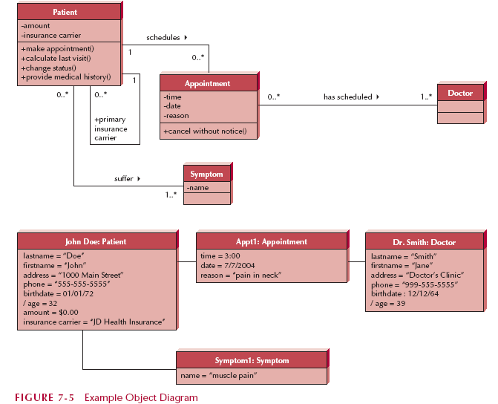
Object Diagrams
Slide <number>

Slide 32
CREATING CRC CARDS AND CLASS DIAGRAMS
Slide <number>

Slide 33
Object Identification
Textual analysis of use-case information
  Nouns suggest classes
  Verbs suggest operations
Creates a rough first cut
Common object list
Incidents
Roles
Slide <number>

Slide 34
Patterns
Useful groupings of classes that recur in various situations
Contain groups of classes that collaborate or work together
Enable reusability
Slide <number>

Slide 35
Steps for Object Identification and Structural Modelling
1. Create CRC cards by performing textual analysis on the use-cases.
2. Brainstorm additional candidate classes, attributes, operations, and
relationships by using the common object list approach.
3. Role-play each use-case using the CRC cards.
4. Create the class diagram based on the CRC cards.
5. Review the structural model for missing and/or unnecessary classes,
attributes, operations, and relationships.
6. Incorporate useful patterns.
7. Review the structural model.
Slide <number>

Slide 36
Summary
CRC cards capture the essential elements of a class.
Class and object diagrams show the underlying structure of an object-oriented system.
Constructing the structural model is an iterative process involving: textual analysis, brainstorming objects, role playing, creating the diagrams, and incorporating useful patterns.
Slide <number>

