Slide 1
Systems Analysis & Design
CS183 Spring Semester 2008
Dr. Jonathan Y. Clark
Email: j.y.clark@surrey.ac.uk
Course Website: www.computing.surrey.ac.uk/personal
/st/J.Y.Clark/teaching/sad/cs183.html
Slide <number>

Slide 2
Adapted from slides © 2005
John Wiley & Sons, Inc.
Slide <number>

Slide 3
Course Textbook:
Systems Analysis and Design With UML 2.0
An Object-Oriented Approach, Second Edition
Chapter 9: Moving on to Design
Chapter 11: Data Management Layer Design
Slide <number>

Slide 4
Course Textbook:
Systems Analysis and Design With UML 2.0
An Object-Oriented Approach, Second Edition
Chapter 9: Moving on to Design
Slide <number>

Slide 5

Key Ideas
The purpose of the analysis phase is to figure out what the business needs. The purpose of the design phase is to figure out how to provide it.
The steps in both analysis and design phases are highly interrelated and may require much “going back and forth”
Slide <number>

Slide 6
Objectives
■ Understand the transition from analysis to design.
■ Be familiar with the custom, packaged, and outsource design alternatives.
■ Be able to create an alternative matrix.
Slide <number>

Slide 7

OO Analysis and Design Foundation
Use-case driven
Architecture centric
Iterative and incremental
Slide <number>

Slide 8


OO Analysis and Design - Combining Three Views
Functional
  use case diagrams
Static
  class diagrams
  object diagrams
Dynamic
  sequence diagrams
  behavioural state machines (state chart diagrams)
Slide <number>

Slide 9
A “Minimalist” Approach
Planning
Gathering requirements
Perform a series of “builds”
Use results of each build as feedback for design and implementation
Slide <number>

Slide 10
EVOLVING THE ANALYSIS MODELS INTO DESIGN MODELS
Slide <number>

Slide 11
Avoid Classic Design Mistakes
Reducing design time
Feature creep
Silver bullet syndrome
Switching tools in mid-project
Slide <number>

Slide 12
DESIGN STRATEGIES
Custom Development
Packaged Software
System Integration
Outsourcing
Slide <number>

Slide 13
Custom Development
Allows for meeting highly specialized requirements
Allows flexibility and creativity in solving problems
Easier to change components
Builds personnel skills
May stretch company’s resources
May add significant risk
Slide <number>

Slide 14

Packaged Software
Software already written
May be more efficient
May be more thoroughly tested and proven
May range from components to tools to whole enterprise systems
Must accept functionality provided
May require change in how the firm does business
May require significant “customization” or “workarounds”
Slide <number>

Slide 15
System Integration
The process of combining packages, legacy systems, and new software
Key challenge is integrating data
Write data in the same format
Revise existing data formats
Develop “object wrappers”
Slide <number>

Slide 16
Outsourcing
Hire external firm to create system
May have more skills
May extend existing resources
Never outsource what you don’t understand
Carefully choose vendor
Prepare contract and payment style carefully
Slide <number>

Slide 17

Outsourcing Guidelines
Keep lines of communication open with outsourcer
Define and stabilize requirements before signing a contract
View outsourcing relationship as partnership
Select outsource vendor carefully
Assign person to manage relationship
Don’t outsource what you don’t understand
Emphasize flexible requirements, long-term relationships, and short-term contracts
Slide <number>

Slide 18
Selecting a Design Strategy
Business need
In-house experience
Project skills
Project management
Time frame
Slide <number>

Slide 19
The Alternative matrix
Combines several feasibility analyses into one grid
Revisits technical, economic, and organizational feasibility
Slide <number>

Slide 20
Request for Proposals
Description of the system you propose to be built
Vendors, developers, service providers respond with proposals including how they will address needs as well as stating cost and time requirements.
Slide <number>

Slide 21
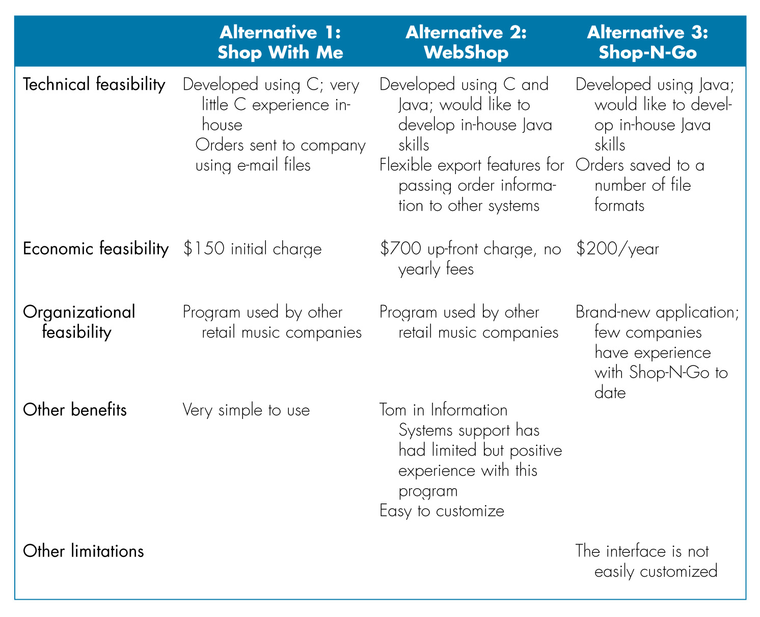
CD Selections
Slide <number>

Slide 22
Course Textbook:
Systems Analysis and Design With UML 2.0
An Object-Oriented Approach, Second Edition
Chapter 11: Data Management Layer Design
Slide <number>

Slide 23
Objectives
Become familiar with several object-persistence formats.
Be able to apply the steps of normalization to a relational database.
Be able to optimize a relational database for object storage and access.
Slide <number>

Slide 24

Data Management Layer
Choose object-persistence format to support the system
  Problem domain objects drive object storage design
Design of Data Storage
  Must optimize processing efficiency
Data access and manipulation
  Separate problem domain classes from storage format
  Handle all communication with the database
Slide <number>

Slide 25
Object Persistence Formats
Files (Sequential and Random)
Relational databases
Object-relational databases
Object-oriented databases
Slide <number>

Slide 26
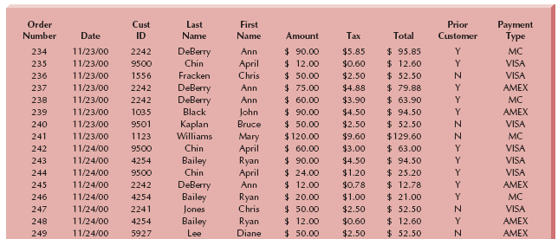
Customer Order File
Slide <number>

Slide 27
Sequential Access Files
Sequential access files allow sequential operations
  Read, write, and search
  Efficient for report writing
  Searches are not efficient because an average of 50% of records have to be accessed
  Two versions
    Ordered
    unordered
Slide <number>

Slide 28
Random Access Files
Allow only random or direct file operations
Good for finding and updating a specific object
Inefficient report writing
Slide <number>

Slide 29
Application File Types
Master Files
Look-up files
Transaction files
Audit file
History file
Slide <number>

Slide 30
Relational Databases
Collection of tables
  Comprised of fields that define entities
  Primary key has unique values in each row of a table
  Foreign key is primary key of another table
Tables related to each other
  Primary key field of a table is a field of another table and called a foreign key
  Relationship established by a foreign key of one table connecting to the primary key of another table
Slide <number>

Slide 31
Database Management System (DBMS)
Software that creates and manipulates a database
RDBMS is a DBMS for a relational database
RDBMS usually support Referential Integrity
Slide <number>

Slide 32
Referential Integrity
the idea of ensuring that values linking the tables together through the primary and foreign keys are valid and correctly synchronized.
Slide <number>

Slide 33
Referential Integrity Example
Cust. ID is a primary key for the customer table
Cust. ID is a foreign key for the order table
A violation of referential integrity would happen if an order was entered in the order table for a Cust. ID that had not been entered into the customer table first
An RDBMS prevents such a record from being entered
Slide <number>

Slide 34
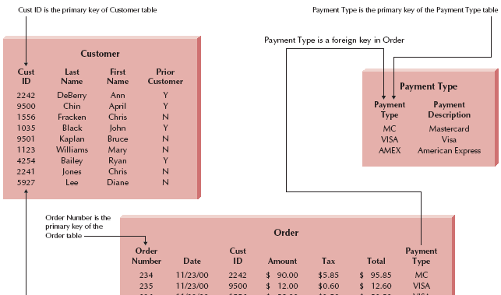
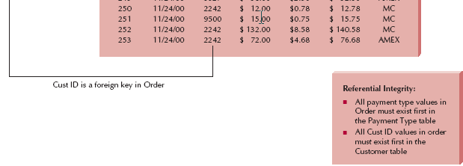
Example of Referential Integrity
Slide <number>

Slide 35
Structured Query Language (SQL)
Standard language for accessing data in tables
SQL Commands
  Create, edit, and delete tables
  Add, edit, and delete data
  Display data from one or more related tables
  Display data computed from data in one or more related tables
Slide <number>

Slide 36
Criteria for Object Persistence Formats
Data types supported
Types of application systems (transaction processing, DSS, …)
Existing Storage Formats
Future Needs
Other miscellaneous Criteria (cost, concurrency control, …)
Slide <number>

Slide 37
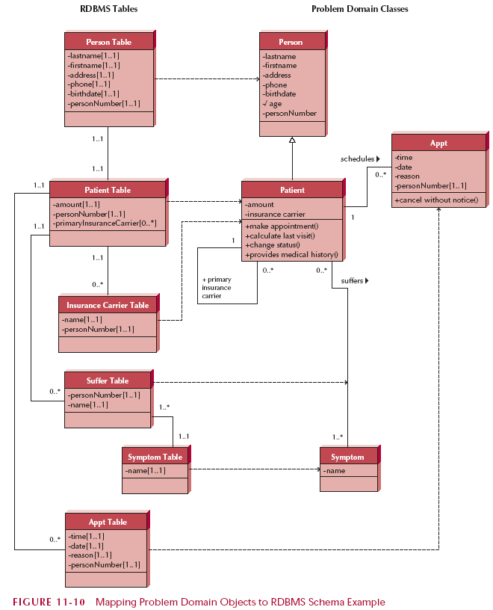
Mapping RDBMS Tables to Problem Domain Classes
Slide <number>

Slide 38

Optimize RDBMS Object Storage
Redundant data
  Wastes space
  Allow more room for error
Null values in tables
  Difficult to interpret
Slide <number>

Slide 39
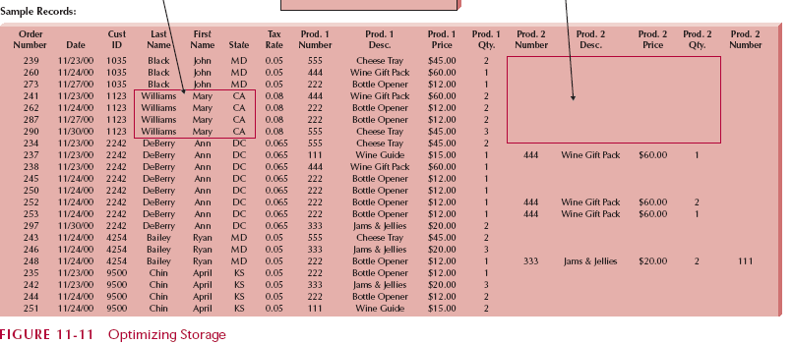
Example of Non-normalized Data
Slide <number>

Slide 40
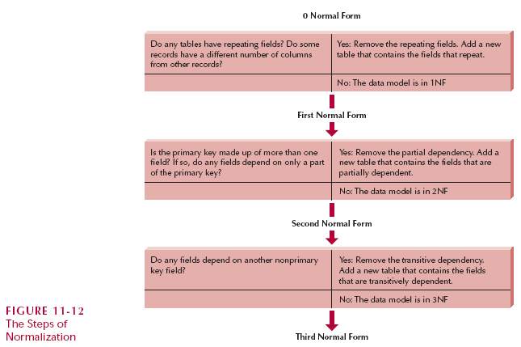
Normalization
Slide <number>

Slide 41
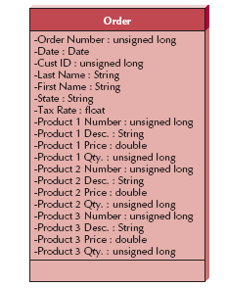
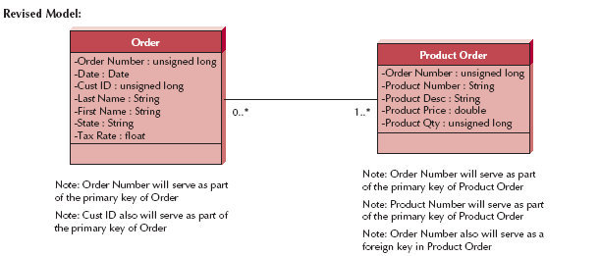
Normalization Example
Original Model
Slide <number>

Slide 42
Normalization
Slide <number>

Slide 43
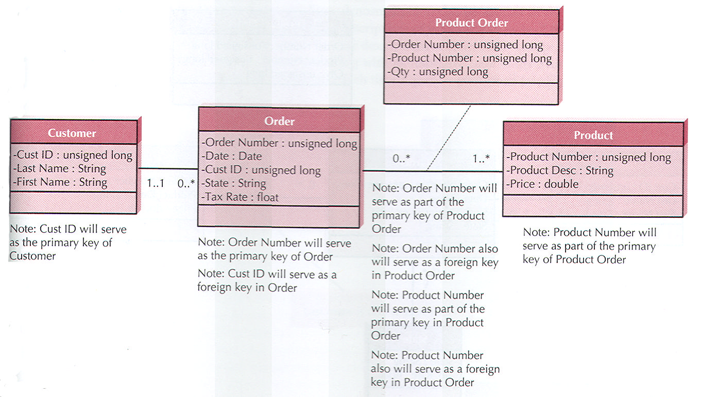
2NF Normalized Model
Slide <number>

Slide 44
Normalization
Slide <number>

Slide 45
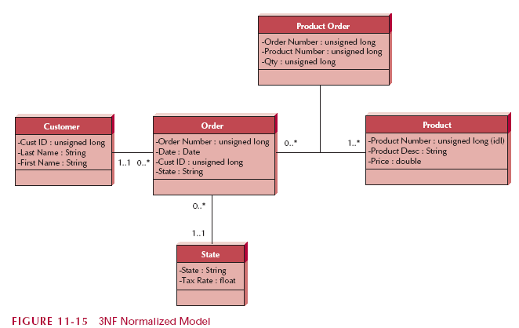
3NF Normalized Model
Slide <number>

Slide 46
Problems with RDBMS
To access data in multiple tables, the tables must be joined
This can result in many database operations and lead to huge tables and slow processing
Slide <number>

Slide 47
Speeding up access
Denormalization – Adds data from one table to another in order to speed processing and eliminate a join operation
Example: Add customer last name to order table to avoid joining order to customer to get just last name
Slide <number>

Slide 48
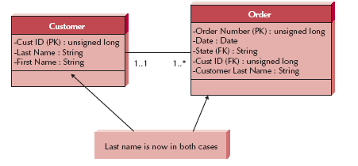
Example
Slide <number>

Slide 49
Clustering
Interfile clustering
  Arrange records on storage media so that similar records are stored close together
  inter-file cluster would be similar to storing peanut butter, jelly, and bread next to each other in a grocery store since they are often purchased together.
Slide <number>

Slide 50
Indexing
An index in data storage is like an index in the back of a textbook;
it is a mini table that contains values from one or more columns in a table and the location of the values within the table.
A query can use an index to find the locations of only those records that are included in the query answer, and
a table can have an unlimited number of indexes but too many can add overhead
Slide <number>

Slide 51
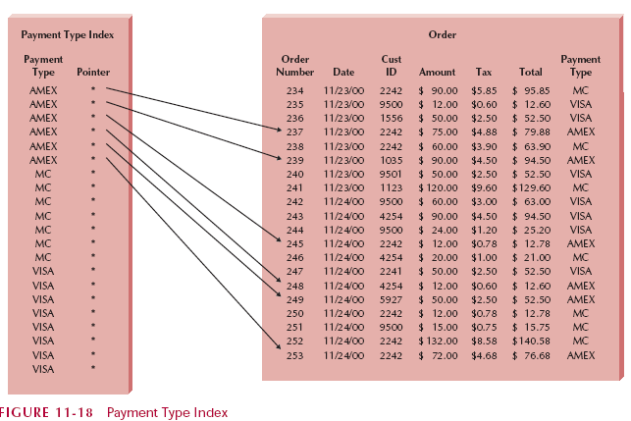
Indexing Example
Slide <number>

Slide 52
CD Selections Example
Most of the data would be text and numbers
Thus a relational database would be able to handle the data effectively
However, images for the catalog require complex data objects for sound and video
Slide <number>

Slide 53
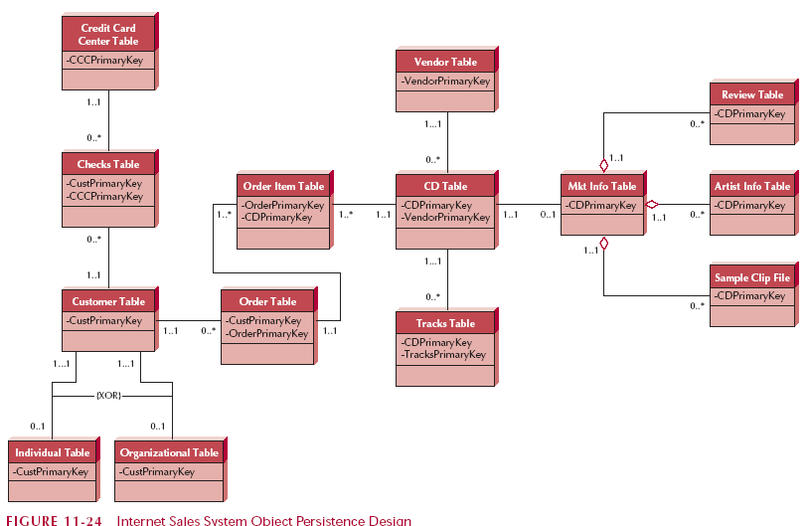
CD Selections Example
Slide <number>

Slide 54
Summary
Object-persistence format
  Files (sequential or Random Access)
  Databases (RDBMS, ORDBMS, OODBMS)
Map problem domain objects to Data
Optimizing object storage
  Normalization
  Clustering, Indexes
Slide <number>

