Slide 1
Metrics

Slide 3
McCall’s Triangle of Quality
M
a
i
n
t
a
i
n
a
b
i
l
i
t
y
M
a
i
n
t
a
i
n
a
b
i
l
i
t
y
P
o
r
t
a
b
i
l
i
t
y
P
o
r
t
a
b
i
l
i
t
y
F
l
e
x
i
b
i
l
i
t
y
F
l
e
x
i
b
i
l
i
t
y
R
e
u
s
a
b
i
l
i
t
y
R
e
u
s
a
b
i
l
i
t
y
T
e
s
t
a
b
i
l
i
t
y
T
e
s
t
a
b
i
l
i
t
y
I
n
t
e
r
o
p
e
r
a
b
i
l
i
t
y
I
n
t
e
r
o
p
e
r
a
b
i
l
i
t
y
P
R
O
D
U
C
T
R
E
V
I
S
I
O
N
P
R
O
D
U
C
T
T
R
A
N
S
I
T
I
O
N
P
R
O
D
U
C
T
R
E
V
I
S
I
O
N
P
R
O
D
U
C
T
T
R
A
N
S
I
T
I
O
N
P
R
O
D
U
C
T
O
P
E
R
A
T
I
O
N
P
R
O
D
U
C
T
O
P
E
R
A
T
I
O
N
C
o
r
r
e
c
t
n
e
s
s
C
o
r
r
e
c
t
n
e
s
s
U
s
a
b
i
l
i
t
y
U
s
a
b
i
l
i
t
y
E
f
f
i
c
i
e
n
c
y
E
f
f
i
c
i
e
n
c
y
R
e
l
i
a
b
i
l
i
t
y
I
n
t
e
g
r
i
t
y
R
e
l
i
a
b
i
l
i
t
y
I
n
t
e
g
r
i
t
y
Notes:
McCall’s quality factors were proposed in the
early 1970s. They are as valid today as they were
in that time. It’s likely that software built to conform
to these factors will exhibit high quality well into
the 21st century, even if there are dramatic changes
in technology.

Slide 4
Measures, Metrics and Indicators
A measure provides a quantitative indication of the extent, amount, dimension, capacity, or size of some attribute of a product or process
The IEEE glossary defines a metric as “a quantitative measure of the degree to which a system, component, or process possesses a given attribute.”
An indicator is a metric or combination of metrics that provide insight into the software process, a software project, or the product itself
Notes:
Software Metrics
Want to detect problems before the problems get out of hand
Can serve as an early warning system for potential problems
We use measures to better understand the attributes of the models we create and to assess the quality of engineered products that we build.

Slide 5
Measures, Metrics and Indicators
Without measurements (metrics), it is impossible to detect problems early in the software process.
Notes:
Software Metrics
Want to detect problems before the problems get out of hand
Can serve as an early warning system for potential problems
We use measures to better understand the attributes of the models we create and to assess the quality of engineered products that we build.

Slide 6
Measurement Process
Formulation. The derivation of software measures and metrics appropriate for the representation of the software that is being considered.
Collection. The mechanism used to accumulate data required to derive the formulated metrics.
Analysis. The computation of metrics and the application of mathematical tools.
Interpretation. The evaluation of metrics results in an effort to gain insight into the quality of the representation.
Feedback. Recommendations derived from the interpretation of product metrics transmitted to the software team.
Notes:
Software Metrics
Want to detect problems before the problems get out of hand
Can serve as an early warning system for potential problems
We use measures to better understand the attributes of the models we create and to assess the quality of engineered products that we build.

Slide 7
Goal-Oriented Software Measurement
The Goal/Question/Metric Paradigm
  (1) establish an explicit measurement goal that is specific to the process activity or product characteristic that is to be assessed
  (2) define a set of questions that must be answered in order to achieve the goal, and
  (3) identify well-formulated metrics that help to answer these questions.
Goal definition template
  Analyze {the name of activity or attribute to be measured}
  for the purpose of {the overall objective of the analysis}
  with respect to {the aspect of the activity or attribute that is considered}
  from the viewpoint of {the people who have an interest in the measurement}
  in the context of {the environment in which the measurement takes place}.

Slide 8
Major Types of Software Metrics
Product metrics
  Measure some aspect of the product itself
Process metrics
  Measure some aspect of the software process being used to develop the product
Notes:
Product metrics
Examples:
Lines of code
Mean time between failures
Product metrics
Used by developers to deduce information about the software process
Example:
Requirements volatility
Cost
Duration in months
Effort in person-months

Slide 9
Software Metric Types
Analysis Metrics
Architectural Design Metrics
Design Metrics
Operational Metrics
Notes:
Product metrics
Examples:
Lines of code
Mean time between failures
Product metrics
Used by developers to deduce information about the software process
Example:
Requirements volatility
Cost
Duration in months
Effort in person-months

Slide 10
Analysis Metrics
Function-based metrics: use the function point as a normalizing factor or as a measure of the “size” of the specification
Specification metrics: used as an indication of quality by measuring number of requirements by type

Slide 11
Function-Based Metrics
The function point metric (FP), first proposed by Albrecht [ALB79], can be used effectively as a means for measuring the functionality delivered by a system.
Function points are derived using an empirical relationship based on countable (direct) measures of software's information domain and assessments of software complexity

Slide 12
Function-Based Metrics
Information domain values are defined in the following manner:
  number of external inputs (EIs)
  number of external outputs (EOs)
  number of external inquiries (EQs)
  number of internal logical files (ILFs)
  Number of external interface files (EIFs)

Slide 13
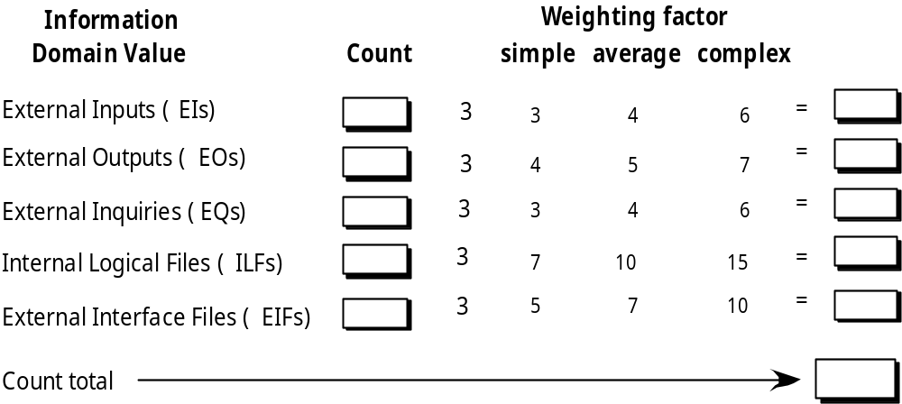
Function Points

Slide 14
USE CASE Function Points
Another technique for measuring functionality is to measure the function points in each use case. Since in analysis you often may not have ALL the use cases evolved, it is somewhat fuzzy.
However it still helps you in estimation.

Slide 15
USE CASE Function Points
Steps for UCP (Use Case Points) Estimation
Determine the UAW (Unadjusted Actor weight)
Determine number of UUCW (Unadjusted Use case Weight)
Determine Total UUCP (Unadjusted Use Case Point)
Computing technical and environmental factors

Slide 16
Architectural Design Metrics
Architectural design metrics
  Structural complexity = g(fan-out)
  Data complexity = f(input & output variables, fan-out)
  System complexity = h(structural & data complexity)
HK metric: architectural complexity as a function of fan-in and fan-out
Morphology metrics: a function of the number of modules and the number of interfaces between modules

Slide 17
Metrics for OO Design
Whitmire [WHI97] describes nine distinct and measurable characteristics of an OO design:
  1. Size - Size is defined in terms of
      Volume – number of
        Database references or
        Transactions
        Database updates, etc
      Length – lines of code, number of classes, number of instances, tec
      Functionality – using function point analysis or use case point analysis

Slide 18
Metrics for OO Design
Whitmire [WHI97] describes nine distinct and measurable characteristics of an OO design:
  2. Complexity
    How classes of an OO design are interrelated to one another
    Halstead Complexity
    McCabes Cyclomatic Complexity
  3. Coupling
    The physical connections between elements of the OO design
      Component coupling (packages), Class coupling, data coupling

Slide 19
Metrics for OO Design
Whitmire [WHI97] describes nine distinct and measurable characteristics of an OO design:
  4. Sufficiency
    “the degree to which an abstraction possesses the features required of it, or the degree to which a design component possesses features in its abstraction, from the point of view of the current application.”

Slide 20
Metrics for OO Design
Whitmire [WHI97] describes nine distinct and measurable characteristics of an OO design:
  5. Completeness
    An indirect implication about the degree to which the abstraction or design component can be reused
      Degree of reuse, degree of package, class, method independence.

Slide 21
Metrics for OO Design-II
  6. Cohesion
    The degree to which all operations working together to achieve a single, well-defined purpose
  7. Primitiveness
    Applied to both operations and classes, the degree to which an operation is atomic
  8. Similarity
    The degree to which two or more classes are similar in terms of their structure, function, behavior, or purpose
  9. Volatility
    Measures the likelihood that a change will occur

Slide 22
Class-Oriented Metrics
Proposed by Chidamber and Kemerer:
weighted methods per class (WMC)
depth of the inheritance tree (DIT)
number of children (NOC)
coupling between object classes
response for a class (RPC)
lack of cohesion in methods (LCOM)

Slide 23
Class-Oriented Metrics
Proposed by Lorenz and Kidd [LOR94]:
class size (LOC)
number of operations overridden by a subclass
number of operations added by a subclass

Slide 24
Class-Oriented Metrics
The MOOD Metrics Suite
Method inheritance factor
Coupling factor
Polymorphism factor

Slide 25
Operation-Oriented Metrics
Proposed by Lorenz and Kidd [LOR94]:
average operation size (method LOC)
operation complexity (method)
average number of parameters per operation

Slide 26
Component-Level Design Metrics
Cohesion metrics: a function of data objects and the locus of their definition
Coupling metrics: a function of input and output parameters, global variables, and modules called
Complexity metrics: hundreds have been proposed (e.g., cyclomatic complexity)

Slide 27
Code Metrics
Halstead’s Software Science: a comprehensive collection of metrics all predicated on the number (count and occurrence) of operators and operands within a component or program
  It should be noted that Halstead’s “laws” have generated substantial controversy, and many believe that the underlying theory has flaws. However, experimental verification for selected programming languages has been performed (e.g. [FEL89]).

Slide 28
Metrics for Testing
Testing effort can also be estimated using metrics derived from Halstead measures
Binder [BIN94] suggests a broad array of design metrics that have a direct influence on the “testability” of an OO system.
  Lack of cohesion in methods (LCOM).
  Percent public and protected (PAP).
  Public access to data members (PAD).
  Number of root classes (NOR).
  Fan-in (FIN).
  Number of children (NOC) and depth of the inheritance tree (DIT).

Slide 29
Metrics for Design
McCabe’s Cyclomatic Complexity
  Measures the number of linearly independent paths within code
  Defined as number of decision points + 1
    where decision points are conditional statements such as if/else or while
Notes:
Complexity
Cyclomatic complexity is the number of branches in a module; measure of design quality (the lower the better)
The goal is code that is not very complex and, therefore, low risk.
Low level of complexity within a method makes methods more understandable and maintainable
Decision point
An if is the decision point; it doesn’t matter how many conditionals are within the if

Slide 30
Metrics for Design
McCabe’s Cyclomatic Complexity
      lettergrade = “F”;
      if (average >= 90)
      lettergrade = “A”;
      else if (average >= 80)
      lettergrade = “B”;
      else if (average >= 70)
      lettergrade = “C”;
      else
      lettergrade = “D”;
Notes:
the cyclomatic complexity for the source code shown is 5 because there are 5 logical paths within the code

Slide 31
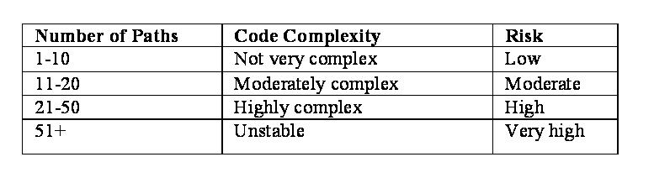
Metrics for Design
McCabe’s Cyclomatic Scale
Notes:
The goal is code that is not very complex and, therefore, low risk.
Low level of complexity within a method makes methods more understandable and maintainable

Slide 32
Metrics for Design
Cohesion and Coupling
  Widely accepted measures of the quality of the design
Notes:
2) Cohesion and coupling
Measures of the quality of the design

Slide 33
Cohesion
Measure of degree of interaction within a module
Measure of the strength of association of the elements inside a module
Functionality inside a module should be so related that anyone can easily see what the module does
Goal is a highly cohesive module
Notes:
Cohesion
Kang defines method cohesion as the relatedness of a module’s components
Refers to the internal “glue” with which a component is constructed
The more cohesive a module, the more related are the internal parts of the module to each other and to its overall purpose
a module is cohesive if all elements of the component are directed toward and essential for performing the same task

Slide 34
Cohesion
For structured design
  Deals with the cohesion of the actions in a module (unit) to perform one and only one task
For object-oriented methods
  Deals with the ability of a module to produce only one output for one module
Notes:
Cohesion for object-oriented methods
Deals with the ability of a module to produce only one output for one module
To change the state of only one object

Slide 35
Levels of Cohesion in Structured Design
Functional cohesion (Good)
Sequential cohesion
Communicational cohesion
Procedural cohesion
Temporal cohesion
Logical cohesion
Coincidental cohesion (Bad)
Notes:
First 2 levels are equally good:
Functional cohesion is optimal for procedural paradigm

Slide 36
Comparison of Cohesion Levels for Structured Design
Cohesion Level | Cleanliness of Implementation | Reusability | Modifiability | Understand-ability
Functional | Good | Good | Good | Good
Sequential | Good | Medium | Good | Good
Communicational | Good | Poor | Medium | Medium
Procedural | Medium | Poor | Variable | Variable
Temporal | Medium | Bad | Medium | Medium
Logical | Bad | Bad | Bad | Poor
Coincidental | Poor | Bad | Bad | Bad
Notes:
From Page-Jones book The Practical Guide to Structured Systems Design

Slide 37
Levels of Cohesion for Object-oriented Methods
Functional cohesion (Good)
Sequential cohesion
Communicational cohesion
Iterative cohesion
Conditional cohesion
Coincidental cohesion (Bad)
Notes:
First 2 levels are equally good:
Information cohesion is optimal for object-oriented paradigm
Functional cohesion is optimal for procedural paradigm

Slide 38
Functional Cohesion in Structured Design
IN STRUCTURED DESIGN
A module performs exactly one action or achieves a single goal
IN OO DESIGN
Only one output exists for the module
Ideal for object-oriented paradigm
Notes:
Functional cohesion
ideal
Everything in the module contributes to the same single function
Module has a strong, single-minded purpose
Modules are:
Maintainable (because fault isolation – can find and fix fault easier)
Reusable (because one action that it performs often needs to be performed in other products)
Easily tested

Slide 39
Functional Cohesion for Object-oriented Methods
  public void deposit (double amount)
  {
  balance = balance + amount;
  }
Notes:
Functional Cohesion
The module, deposit, illustrates object-oriented functional cohesion because it produces only one output for one module (i.e., to change the state of only one object).

Slide 40
Sequential Cohesion in Structured Design
STRUCTURED DESIGN
Outputs of one module serve as input data for the next module
OBJECT ORIENTED DESIGN
One output is dependent on the other output
Modifications result in changing only one instance variable
Notes:
Sequential Cohesion
One whose elements are involved in activities such that output data from one activity serves as input data to the next
Contains activities that will not in general be useful together
Like an assembly line
Usually has good coupling and is easily maintained
Only real disadvantage is that it is not so readily reusable as is a functionally cohesive module
Example
These activities cannot be summed up as a single function
The output from the first (format raw record) is the input to the second (cross-validate)

Slide 41
Sequential Cohesion for Object-oriented Methods
public double withdraw (double amount, double fee)
{
amount = amount + fee;
if (amount < 0)
System.out.println (“Error: withdraw amount is invalid.”);
else if (amount > balance)
System.out.println (“Error: Insufficient funds.”);
else
balance = balance – amount;
return balance;
}
Notes:
Sequential Cohesion
In the module withdraw, two objects (variables), namely amount and balance, are modified.
However, both modifications result in changing only one instance variable (balance).

Slide 42
Communicational Cohesion in Structured Design
STRUCTURED DESIGN
Various functions within a module perform activities on the same data
OBJECT ORIENTED DESIGN
Two outputs are iteratively dependent on the same input
Notes:
Communicational cohesion
Order of execution of the functions is unimportant
A communicationally cohesive module is one whose elements perform different functions, but each function references the same input information or output
Solution: reorganize into separate modules, each performing one action

Slide 43
Communicational Cohesion for Object-oriented Methods
public void addCD (String title, String artist,
double cost, int tracks)
{
if (count = = collection.length)
increaseSize ( );
collection [count] = new CD (title, artist, cost, tracks);
totalCosts = totalCosts + cost;
count++;
}
Notes:
Communicational Cohesion
The module addCD modifies more than one object (variable), and those outputs are dependent on only one common input, namely the CD.
Thus, addCD is an example of communicational cohesion.

Slide 44
Iterative Cohesion for Object-oriented Methods
Two outputs are iteratively dependent on the same input
Notes:
Iterative Cohesion
In the module formDet, there are several objects (array variables) modified.
However, each modification is a result of looping.
Although this level of cohesion is acceptable, it could be improved by calling a method that changes the three variables rather than changing them within the loop.
A meaningful name for such a method would increase the understandability of this module.

Slide 45
Iterative Cohesion for Object-oriented Methods
  void formDet (float Equations[2][3], float x[2][2],
  float y[2][2], float D[2][2])
  {
  for (int Row = 0; Row < 2; ++Row)
  for (int Col = 0; Col < 2; ++Col)
  {
  x[Row][Col] = Equations[Row][Col];
  y[Row][Col] = Equations[Row][Col];
  D[Row][Col] = Equations[Row][Col];
  }
  x[0][0] = Equations[0][2];
  x[1][0] = Equations[1][2];
  y[0][1] = Equations[0][2];
  y[1][1] = Equations[1][2];
  }
Notes:
Iterative Cohesion
In the module formDet, there are several objects (array variables) modified.
However, each modification is a result of looping.
Although this level of cohesion is acceptable, it could be improved by calling a method that changes the three variables rather than changing them within the loop.
A meaningful name for such a method would increase the understandability of this module.

Slide 46
Conditional Cohesion for Object-oriented Methods
Two outputs are conditionally dependent on the same input
Notes:
Conditional Cohesion
In the following method, there is more than one object output, namely dueDate, availability, and the return variable.
All modifications are the result of an if statement.
Again, this is an acceptable level of cohesion, but it could be made better by adding a method to change dueDate and availability.

Slide 47
Conditional Cohesion for Object-oriented Methods
public boolean checkBookIn ( )
{
if (this.isAvailable ( ))
{ //this object cannot be checked out
System.out.println (“Error: “ + callNumber +
“ is not checked out”);
return false;
}
else
{
dueDate = null;
availability = true;
return true;
}
}
Notes:
Conditional Cohesion
In the following method, there is more than one object output, namely dueDate, availability, and the return variable.
All modifications are the result of an if statement.
Again, this is an acceptable level of cohesion, but it could be made better by adding a method to change dueDate and availability.

Slide 48
Coincidental Cohesion for Object-oriented Methods
Two outputs have no dependence relationship with each other and no dependence relation on a common input
Notes:
Coincidental Cohesion
In the method readInput, various objects are modified, but no loop or selection statement defines what will be modified.
The readInput method does not demonstrate an acceptable level of cohesion, but it can be improved.

Slide 49
Coincidental Cohesion for Object-oriented Methods
public void readInput ( )
{
System.out.println (“Enter name of item being purchased: “);
name = MyInput.readLine ( );
System.out.println (“Enter price of item: “);
price = MyInput.readLineDouble ( );
System.out.println (“Enter number of items purchased: “);
numberBought = MyInput.readLineInt ( );
}
Notes:
Coincidental Cohesion
In the method readInput, various objects are modified, but no loop or selection statement defines what will be modified.
The readInput method does not demonstrate an acceptable level of cohesion, but it can be improved.

Slide 50
Coincidental Cohesion for Object-oriented Methods
public String AcceptItemName ( )
{
System.out.println (“Enter name of item being purchased: “);
name = MyInput.readLine ( );
return name;
}
Notes:
Coincidental Cohesion
In this method, objects are placed together because they are modified at the same time, and the modifications yield all the input for the program.
However, a better solution would be to embed three separate methods (each containing the appropriate prompt and read statements for one variable) in readInput.
The readInput method could then simply call the individual input methods for each variable. Each embedded method (for example, AcceptItem) would be more easily modifiable, more maintainable, and reusable.

Slide 51
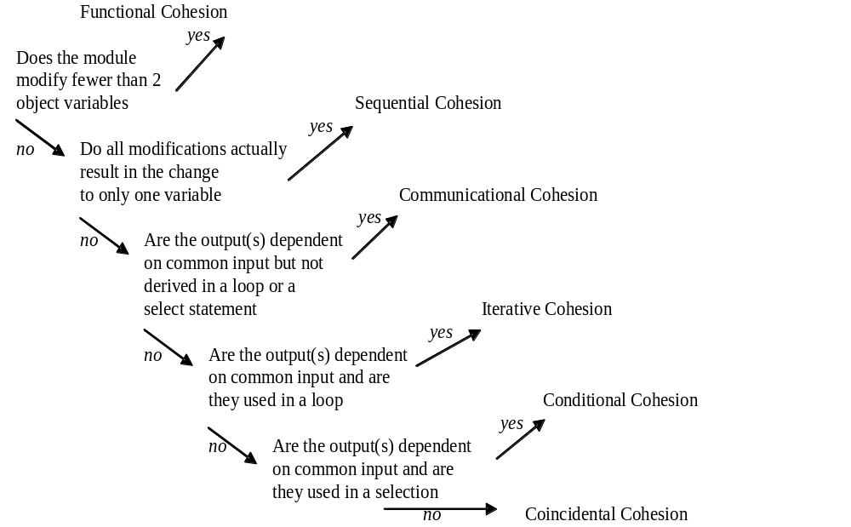
Cohesion Decision Tree for Object-oriented Methods

Slide 52
Coupling
Measure of degree of interaction between two modules
Measure of interdependence of modules
Goal is to have so little coupling that changes can be made within one module without disrupting other modules
Notes:
Coupling
depends on:
1) references made from one module to another (example: A invokes B so A depends on B for completion of function); to understand A, you must understand B
2) amount of data passed from one module to another (parameters)
want to reduce the number and types of interconnections that exist between modules
advantages to using coupling:
1) improves readability of design and code
2) improves maintainability of code
low coupling helps to minimize the number of modules needing revision
3) reduces ripple effect of bugs or changes
If a module is tightly coupled to another module, then a change to one module may require a corresponding change to the other module; the change in the 2nd module may be missed and result in a fault which doesn’t reveal itself to later

Slide 53
Levels of Coupling for Object-oriented Methods
No coupling (Good)
Sequential coupling
Computational coupling
Conditional coupling
Common coupling
Content coupling (Bad)
Notes:
Couplling
Between methods within multiple collaborating classes
Research has shown that strong coupling (bad end) inhibits understandability, maintainability, testability, and reusability, and increase fault proneness.
Goal is loose coupling
The goal is to have weakly coupled components because coupling is a measurement of the understandability, maintainability, and reusability for that component
Acceptable levels of coupling: no coupling, sequential coupling, computational coupling, conditional coupling
Unacceptable levels of coupling: common coupling, content coupling

Slide 54
No Coupling for Object-oriented Methods
No global data sharing or functional calls between two modules
Notes:
No Coupling
Weakest coupling (most desired)
No coupling is defined as two components with no data sharing and no calls between the two components

Slide 55
Sequential Coupling for Object-oriented Methods
Two modules exist where the outputs of one module are the inputs of another
Notes:
Sequential Coupling
Sequential coupling is a weak form of coupling and therefore is acceptable
“input of another” means it is used in the calling method
Occurs when the outputs of one component are passed as input to another component
This coupling may exist without any parameter passing and would be classified by Myers as “no coupling”

Slide 56
Computational Coupling for Object-oriented Methods
Two modules exist where one module passes a parameter to another module and the parameter has control or data dependence on the output
Notes:
Computational Coupling
acceptable level of coupling
Also known as iterative coupling
Occurs when one component passes to another component a piece of information in order to control the iterative behavior of the component
Is an acceptable level of coupling

Slide 57
Conditional Coupling for Object-oriented Methods
One module passes a parameter to another module and the parameter has control dependence on an output
Notes:
Conditional Coupling
emerged from the control coupling of structured development
Occurs when one component passes to another component a piece of information in order to control the internal logic of that component
Passes a flag and/or object as a parameter to achieve this control
Conditional coupling is a moderate level of coupling that allows dependence between two components
Often an indication of some other problem in the design
Problems are decreased understandability, reusability, and maintainability
Understandability is reduced since the developers of one component must know the details of the internal logic of another component

Slide 58
Common Coupling for Object-oriented Methods
One module writes to the global data and another module reads from the global data
Notes:
Common Coupling
also called global coupling
Occurs when global variables are shared; thus, all components referring to those global variables are linked or coupled to each other
Although common data is often used, this practice degrades the idea of information hiding and encapsulation by allowing data to reside outside the strict limits of a component
Reduces software understandability, maintainability, and reusability
Decreases understandability of the software by requiring developers to reference global variable information in order to understand a component that is coupled to that data
Decreases maintainability of software by creating unexpected results when modifications are made to the global data, thereby causing a ripple effect through coupled components
When modifications are made to the global data, it is difficult to identify which components are impacted
Each change or defect in global variables can produce a ripple effect that adversely affects all the components that use the global data

Slide 59
Content Coupling for Object-oriented Methods
One module references the contents of another module
Notes:
Content Coupling
undesirable form of coupling in which a component references or surreptitiously modifies data or content internal to another component
Represents the most severe form of connection between system elements because it allows a component to be completely dependent on another component

Slide 60
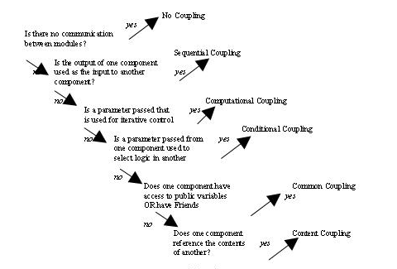
Coupling Decision Tree for Object-oriented Methods
Notes:
Couplling
Between methods within multiple collaborating classes

