Slide 1
Database

Slide 2
Introduction to Database & DBMS
What is a database ?
A database is a systematic collection of data. Databases support storage and manipulation of data. Databases make data management easy
What Is Database Management System (DBMS)
Database Management System (DBMS) is a collection of programs which enables its users to access database, manipulate data, reporting / representation of data .

Slide 3
What’s SQL
SQL = Structured Query Language
SQL is a standard computer language for relational database management and data manipulation.

Slide 4
What’s NoSQL
NoSQL is an upcoming category of Database Management Systems. Its main characteristic is its non-adherence to Relational Database Concepts. NOSQL means "Not only SQL".
NOSQL database are non-relational databases that scale out better than relational databases and are designed with web applications in mind.

Slide 5
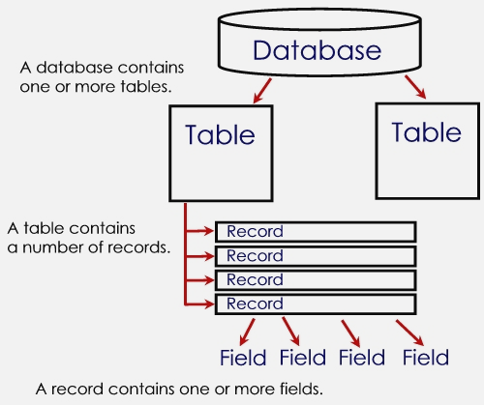
Basic Concept of Database

Slide 6



Basic Concept of Database
TABLE | RECORD | FIELD
also known as database file/s. organized data in rows and columns. contain fields (column) and records (row). Data file – collection of related records, stored in any available storage medium. | also known as rows/tuple. Contains data values (name for a person, of a product, an ID for student). a collections of related fields in a database. also represent a data attributes (describing an entity). | also known as a columns contains a specific category of data within a record. single category of data to be stored in database. field name – uniquely identifies each field. field size – defines the maximum of characters a field can contain.

