Slide 1
Database

Slide 2
Introduction to Database & DBMS
What is a database ?
A database is a systematic collection of data. Databases support storage and manipulation of data. Databases make data management easy
What Is Database Management System (DBMS)
Database Management System (DBMS) is a collection of programs which enables its users to access database, manipulate data, reporting / representation of data .

Slide 3
What’s SQL
SQL = Structured Query Language
SQL is a standard computer language for relational database management and data manipulation.

Slide 4
What’s NoSQL
NoSQL is an upcoming category of Database Management Systems. Its main characteristic is its non-adherence to Relational Database Concepts. NOSQL means "Not only SQL".
NOSQL database are non-relational databases that scale out better than relational databases and are designed with web applications in mind.

Slide 5
Relational databases VS NoSQL
Relational databases have the following advantages over NOSQL databases :
SQL(relational) databases have a mature data storage and management model . This is crucial for enterprise users.
SQL databases support the notion of views which allow users to only see data that they are authorized to view. The data that they are not authorized to see is kept hidden from them.
SQL databases support stored procedure sql which allow database developers to implement part of the business logic into the database.
SQL databases have better security models compared to NoSQL databases.

Slide 6
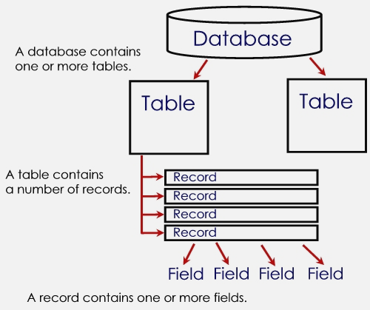
Basic Concept of Database

Slide 7



Basic Concept of Database
TABLE | RECORD | FIELD
also known as database file/s. organized data in rows and columns. contain fields (column) and records (row). Data file – collection of related records, stored in any available storage medium. | also known as rows/tuple. Contains data values (name for a person, of a product, an ID for student). a collections of related fields in a database. also represent a data attributes (describing an entity). | also known as a columns contains a specific category of data within a record. single category of data to be stored in database. field name – uniquely identifies each field. field size – defines the maximum of characters a field can contain.

Slide 8
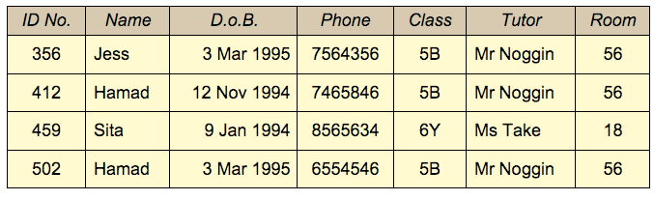
Basic Concept of Database

Slide 9

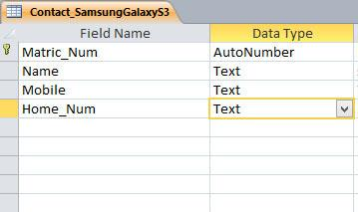
Primary Key
Primary Key (in database) – a field, uniquely identifies each record in a file.
also known as a key field
data (in the field) is unique.
can be used to integrate data in database.

Slide 10
Primary Key
Primary Key (PK) (in database) – should follow the listed rules (in order to use it in database)
PK must contain a value – that is must be declared (NOT NULL).
PK value must be unique for each record (row).
PK value must no change or become NULL
Benefits of using primary key (in database) ;
ensuring there’s no duplicate records in database.
preventing a NULL value being entered in unique field.

Slide 11

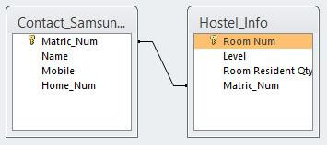
Foreign Key
Foreign Key (in database) – a field in relational table, that matches primary key column of another table.
1
2
1
1st Table
2
2nd Table
3
Relational / Relationships Line
Connecting 1st and 2nd Table
3

Slide 12
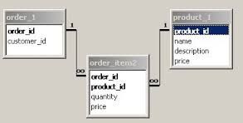
Composite Key
A composite key is a combination of two or more columns in a table that can be used to uniquely identify each row in the table when the columns are combined uniqueness is guaranteed, but when it taken individually it does not guarantee uniqueness.

Slide 13
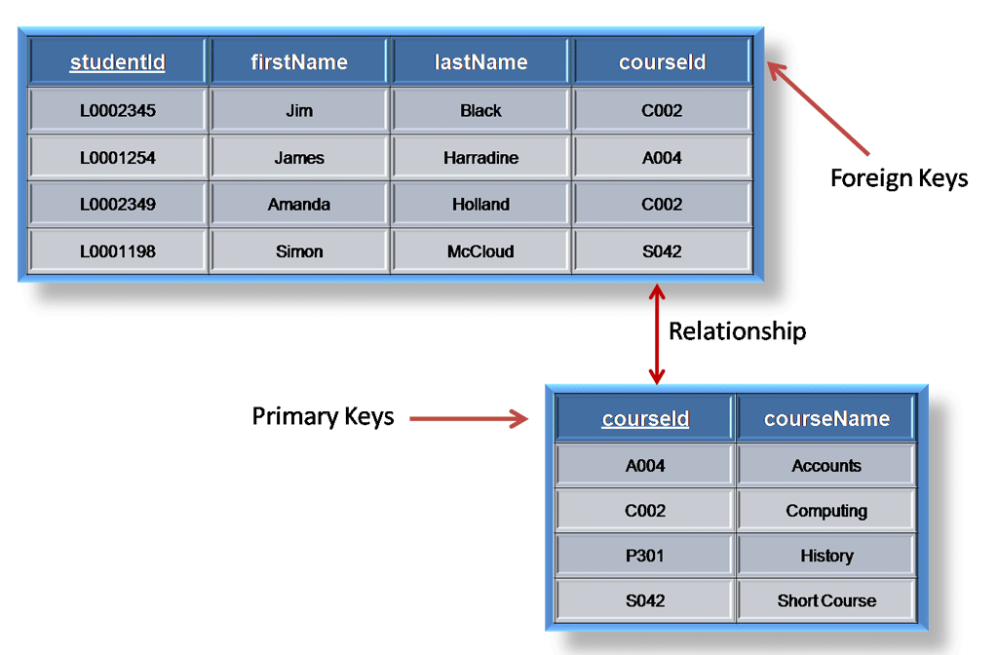
Primary Key & Foreign Key

Slide 14
Normalization
The biggest problem needed to be solved in database is data redundancy
Why data redundancy is the problem? Because it causes:
Insert Anomaly
Update Anomaly
Delete Anomaly

Slide 15
Normalization
Teacher | Subject | Teacher Degree | Tel
Billy | Database | Master's | 012666777
William | Database | Bachelor's | 017678678
Billy | E-Commerce | Master's | 012666777

Slide 16
Normalization
Normalization is the process of removing redundant data from your tables to improve storage efficiency, data integrity, and scalability.

Slide 17
Steps of Normalization
First Normal Form (1NF)
Second Normal Form (2NF)
Third Normal Form (3NF)
Boyce-Codd Normal Form (BCNF)
Fourth Normal Form (4NF)
Fifth Normal Form (5NF)
In practice, 1NF, 2NF, and 3NF are enough for database.

Slide 18
First Normal Form (1NF)
The official qualifications for 1NF are:
Each attribute name must be unique.
Each attribute value must be single.
Each row must be unique.
There is no repeating groups.
Additional: Choose a primary key.
Reminder:
A primary key is unique, not null, unchanged. A primary key can be either an attribute or combined attributes.

Slide 19
First Normal Form (1NF)
Example of a table not in 1NF :
Group | Topic | Student | Score
Group A | Intro MongoDB | Tina Fey | 18 marks
 |  | Joey Graceffa | 17 marks
Group B | Intro MySQL | Morgan Freeman | 19 marks
 |  | Sophie Martin | 16 marks

Slide 20
First Normal Form (1NF)
After Eliminating:
Group | Topic | Family Name | Given Name | Score
A | Intro MongoDB | Tina | Fey | 18
A | Intro MongoDB | Joey | Graceffa | 17
B | Intro MySQL | Morgan | Freeman | 19
B | Intro MySQL | Sophie | Martin | 16

Slide 21
Functional Dependencies
We say an attribute, B, has a functional dependency on another attribute, A, if for any two records, which have
the same value for A, then the values for B in these two records must be the same. We illustrate this as:
A → B (read as: A determines B or B depends on A)
employee name | project | email address
Sok San | POS Mart Sys | soksan@yahoo.com
Sao Ry | Univ Mgt Sys | sao@yahoo.com
Sok San | Web Redesign | soksan@yahoo.com
Chan Sokna | POS Mart Sys | chan@gmail.com
Sao Ry | DB Design | sao@yahoo.com
employee name → email address

Slide 22
Functional Dependencies
EmpNum
EmpEmail
EmpFname
EmpLname
123
jdoe@abc.com
John
Doe
456
psmith@abc.com
Peter
Smith
555
alee1@abc.com
Alan
Lee
633
pdoe@abc.com
Peter
Doe
787
alee2@abc.com
Alan
Lee
If EmpNum is the PK then the FDs:
EmpNum → EmpEmail, EmpFname, EmpLname

Slide 23
Second Normal Form (2NF)
The official qualifications for 2NF are:
A table is already in 1NF.
All nonkey attributes are fully dependent on the primary key.
All partial dependencies are removed to place in another table

Slide 24
Second Normal Form (2NF)
Example of a table not in 2NF:
CourseID | SemesterID | Num Student | Course Name
IT101 | 201301 | 25 | Database
IT101 | 201302 | 25 | Database
IT102 | 201301 | 30 | Web Prog
IT102 | 201302 | 35 | Web Prog
IT103 | 201401 | 20 | Networking
Primary Key
The Course Name depends on only CourseID, a part of the primary key not the whole primary {CourseID, SemesterID}.It’s called partial dependency.
Solution:
Remove CourseID and Course Name together to create a new table.
24

Slide 25
Second Normal Form (2NF)
CourseID | Course Name
IT101 | Database
IT101 | Database
IT102 | Web Prog
IT102 | Web Prog
IT103 | Networking
CourseID | SemesterID | Num Student
IT101 | 201301 | 25
IT101 | 201302 | 25
IT102 | 201301 | 30
IT102 | 201302 | 35
IT103 | 201401 | 20
Done? Oh no, it is still not in 1NF yet. Remove the repeating groups too.
Finally, connect the relationship.
CourseID | Course Name
IT101 | Database
IT102 | Web Prog
IT103 | Networking

Slide 26
Third Normal Form (3NF)
The official qualifications for 3NF are:
A table is already in 2NF.
Non-primary key attributes do not depend on other non-primary key attributes (i.e. no transitive dependencies)
All transitive dependencies are removed to place in another table.

Slide 27
Third Normal Form (3NF)
StudyID | Course Name | Teacher Name | Teacher Tel
1 | Database | Sok Piseth | 012 123 456
2 | Database | Sao Kanha | 0977 322 111
3 | Web Prog | Chan Veasna | 012 412 333
4 | Web Prog | Chan Veasna | 012 412 333
5 | Networking | Pou Sambath | 077 545 221
The Teacher Tel is a non-key attribute, and the Teacher Name is also a non-key atttribute.
But Teacher Tel depends on Teacher Name.
It is called transitive dependency.
Primary Key
Solution : Remove Teacher Name and Teacher Tel together to create a new table.

Slide 28
Third Normal Form (3NF)
Teacher Name | Teacher Tel
Sok Piseth | 012 123 456
Sao Kanha | 0977 322 111
Chan Veasna | 012 412 333
Chan Veasna | 012 412 333
Pou Sambath | 077 545 221
Teacher Name | Teacher Tel
Sok Piseth | 012 123 456
Sao Kanha | 0977 322 111
Chan Veasna | 012 412 333
Pou Sambath | 077 545 221
StudyID | Course Name | T.ID
1 | Database | T1
2 | Database | T2
3 | Web Prog | T3
4 | Web Prog | T3
5 | Networking | T4
ID | Teacher Name | Teacher Tel
T1 | Sok Piseth | 012 123 456
T2 | Sao Kanha | 0977 322 111
T3 | Chan Veasna | 012 412 333
T4 | Pou Sambath | 077 545 221
Note about primary key:
In theory, you can choose Teacher Name to be a primary key.
But in practice, you should add Teacher ID as the primary key.

Slide 29
Boyce Codd Normal Form (BCNF) – 3.5NF
The official qualifications for BCNF are:
A table is already in 3NF.
All determinants must be superkeys.
All determinants that are not superkeys are removed to place in another table.

Slide 30
Boyce Codd Normal Form (BCNF) – 3.5NF
Example of a table not in BCNF:
Student | Course | Teacher
Sok | DB | John
Sao | DB | William
Chan | E-Commerce | Todd
Sok | E-Commerce | Todd
Chan | DB | William
Key: {Student, Course}
Functional Dependency:
{Student, Course}→ Teacher
Teacher → Course
Problem: Teacher is not a superkey but determines Course.

Slide 31
Boyce Codd Normal Form (BCNF) – 3.5NF
Student | Course
Sok | DB
Sao | DB
Chan | E-Commerce
Sok | E-Commerce
Chan | DB
Course
DB
E-Commerce
Course | Teacher
DB | John
DB | William
E-Commerce | Todd
Solution: Decouple a table contains Teacher and Course from from original table (Student, Course). Finally, connect the new and old table to third table contains Course.
31

Slide 32
Study Case
Project No | Project Name | Employee No | Employee Name | Grade | Salary
NP001 | Project-1 | EMP001 | Antony | A | $ 10.000
 |  | EMP002 | Paula | B | $ 2.000
 |  | EMP006 | Coco | C | $75.00
NP002 | Project-2 | EMP001 | Kenny | A | $ 10.000
 |  | EMP012 | Susi | B | $9.000
 |  | EMP014 | Rony | B | $9.000
Notes:
http://www.slideshare.net/simonpatabang/6-materi-kuliah-normalisasi-tabel-database

Slide 33
Study Case
No Mahasiswa | Student Name | Jurusan | Kode Matakulaih | Nama Mata Kuliah | Kode Dosen | Nama Dosen | Nilai
2636 | Budi | MI | MI359 | DBMS | B001 | Widy | A
 |  |  | MI738 | UML | B002 | Trenggana | B
7283 | Roni | KA | MI359 | DBMS | B001 | Widy | A
 |  |  | AKN0029 | Akutansi Biaya | B003 | Susi | B
 |  |  | MKT002 | Marketing | B004 | Johan | C
Notes:
http://www.slideshare.net/simonpatabang/6-materi-kuliah-normalisasi-tabel-database

Slide 34
Entity Relationship
TERM | EXAMPLES
Entity (a noun) | Product, Name, Book, Student, Model, Lecturer, Staff.
Relationship (a verb) | order, register, claim, enroll, pay.
Cardinality (type of relationship) | One-to-One (1:1) One-to-Many (1:M) Many-to-One (M:1) Many-to-Many (M:N)
Attribute (entity’s property) | product_serial_num, product_price, product_name,

Slide 35
Entity Relationship
TERM | DIAGRAM SYMBOL
Entity (a noun) | rectangle/square
Relationship (a verb) | a diamond shape
Cardinality (type of relationship) | writing type of relationship on each relationship lines
Attribute (entity’s property) | an oval shape
1
1

Slide 36
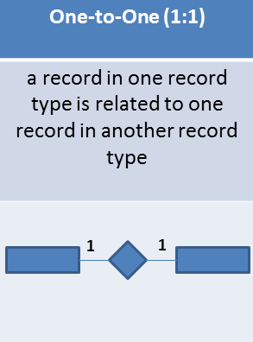
Entity Relationship ( Cardinality )
Example 1
2 entity, Teacher and Subject, the relationship is supervise,
Cardinality is 1:1
Teacher
1
supervise
1
Subject
Example 2
2 entity, Student and Module, the relationship is enroll,
Cardinality is 1:1
Student
1
enroll
1
Module

Slide 37
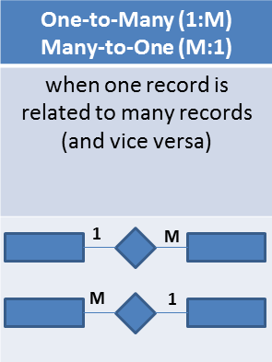
Entity Relationship ( Cardinality )
Example 1
2 entity, Football Team and Player,
the relationship is join,
Cardinality is 1:M
Football Team
1
join
M
Player
Example 2
2 entity, Person and Location,
the relationship is birthplace,
Cardinality is M:1
Person
M
birthplace
1
Location

Slide 38
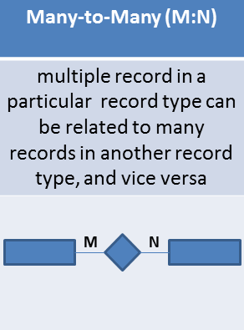
Entity Relationship ( Cardinality )
Example 1
2 entity, Book and Author,
the relationship is written,
Cardinality is M:N
Book
M
written
N
Author
Example 2
2 entity, Student and Course,
the relationship is register,
Cardinality is M:N
Student
M
register
N
Course

Slide 39
Classification of Relationship
Optional Relationship
An Employee may or may not be assigned to a Department
A Patient may or may not be assigned to a Bed
Mandatory Relationship
Every Course must be taught by at least one Teacher

Slide 40
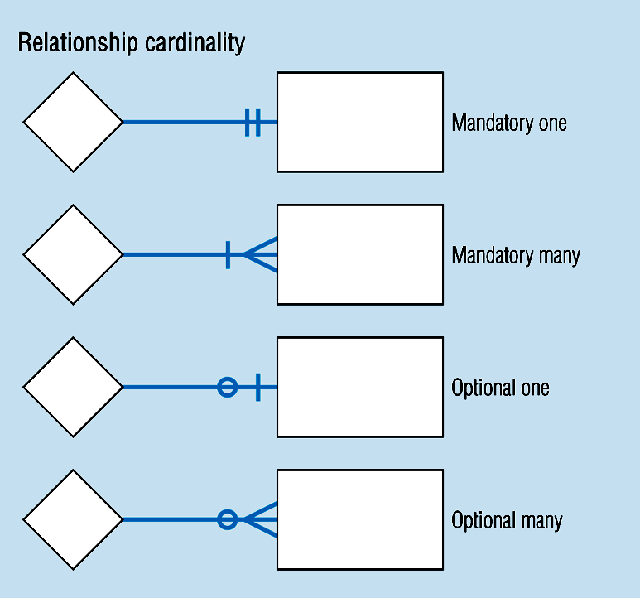
Cardinality Constraints

Slide 41
Cardinality Constraints Example
In our model, we wish to indicate that each school may enroll many students, or may not enroll any students at all.
We also wish to indicate that each student attends exactly one school. The following diagram indicates this optionality and cardinality:

Slide 42
Cardinality Constraints Example

Slide 43
General Steps to create an ERD
Identify the entity
Identify the entity's attributes
Identify the Primary Keys
Identify the relation between entities
Identify the Cardinality constraint
Draw the ERD
Check the ERD

Slide 44
Steps in building an ERD

Slide 45
Developing an ERD
The process has ten steps:
1. Identify Entities
2. Find Relationships
3. Draw Rough ERD
4. Fill in Cardinality
5. Define Primary Keys
6. Draw Key-Based ERD
7. Identify Attributes
8. Map Attributes
9. Draw fully attributed ERD
10. Check Results
Notes:
http://www.slideshare.net/tameemyousaf/entity-relationship-diagram-erd?qid=d93c0f30-a332-4d0e-b4e1-6e566c6c6c77&v=&b=&from_search=1

Slide 46
Study Case
A company has several departments. Each department has a supervisor and at least one employee. Employees must be assigned to at least one, but possibly more departments. At least one employee is assigned to a project, but an employee may be on vacation and not assigned to any projects. The important data fields are the names of the departments, projects, supervisors and employees, as well as the supervisor and employee number and a unique project number.

Slide 47

MYSQL Database
MySQL is an open source relational database.
MySQL is cross platform which means it runs on a number of different platforms such as Windows, Linux, and Mac OS etc.

Slide 48
Why Use MYSQL
MySQL supports.
InnoDB: - its default storage engine provided with MySQL as of version 5.5. InnoDB supports foreign keys for referential integrity and also supports ACID-standard transactions.
MyISAM: - it was the default storage engine for MySQL prior to version 5.5. MyISAM lacks support for transactions. Its advantages over InnoDB include simplicity and high performance.
MySQL has high performance compared to other relation database systems.
Cost effective, it's relatively cheaper in terms of cost when compared to other relational databases
Cross platform

Slide 49
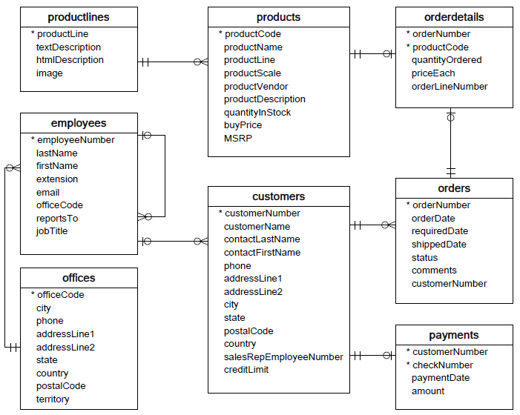
Create Structure Table

