Slide 1
MySQL

Slide 2
MySQL data types
MySQL uses many different data types which were categorized into 3 parts:
6.1. Numeric Data type,
6.2. Date and Time and
6.3. String data types.
6.1. Numeric Data Types:
INT: Numeric data type. maximum number of digits may be specified in parenthesis
The following data types are use for maximum numbers of data storage and retrieval
INYINT
SMALLINT
BIGINT
FLOAT
DOUBLE
DECIMAL

Slide 3
MySQL data types
6.2. Date and Time Types:
DATE: Format: YYYY-MM-DD
DATETIME: Date and time combination. Format: YYYY-MM-DD HH:MI:SS
TIMESTAMP: This values are stored as the number of seconds. Format like YYYY-MM-DD HH:MI:SS
TIME: Format: HH:MI:SS
YEAR: Year in two-digit or four-digit. [eg. two digit: 80 to 90, representing years from 1980 to 1990]
6.3. Text (String) Types:
CHAR: Fixed length string(contain letters, numbers, and characters). The fixed size is specified in parenthesis. Can store up to 255 characters.
VARCHAR: Field is a set of character data of indeterminate legth. The maximum size is specified in parenthesis. Can store up to 255 characters
TINYTEXT: Holds a string with a maximum length of 255 characters
BLOB or TEXT: These are use for huge data storing. Holds a string with a maximum length of more than 65 thousand characters.
MEDIUMBLOB or MEDIUMTEXT: Holds a string with a maximum length of more than 16 lakh characters.
LONGBLOB or LONGTEXT: Holds a string with millions of characters
ENUM: You enter the possible values in this format: ENUM('X','Y','Z').

Slide 4
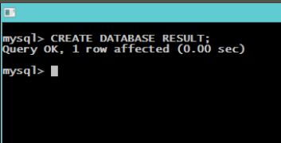
Basic MySQL Commands
1. CREATE : (DDL). That allows to create database.
Command: CREATE DATABASE <database name>;
For eg.: CREATE DATABASE RESULT;
Now we will show the RESULT database is created or not.
Command: SHOW DATABASES;
N:B: The RESULT database is created.

Slide 5
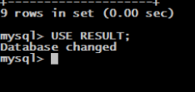
Basic MySQL Commands
2. DROP (DDL): This command allows us to remove database or entire objects from the database. Be careful while deleting any database because you will lose your all the data available in your database
Command: DROP DATABASE <database name>;
or DROP TABLE <table name>;
3. USE database: Now we will create table. Before creating the table we need to select the specific database, in which database you are going to create tables and store the data.......
Command: USE <database name>;
For eg.: We will use the database RESULT.
Command: USE RESULT;

Slide 6
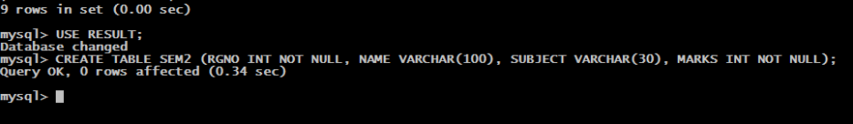
Basic MySQL Commands
4. CREATE TABLE: We selected a specific database. Now create the table.
Command: CREATE TABLE <table name> (column1 data type, column2 data type, column3);
Eg.: CREATE TABLE SEM2 (REGNO INT NOT NULL, NAME VARCHAR(100), SUBJECT VARCHAR(30), MARKS INT NOT NULL);
5. DROP TABLE: Same as previous drop command.

Slide 7
Basic MySQL Commands
6. INSERT INTO (DML): To insert data into MySQL table, you would need to use SQL INSERT INTO command. You can insert data into MySQL table by using following command
Command:INSERT INTO <table name> (column1, column2, column3) values (.......................);
For eg.: We will insert values into SEM2 table
Command: INSERT INTO SEM2 (REGNO, NAME, SUBJECT, MARKS)
VALUES (1234, 'BWSRANG', 'INFORMATION STORAGE AND RETRIEVAL', 80);

Slide 8
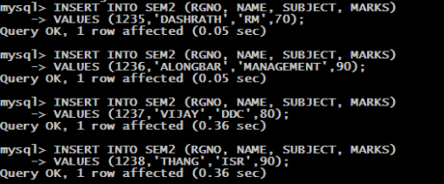

Slide 9
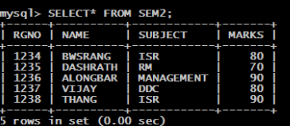
Basic MySQL Commands
7. SELECT (DRL): Use for retrieve data from database. Use for selecting various attributes or column of a table. The SQL SELECT command is used to fetch data from MySQL database
Command: SELECT* FROM <table name>;
SELECT* FROM SEM2;

Slide 10
Basic MySQL Commands
If you want to retrieve some attributes from the table
command: SELECT <column1> FROM <table> WHERE <condition>;
eg. 1: SELECT SUBJECT FROM SEM2 WHERE MARKS='80';
You can retrieve different condition from table:
eg.2: SELECT* FROM SEM2 WHERE MARK >'80';
here all the greater than 80 marks from SEM2 table will be retrieved.

Slide 11
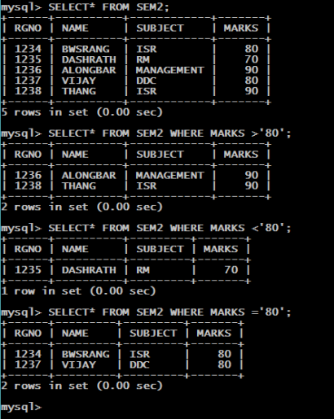

Slide 12
Basic MySQL Commands
8. Where clause: We have seen SQL SELECT command to fetch data from MySQL table. It works like an if condition in any programming language. We can use a conditional clause called WHERE clause to filter out results. Using WHERE clause, we can specify a selection criteria to select required records from a table.
WHERE clause is an optional part of SELECT command.
You can specify any condition using WHERE clause. (area, mark less than and greater than etc.)
You can specify more than one conditions using AND or OR operators.
A WHERE clause can be used along with DELETE or UPDATE SQL command also to specify a condition.

Slide 13
Basic MySQL Commands
9. UPDATE (DML): There may be a requirement where existing data in a MySQL table needs to be modified. You can do so by using SQL UPDATE command. This will modify any field value of any MySQL table. The WHERE clause is very useful when you want to update selected rows in a table.
Command: UPDATE <table name>
SET COLUMN1=values
WHERE <condition>;
eg.: UPDATE SEM2
SET SUBJECT='ISR' WHERE NAME ='BWSRANG';

Slide 14
Basic MySQL Commands
10. DELETE (DML) : Use for delete data from table (only specific data). If you want to delete a record from any MySQL table, then you can use SQL command DELETE FROM. You can delete records in a single table at a time.
Command: DELETE FROM
eg.: DELETE FROM SEM2 WHERE MARK='90';
11. ALTER (DDL): Use for modifies an existing database objects. MySQL ALTER command is very useful when you want to change a name of your table, any table field or if you want to add or delete an existing column in a table.
Command: (Add)
ALTER TABLE SEM2 ADD POINT INT;
Command: (Drop)
ALTER TABLE SEM2 DROP POINT;
eg.: ALTER TABLE SEM2
MODIFY NAME VARCHAR(100) NOT NULL;

Slide 15
MySQL Constraints
Constraints are used to specify rules for the data in table.
NOT NULL: Used to represent a column can not have value(empty).
eg.: SELECT ID, NAME, AGE, ADDRESS, SALARY FROM CUSTOMERS WHERE SALARY IS NOT NULL;
DEFAULT: Provide a default value for a column when none is specified.
UNIQUE: Ensures that all the values in columns are unique. (different)
Duplication can not be happen.
eg. Roll No., date of birth.
PRIMARY KEY: Combination of NOT NULL and UNIQUE.
FOREIGN KEY : Uniquely identify a row / record in any other database table.
CHECK: The check constraints ensures that all values in a column specify certain condition.
INDEX: Use to create and retrieve data from database very quickly.

