Slide 1
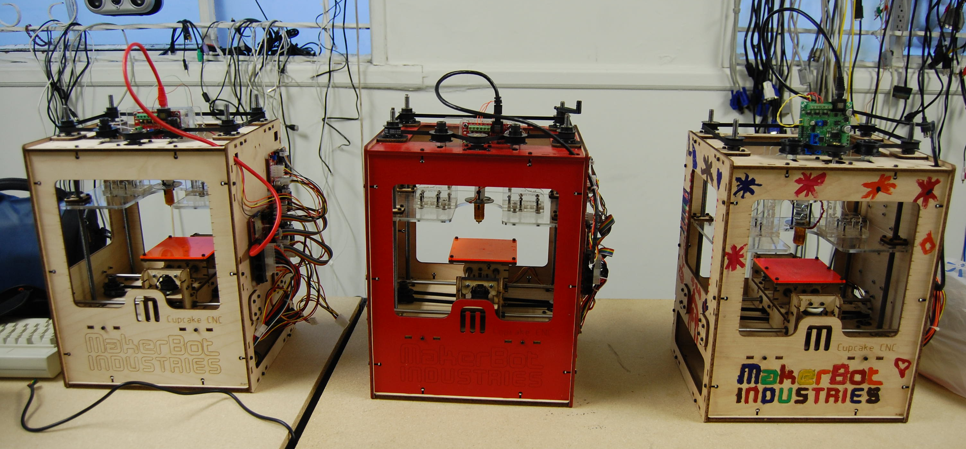
MakerBot 101

Slide 2
What Is A 3D MakerBot?
3D printer
RepRap derivative
Several generations
  MakerBot Cupcake CNC
  Thing-O-Matic
  Replicator
  Replicator2

Slide 3
What Is A 3D Printer?
3-axis CNC machine
Extrudes melted plastic
"Draws" each layer from bottom to top
Fused Deposition Modeling (FDM)

Slide 4
Hardware
MakerBot
  Case
  Electronics
  It's a robot!
  Plastruder
  SD card slot
Computer
  USB cable

Slide 5
CRASHbot Upgrades
You kids have it so easy
Heated Build Platform (HBP)
Stepstruder Mk6
Generation 4 Electronics

Slide 6
Software
ReplicatorG
  Sends gcode to the MakerBot
  Currently version 0040
Skeinforge
  Converts 3D model into gcode
  Built into ReplicatorG
Blender / SketchUp / OpenSCAD
  Create 3D model
Meshlab
  Test/repair 3D model

Slide 7
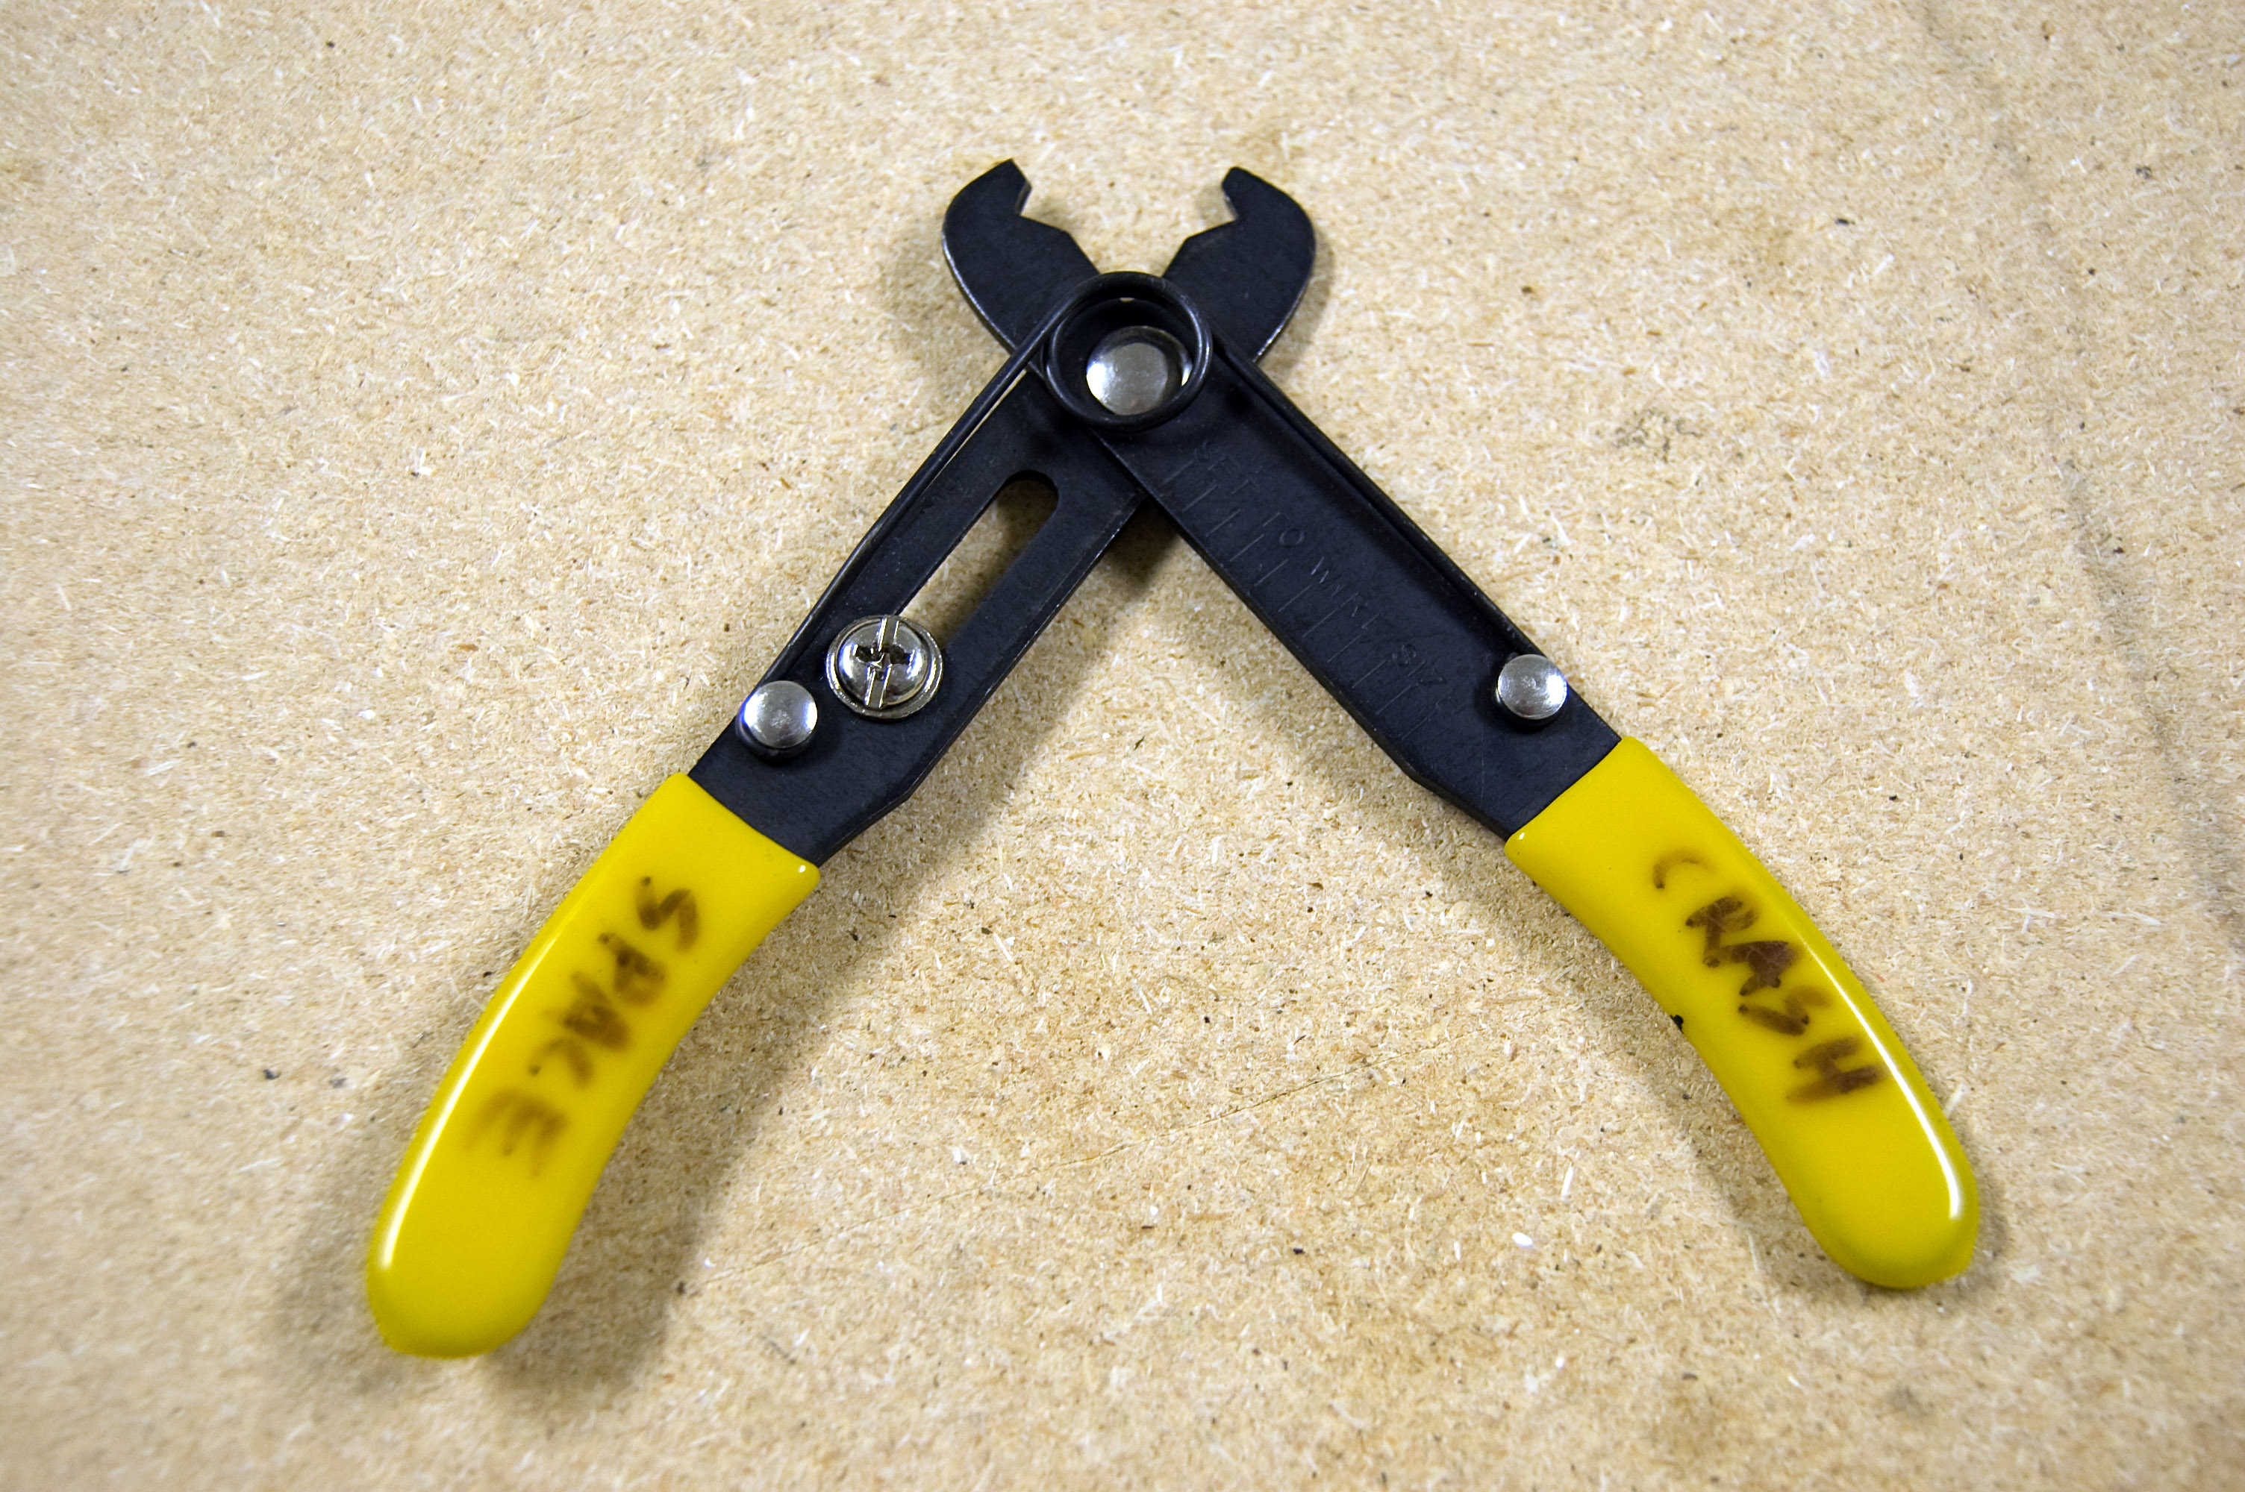
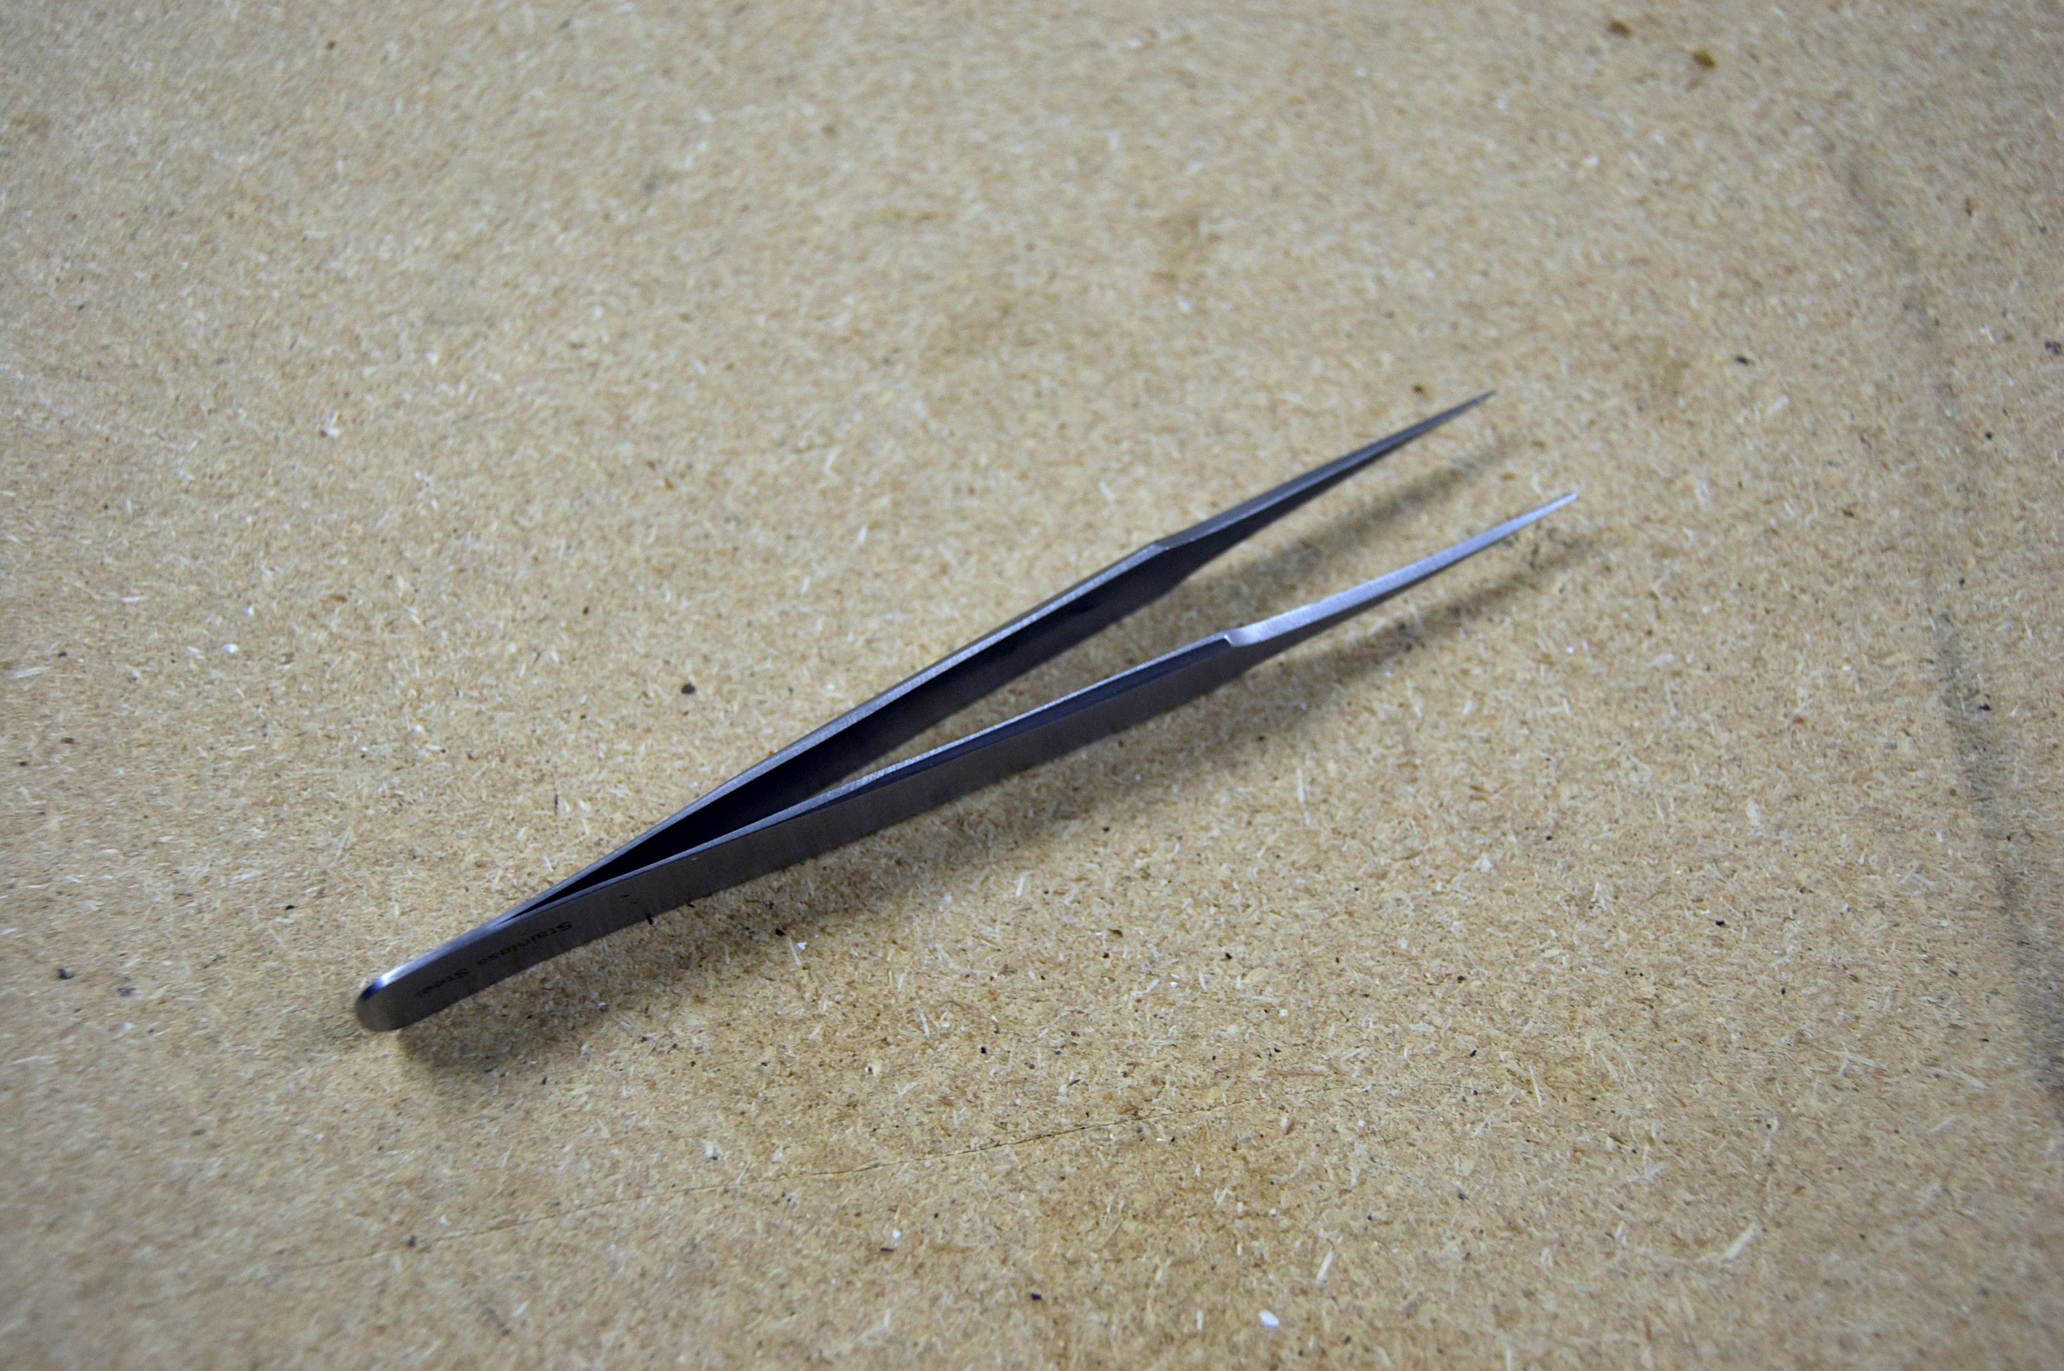
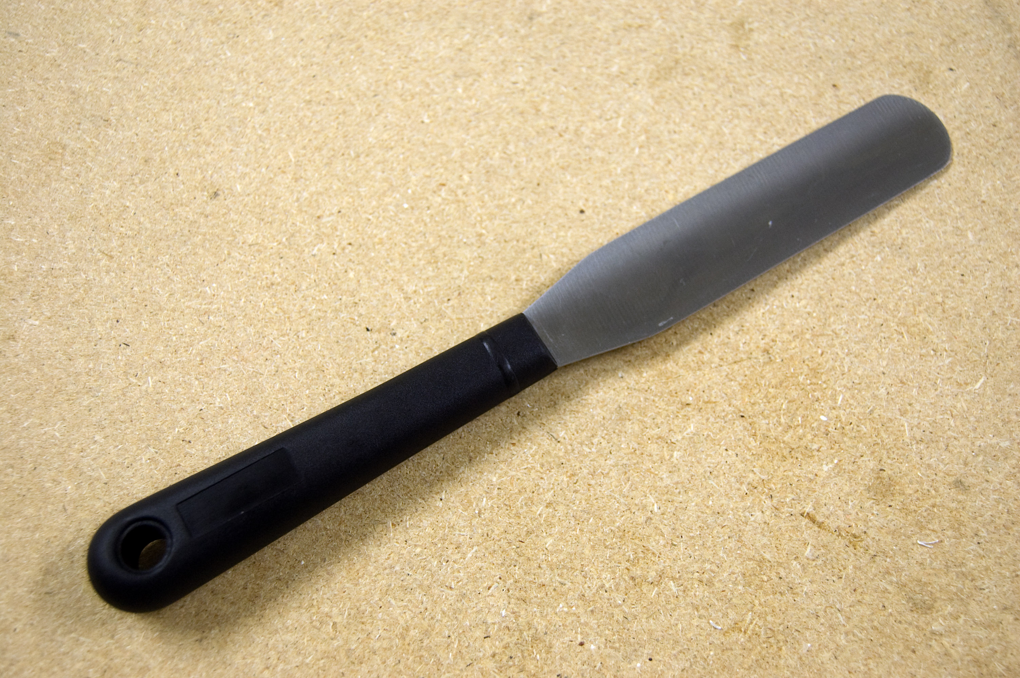
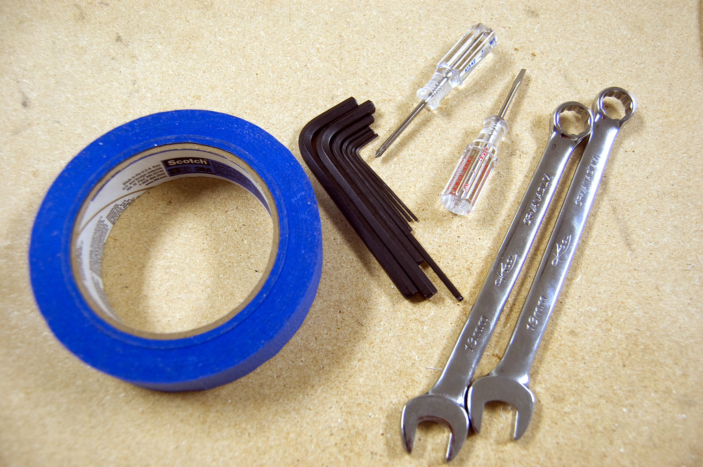
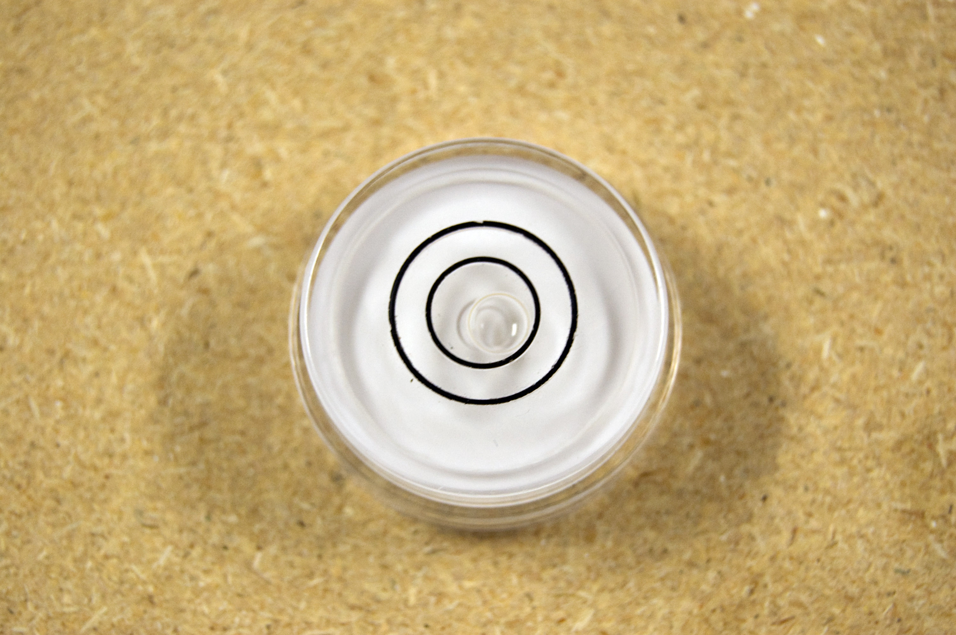
Tools

Slide 8
Tools
But mostly you need tweezers and spatula

Slide 9
Objects
Print 3D Models
Need STL Files
  Stereolithography 3D solid CAD file format
Get
  Thingiverse
Make
  Use CAD software Blender, etc.
  Scan with 3D scanner
Printability
  Size
  Overhangs

Slide 10
Basic Steps
Preflight
Power
Level
Software
Heat
Model
Print

Slide 11
Preflight
Check Mechanics
  Make sure everything looks right
    Z rods
    Belts
    Extruder
Check Cables (where applicable)
Check Platforms
  Build platform
  Z platform (Cupcake only)

Slide 12
Power
Power Supply Switch
Computer (optional)
USB Cable (optional)
  If you turn the power on before plugging in the USB, it can sometimes not reset the electronics correctly
  Correct by resetting the MakerBot

Slide 13
Level (CRASHbot)
Should mostly be a non-issue. Mostly.
MakerBot
  Should be roughly level
Build Platform
  Most important - needs to be level relative to MakerBot
  X/Y motion can't alter distance of platform to nozzle
Z Platform
  Should be roughly level relative to Makerbot
  Helps with Z axis motion
  Use hash marks on body

Slide 14
Level
Build platform must be level
You probably don't have to adjust it. Probably
If your prints curl or lift up on one side, that side is too low
Platform leveling routine works OK
  Use piece of paper as a gauge and make sure it's the same everywhere on the platform
  Turn the thumbscrews in the corners to adjust

Slide 15
Software
RepliatorG
  Serial port
  Driver
    Cupcake CNC w/ HBP + Mk6+ (CRASHbot)
    The Replicator Dual (Replicator)
Skeinforge
  CRASHbot Mk6 profile
  Use default for Replicator
Control Panel
  Check movement
  Center build platform (CRASHbot)
  Zero (CRASHbot)

Slide 16
Stepper Motors
Stepper motors are cool but we have a problem with the settings on the drivers
They can overheat if left engaged
After you move the robot, click Disable to avoid overheating

Slide 17
Heat
No need to pre-heat!
  Really
  No, really
Extruder
  Target temperature is 225 C (ABS)
  Target temperature is 190 C (PLA)
  PTFE starts to break down at 240 C - VERY BAD!!!!!!!!!!
Heated Build Platform
  ~120 C (ABS)
  ~50 C (PLA)

Slide 18
Extrusion
Control Panel
Manual extrusion is controlled by time
Filament feeds from top
Ooze
  What ooze?
  OK, there is still a bit

Slide 19
Alignment (CRASHbot)
X Axis
  Use "M" to center front of X/Y carriage
Y Axis
  Visually align heat spreader line with nozzle
Z Axis
  End stop – auto alignment
Disable stepper motors when not in use
  They get hot if left engaged
  Can damage the motors

Slide 20
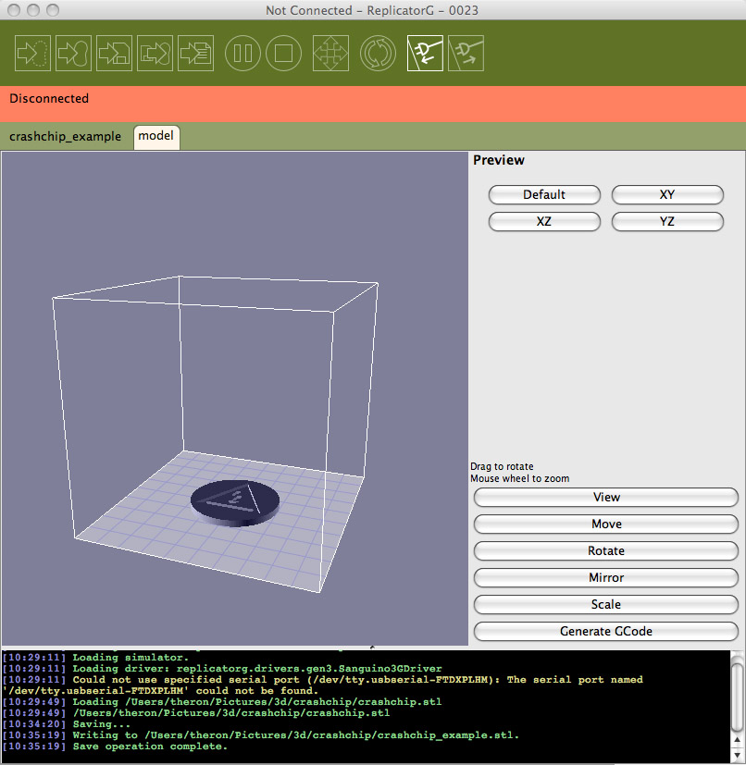
Object
Open STL file in ReplicatorG
  Scale if desired
  Center
  Place on platform

Slide 21
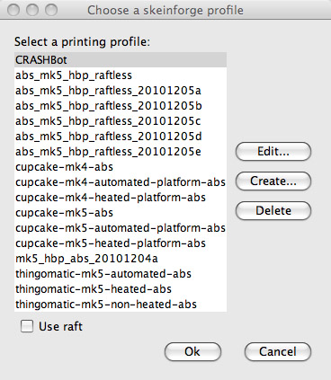
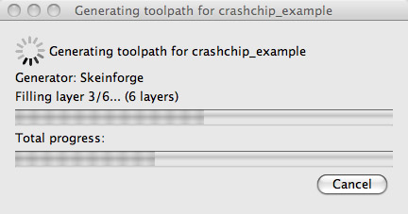
Generate GCode
Click "Generate GCode" button
Choose profile
G-Code preview

Slide 22
Build
Estimate
Build
Build To SD File
  Copy To SD Card
Build From SD Card
USE THE SD CARD
  "Interference"
  Speed
  Interface

Slide 23
Raft
Forget about it. But leave it checked.
Purpose
How It Works
Removal

Slide 24
Raftless Plug-in
All advantages of raft without extra layers
Slows down first perimeter to emulate raft
Extrusion introduction
  "tail"
  first bit is always screwed up, so make it happen elsewhere
Controlled by Raft plug-in

Slide 25
Build Sequence
Axis calibration
Heating position
Test extrusion
Print
Ejection Position
Cooling

Slide 26
Z Axis Calibration
Moves Z platform to top
Endstop triggers
Does it twice at different speeds to be sure
Knows how far down platform is

Slide 27
Heating Position
Moves extruder to just above build platform
Waits for extruder and platform to come to temperature

Slide 28
Test Extrusion
5 second extrusion
End might be cold or curl so pull it off
  Use the tweezers!

Slide 29
Print
It's mesmerizing – keep an eye on it
Filament slack

Slide 30
Ejection Position
Moves Z platform up
  Cupcake
    Just a bit
    Moves build platform to front eject position
  Replicator
    Moves build platform to bottom

Slide 31
Cooling
Let build platform cool a bit to help remove object
  Monitor on the control panel
  ABS is easiest to remove at about 80 C
  PLA is easiest to remove at about 30 C
Multiple prints
  Set extruder to about 180 C (ABS)
  Set platform to 50 C
After removing object (CRASHbot)
  Center Y axis
  Disable the steppers!

Slide 32
Power Down
Reverse order of power up
  Unplug USB
  Turn off power supply power switch

Slide 33
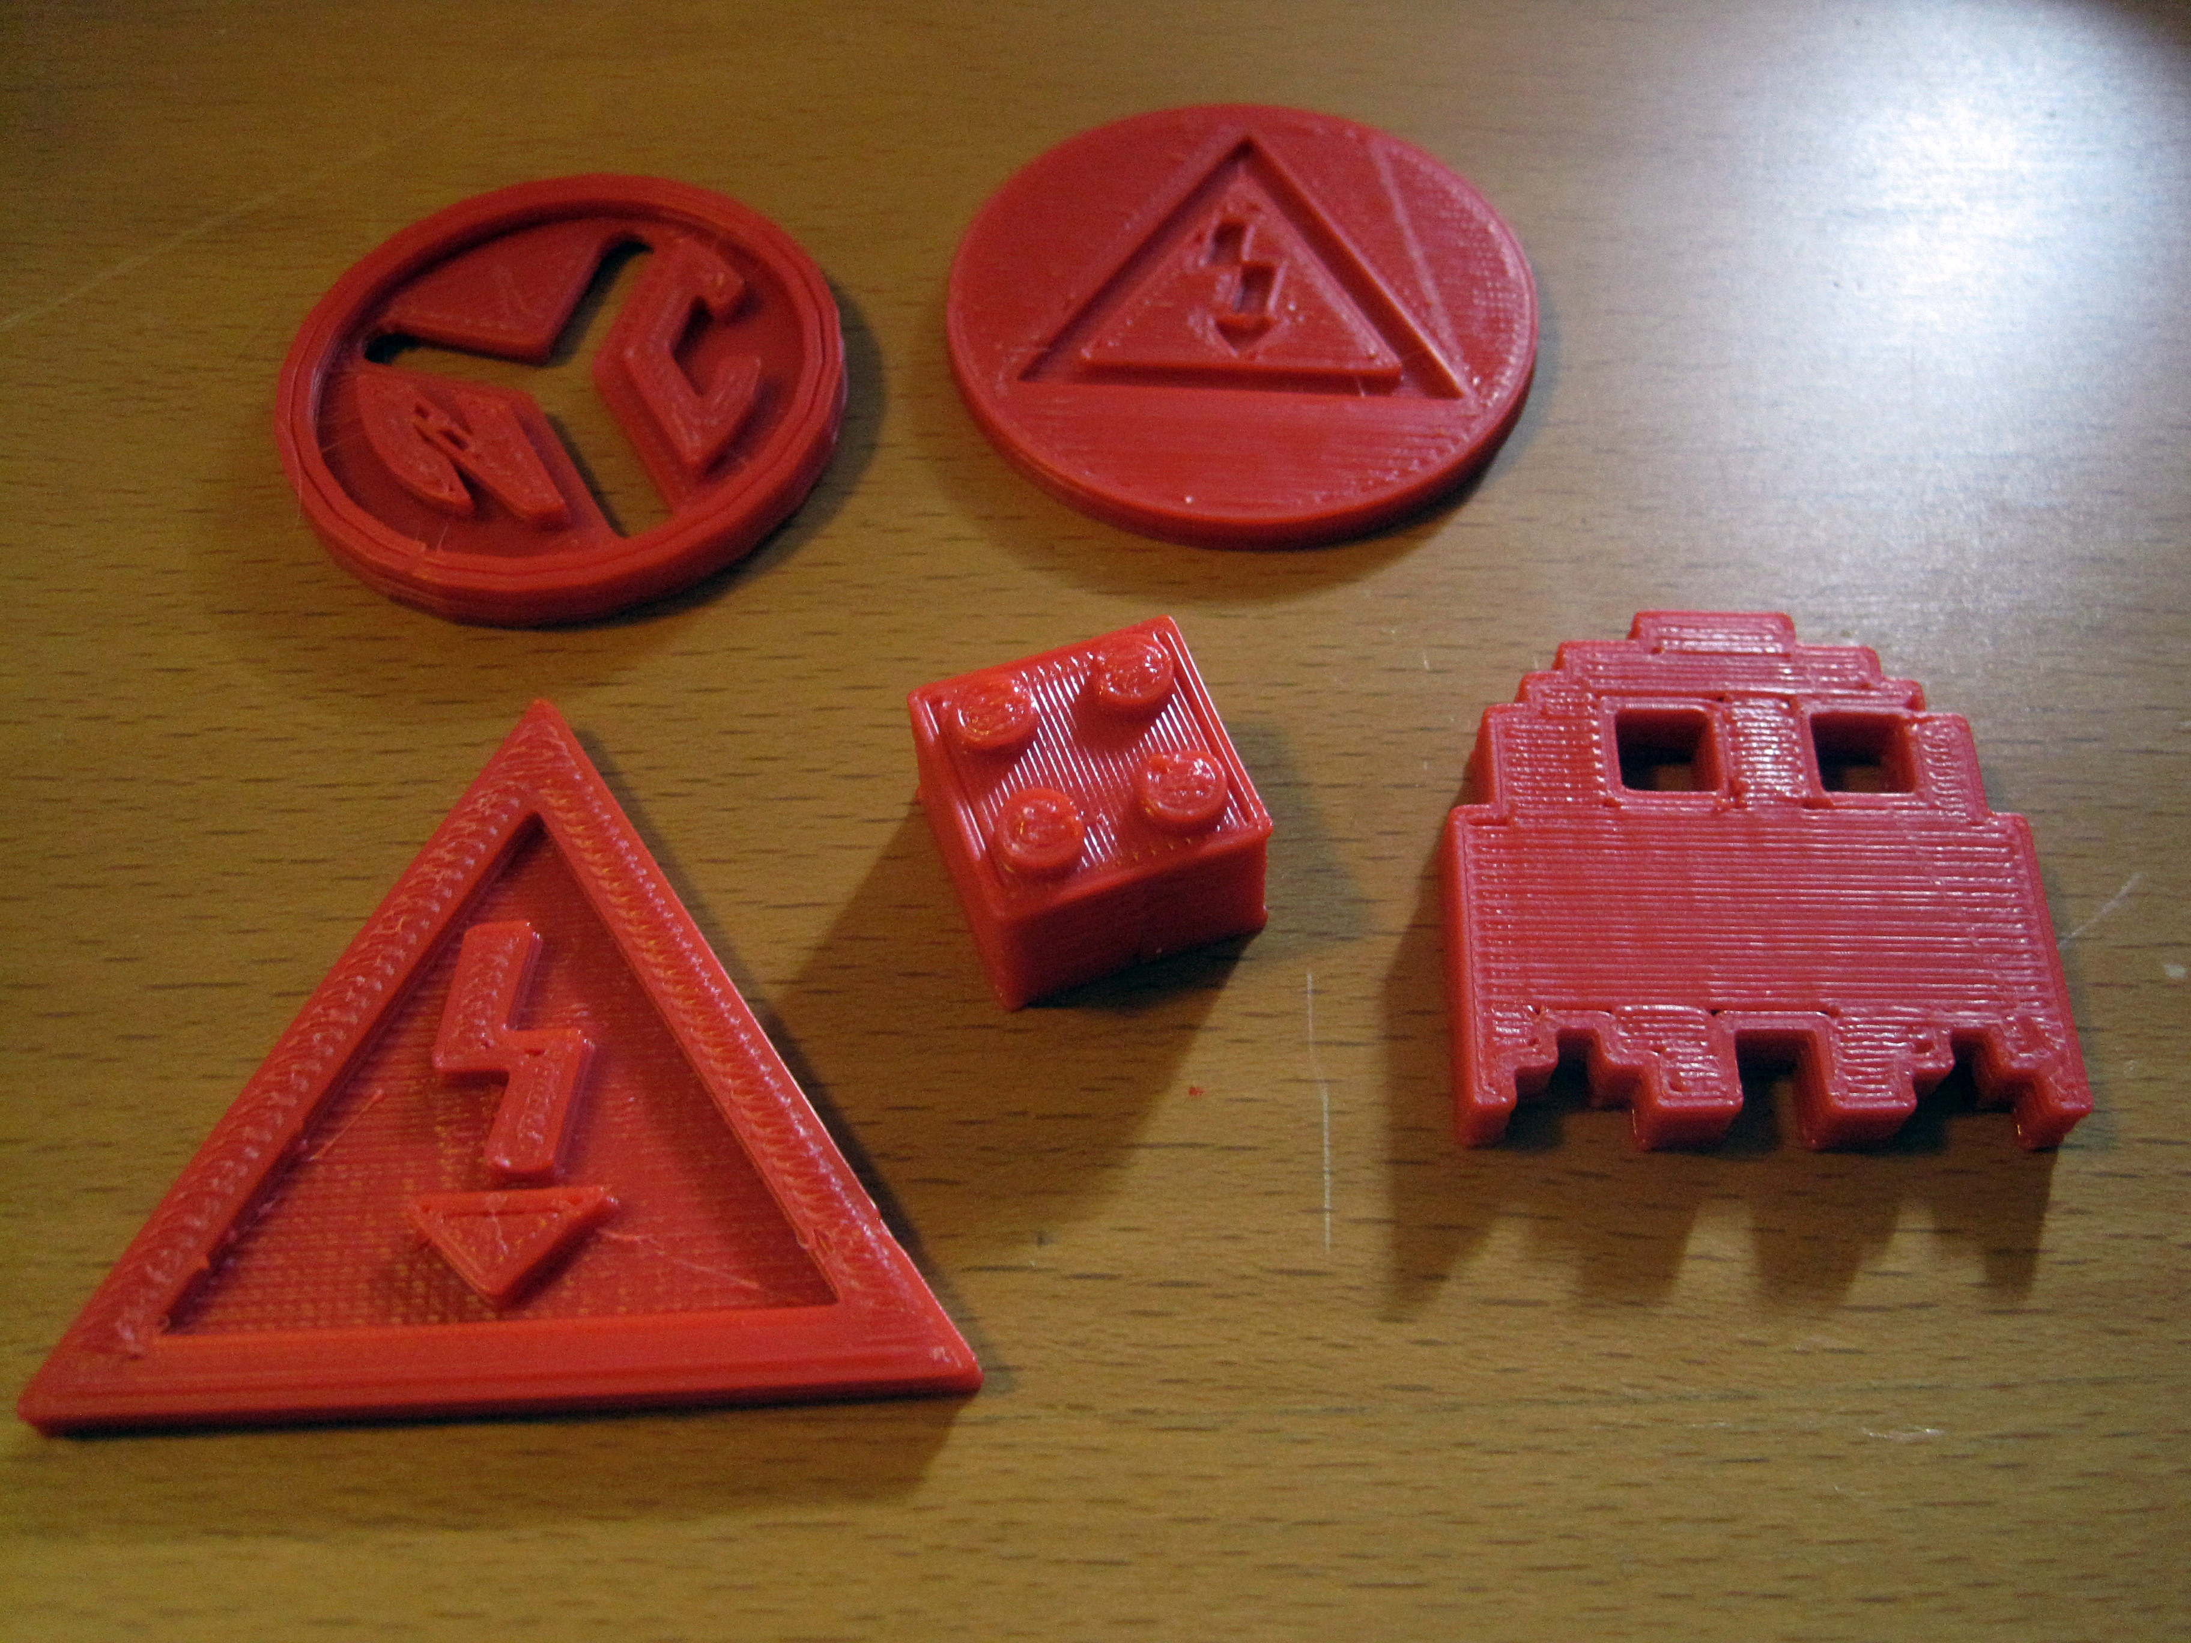
Let's Print!

Slide 34
The End
Thank You
For presentation and models:
https://github.com/bangsplat/MakerBot-101
theron.trowbridge@gmail.com

