Slide 1
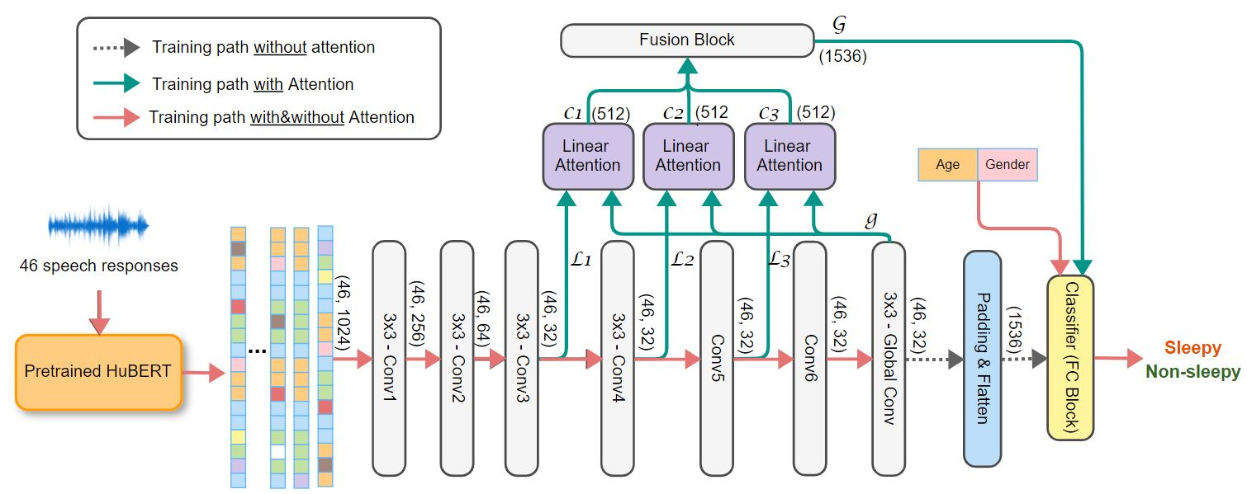
CNN – Attention Model

Slide 2
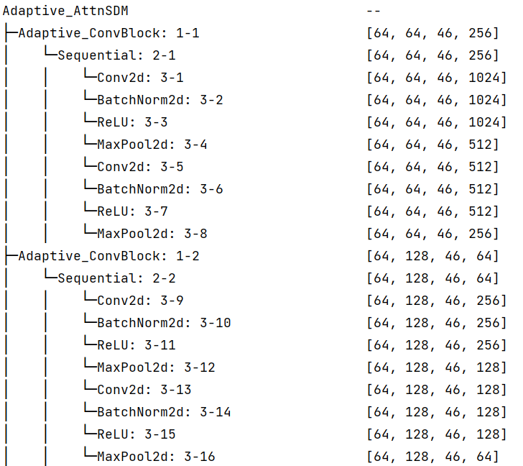
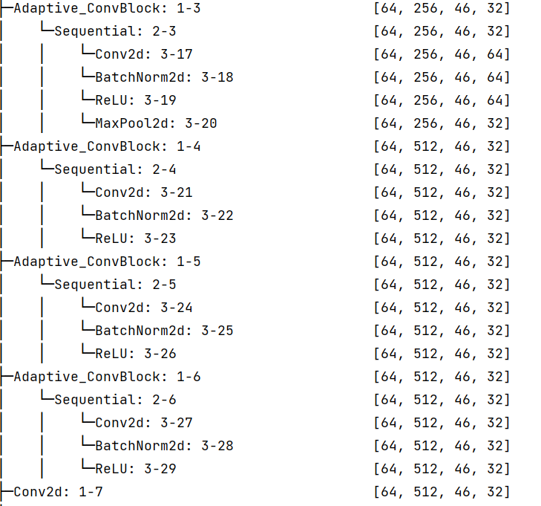
Convolutional Blocks
Conv3
Conv1
Conv4
Conv5
Conv2
Conv6
Dense

Slide 3
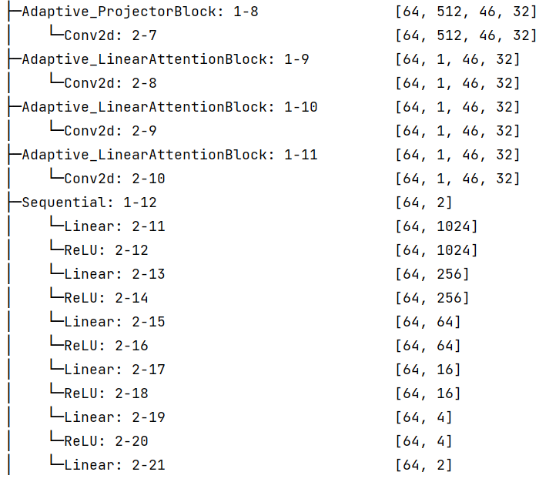
Attentional Blocks
L1
L2
L3
Classification Block

Slide 4
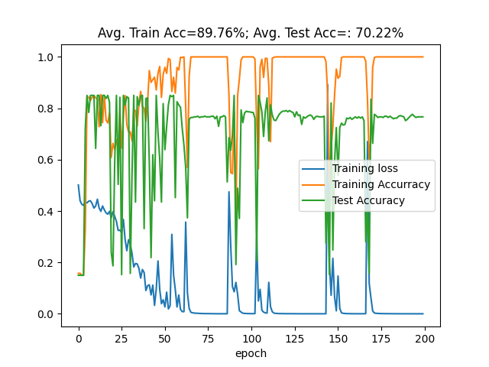
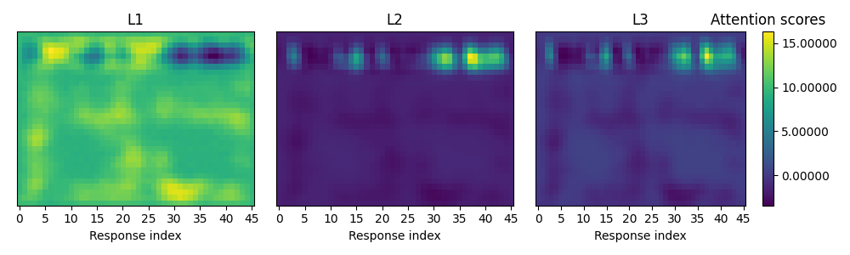
Attention-based model for Sleepiness Detection on Voiceome Dataset
Improve accuracy + F1 score (compare to ICASSP paper)
Attention map shows relevance of audio-responses
Train & Test result
Optimizer: RMSProp, Learning rate = 1e-4
- Train samples: 1,222
- Test samples: 407
How to explain?

Slide 5
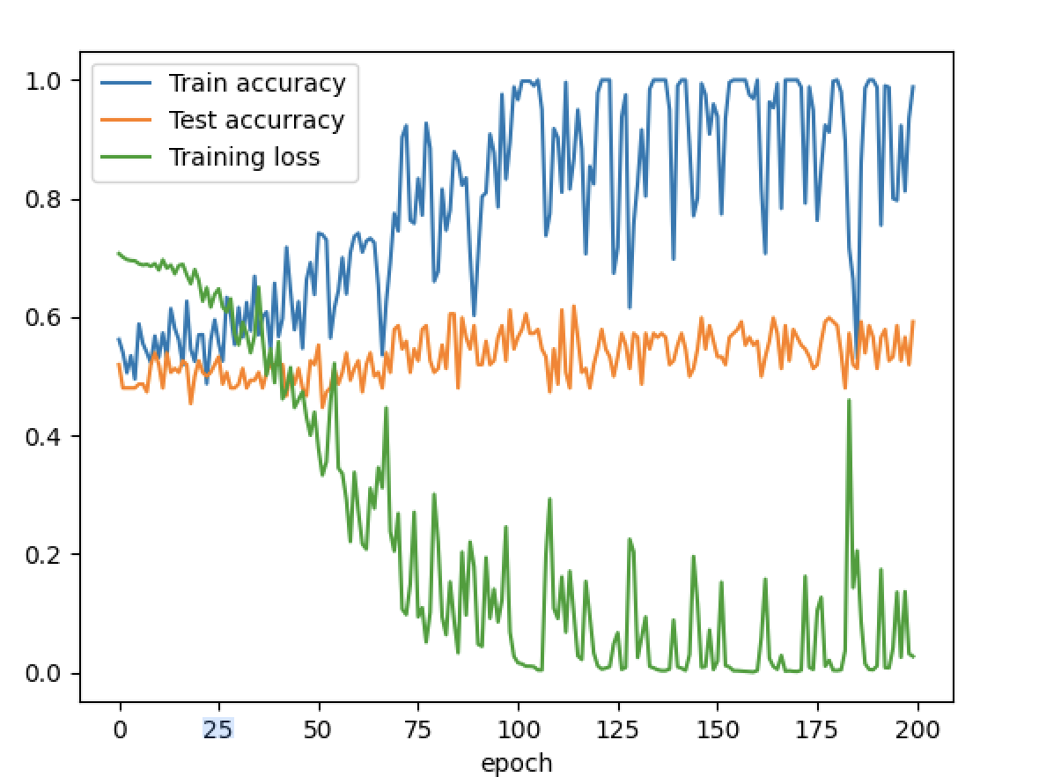
46x46x1024
ICASSP model
81.29%
32x32x46
Model before change to explanation
84.xx%
32x32x46
Untested model before change (original model, don’t keep 46 size)
Accuracy ?
46x1024x1
46 x 1 x 1024 ? → 46x46 x 1024. (original model) → still reduce the size of image.
46 x Time x 1024?
46 x 46 x 1024 → news email 6x (Too bad result on the right figure)
Model After changes (my customized)
67%
46x1024x1
Keep dimension 46 for explanation (change values for average pool layer, stride values, and padding values)
Classifier layers changes
Try with size 32x32x46 → run now (accuracy ??) only HuBERT

Slide 6
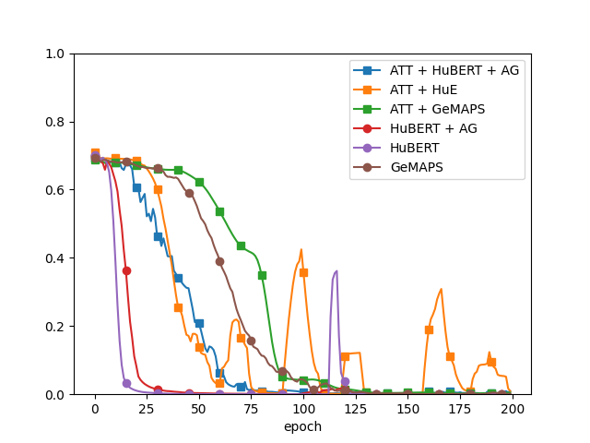
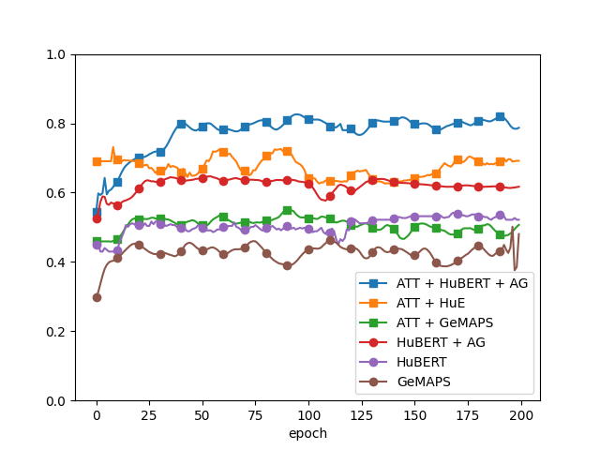
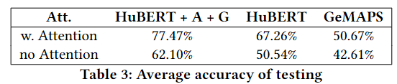
Training loss
Testing accuracy

