Slide 1
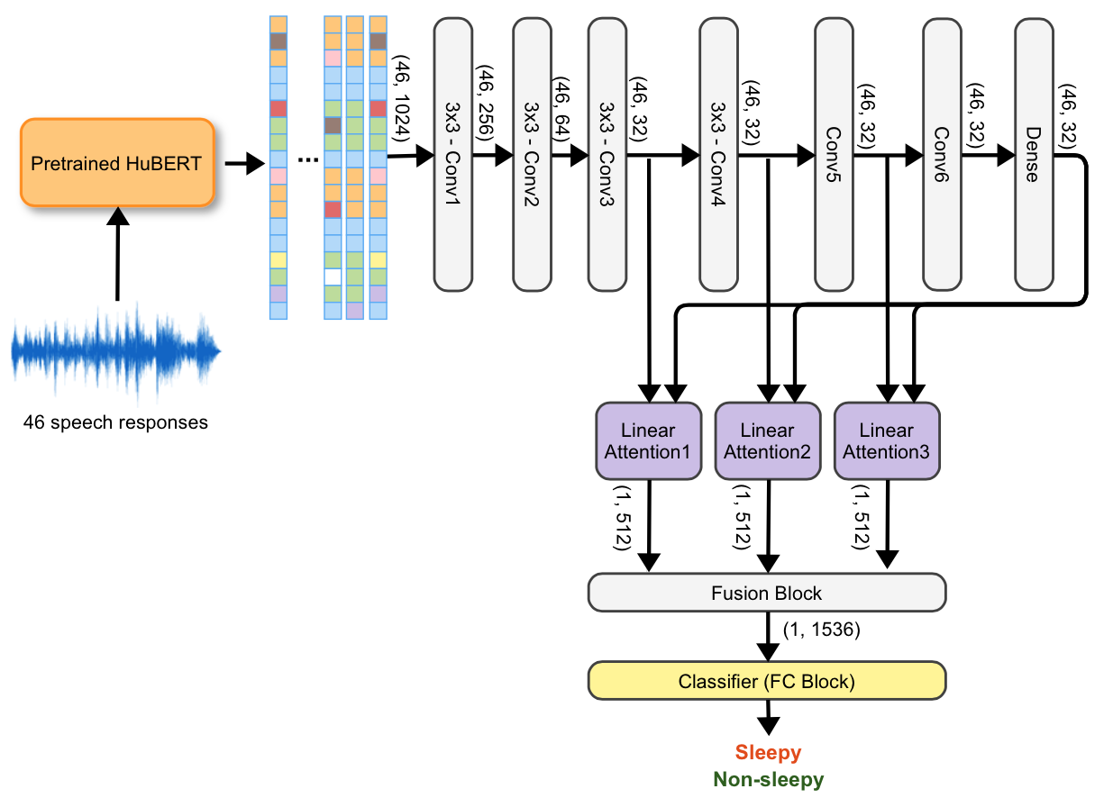
CNN – Attention Model
L1
L2
L3

Slide 2
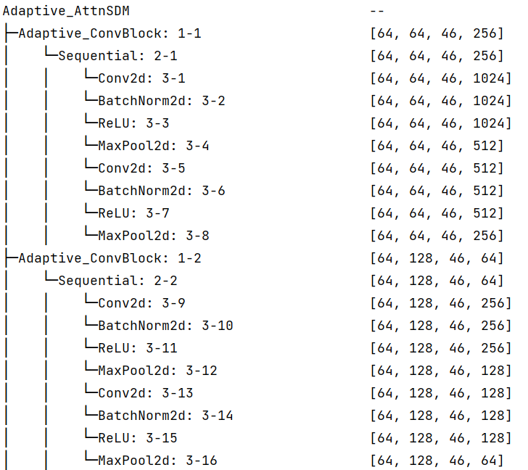
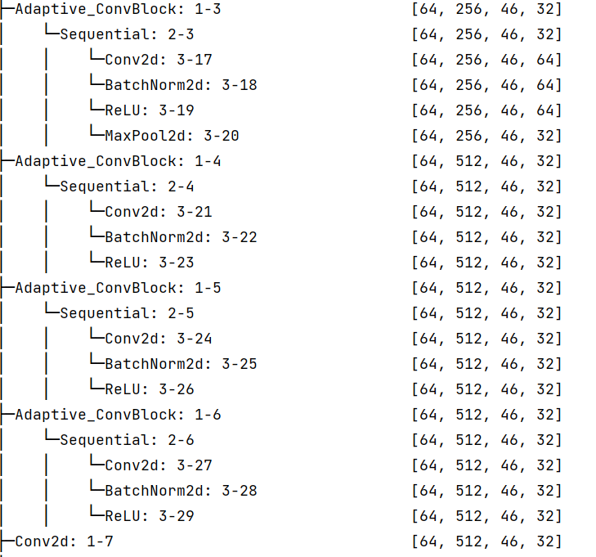
Convolutional Blocks
Conv3
Conv1
Conv4
Conv5
Conv2
Conv6
Dense

Slide 3
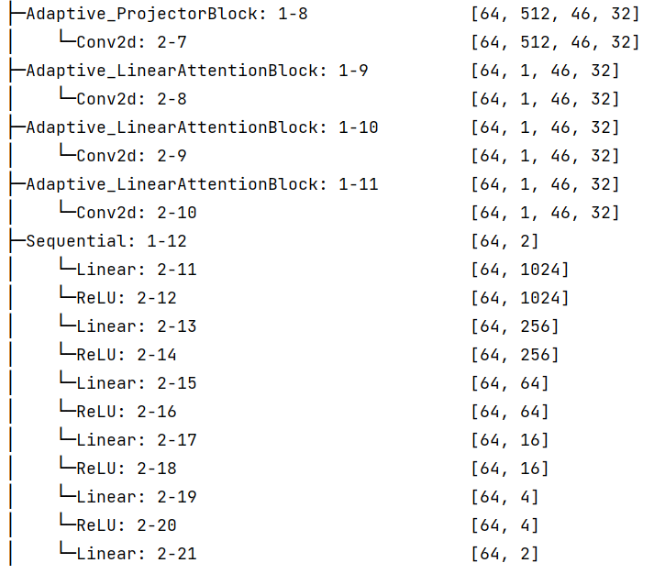
Attentional Blocks
L1
L2
L3
Classification Block

Slide 4
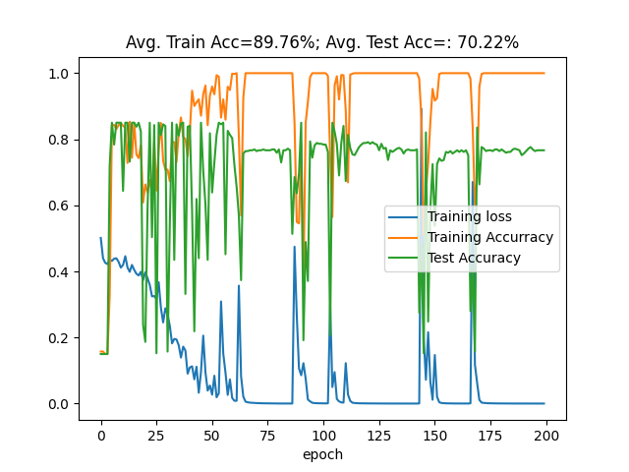
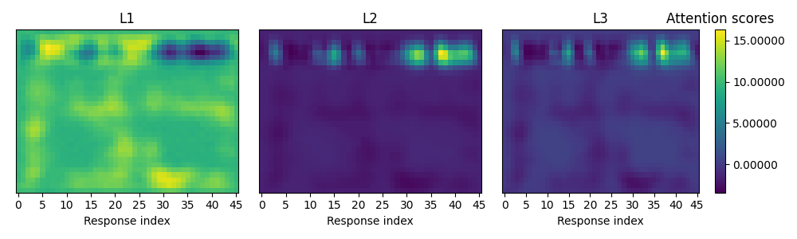
Attention-based model for Sleepiness Detection on Voiceome Dataset
Improve accuracy + F1 score (compare to ICASSP paper)
Attention map shows relevance of audio-responses
Train & Test result
Optimizer: RMSProp, Learning rate = 1e-4
- Train samples: 1,222
- Test samples: 407
How to explain?

