Slide 1
SalesTracker
Hong Chen

Slide 2
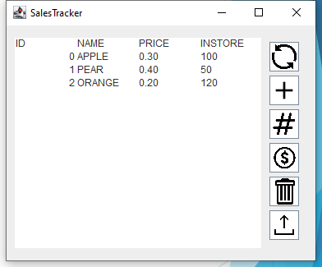
Purpose
Keep tracks of:
Total number of Items being sold
List of Items are being sold
Price of each Item
Amount of each items are in storage

Slide 3
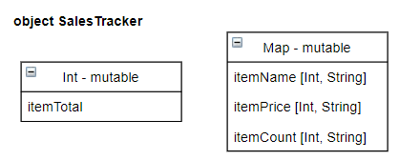
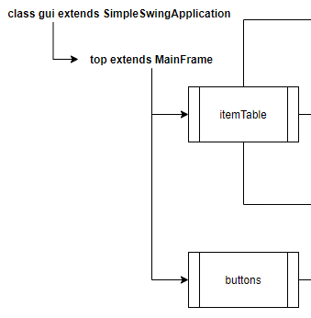
Implementation
GUI
ItemTable
headerTable
updateTable
clearTable
Buttons
add
update
edit
refresh
delete
commit
SalesTracker
newItem
updatePrice
updateCount
printTable
loadFile
clearAll

Slide 4
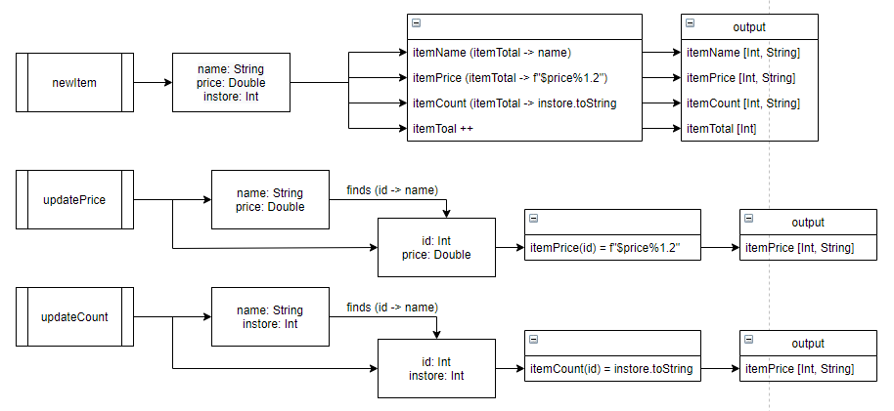
SalesTracker

Slide 5
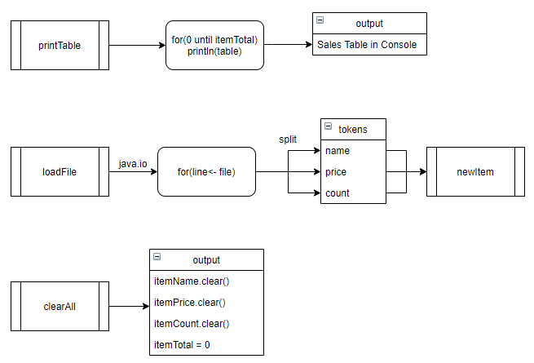
SalesTracker cont.

Slide 6
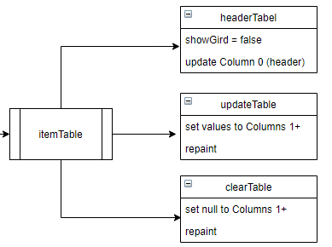
GUI - Table
Libraries:
scala.swing._
javax.swing.ImageIcon
java.io._
scala.io.Source
event._
scala.util.control.Breaks._

Slide 7
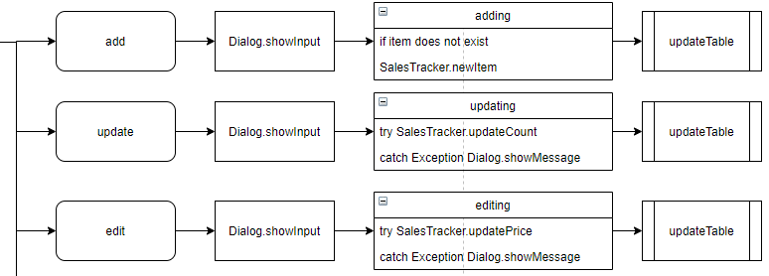
GUI - Buttons

Slide 8
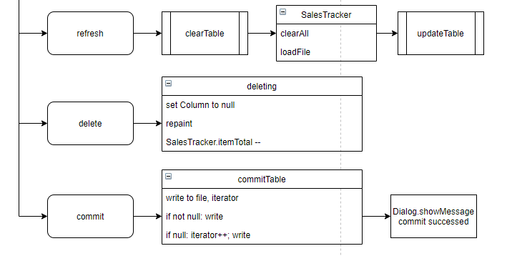
GUI – Buttons cont.

Slide 9
DEMO
GitHub Link: https://github.com/bangumi4346/p0

