Slide 1
Project 0 - Scala SalesTracker
Hong Chen

Slide 2
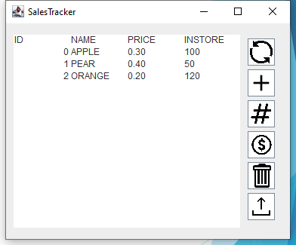
Summary
Keep tracks of:
Total number of Items being sold
List of Items are being sold
Price of each Item
Amount of each items are in storage
Technology:
Scala/Java Libraries
I/O
Swing
SBT
GitHub version control

Slide 3
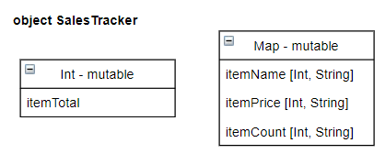
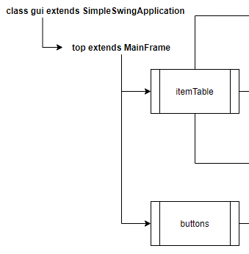
Implementation
GUI
ItemTable
headerTable
updateTable
clearTable
Buttons
add
update
edit
refresh
delete
commit
SalesTracker
newItem
updatePrice
updateCount
printTable
loadFile
clearAll

Slide 4
SalesTracker

Slide 5
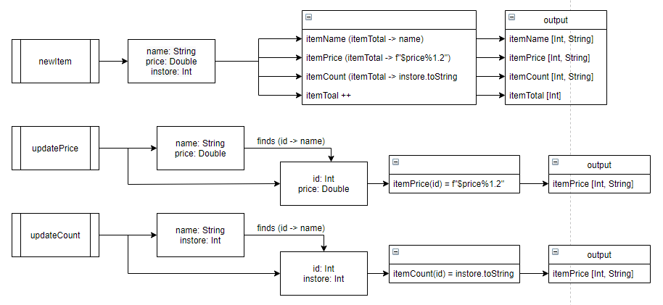
SalesTracker

Slide 6
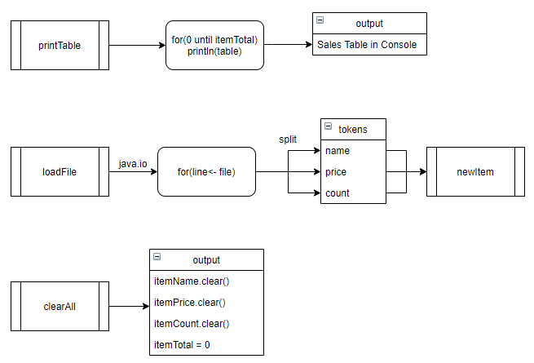
SalesTracker cont.

Slide 7
Graphyical User Interface

Slide 8
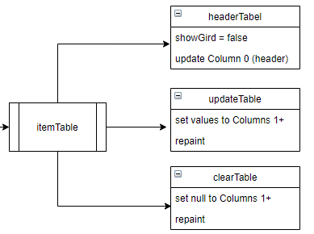
GUI - Table

Slide 9
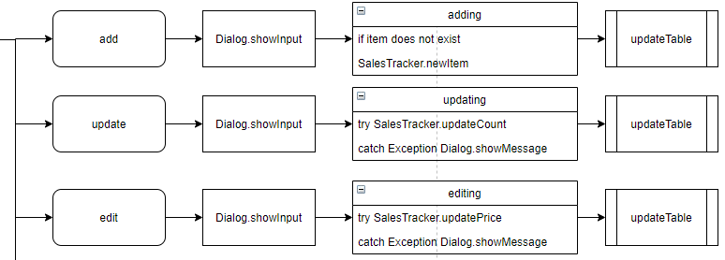
GUI - Buttons

Slide 10
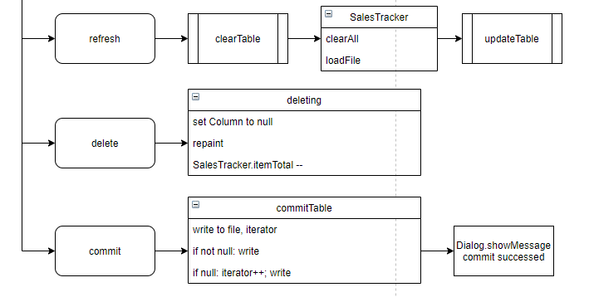
GUI – Buttons cont.

Slide 11
Demo
GitHub: https://github.com/bangumi4346/p0

