Slide 1
p1 – HDFS and Hive
Hong Chen

Slide 2




Technology
Hadoop HDFS 3.1.2
Hive SQL 3.3.1
Spark 3.1.2
Scala 2.11.12
SBT
IntelliJ IDEA
GitHub

Slide 3
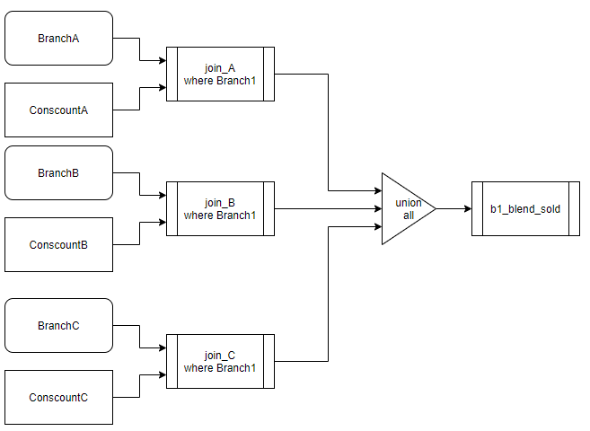
Starting off

Slide 4
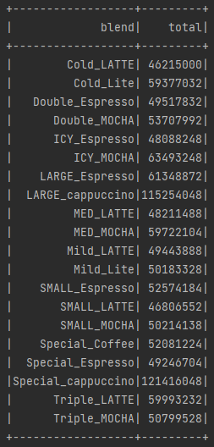
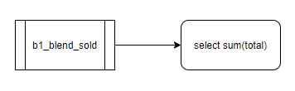
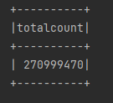
Scenario 1 - totalcount

Slide 5
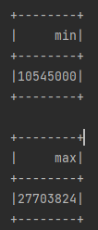

Scenario 2 – Min / Max

Slide 6
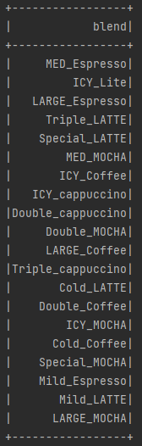
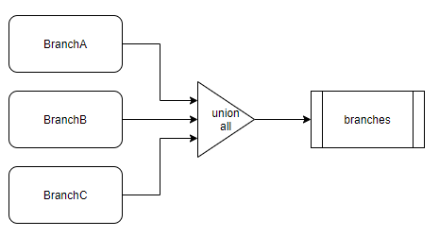
Scenario 3 – available in Branches
Distinct Branches from: 10, 8, 1

Slide 7
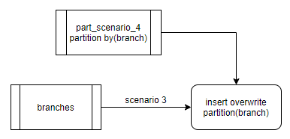
Scenario 4 – Partition and View
create table part_scenario_4 (blend string)
partitioned by (branch string);
insert overwrite table part_scenario_4 partition(branch)
select distinct blend, branch from branches
where branch = "Branch10" or branch = "Branch8" or branch = "Branch1";
Hive:
create view scenario_4 as
select distinct blend from branches
where branch = "Branch10" or branch = "Branch1“or branch = "Branch1“
View
Spark:
view.createOrReplaceTempView(“view_name”)

Slide 8
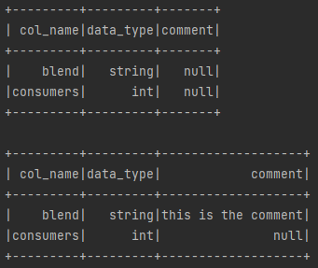
Scenario 5 – add comment
alter table conscounta change blend blend string
comment ‘this is the comment’;

Slide 9
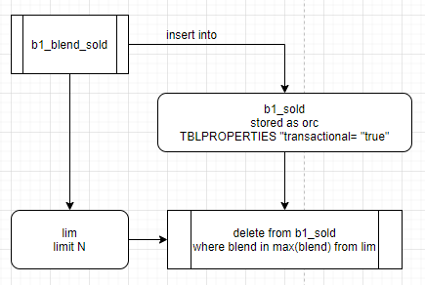
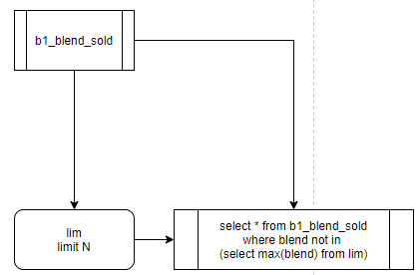
Scenario 6 – delete
Hive:
IntelliJ:

Slide 10
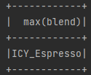
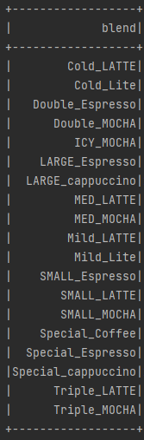
Scenario 6 – delete 5 cont.

Slide 11
Something Interesting
Hive
Does not like Syntax:
SELECT * FROM (SELECT * FROM table_name)
Spark
Does not like Syntax:
CREATE TABLE table_name AS SELECT * FROM table_name
Different coffees are called Beverages instead of Blends

