Slide 1

Equality
Equality, type judgments, propositions, and more

Slide 2

Contents
Equality
Type judgments and inference
Propositions as types
Automation
Equality Properties

Slide 3
Equality

Slide 4
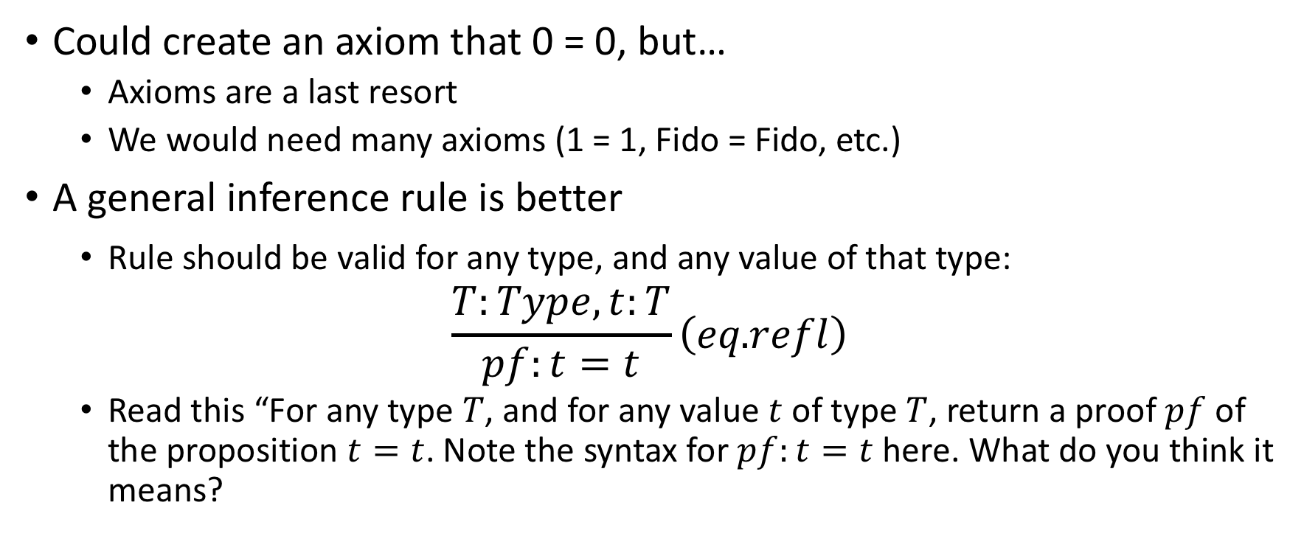
Proof that 0 = 0
Could create an axiom that 0 = 0, but…
Axioms are a last resort
We would need many axioms (1 = 1, Fido = Fido, etc.)
A general inference rule is better
Rule should be valid for any type, and any value of that type:
$$\frac{T:Type, t:T}{pf:t=t}\left(eq\text{.}refl\right)$$
Read this “For any type $T$, and for any value $t$ of type $T$, return a proof $pf$ of the proposition $t=t$. Note the syntax for $pf:t=t$ here. What do you think it means?

Slide 5
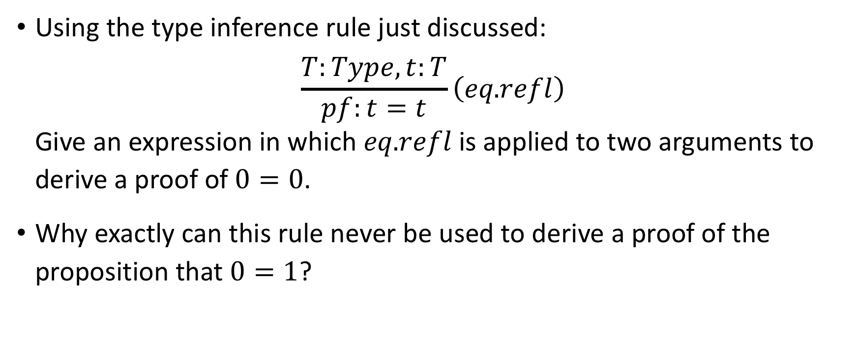
Exercises
Using the type inference rule just discussed: $\frac{T:Type, t:T}{pf:t=t}\left(eq\text{.}refl\right)$ Give an expression in which $eq\text{.}refl$is applied to two arguments to derive a proof of $0=0$.
Why exactly can this rule never be used to derive a proof of the proposition that $0=1$?

Slide 6
Type Judgments and Inference

Slide 7
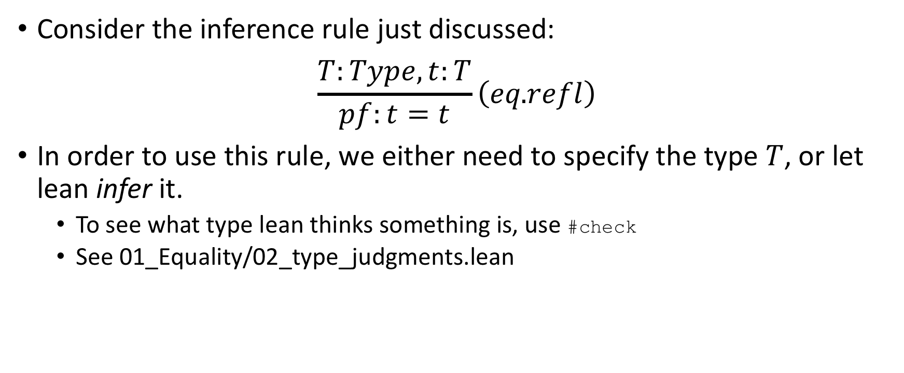
How Type Judgments Arise
Consider the inference rule just discussed: $\frac{T:Type, t:T}{pf:t=t}\left(eq\text{.}refl\right)$
In order to use this rule, we either need to specify the type $T$, or let lean infer it.
To see what type lean thinks something is, use #check
See 01_Equality/02_type_judgments.lean

Slide 8
Do Types Have Types?
What happens if we #check nat or #check bool, etc?
Types are of type Type
With one group of exceptions:
Type is of type Type 1
Type 1 is of type Type 2
Etc.
Note that Type is synonymous with Type 0.

Slide 9
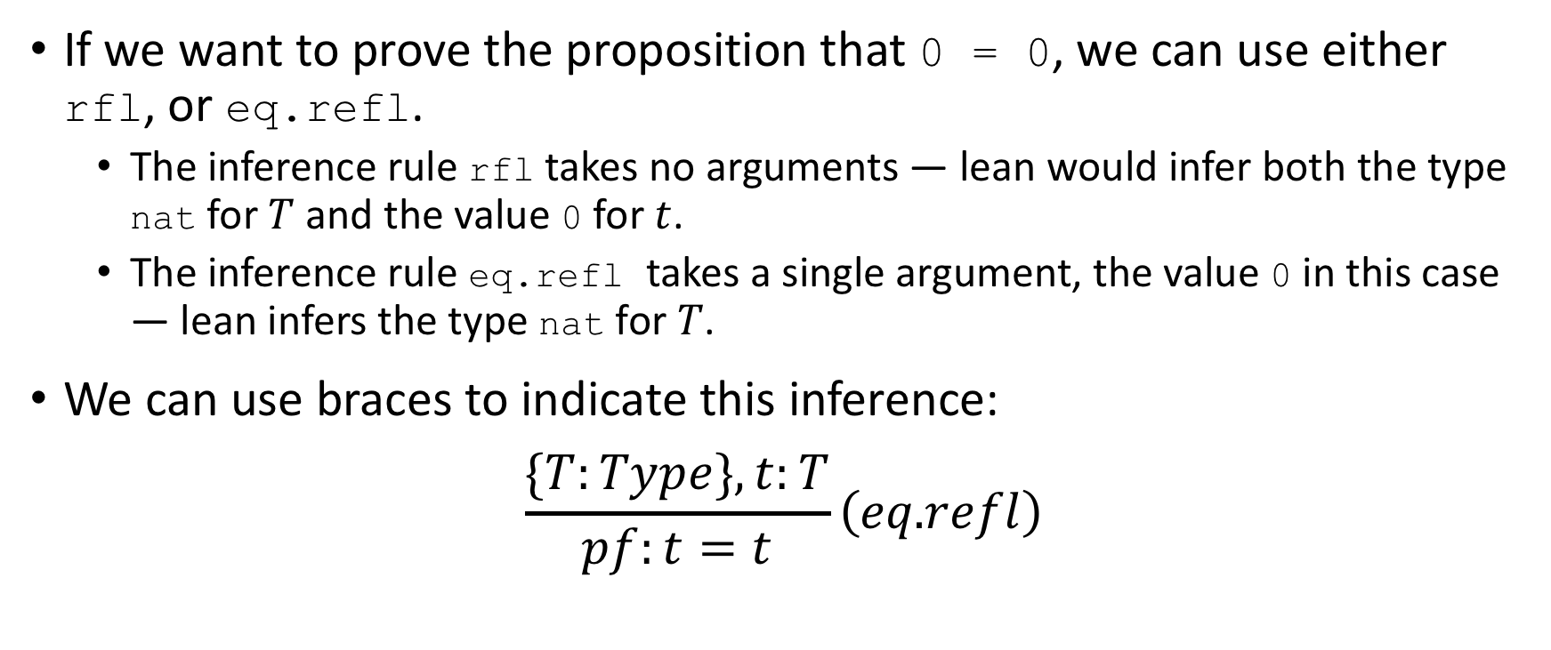
The Logical Inference Rule eq.refl
If we want to prove the proposition that 0 = 0, we can use either rfl, or eq.refl.
The inference rule rfl takes no arguments — lean would infer both the type nat for $T$ and the value 0 for $t$.
The inference rule eq.refl takes a single argument, the value 0 in this case — lean infers the type nat for $T$.
We can use braces to indicate this inference: $\frac{\{T:Type\}, t:T}{pf:t=t}\left(eq\text{.}refl\right)$

Slide 10
Type Judgment Exercises
If we imagine that we have a function eq_refl that takes two arguments, a type and a value and returns a proof of the proposition that the value equals itself, what would a call to that function look like when applied to:
0 = 0
eq_refl nat 0
tt
“Hello Lean”

Slide 11
Checking Lean’s Type Inference
To check what type Lean will infer for a particular value, use #check
See 01_Equality/03_type_inference.lean
If we #check (eq.refl 0) we see that its type is a proof that 0 = 0!
What does this mean?

Slide 12

Type Inference Exercises
Use #check to see what the type is for eq.refl t, for the case when t = tt and for the case when t = "Hello Lean!"
For the case when t = tt, what value does Lean infer for the parameter, $T$?

Slide 13
Propositions as Types

Slide 14
Propositions and Proofs
Recall that #check (eq.refl 0) we see that its type is reported as 0 = 0!
Recall that 0 = 0 is a proposition.
What does it mean when that is reported as a type?
These are the reported types of inference rules.
Lean is reporting that the inference rule is of a proof type that satisfies the proposition 0 = 0.

Slide 15
Types in General
Recall that the type of 0 and 1 are of type ℕ in Lean
Other languages that rely on type inference might consider these to be of type ℤ
Or more precisely of type IEEE 32-bit or 64-bit integers (signed or unsigned).
Many programming languages do type-checking, but how rigorous is that type-checking?
The maximum possible 32-bit unsigned integer is 4,294,967,295
What is the type of 4,294,967,295 + 1?
In SPARK Ada, it’s not a 32-bit unsigned integer, and if you will be unable to do perform that computation and assign it to a 32-bit integer. SPARK Ada will type-check this at compile time!
Why does this matter?

Slide 16
Boeing 787 Dreamliner Integer Overflow
From Ars Technica: Boeing 787 Dreamliners contain a potentially catastrophic software bug
“[A] Model 787 airplane that has been powered continuously for 248 days can lose all alternating current (AC) electrical power due to the generator control units (GCUs) simultaneously going into failsafe mode”
If this code had been written in SPARK Ada (or with a similarly strong type-checker), this defect would never have gotten onto the plane
This is one reason why Discrete Math is so important to Computer Science!

Slide 17
Binding Types and Values to Variables in Lean
To declare a variable n of type ℕ and with the value 1 in Lean: def n : nat := 1 -- variable type bind value
We can also create a variable p of type 0 = 0 (a proposition) and assign it a value of eq.refl 0 (a proof): def p : 0 = 0 := (eq.refl 0) -- variable type bind value
Because this is a proposition, however, lemma (or theorem) is preferred: lemma p : 0 = 0 := (eq.refl 0)

Slide 18
Exercises
To the variable s, bind a proof of the proposition that "Hello Lean!" is equal to itself.
To the variable s, bind a proof of the proposition that tt is equal to itself.
Explain precisely why Lean reports an error for this code (see 01_Equality/04_propositions_as_types.lean) and what it means: def p' : 0 = 0 := (eq.refl 1)
Use theorem instead of def to bind a proof of 0 = 0 to a variable, s'.

Slide 19
More Exercises
Prove theorems for the following propositions:
oeqo : 1 = 1
heqh : "Hello Lean! = Hello Lean!"
teqt : 2 = 1 + 1
What is the type of (0 = 1) in Lean? Answer before you #check it, then #check it to confirm. (see 01_Equality/04_propositions_as_types.lean)
What is the type of "Hello Lean" = "Hello Lean" in Lean?

Slide 20
Proofs and Propositions as Types in Lean
(is of type)
(is of type)
eq.refl 0
0 = 0
Prop
#check
Type
Type 1
Type 2
…
1
nat

Slide 21
Automation

Slide 22
Tactics/Strategies
The inference rule eq.refl is very simple — it takes a single argument, e.g. 0, and creates a proof of a proposition that the argument equals itself, e.g., 0 = 0
The tactic rfl might seem simpler because it takes no argument, but because it must infer not just the type but also the value to use for the proposition, the tactic’s logic is more complicated
Building up more complicated rules from simpler rules is common in provers
In some provers (e.g., Lean) these are called tactics, and in other provers (e.g., PVS) these are call strategies, but the idea is the same across provers

Slide 23
Reduction in Lean
Another useful feature of Lean is its ability to automatically reduce simple arithmetic examples
Use #reduce to see how Lean will reduce
This is useful for proofs, e.g., when proving that 2 = 1 + 1: theorem t1 : 2 = 1 + 1 := rfl
Lean can reduce 1+1 to 2 and then use rfl to prove 2 = 2.

Slide 24
Exercises
Use rfl to produce a proof, h, of the proposition, "Hello" = "He" ++ "llo".
Use rfl to prove p: 3*3+4*4=5*5.
Prove as a theorem, tthof (a silly and uninformative name to be sure), that 2 + 3 = 1 + 4.
Prove as a theorem, hpleqhl, that "Hello " ++ "Lean! is equal to "Hello Lean!"

Slide 25
Equality Properties

Slide 26
Properties of Equality
Reflexivity
a = a
Symmetry
a = b ⇔ b = a
Transitivity
a = b ∧ b = c ⇒ a = c
Homework!
01_Equality/06_properties.lean

Slide 27

Fin

