Slide 1

Functions

Slide 2
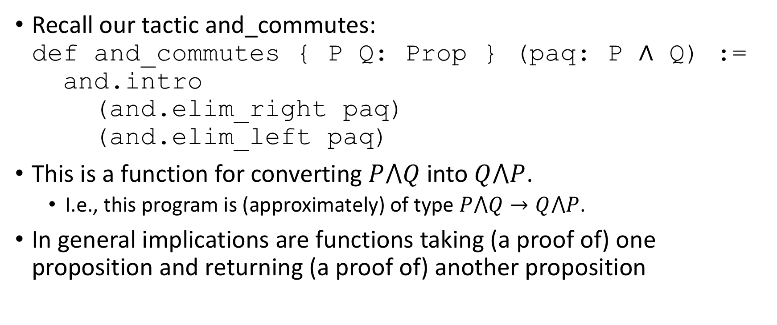
Implication creation review
Recall our tactic and_commutes: def and_commutes { P Q: Prop } (paq: P ∧ Q) := and.intro (and.elim_right paq) (and.elim_left paq)
This is a function for converting $P⋀Q$ into $Q⋀P$.
I.e., this program is (approximately) of type $P⋀Q→Q⋀P$.
In general implications are functions taking (a proof of) one proposition and returning (a proof of) another proposition

Slide 3
Exercise
We’ve just seen how to create a function that takes a proof as an argument and returns a different proof
Lean allows functions from any type to any other type
Exercise: Give some examples of interesting functions from nat to bool
def positive (n: nat) : bool :=
if n > 0 then tt else ff
def uint32 (n: nat) : bool :=
if n >= 0 ∧ n < 2^32 then tt else ff

Slide 4
Lambda expressions
Lambda expressions are basically anonymous functions:
λ n : nat,
(if n > 0 then tt else ff : bool)
Many ways to create the λ symbol, but please don’t use \lamda 🙄
#check λ n : nat, (if n > 0 then tt else ff : bool)
#check λ n,(if n > 0 then tt else ff)
#check λ n, n > 0

Slide 5
Alternate Formulations
There are multiple ways to write a function
The best way depends on taste, but also sometimes on context
def positive (n: nat) : bool :=
if n > 0 then tt else ff
def positive' : nat → bool :=
λ n : nat,
(if n > 0 then tt else ff : bool)
def positive'' : nat → bool :=
λ n, if n > 0 then tt else ff
def positive’'' := λ n, if n > 0 then tt else ff

Slide 6
Exercise
Exercise: Give some examples of interesting functions from ℕ to ℕ
def double (n: ℕ) := 2 * n
#check double
#check double 3
#reduce double 3
def square (n: ℕ) := n * n
#check square
#reduce square 3

Slide 7
Functions as types
Recall that a function from ℕ to ℕ is of type ℕ → ℕ
If a function has a type, can it be an argument to another function?
Discuss

Slide 8
Examples of functions as arguments
def compose (f: ℕ → ℕ) (g: ℕ → ℕ) (x: ℕ) : ℕ :=
f (g x)
#check compose
#reduce compose double double 3
#reduce compose square double 3
#reduce square (double 3)
def do_twice (f : ℕ → ℕ) (x: ℕ) : ℕ := f (f x)
#check do_twice
#reduce do_twice square 3

Slide 9
Alternate do_twice representations
def do_twice (f : ℕ → ℕ) (x: ℕ) : ℕ := f (f x)
def do_twice' : (ℕ → ℕ) → ℕ → ℕ := λ f x, f (f x)
def do_twice'' : (ℕ → ℕ) → ℕ → ℕ :=
λ f : (ℕ → ℕ),
λ (x : ℕ), f (f x)
theorem dt_eq_dt : do_twice = do_twice'' := rfl

Slide 10
Inception
def do_twice' (f: (ℕ → ℕ) → ℕ → ℕ) (x: (ℕ → ℕ)) : (ℕ → ℕ) := f (f x)
#check do_twice'
#check do_twice' do_twice
#eval (do_twice' do_twice) square 2
Why not #reduce?

Slide 11
Story time
It’s important to get your functions correct
Omitting an “overbar” from an equation in the Mariner 1 software (1962) caused the guidance system to interpret normal movement in the spacecraft as something that needed to be compensated for
Mariner 1 had to be destroyed 293 seconds into its mission
How could this have been prevented?
Image courtesy Wikimedia commons: https://commons.wikimedia.org/wiki/File:Punch-card-cobol.jpg

Slide 12

Fin

