Slide 1

Negation

Slide 2
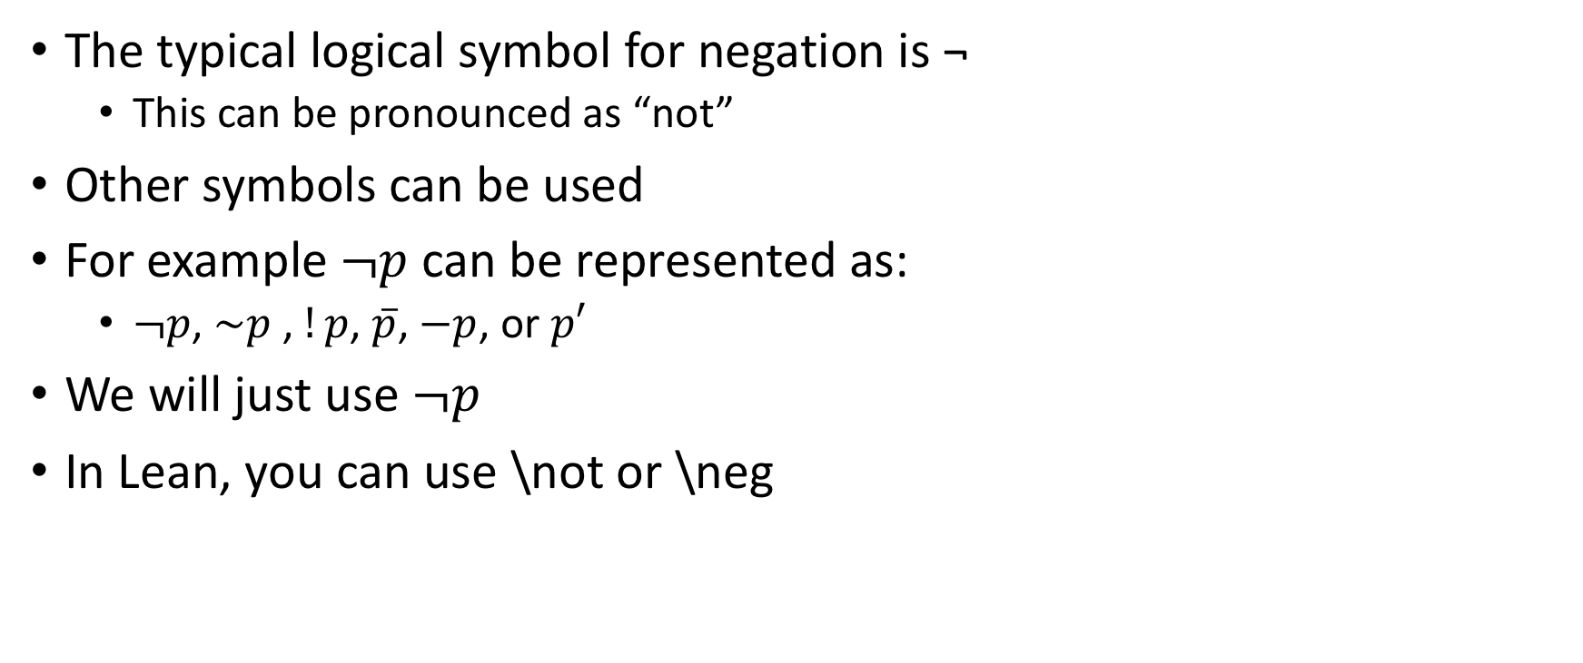
Terminology
The typical logical symbol for negation is ¬
This can be pronounced as “not”
Other symbols can be used
For example $¬p$ can be represented as:
$¬p$, $\sim p$ , $!p$, $\overline{p}$, $−p$, or $p′$
We will just use $¬p$
In Lean, you can use \not or \neg

Slide 3
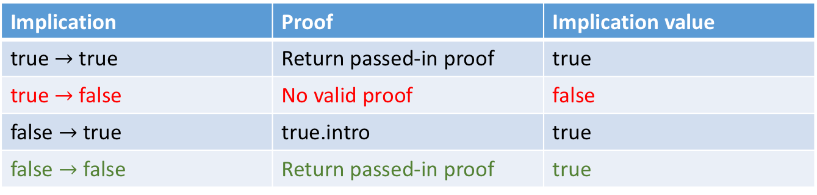
Stating a negation
Propositions can be true or false
So far, we have been interested in proving that propositions are true
One way to prove a proposition is false, is to prove its negation is true
¬P is thus shorthand for P → false — remember this!!
Remember our implication truth table:
Implication | Proof | Implication value
true $→$ true | Return passed-in proof | true
true $→$ false | No valid proof | false
false $→$ true | true.intro | true
false $→$ false | Return passed-in proof | true

Slide 4
What is a negation in constructive logic?
As we’ve already said, ¬P is shorthand for P → false variable P : Prop -- assume P is some Prop theorem same : (¬ P) = (P → false) := rfl
A proof that P → false necessarily means that there can be no (valid) proof for P.
So negation of P means that we can prove that there is no proof of P.
More on this later…

Slide 5
Inequality (not equals)
0 ≠ 1 is just different notation for ¬ 0 = 1
≠ can be written with \ne or \neq
On a Mac, ≠ can also be written with [option]+=, and ¬ can be written with [option]+l (that’s a lower-case L)
theorem zneqo : 0 ≠ 1.
#check zneqo
Woah, a period? This means that Lean just knows it is true.
theorem zneqoeqzneqo : (0 ≠ 1) = ¬(0 = 1) := rfl

Slide 6
Disjointness of constructors
Zero is created by the “base” constructor for naturals
#reduce nat.zero
One is created by using the successor of zero
#reduce nat.succ(0)
Two is the successor of 1
#reduce nat.succ(nat.succ(0))
theorem zneqo' : 0 = 1 → false :=
λ h : (0 = 1),
nat.no_confusion h

Slide 7
Assume-show-from proof pattern
Assume works on an implication, either explicit or implicit
Assume assumes the antecedent (the left-hand side of the implication)
New goal is now the consequent (the right-hand side)
show <arg> finds the first goal matching <arg>. This goal now becomes the main goal, after unification (a topic we will discuss later)
from is synonymous with exact, but is useful for demonstrating an assume/show/from pattern.
theorem zneqo'' : ¬ 0 = 1 :=
begin
assume h : (0 = 1),
show false,
from nat.no_confusion h
end
We prove that 0 ≠ 1 by assuming 0 = 1 and by showing that this assumption leads to a contradiction. As that is impossible, there must be no such proof of 0 = 1. That proves ¬ 0 = 1, i.e., 0 ≠ 1.

Slide 8
Disjointedness with booleans
theorem ttneqff' : ¬ tt = ff :=
begin
assume h : (tt = ff),
show false,
from bool.no_confusion h
end
How does this work?
How else could we have proved it?
theorem ttneqff : tt ≠ ff.

Slide 9
Exercises
EXERCISE: Is it true that "Hello, Lean!" ≠ "Hello Lean!"? Can you prove it? If so, how? If not, why not?
theorem ex1 : "Hello, Lean!" ≠ "Hello Lean!" :=
begin
assume h : ("Hello, Lean!" = "Hello Lean!"),
show false,
from string.no_confusion h
end
EXERCISE: What about 2 ≠ 1?
theorem ex2 : 2 ≠ 1.

Slide 10
Proof of negation
To derive ¬P:
show that from an assumption of (a proof of P) some kind of contradiction that cannot occur would follow, and
thus a proof of false would follow, leading to
the conclusion that there must be no proof of P, that it isn’t true, and that ¬P therefore is true.
This is called "proof by negation.”
theorem proof_by_negation : ∀ P : Prop,
(P → false) → ¬P :=
λ P p, p

Slide 11
Another proof that 0 ≠ 1
lemma zneqo''': ¬ (0 = 1) :=
begin
apply proof_by_negation,
assume h: (0 = 1),
show false,
from (nat.no_confusion h)
end
Compare to:
theorem proof_by_negation : ∀ P : Prop,
(P → false) → ¬P :=
λ P p, p

Slide 12
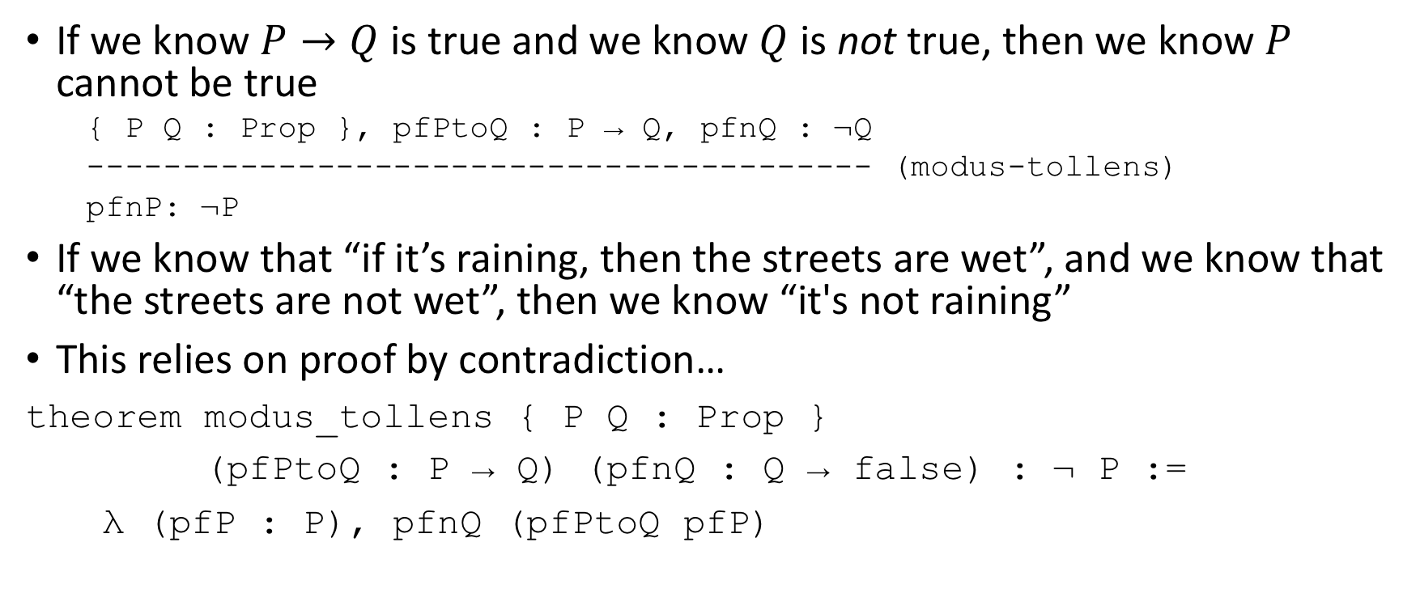
Modus Tollens (update!)
If we know $P→Q$ is true and we know $Q$ is not true, then we know $P$ cannot be true
{ P Q : Prop }, pfPtoQ : P → Q, pfnQ : ¬Q
----------------------------------------- (modus-tollens)
pfnP: ¬P
If we know that “if it’s raining, then the streets are wet”, and we know that “the streets are not wet”, then we know “it's not raining”
This relies on proof by contradiction…
theorem modus_tollens { P Q : Prop }
(pfPtoQ : P → Q) (pfnQ : Q → false) : ¬ P :=
λ (pfP : P), pfnQ (pfPtoQ pfP)

Slide 13
Unpacking modus tollens
theorem modus_tollens { P Q : Prop }
(pfPtoQ : P → Q) (pfnQ : Q → false) : ¬ P :=
λ (pfP : P), pfnQ (pfPtoQ pfP)
Given a proof of P implies Q and a proof that Q is false, we can prove that P is false
Steps:
Provide a function that takes a proof of P,
apply that to our implication that P implies Q to get a proof of Q,
apply that to our implication that Q implies false to get a proof that P implies false, hence
Recall that ¬P is actually synonymous with P implies false

Slide 14
Exercise
theorem modus_tollens' { P Q : Prop }
(pfPtoQ : P → Q) (pfnQ : ¬ Q) : ¬ P:=
λ (pfP : P), pfnQ (pfPtoQ pfP)
EXERCISE: present this same construction using a lambda expression. This presentation style makes the proposition, modus tollens, explicit: for all P and Q : Prop, (P → Q) → (¬ Q → ¬ P). Fill in the blank.
theorem modus_tollens:
∀ { P Q: Prop }, (P → Q) → ¬ Q → ¬ P :=
λ P Q pfPQ pfnQ pfP,
sorry
pfnQ (pfPQ pfP)

Slide 15
Proving Q and not Q is false
Something cannot be both true and not true
theorem qAndNotQfalse { P Q: Prop }
(pf: Q ∧ ¬Q) : false :=
pf.2 pf.1
pf.1 takes the left side of the conjunction, pf.2 takes the right
Exercise: explain how this theorem works
¬Q is an implication that Q → false
What do we get when we apply that implication to Q?

Slide 16
Non-contradiction
The principle of non-contradiction says that a proof of any proposition, Q, and also of its negation, ¬ Q, gives rise to a contradiction.
Therefore such a contradiction cannot arise.
Now consider the proof of the negation:
theorem no_contra :
∀ Q: Prop, ¬ (Q ∧ ¬ Q) :=
λ (Q : Prop) (pf : Q ∧ ¬ Q),
(and.elim_right pf) (and.elim_left pf)
Exercise: discuss how this proof works

Slide 17
Non-contradiction application
Now that we’ve created our no_contra theorem, we can use it:
variables a b : nat
theorem ncab : ¬ ((a = b) ∧ (a ≠ b)) :=
begin
apply no_contra
end
See what happens if you add a third variable, c, and replace one b in the theorem with a c

Slide 18
Manual non-contradiction proof by steps
theorem ncab' : ¬ ((a = b) ∧ (a ≠ b)) :=
begin
assume c : ((a = b) ∧ (a ≠ b)),
have l := c.1, -- short for left elim
have r := c.2, -- same for right elim
have f := r l, -- now a proof of false
assumption -- and that proves it
end

Slide 19
Negation elimination
Does ¬¬P equal P?
Classically, yes
Not in constructive logic, though
Why not?!?
Consider the proposition, “the word heterological is homological”
We can show that this proposition cannot be proven
This does not mean we can prove its opposite
In fact, we can show that we cannot prove its opposite

Slide 20
Axiom of the Excluded Middle
axiom excluded_middle : ∀ P, P ∨ ¬ P
axiom excluded_middle' (P : Prop) : P ∨ ¬ P
What does this mean? In short, it means that ¬¬P now equals P
Why?

Slide 21
Double negative elimination
theorem double_neg_elim: ∀ { P }, ¬ ¬ P → P :=
begin
assume P : Prop,
assume pfNotNotP : ¬ ¬ P,
cases excluded_middle P,
show P, from h,
have f: false := pfNotNotP h,
exact false.elim f
end

Slide 22
Application
Derive P by double negation elimination
variable notNotP : ¬ ¬ P -- assume ¬ ¬ P
theorem pfP : P := double_neg_elim notNotP

Slide 23
Proof by contradiction
Proof by contradiction has us assume the opposite of what we want to prove and show that it is false
I.e., assume “not P” and show it has a false truth judgment
theorem proof_by_contradiction : ∀ P : Prop,
(¬ P → false) → P :=
@double_neg_elim
The @ here turns off type inferencing for this one reference to double_neg_elim. It is a detail here. We'll discuss @ later.

Slide 24
Application
theorem zeqz : 0 = 0 :=
begin
apply proof_by_contradiction,
assume pf: 0 = 0 → false,
show false,
from pf (eq.refl 0)
end

Slide 25
Classical proof by contradiction
open classical -- requires classical logic!
example
{ P Q : Prop }
(pf: ¬ P → (Q ∧ ¬ Q))
: P :=
begin
apply proof_by_contradiction,
assume notP: ¬ P,
have contra := (pf notP),
show false,
from no_contra Q contra
end

Slide 26
Proof by contrapositive
(¬Q → ¬P) → (P → Q)
Very similar to modus tollens (see slide 12)
theorem proof_by_contrapositive:
∀ P Q : Prop, (¬Q → ¬P) → (P → Q) :=
begin
assume P Q: Prop,
assume nqnp: (¬Q → ¬P),
assume p : P,
have nqf : ¬Q → false :=
λ nq : ¬Q,
no_contra P (and.intro p (nqnp nq)),
have nnq : ¬¬Q := nqf,
show Q,
from double_neg_elim nnq
end

Slide 27
Application
theorem zeqz' : 0 = 0 → true :=
begin
apply proof_by_contrapositive,
assume nt : ¬true,
have pff := nt true.intro,
show ¬ 0 = 0,
from false.elim pff
end

Slide 28
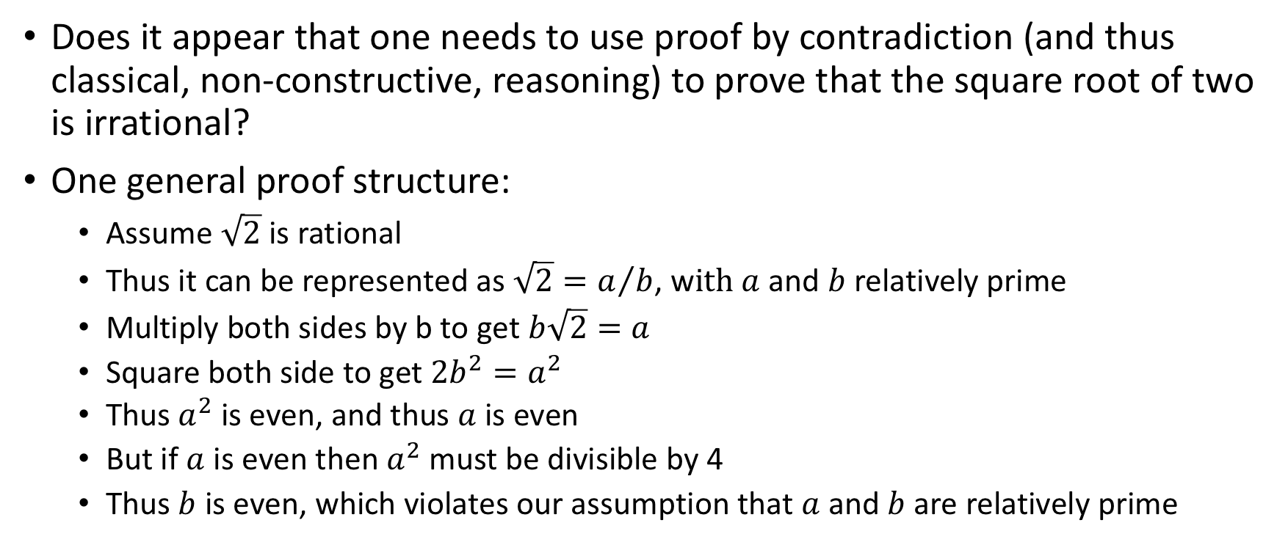
Exercise
Does it appear that one needs to use proof by contradiction (and thus classical, non-constructive, reasoning) to prove that the square root of two is irrational?
One general proof structure:
Assume $\sqrt{2}$ is rational
Thus it can be represented as ${\sqrt{2}=a}/b$, w$ith a$ and $b$ relatively prime
Multiply both sides by b to get $b\sqrt{2}=a$
Square both side to get $2b^{2}=a^{2}$
Thus $a^{2}$ is even, and thus $a$ is even
But if $a$ is even then $a^{2}$ must be divisible by 4
Thus $b$ is even, which violates our assumption that $a$ and $b$ are relatively prime

Slide 29

Fin

