Slide 1

Mapping & Univers∀l Qu∀ntification

Slide 2
Mapping

Slide 3
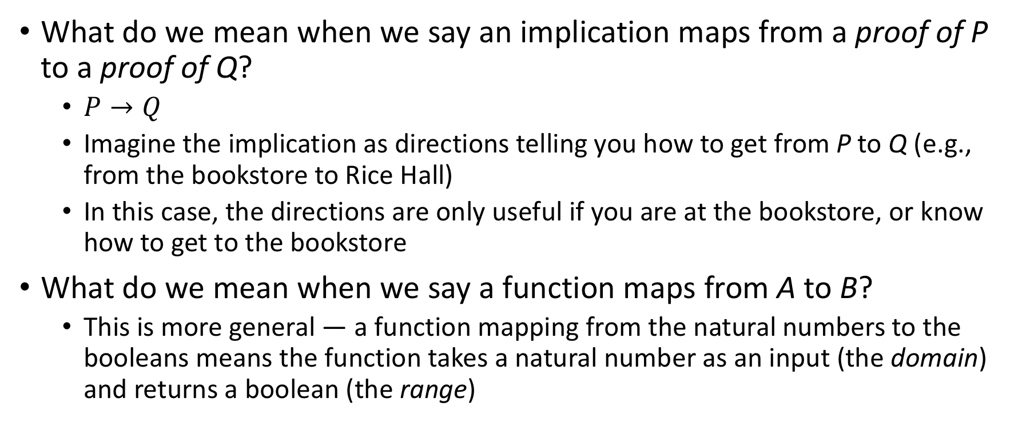
What do we mean by “mapping”
What do we mean when we say an implication maps from a proof of P to a proof of Q?
$P→Q$
Imagine the implication as directions telling you how to get from P to Q (e.g., from the bookstore to Rice Hall)
In this case, the directions are only useful if you are at the bookstore, or know how to get to the bookstore
What do we mean when we say a function maps from A to B?
This is more general — a function mapping from the natural numbers to the booleans means the function takes a natural number as an input (the domain) and returns a boolean (the range)

Slide 4
Caution about use of the word “mapping”
Lean (and other languages) have maps that take specific sets of inputs and return specific sets of outputs
For example, a phone book could be a (rather large) map — it maps names to phone numbers
A dictionary is another example
We will not be discussing these types of maps in more detail yet

Slide 5
Univers∀l Qu∀ntification

Slide 6
Notation
In general mathematics:
∀ n ∈ ℕ: n + 1 ≠ 0
In Lean:
∀ (n : nat), n + 1 ≠ 0
Parentheses around (n : nat) are optional
Read this as:
“For all n that are members of ℕ, n + 1 is not equal to zero”
This is just another proposition
#check ∀ n : nat, n + 1 ≠ 0

Slide 7
Proof
example : ∀ (n : nat), n + 1 ≠ 0 :=
-- assume an arbitrary nat, n
λ n : nat,
-- assume proof of n + 1 = 0
λ h : (n + 1 = 0),
-- derive a contradiction
(nat.no_confusion h : false)
-- therefore n + 1 ≠ 0

Slide 8
Proof 2
example : ∀ (P : Prop), ¬ (P ∧ ¬ P) :=
-- assume an arbitrary proposition
λ P : Prop,
-- assume it's both true and false
λ h : (P ∧ ¬ P),
-- derive a contradiction
(h.right h.left : false)
-- thereby proving ¬ h

Slide 9
Another example
example : ∀ (n : nat), ∀ (m : nat),
m = n ∨ m ≠ n :=
begin
assume n : nat,
-- the context now includes n
assume m : nat,
-- the context now also has m
sorry
end

Slide 10
Forall as implication
What does ∀(p : P), Q mean?
variables P Q : Prop
#check (∀ (p : P), Q)
[Lean] P → Q : Prop
How is this the same as an implication?
theorem same : (∀ (p : P), Q) = (P → Q) := rfl

Slide 11
Forall as implication (2)
variable ap2q : (∀(p : P), Q)
Assume a proof of P.
variable p : P
What is the type of (ap2q p)?
#check ap2q p
Q
∀(p : P), Q is thus a mapping of total functions from P to Q
What are total functions? It must be defined over its entire domain.
What is an example of a partial function?

Slide 12
So, why not use implication?
Forall lets us name our assumed value
#check ∀(n : nat), n = 0 ∨ n ≠ 0.
For some cases, implications make more sense, in other cases we will use forall.
If both work, there’s not necessarily a “better” way

Slide 13
Nested bindings
#check ∀(p: P), (∀(q: Q), R)
#check ∀(n: ℕ), (∀(m: ℕ), m + n >= 0)
Nesting bindings will become more useful when we introduce existential quantifiers!
Fun question: what does the phrase “you can fool all of the people some of the time and some of the people all of the time” mean?

Slide 14

Fin

