Slide 1
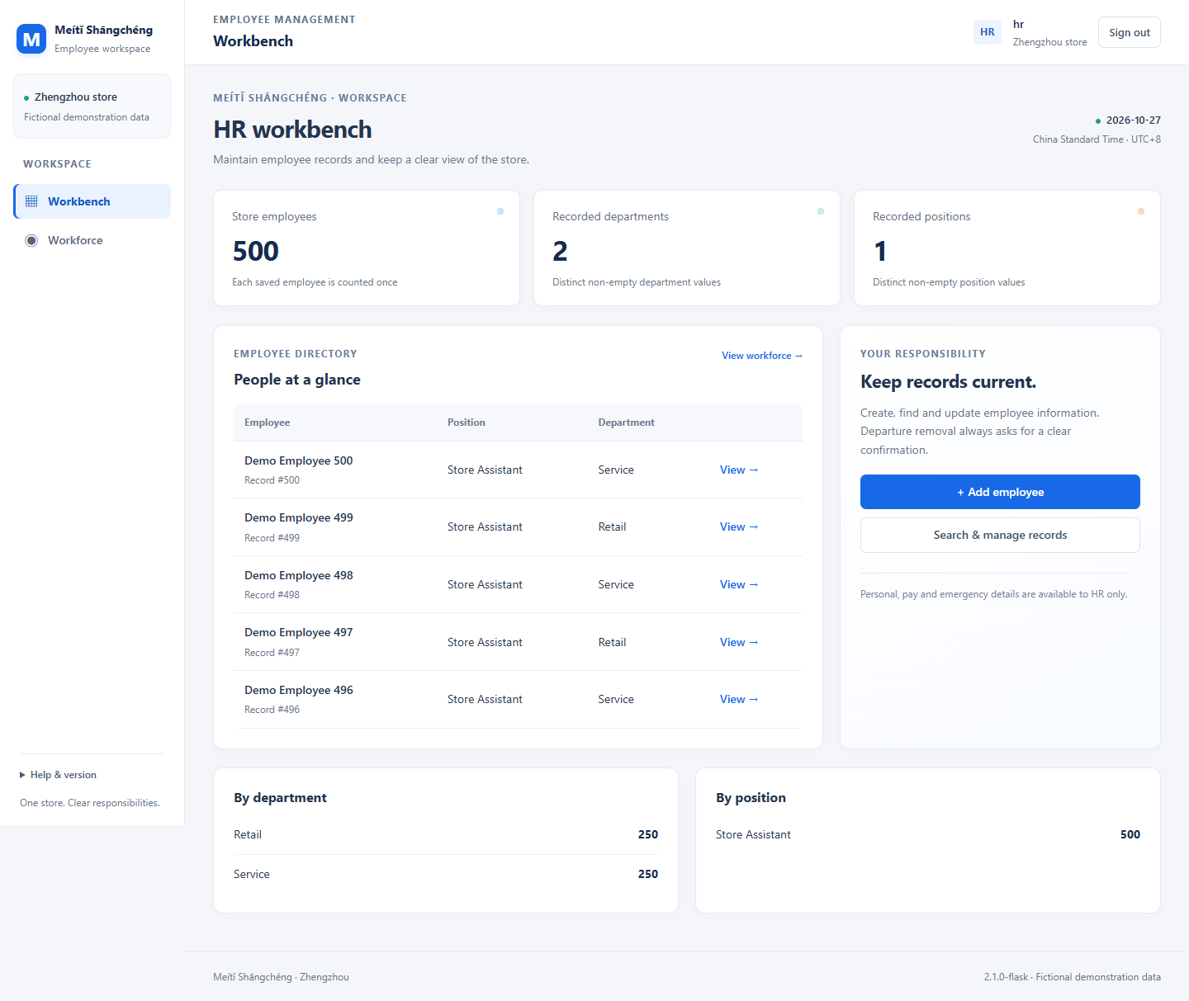
GROUP 2 · FINAL PROJECT REVIEW
Employee
Management
System
One workforce.
Three clear roles.
Liang Bangyu · Li Yuanxiang
Liu Yixuan · Liu Shuai
Local HR workbench · Fictional demonstration data
Meiti Shangcheng · 28 October 2026 · Local release 2.1.0-flask
01
Notes:
Hello, everyone. We are Group Two: Liang Bangyu, Li Yuanxiang, Liu Yixuan and Liu Shuai. Our project is an employee management system for the Meiti Shangcheng store scenario. We will explain the client problem, connect the coursework to the implementation, and demonstrate three role-based workspaces. The teacher is our client reviewer. The people and schedules in the demonstration are fictional. This presentation introduces the user-authorized enhancement of our local Flask release.

Slide 2
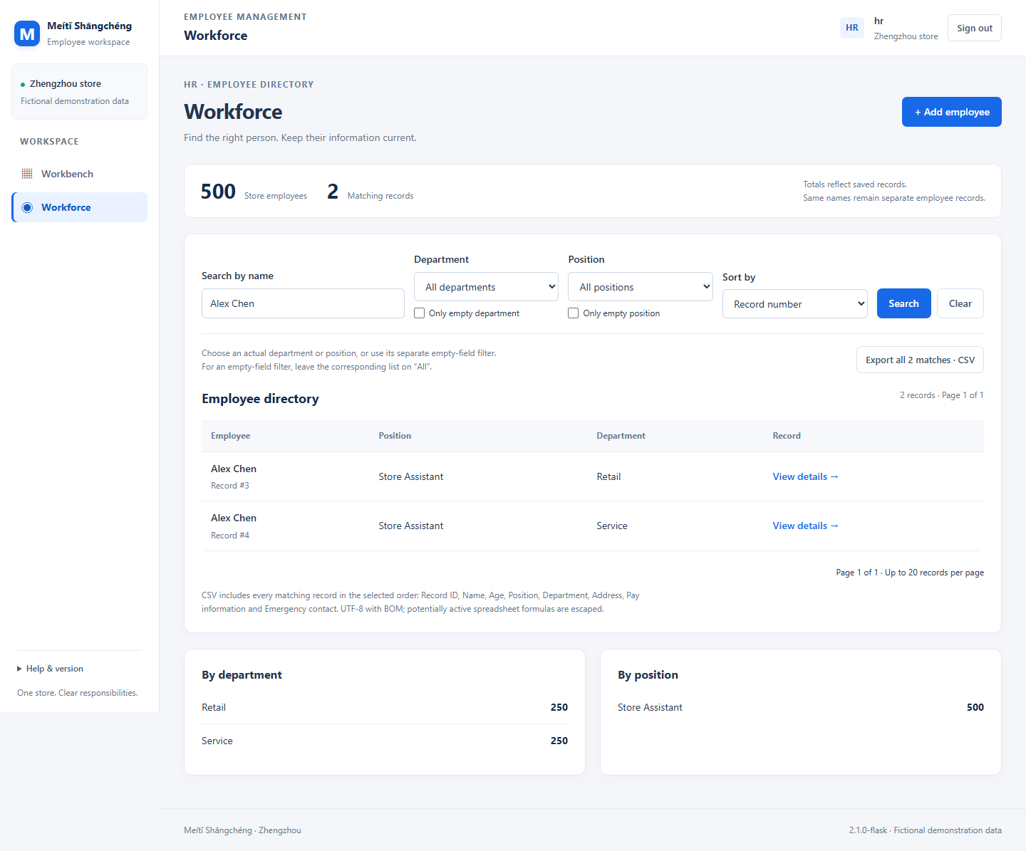
The client problem
Keep records
current
See the workforce
clearly
Arrange dependable
shifts
A clear, persistent
employee workspace.
HR directory · Fictional test data
02
Notes:
The client needs current employee records and understandable work arrangements. HR needs to find the correct person, supervisors need to review their own team, and employees need to understand their personal shifts. The enhancement gives each role a clear starting page and useful navigation. The interface takes inspiration from an office workspace: a side navigation, a light background, white content areas and blue action buttons. The project keeps its own identity. We will demonstrate practical tasks rather than claim an unmeasured increase in productivity.

Slide 3
Clear roles, focused scope
HR
Supervisor
Employee
Manage employee
records
Schedule their
own team
View own shifts
and check in
Find · filter · export
Manual draft · review
Own shifts · history
Scoped access. Valid weeks. Saved records.
Excluded: inventory, automatic scheduling and payroll processing.
03
Notes:
HR can combine directory filters, choose an available sort order, and export matching employee records. A supervisor can review a saved team week and manually load a previous week into an unsaved draft. An employee can review today's work, the next saved shift, weekly totals and personal check-in history. Access still follows the signed-in identity. The supervisor's views stay within the assigned team, and personal views stay within the employee's account. Inventory, approval workflows, leave management, payroll calculation and automatic scheduling remain outside our scope.

Slide 4
Five deliverables, one release
01
02
03
04
Project
Plan
Class
model
URS
Test Plan
Scope and
delivery
Behavior and
acceptance
Actual Python
models
Observable
workflows
05 · Scrum board
Tasks, owners, acceptance conditions and evidence
Python + Flask + SQLite + Jinja
Server-rendered forms and navigation · No JavaScript
04
Notes:
The five coursework artifacts describe the same system. The project plan defines scope and delivery. The URS defines user behavior and acceptance conditions. The class diagram explains the business models and their relationships. The test plan connects observable steps with expected results, while the Scrum board connects tasks, owners and evidence. The new workspace functions are enhancements authorized by the user on October twenty-sixth. We will identify these separately from the original requirements. Updated documents and the website must describe the same release before final handover.

Slide 5
Five business models, one request
User
Employee
Team
ScheduleWeek
CheckIn
Signed-in
identity
Seven
info groups
Supervisor
scope
Complete
team week
Signed
operation
Create an employee
HTML form
Flask route
Employee
SQLite
Rendered page
Role + CSRF
Validate
Write data
Redirect / render
Five models. workspace.py holds query, date and CSV helpers; see the Class Diagram for details.
05
Notes:
The implementation uses Python, Flask, SQLite, Jinja templates and CSS, without application JavaScript. User, Employee, Team, ScheduleWeek and CheckIn remain the five business models. The workspace module supplies readable helpers for queries, dates, summaries and CSV output. For example, an employee form sends a request to Flask. The server checks the session, role and form token, validates the input, and writes parameterized SQL to SQLite. It then redirects and renders a new page. Directory values become query parameters, while sorting is selected from a fixed whitelist. This keeps the request flow concrete enough to explain.

Slide 6
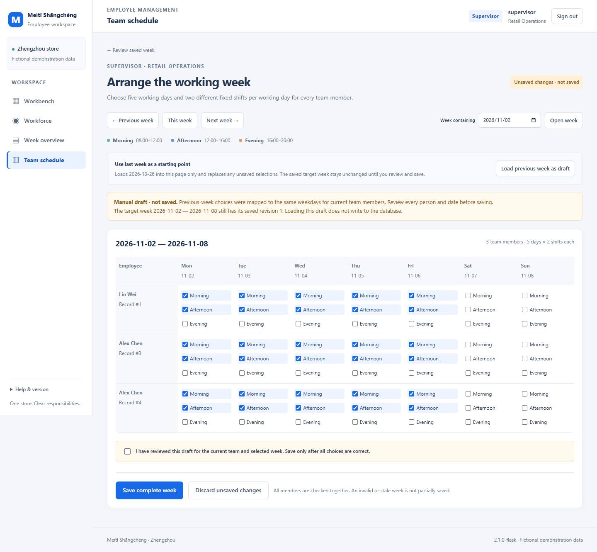
Three workflows, live
01 · HR
Find a record
02 · SUPERVISOR
Load a draft
without saving
03 · EMPLOYEE
View own work
and history
2 min 30 sec · Unsaved draft · Fictional data
06
Notes:
We start as HR and open the directory from the dashboard. We filter the records and open the correct person. Next, we sign out and enter the supervisor workspace. The target is the week beginning November second. We manually load the week beginning October twenty-sixth as an unsaved draft, then discard it. We do not save a new schedule during this route. Finally, we enter the employee workspace, inspect personal work and open check-in history. CSV, printing and a complete reviewed save are separate question-time demonstrations.

Slide 7
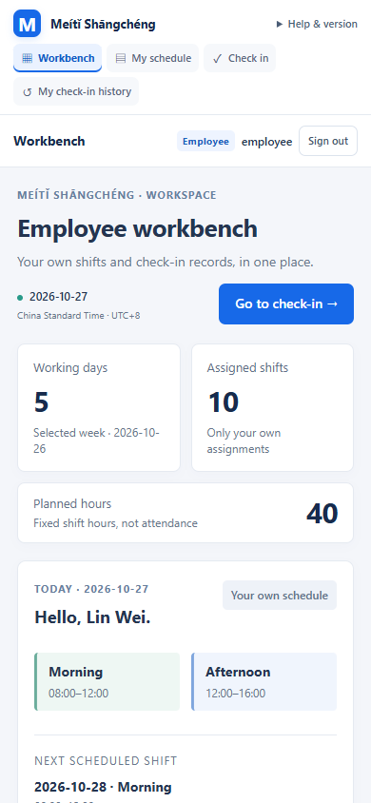
Technical evidence, clear limits
40
26
13
Core regression
Enhanced checks
Browser checks
Flask + SQLite
Role workflows
JavaScript off
JavaScript disabled
Local technical verification.
Independent users and client acceptance remain pending.
Mobile: viewport emulation. Network sources: simulation.
Mobile view · sample data
07
Notes:
The technical evidence is reported in three separate suites. The core regression suite passed 40 checks, the enhancement suite passed 26 checks, and the browser suite passed 13 workflows with application JavaScript disabled. The first two use Flask test clients and temporary SQLite databases. The browser checks also use isolated data. The mobile picture is viewport emulation, and local check-in is a connection simulation. Independent users, physical devices, a real store network and teacher acceptance require separate evidence.

Slide 8
People review what AI assists
PROPOSED RESPONSIBILITIES
Liang Bangyu
AI-assisted output
Coordination and requirements
Source comparison
Code and documents
Technical checks
Li Yuanxiang
Data, backend and class model
Liu Yixuan
Templates and scheduling
Members review,
explain and rehearse.
Liu Shuai
Testing and release
Confirm actual contributions before presenting · Local board records files and evidence from 26 October.
08
Notes:
We propose four responsibility areas: requirements and coordination, data and backend, templates and scheduling, and testing and delivery. Each member must confirm the work they actually performed. AI has assisted requirement comparison, implementation, document preparation and technical checks. Members remain responsible for reviewing the output and explaining the relevant code. The board should link current tasks to requirements and evidence. Before the classroom presentation on October twenty-eighth, we still need a timed team rehearsal, clear speaker handovers and a reliable local demonstration setup.

Slide 9
What changed, and why
Role workspaces → clearer navigation
Previous week → unsaved manual draft
CSV text → formula-safe handling
Next: independent user testing and a timed team rehearsal.
09
Notes:
This iteration responds to the user's request for more useful role functions and a clearer interface. The main decisions concern navigation, visible state and controlled actions. A previous-week draft requires human review before saving. CSV exports use the matching query and protect text that could become a spreadsheet formula. Personal summaries distinguish the selected week from today's date and the future search window. These details make the behavior easier to inspect. Our reflection should explain the problems we actually observed and corrected, supported by the final release evidence.

Slide 10
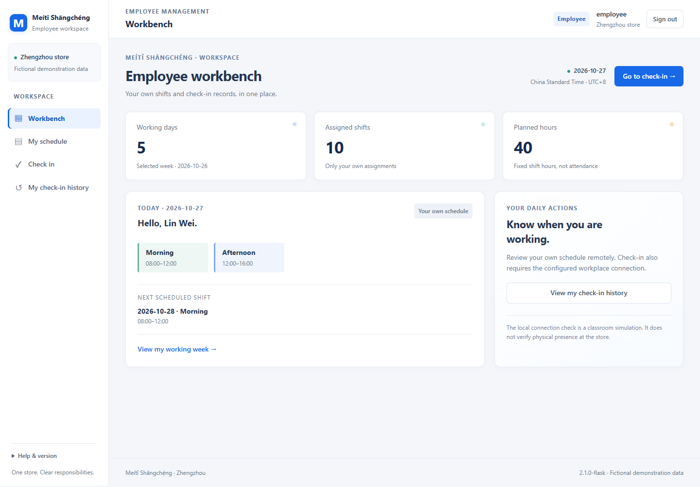
Ready for client review
Five deliverables.
One local release.
Demonstrate the identified release
Record findings
Agree corrections
Thank you. Questions are welcome.
Employee workbench · Fictional demonstration data
10
Notes:
Our handover brings together five coursework artifacts and one identified local release. The proposed enhancement keeps role boundaries and manual control while making everyday tasks easier to find. The next step is to demonstrate the frozen version, record findings and agree any corrections. Final acceptance remains the client's decision. Thank you for listening. We are ready for your questions.

