Slide 1
ETHERNET
CONTENT
HARDWARE ARCHITECTURE
SOFTWARE ARCHITECTURE

Slide 2
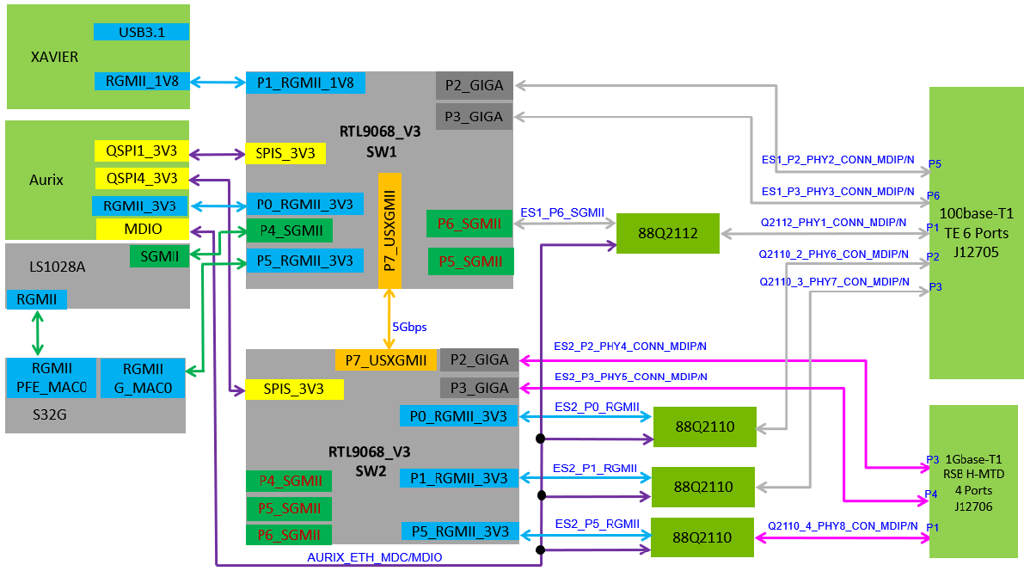
I. HARDWARE ARCHITECTURE

Slide 3
II. SOFTWARE ARCHITECTURE
1. Data Flow

Slide 4
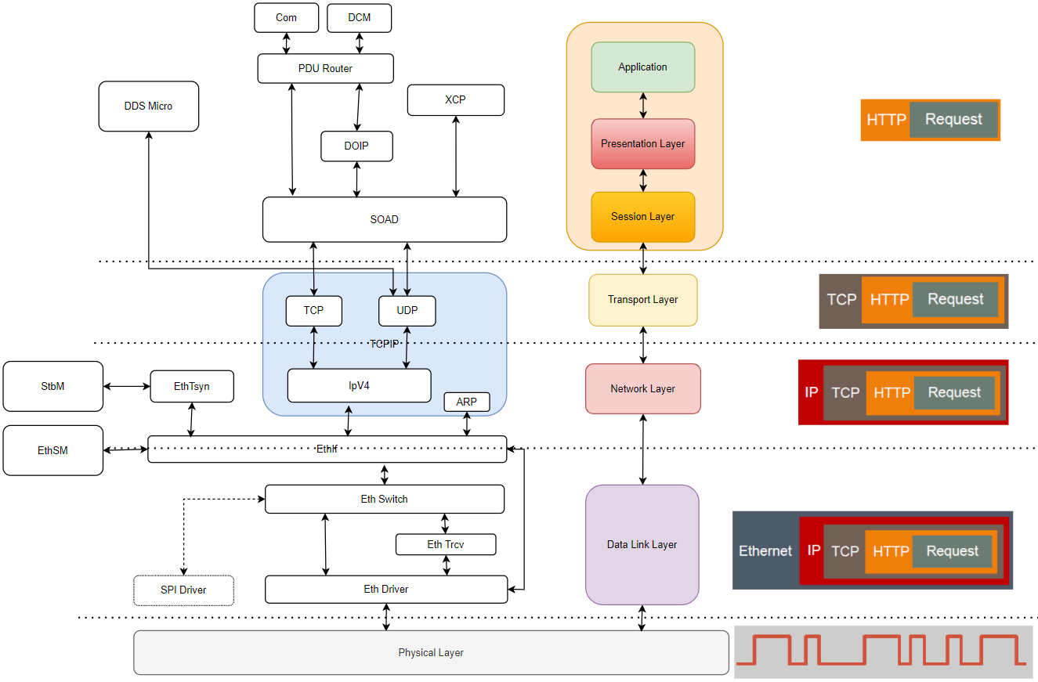

Slide 5
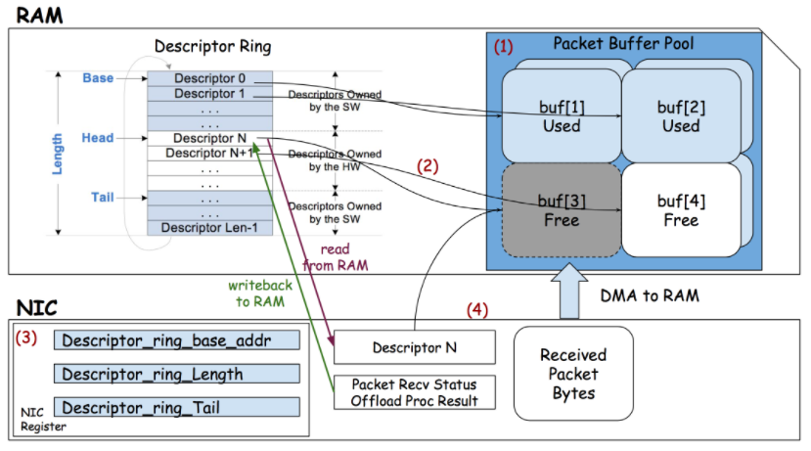
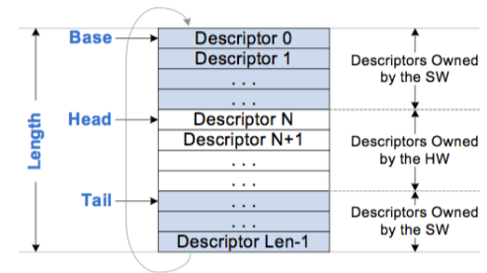
II. SOFTWARE ARCHITECTURE
2. Ethernet Driver

Slide 6
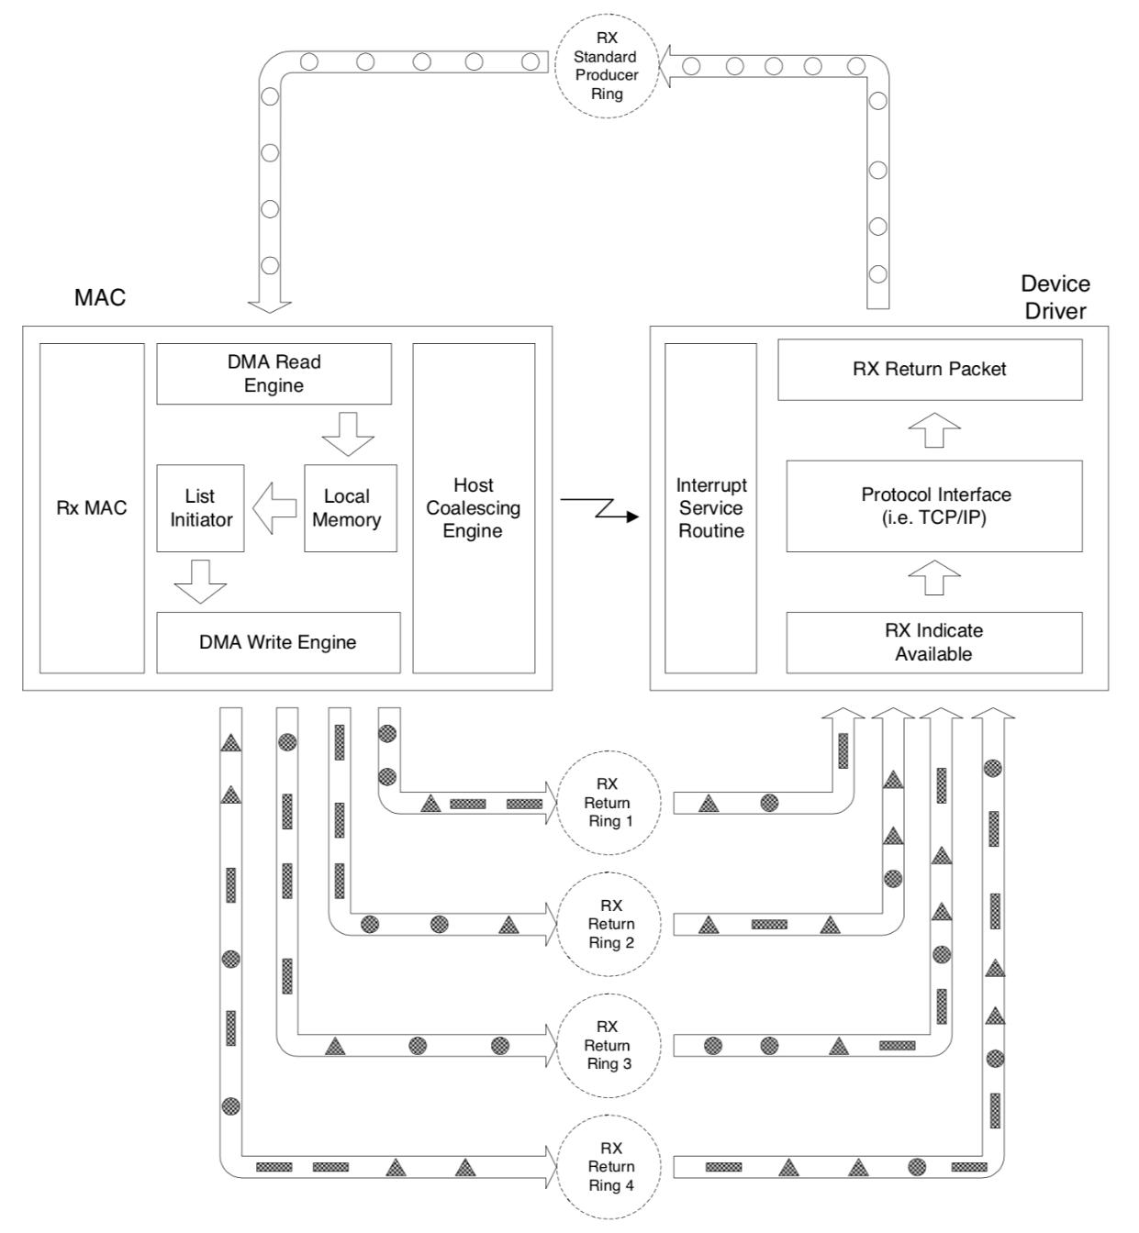
II. SOFTWARE ARCHITECTURE
2. Ethernet Driver

Slide 7
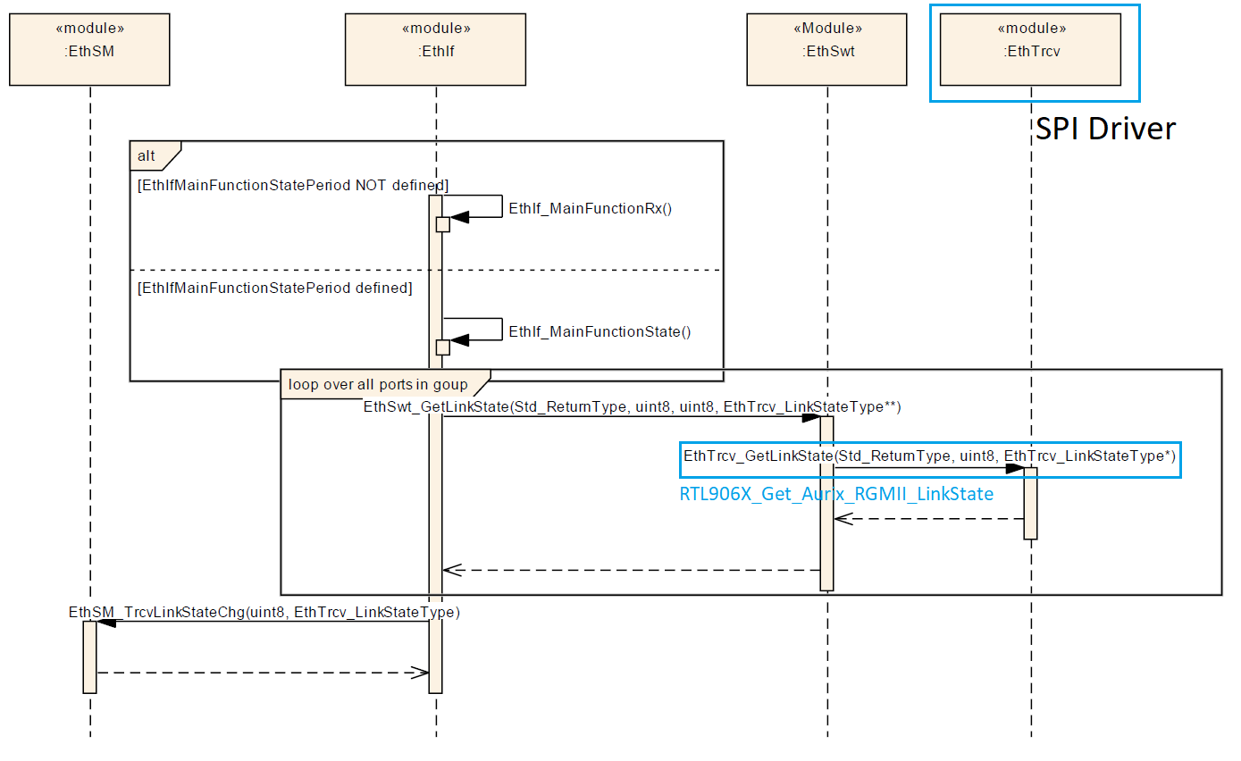
II. SOFTWARE ARCHITECTURE
3. Ethernet sequence

Slide 8
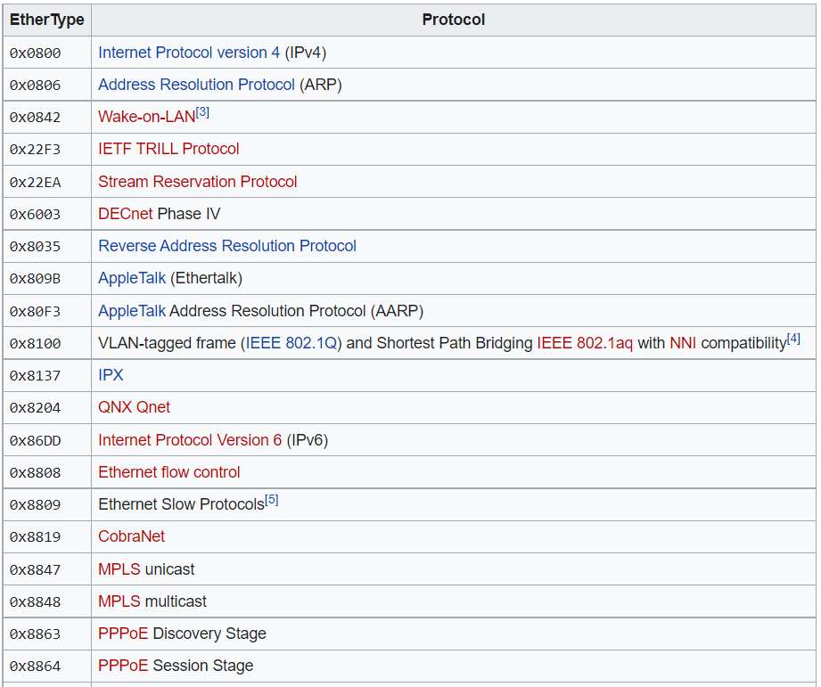
II. SOFTWARE ARCHITECTURE
4. Ethernet type

Slide 9
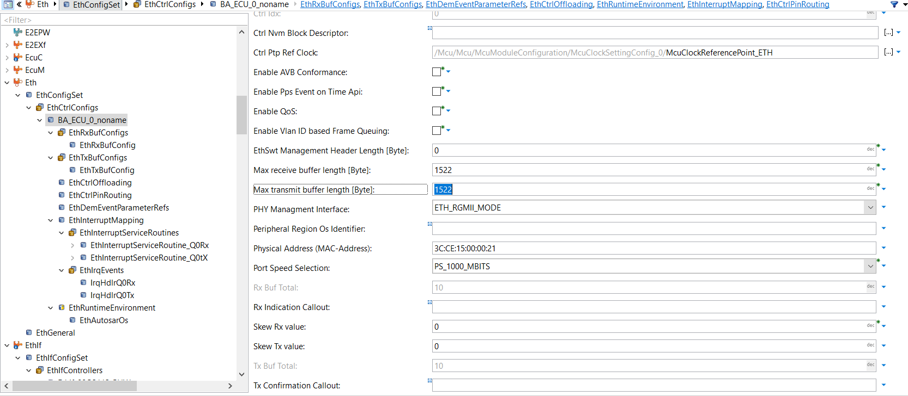
II. SOFTWARE ARCHITECTURE
5. Ethernet Configuration

Slide 10
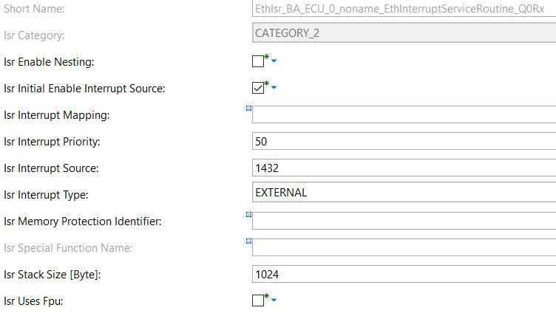
II. SOFTWARE ARCHITECTURE
5. Ethernet Configuration

Slide 11
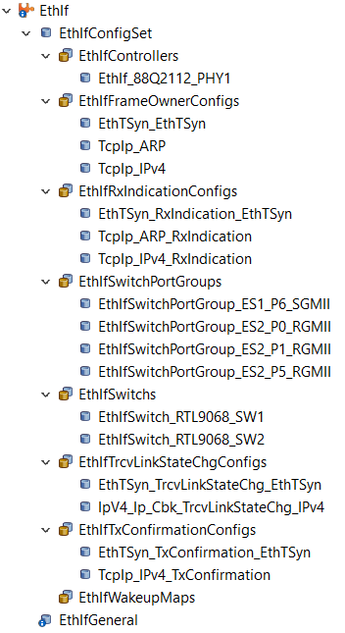
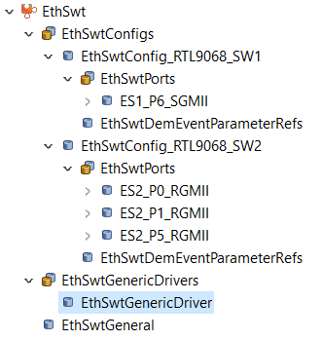
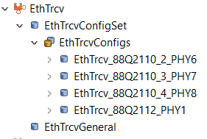
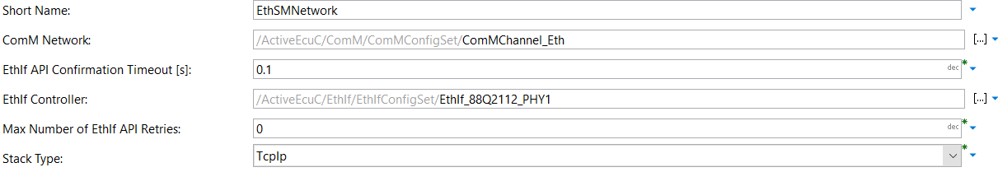
II. SOFTWARE ARCHITECTURE
5. Ethernet Configuration

Slide 12
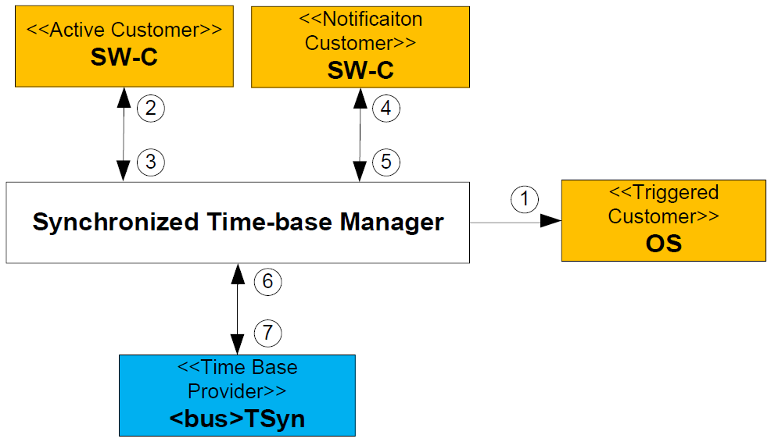
II. SOFTWARE ARCHITECTURE
6. EthTsyn + StbM

Slide 13
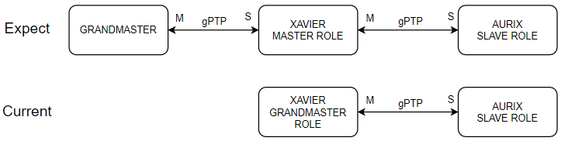
II. SOFTWARE ARCHITECTURE
6. EthTsyn + StbM

Slide 14
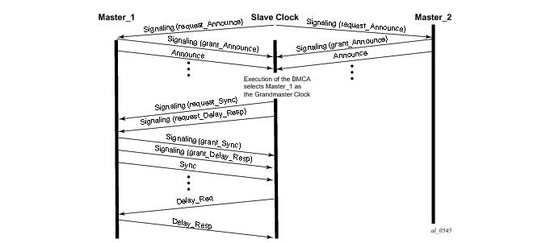
II. SOFTWARE ARCHITECTURE
6. EthTsyn + StbM

Slide 15
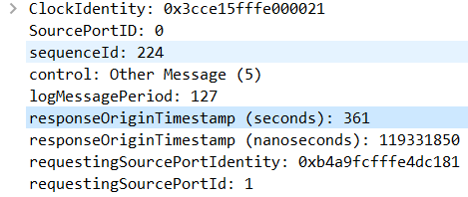
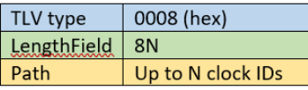
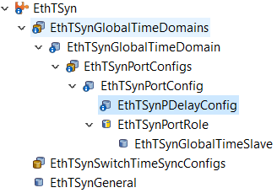
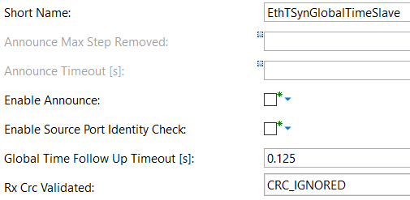
II. SOFTWARE ARCHITECTURE
6. EthTsyn + StbM

Slide 16
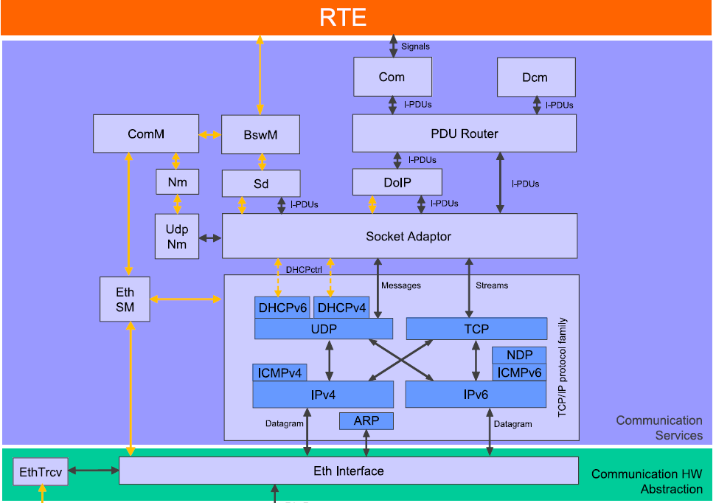
II. SOFTWARE ARCHITECTURE
7. TcpIp

Slide 17
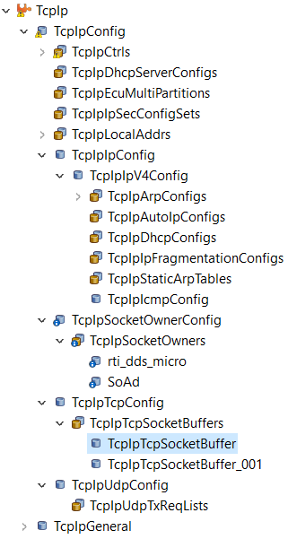
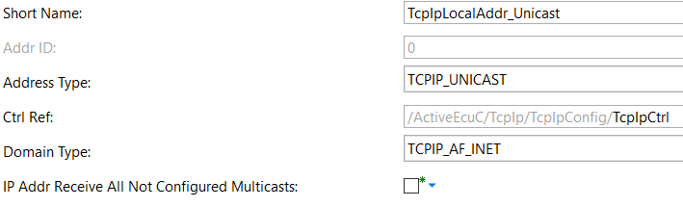
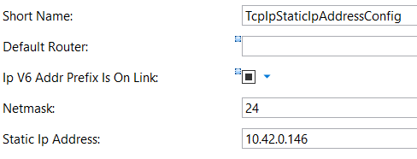
II. SOFTWARE ARCHITECTURE
7. TcpIp

Slide 18
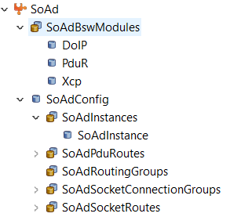
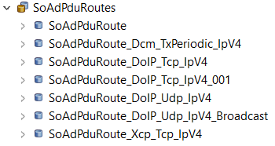
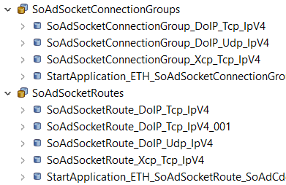
II. SOFTWARE ARCHITECTURE
8. SoAd

Slide 19
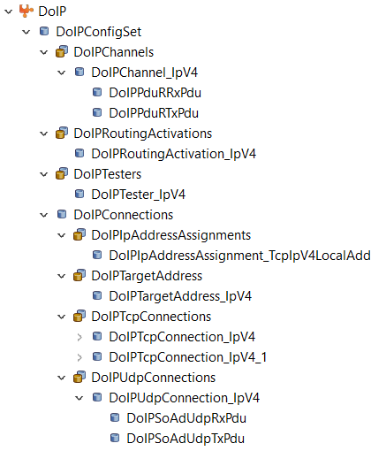
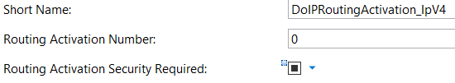
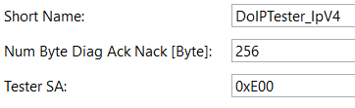
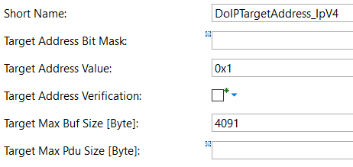
II. SOFTWARE ARCHITECTURE
9. DoIp

Slide 20
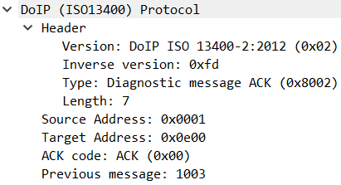
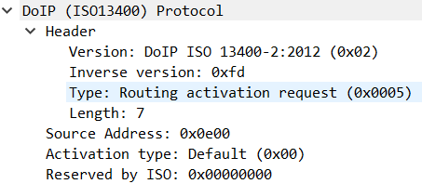
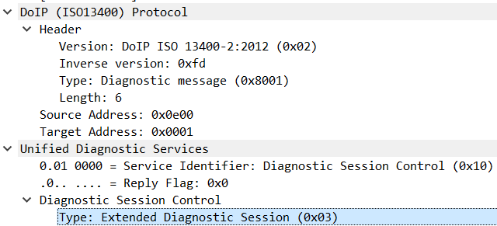
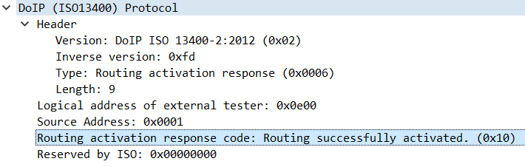
II. SOFTWARE ARCHITECTURE
9. DoIp

Slide 21
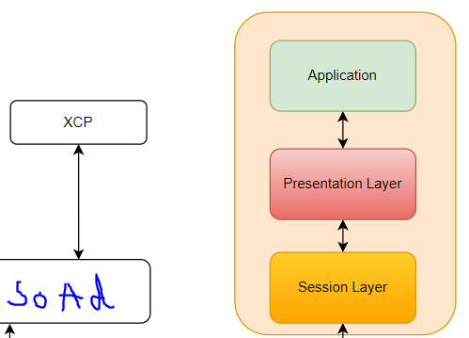
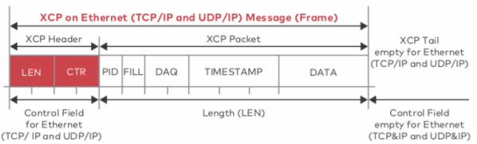
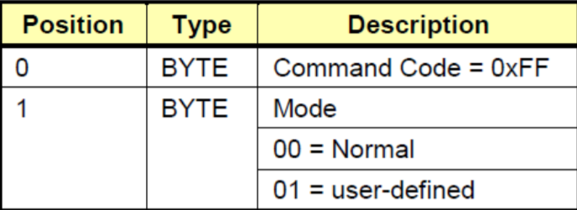
II. SOFTWARE ARCHITECTURE
header
Request connect xcp

