Slide 1
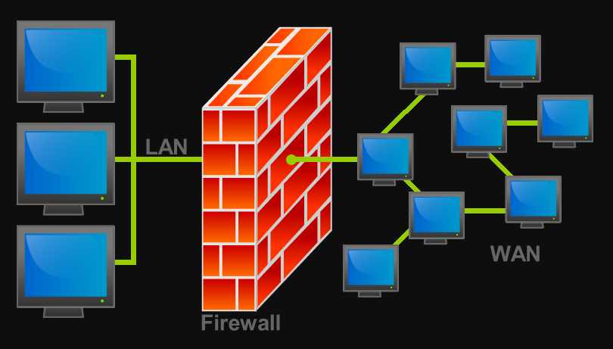
What is firewall?

Slide 2
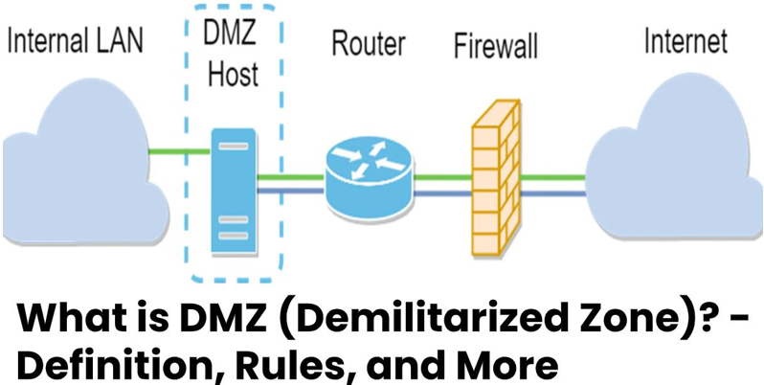

Slide 3
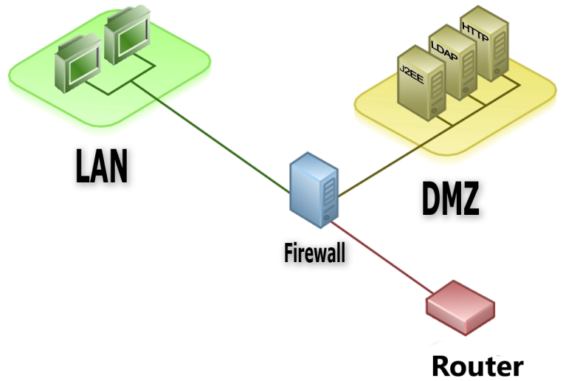

Slide 4
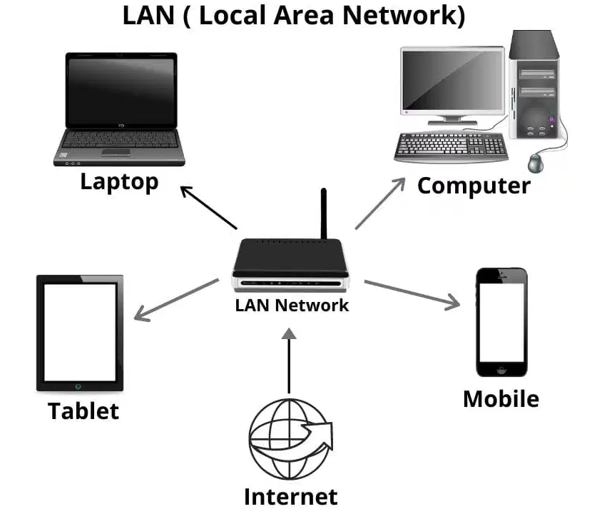
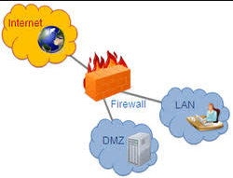
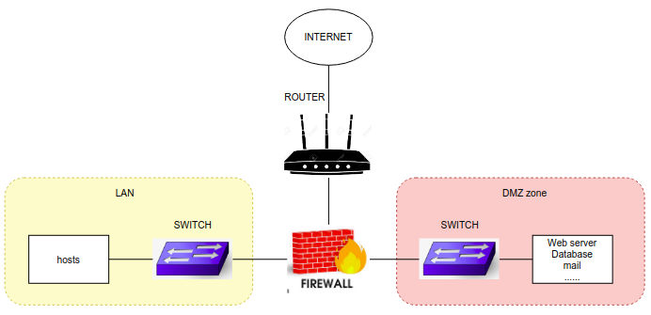
Components of DMZ

Slide 5
Single firewall DMZ

Slide 6
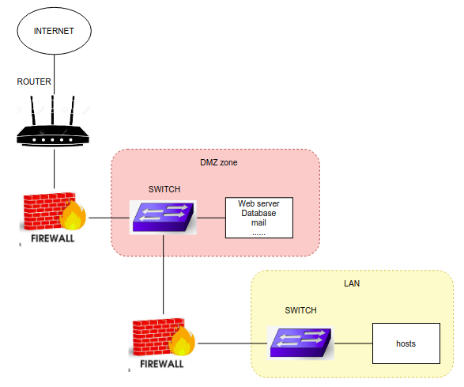
Double firewalls DMZ

Slide 7
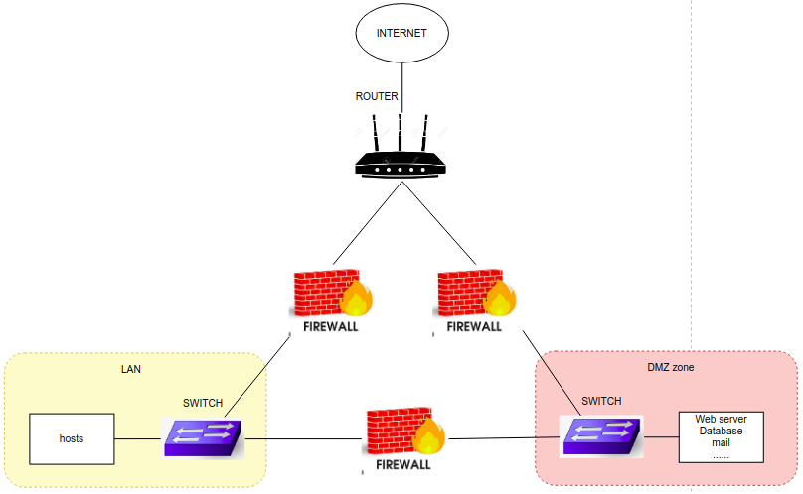
Triple firewalls DMZ

Slide 8
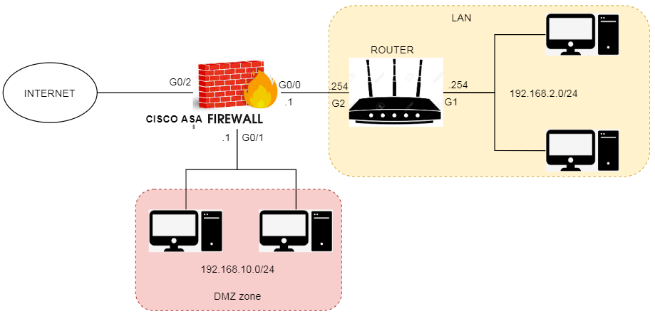
Configure DMZ

Slide 9
Configure DMZ
ciscoasa(config)# policy-map global_policy ciscoasa(config-pmap)# class inspection_default ciscoasa(config-pmap-c)# inspect icmp
ciscoasa(config)# username NAME password PASS ciscoasa(config)# crypto key generate rsa general-keys ciscoasa(config)# ssh 192.168.2.10 255.255.255.255 inside ciscoasa(config)# ssh version 2 ciscoasa(config)# aaa authentication ssh console LOCAL

Slide 10
Configure DMZ
object network DMZ_10.10 host 192.168.10.10
object service RDP service tcp source eq 3389
nat (inside,outside) source static DMZ_10.10 interface service RDP RDP
access-list POLICY extended permit tcp any host 192.168.10.10 eq 3389 access-group POLICY in interface outside
object network USER subnet 192.168.2.0 255.255.255.0
nat (inside,outside) source dynamic USER interface

Slide 11
