Slide 1

Minecraft
Kovács Péter
Bánhidai Mátyás

Slide 2
Miről fogunk beszélni?
Téma bemutatása
Alkalmazott technológiák
1
2
Menürendszer
Bootstrap rács
3
4

Slide 3
Carousel
Github
5
7
Quiz
6

Slide 4
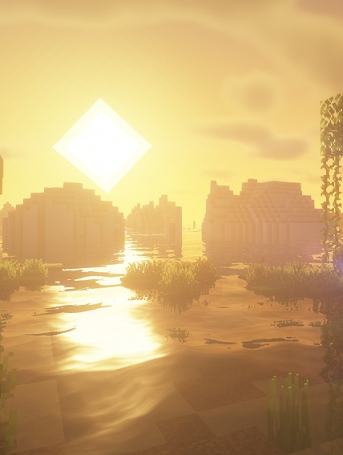
1
Téma bemutatása
Miről szól a játék?
Miért választottuk?

Slide 5

2
Alkalmazott technológiák

Slide 6





Technológiák
Javasript
HTML
Bootstrap
Github

Slide 7

3
Menürendszer

Slide 8
4
Bootstrap rács
Működése
Megjelenése

Slide 9

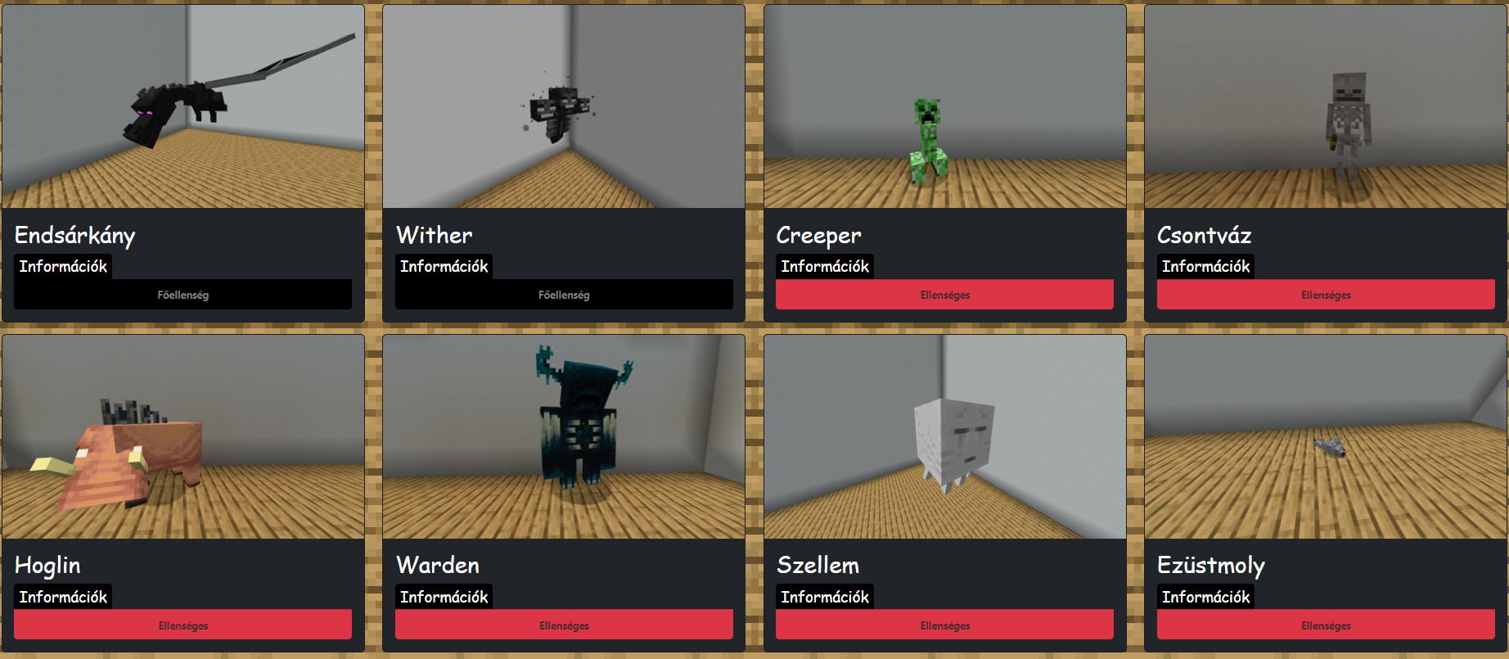
Mobok oldalon
Rács kialakítása
Kinézete

Slide 10
5
Carousel

Slide 11

6
Quiz
Működése
Megjelenése
Funkciók

Slide 12
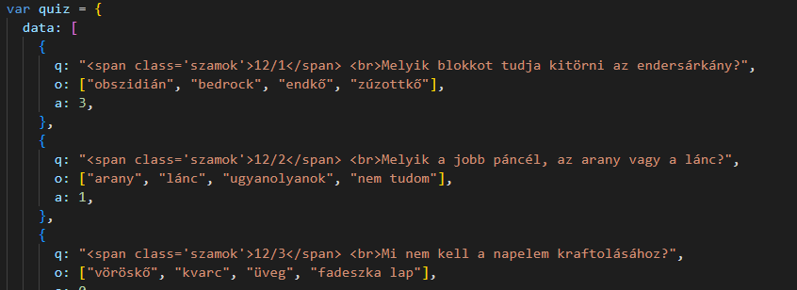
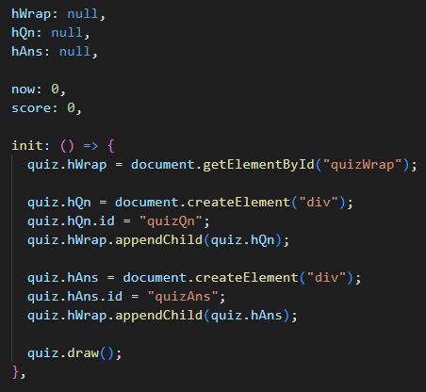
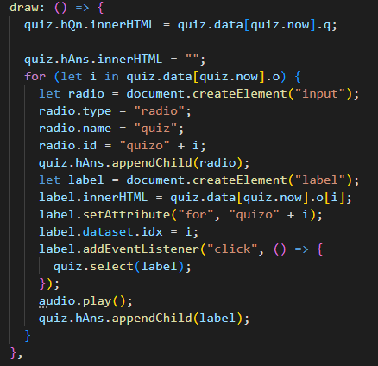
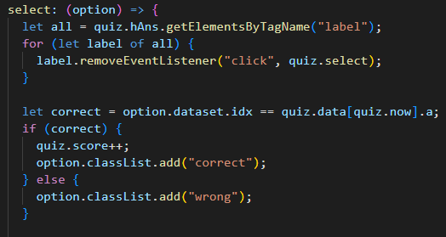
Működése
Javascript

Slide 13
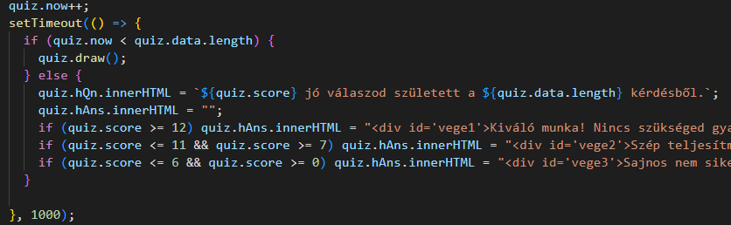
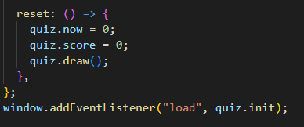
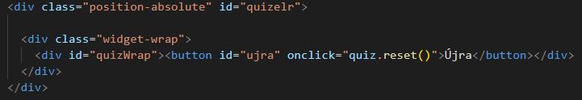
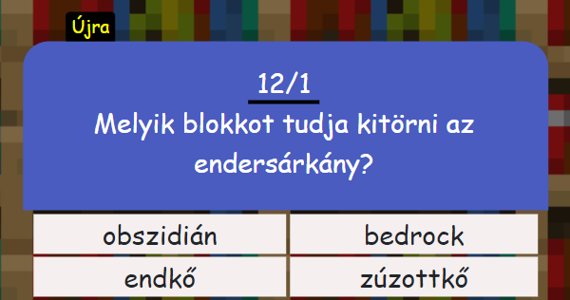
Quiz.html
Kinézete

Slide 14
7
Github
Verziókezelés
Munkamegosztás
Címkék

Slide 15
Mit tanultunk a csoportmunkának köszönhetően?
Mátyás
Kompromisszumkészség
Javascript
Bootstrap
Péter
learning icon pack

Slide 16
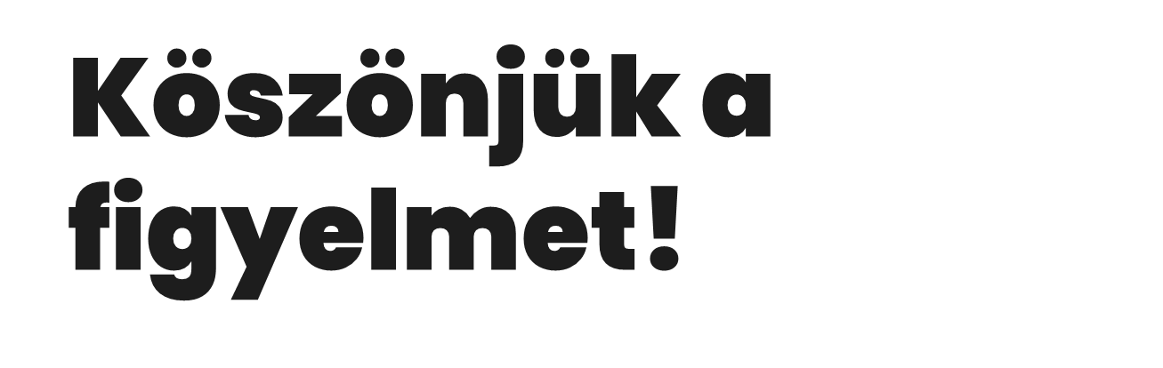
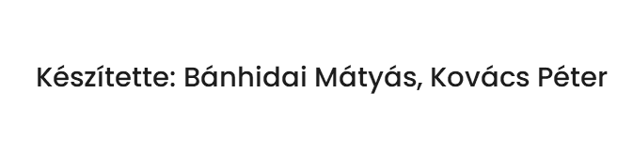

Slide 17
1
Téma bemutatása
Miről szól a játék?
Miért választottuk?

Slide 18
Introduction
You can give a brief description of the topic you want to talk about here. For example, if you want to talk about Mercury, you can say that it’s the smallest planet in the entire Solar System

Slide 19
—Someone Famous
“This is a quote, words full of wisdom that someone important said and can make the reader get inspired.”

Slide 20
What sets us apart?
Mars
Mercury
Venus
Despite being red, Mars is actually a cold place. It’s full of iron oxide dust
It’s the closest planet to the Sun and the smallest one of them all
Venus has a beautiful name and is the second planet from the Sun

Slide 21

A picture is worth a thousand words

Slide 22
Our locations
Mars
Despite being red, Mars is actually a cold place. It's full of iron oxide dust, which gives the planet its reddish cast

Slide 23
The program
Mercury
Venus
It’s the closest planet to the Sun and the smallest one
Venus has a beautiful name and it’s hotter than Mercury
3/5
4/5
The Sun
Jupiter
The Sun is the star at the center of the Solar System
Jupiter is a gas giant and the biggest planet
5/5
2/5

Slide 24
Awesome words

Slide 25
Our academic areas
 | Area 1 | Area 2 | Area 3
Objective 1 | Ceres is in the main asteroid belt | Saturn is a gas giant with rings | Venus has a beautiful name
Objective 2 | Pluto is considered a dwarf planet | Jupiter is the biggest planet | Earth is where we all live
Objective 3 | Mars is actually a very cold place | Mercury is the smallest planet | Neptune is far away from Earth

Slide 26
Our mission and vision
Mission
Vision
Mercury is the closest planet to the Sun and the smallest one of them all—it’s only a bit larger than the Moon
Venus has a beautiful name and is the second planet from the Sun. It’s hot and has a poisonous atmosphere

Slide 27
Our values
Jupiter
Venus
Mercury
Saturn
Mars
Neptune
Jupiter is the biggest planet of them all
Venus is the second planet from the Sun
It’s the closest planet to the Sun
It’s composed of hydrogen and helium
Mars is actually a very cold place
It’s the farthest planet from the Sun

Slide 28
Our success
$1,898
35k
+15%
Ceres is located in the main asteroid belt
Mercury is the smallest planet of them all
Despite being red, Mars is a cold place

Slide 29
287,987
Big numbers catch your audience’s attention

Slide 30
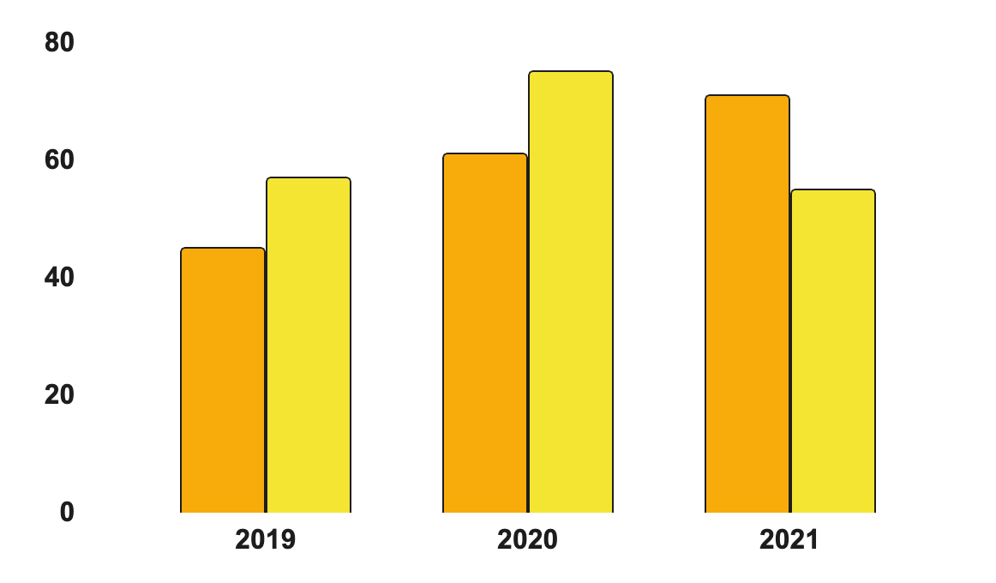
Our statistics
Saturn
It’s a gas giant and has several rings
Jupiter
It’s the biggest planet of them all
Follow the link in the graph to modify its data and then paste the new one here. For more info, click here

Slide 31

Our teachers
Jenna Doe
Timmy Jimmy
You can speak a bit about this person here
You can speak a bit about this person here

Slide 32
Our goals
Saturn
Venus
Jupiter
Mars
Saturn is a gas giant. It’s composed of hydrogen and helium
It has a beautiful name and is the second planet from the Sun
Jupiter is a gas giant and the biggest planet in the Solar System
Mars is full of iron oxide dust, which gives the planet its reddish cast

Slide 33
Student progress
Jupiter is the biggest planet
Mars is actually a cold place
2nd term
4th term
1st term
3rd term
Mercury is the smallest planet
Earth is where we all live

Slide 34
Enrollment process
1
Mercury
Jupiter
2
The Sun
3
It’s the closest planet to the Sun and the smallest one
It’s a gas giant and the biggest planet of them all
The Sun is the star at the center of the Solar System

Slide 35
Special reminders
Do you know what helps you make your point clear?Lists like this one:
They’re simple
You can organize your ideas clearly
You’ll never forget to buy milk!
And the most important thing to know: the audience won’t miss the main point of your amazing presentation

Slide 36
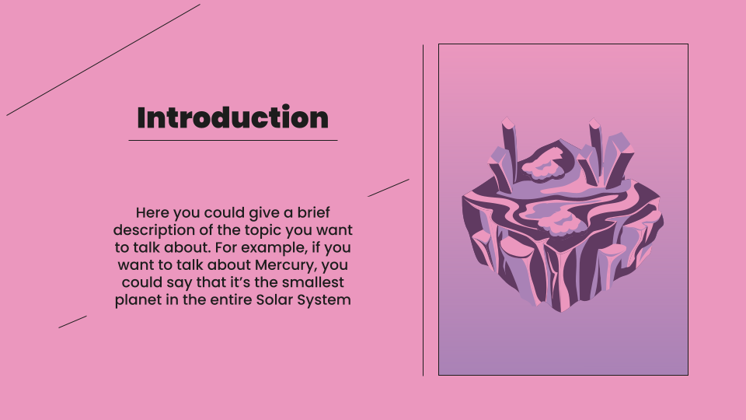
Class demo
Mercury
This planet's name has nothing to do with the liquid metal, since Mercury was named after the Roman messenger god
Insert your multimedia content here

Slide 37



CSS
Discord
VSCode

Slide 38
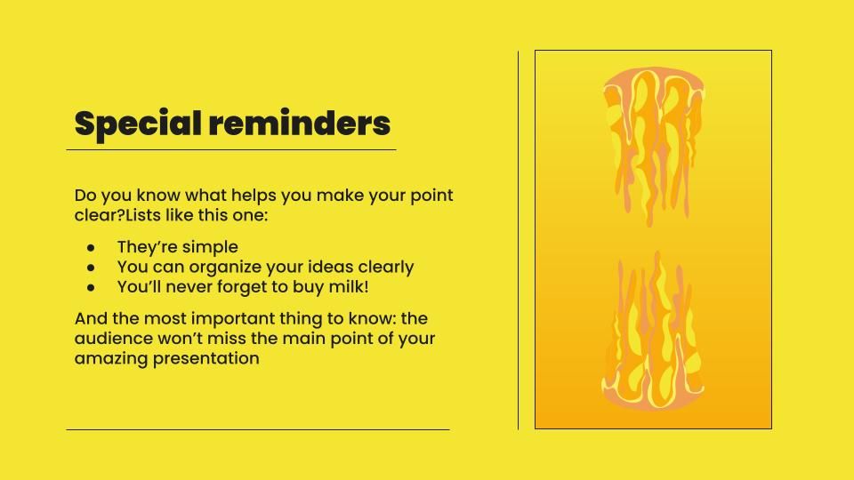
More information on the website
You can replace the image on the screen with your own work. Just right-click on it and select “Replace image”

Slide 39
Thanks!
Do you have any questions?
youremail@freepik.com
+34 654 321 211
yourwebsite.com
Please keep this slide for attribution

Slide 40
E-learning icon pack

Slide 41
Alternative resources
Vectors
Isometric bright game landscape icons collection

Slide 42


