Slide 1
IoT based real-time weather monitoring & ML prediction system with Power BI visualisation
PROJECT MEMBERS :
BANIBRATA MANNA 11200121005
SUSMITA SARKAR 11200121036
SUNAYANI MONDAL 11200121039
MRINMAYEE MAITY 11200121056
NAYAN SAHA 11200122068
ATUL PANDEY 11200221027
STREAM : COMPUTER SCIENCE & ENGINEERING (CSE)
INSTITUTE : GOVERNMENT COLLEGE OF ENGINEERING & LEATHER TECHNOLOGY
⟮0⟯

Slide 2
PROJECT ABSTRACT
The project "IoT–Based Real–Time Weather Monitoring and Machine Learning Prediction System with Power BI Visualization" is designed to capture real–time environmental data using an IoT–integrated weather station. The system utilizes Arduino Uno R4 Wi–Fi as its main microcontroller, interfacing with various sensors including DHT11, MQ–135, LDR, Rain Sensor, and BMP280 to collect temperature, humidity, air quality, atmospheric pressure, rainfall, and light intensity data.
Key Features :
Wireless Data Transmission : Sensor data is sent to the ThingSpeak IoT platform for remote access and analysis.
Machine Learning Integration : Historical weather data is analyzed using ML algorithms to predict future weather patterns.
Power BI Visualization : Real–time graphs and insights help users track environmental changes interactively.
OLED Display Interface : Local monitoring of weather parameters for instant feedback.
Web & Mobile Accessibility : Users can access the system via an interactive web server or mobile application.
⟮1⟯

Slide 3
INTRODUCTION
The Internet of Things (IoT) is revolutionizing technology by enabling interconnected devices to communicate and share data efficiently.
This project focuses on developing an IoT–based weather monitoring system that utilizes sensors and machine learning algorithms to track various environmental parameters such as temperature, humidity, air quality, rain, atmospheric pressure, and altitude.
The gathered data is processed and visualized using Power BI and cloud–based platforms like ThingSpeak.
By leveraging Arduino UNO R4 Wi–Fi and multiple sensors, this system provides real–time monitoring and predictive analytics for weather forecasting.
The integration of wireless technology ensures remote accessibility, allowing users to obtain localized weather insights without relying solely on traditional meteorological institutions.
Additionally, machine learning models analyze historical weather data to improve forecast accuracy.
This intelligent system enhances decision–making in agriculture, urban planning, and environmental management, demonstrating the power of IoT in creating smart and efficient solutions.
⟮2⟯

Slide 4
OBJECTIVES
The primary objective of this project is to develop an IoT–based real–time weather monitoring and machine learning prediction system equipped with Power BI visualization This system aims to:
Monitor key environmental parameters like temperature, humidity, air quality, atmospheric pressure, altitude, and rainfall using a network of sensors.
Ensure real–time data collection and transmission to a cloud–based IoT platform (ThingSpeak) for analysis and visualization.
Utilize machine learning models to process historical weather data, improving forecast accuracy for predictive analytics.
Enable remote access to weather insights through a web–based dashboard and mobile applications, making localized weather information accessible anytime.
Enhance decision–making in agriculture, urban planning, and environmental management by providing detailed analytics and forecast trends.
Integrate Power BI visualization for interactive, data–driven insights and improved user experience.
By combining Arduino UNO R4 Wi–Fi, various sensors, and machine learning algorithms, this project presents a cost–effective, scalable solution** for weather monitoring and forecasting.
⟮3⟯

Slide 5
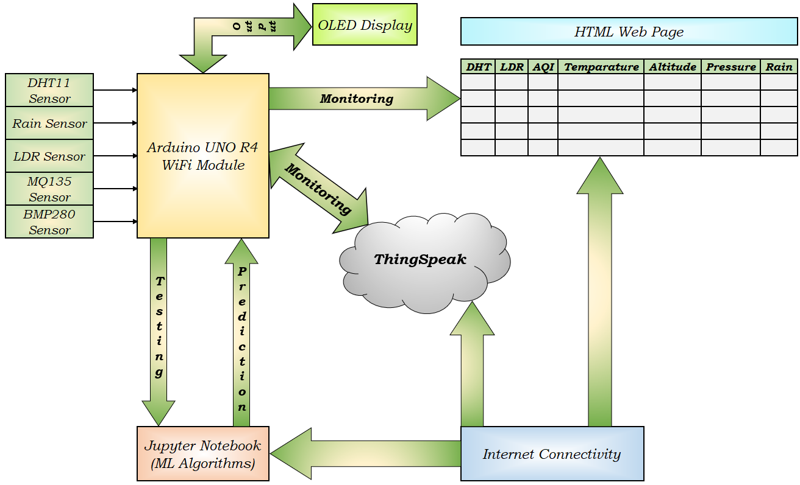
SYSTEM BLOCK DIAGRAM
⟮4⟯
Interconnection Diagram

Slide 6
COMPONENTS USED
Hardwares :
Arduino Uno R4 Wi–Fi
DHT 11 Sensor
Rain Sensor
LDR Sensor
MQ 135 Sensor
BMP 280 Sensor
OLED Display
Softwares :
Arduino IDE
ThingSpeak IoT Platform
Python
PyCharm
MATLAB
⟮5⟯

Slide 7
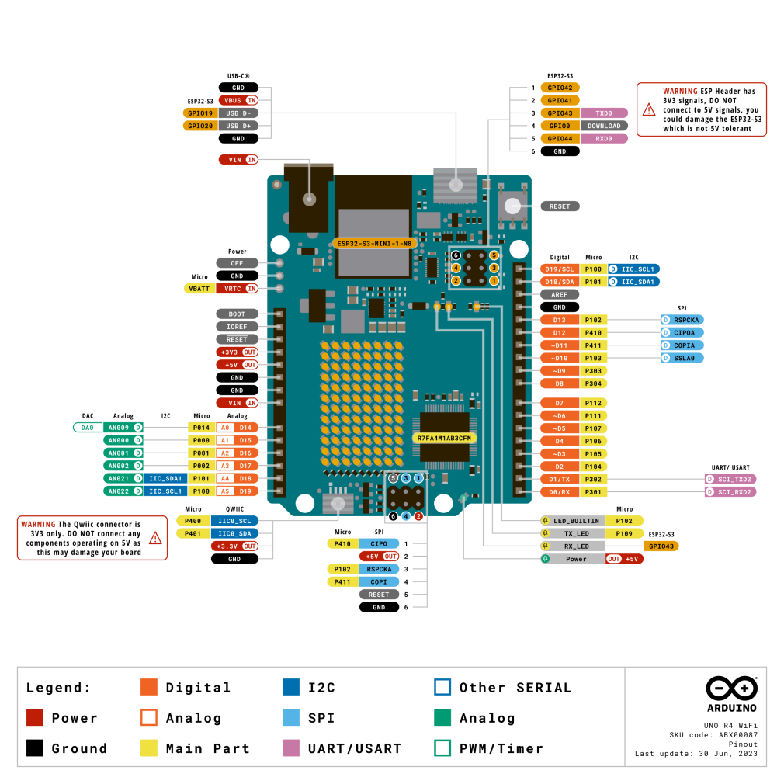
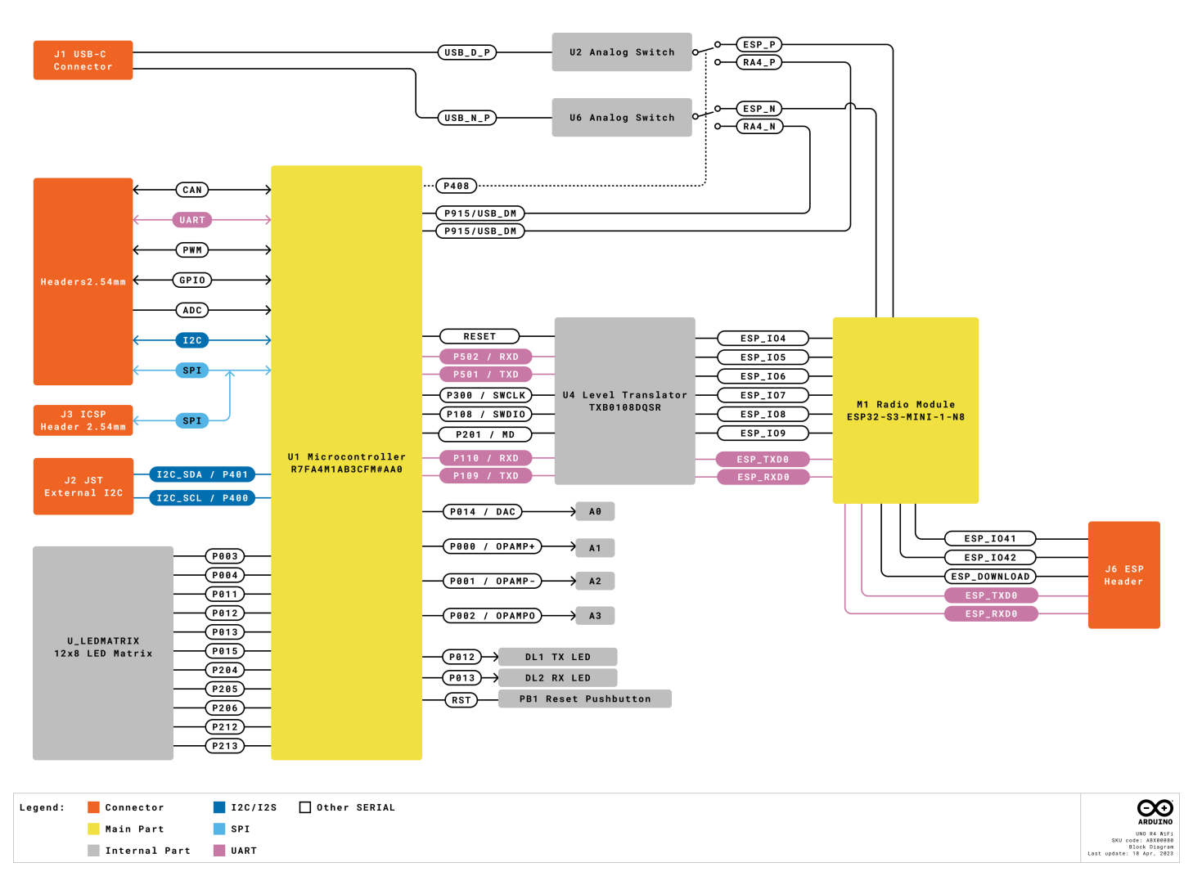
ARDUINO UNO R4 WIFI
⟮6⟯
Interconnection Diagram
Pin Diagram

Slide 8
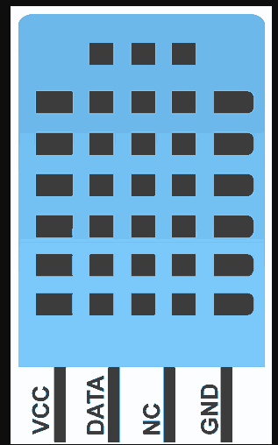
DHT11 SENSOR
Working Principle of DHT11 Sensor :
DHT11 sensor consists of a capacitive humidity sensing element and a thermistor for sensing temperature. The humidity sensing capacitor has two electrodes with a moisture holding substrate as a dielectric between them. Change in the capacitance value occurs with the change in humidity levels. The IC measure, process this changed resistance values and change them into digital form.
For measuring temperature this sensor uses a Negative Temperature coefficient thermistor, which causes a decrease in its resistance value with increase in temperature. To get larger resistance value even for the smallest change in temperature, this sensor is usually made up of semiconductor ceramics or polymers.
The temperature range of DHT11 is from 0 to 50 degree Celsius with a 2–degree accuracy. Humidity range of this sensor is from 20 to 80% with 5% accuracy. The sampling rate of this sensor is 1Hz .i.e. it gives one reading for every second. DHT11 is small in size with operating voltage from 3 to 5 volts. The maximum current used while measuring is 2.5mA.
⟮7⟯
Pin Diagram

Slide 9
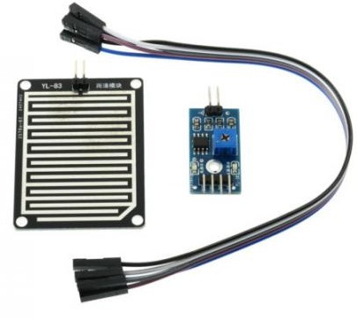
RAIN SENSOR
Working Principle of Rain Sensor :
A rain sensor operates using a conductive material grid or parallel wires, leveraging the conductivity of water for detection. When raindrops fall on the sensing element, they form bridges between conductive pathways, altering electrical resistance or causing a short circuit, which is then detected by an electronic circuit.
The sensor’s signal processing involves a microcontroller or integrated circuit, which translates changes in resistance into either a digital or analog output. If rain is detected, the signal state changes, typically switching from high to low.
Diagram
⟮8⟯

Slide 10
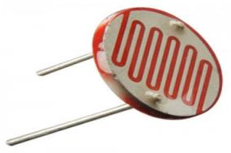
LDR SENSOR
Working Principle of LDR Sensor :
LDR stands for Light Dependent Resistor. The working principle of an LDR is photoconductivity, which is nothing but an optical phenomenon. When the light is absorbed by the material then the conductivity of the material enhances. When the light falls on the LDR, then the electrons in the valence band of the material are eager to the conduction band.
But, the photons in the incident light must have energy superior to the bandgap of the material to make the electrons jump from one band to another band (valance to conduction). Hence, when light having ample energy, more electrons are excited to the conduction band which grades in a large number of charge carriers. When the effect of this process and the flow of the current starts flowing more, the resistance of the device decreases.
Diagram
⟮9⟯

Slide 11
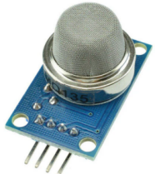
MQ135 SENSOR
Working Principle of MQ135 Sensor :
Pre–heating : Before operation, the MQ135 sensor requires a preheating phase of 20–30 seconds to reach 300°C, maintained throughout its power cycle.
Sensitivity Layer Formation : The tin dioxide sensing element absorbs oxygen, forming a resistant sensing layer that limits free electron interaction in pure air conditions.
Gas Interaction : When target gases like smoke or ammonia are present, they disrupt the sensing layer, increasing electrical conductance.
Analog Output Generation : A higher gas concentration results in higher analog signal values, which are processed by microcontrollers for environmental monitoring.
This real–time air quality sensor effectively detects pollutants and aids in atmospheric analysis for smart environments.
Diagram
⟮10⟯

Slide 12
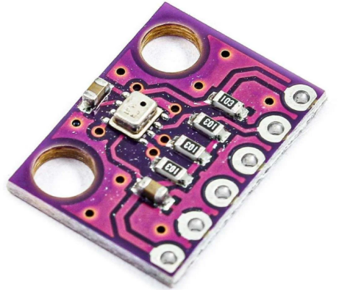
BMP280 SENSOR
Working Principle of BMP280 Sensor :
Pressure Measurement : The BMP280 measures atmospheric pressure by detecting the deflection of a silicon diaphragm. This deflection alters electrical resistance, which is amplified and processed by internal circuitry. Built–in algorithms calibrate the raw data, correcting for temperature effects and sensor–specific deviations.
Temperature Measurement : A thermistor measures temperature by sensing resistance changes caused by heat. These readings are converted into temperature values and also used to improve pressure measurement accuracy through compensation.
Data Processing and Output : The sensor combines pressure and temperature data to produce compensated, accurate outputs. This enhances reliability in applications like altitude estimation. Data is transmitted digitally via I²C or SPI, allowing seamless integration into various systems.
Diagram
⟮11⟯

Slide 13
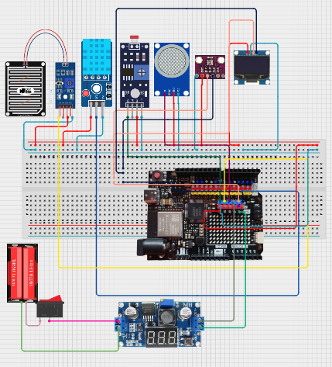
SYSTEM ARCHITECTURE
⟮12⟯
Diagram

Slide 14
WORKING PRINCIPLE
The IoT–based real–time weather monitoring and machine learning prediction system and Power BI Visualization operates through a network of sensors, microcontrollers, and cloud platforms to collect, process, and analyze environmental data.
Data Acquisition : Sensors such as DHT11, BMP280, MQ–135, LDR, and Rain Sensor continuously measure temperature, humidity, air quality, atmospheric pressure, altitude, and rainfall.
Microcontroller Processing : The Arduino UNO R4 Wi–Fi retrieves sensor data, ensuring seamless communication between hardware components.
Wireless Data Transmission : Acquired data is transmitted via “Wi–Fi connectivity” to the “ThingSpeak IoT cloud”, enabling remote monitoring.
Machine Learning Predictions : Historical and real–time data are processed using “predictive analytics models”, refining weather forecasts.
Power BI Visualization : Interactive dashboards present trends, allowing users to interpret meteorological patterns effectively.
Web & Mobile Interface : Users can access real–time updates through an online portal or a mobile application.
This intelligent IoT–based approach enhances weather forecasting accuracy while enabling efficient environmental monitoring and data–driven decision–making
⟮13⟯

Slide 15
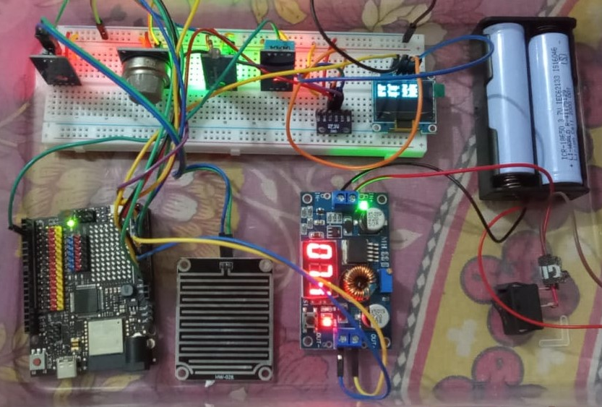
HARDWARE SETUP
⟮14⟯
Diagram

Slide 16
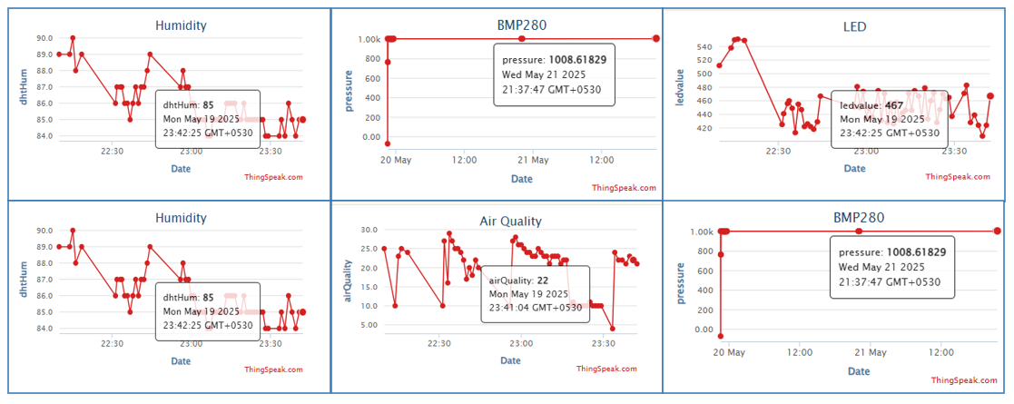
IOT PLATFORM : THINGSPEAK
Diagram
⟮15⟯

Slide 17
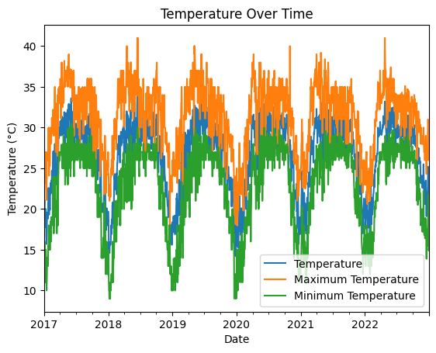
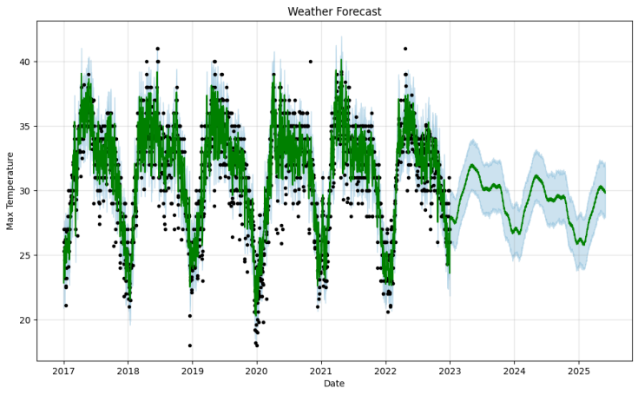
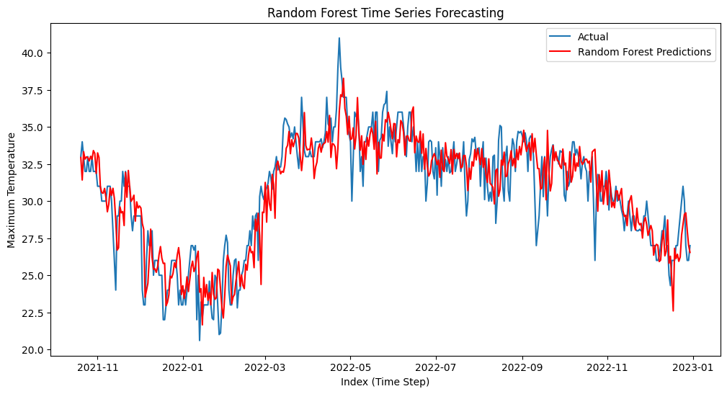
MACHINE LEARNING FOR WEATHER PREDICTION
Diagrams
⟮16⟯

Slide 18
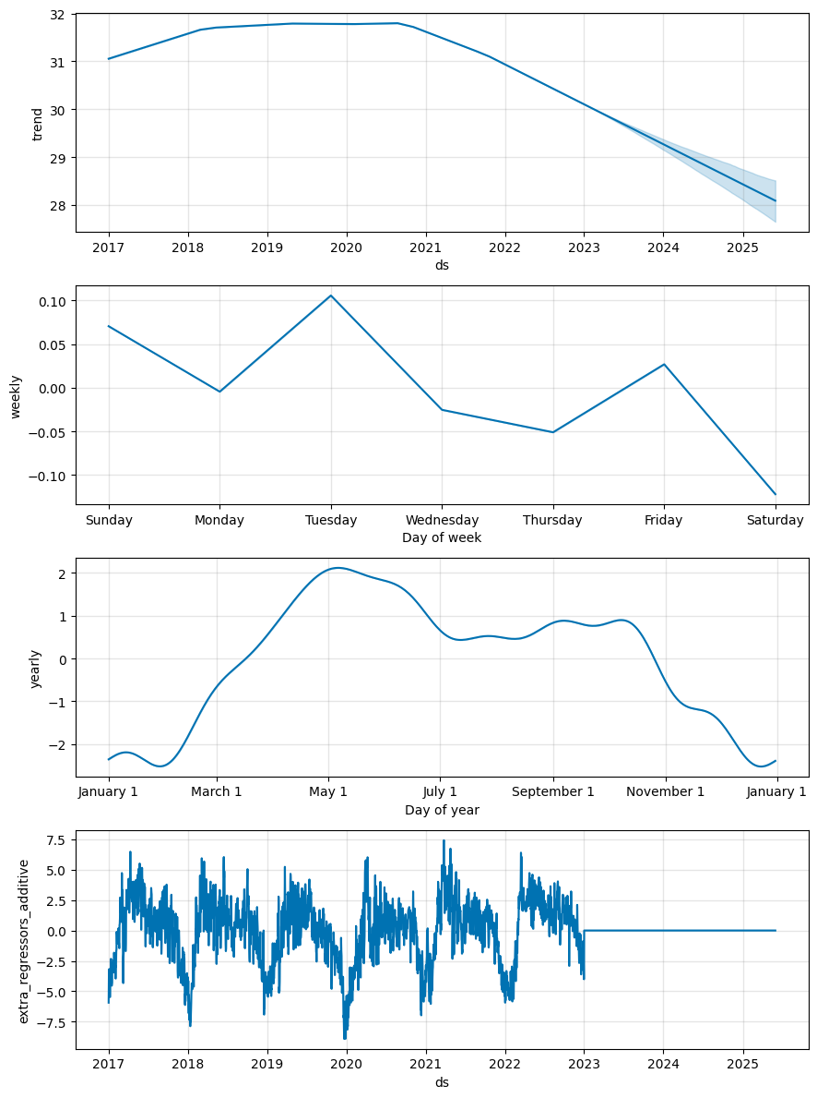
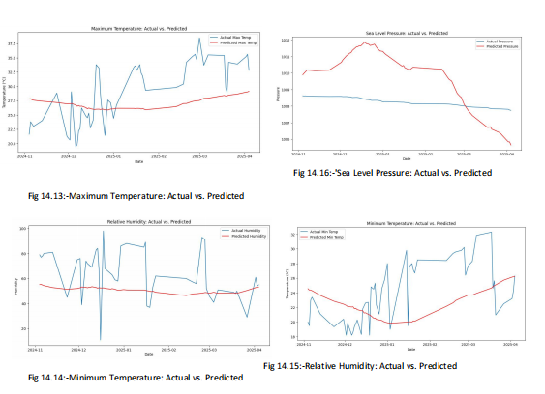
MACHINE LEARNING FOR WEATHER PREDICTION
⟮17⟯
Diagrams

Slide 19
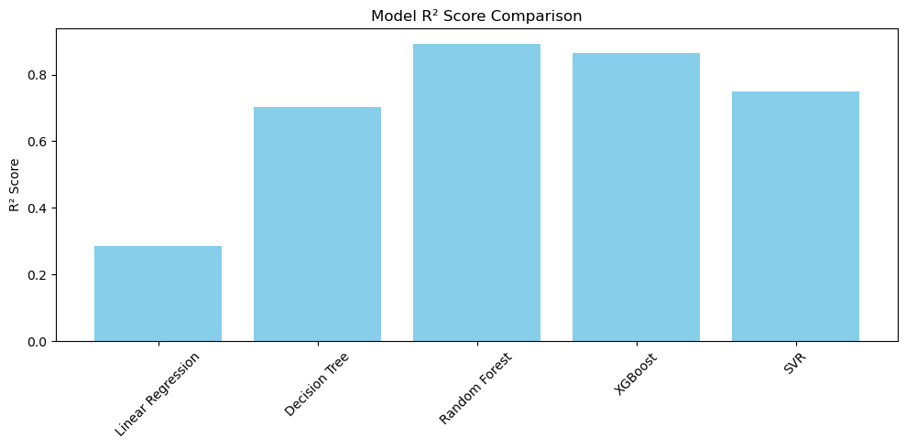
WEATHER PREDICTION METRICS
Model | Accuracy | Precision (Rain) | Recall (Rain) | F₁–Score (Rain)
Logistic Regression | 0.976878612716763 | 0.9925373134328358 | 0.9779411764705882 | 0.9851851851851852
Decision Tree | 1 | 1 | 1 | 1
Random Forest | 1 | 1 | 1 | 1
KNN | 0.976878612716763 | 0.9852941176470589 | 0.9852941176470589 | 0.9852941176470589
SVM | 0.9653179190751445 | 0.9710144927536232 | 0.9852941176470589 | 0.9781021897810219
Model | MSE | R² Score
Linear Regression | 29.944495688184375 | 0.6811424035886136
Random Forest | 5.417698684698235 | 0.9423107873088795
XGBoost | 9.16129938564439 | 0.9024478510999161
⟮18⟯
Tables & Diagram

Slide 20
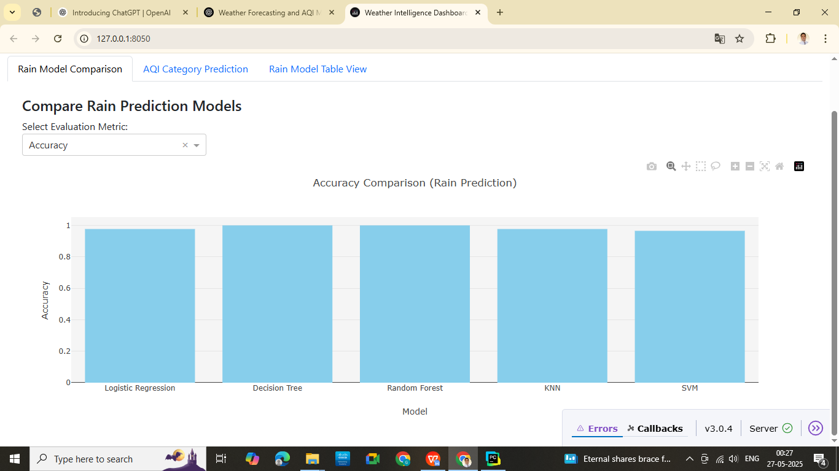
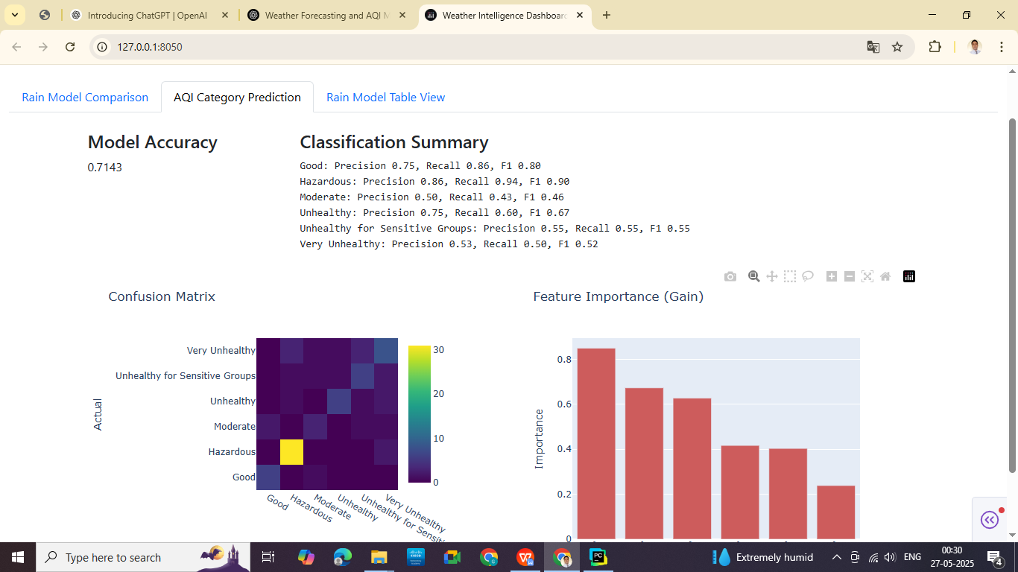
INTELLIGENT DASHBOARD
Intelligent Dashboards
⟮19⟯

Slide 21
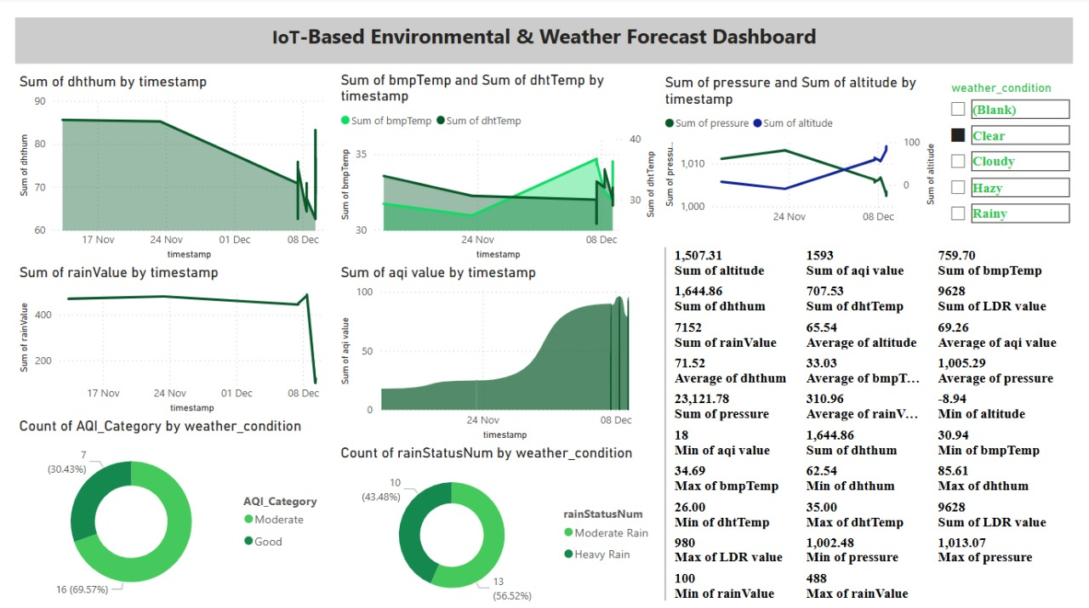
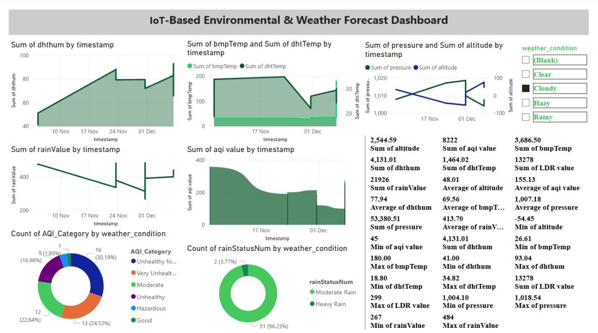
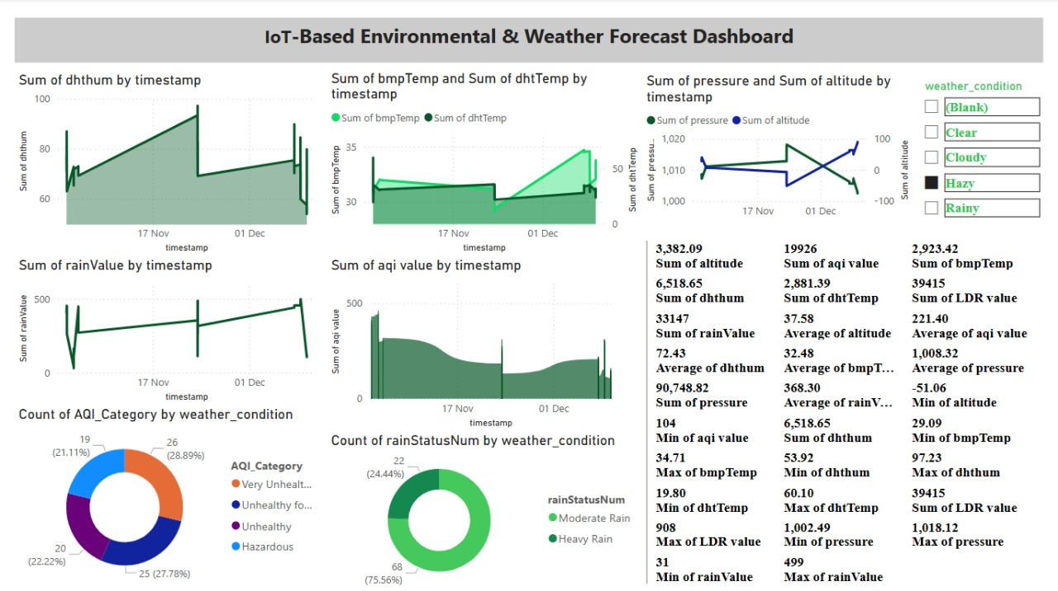
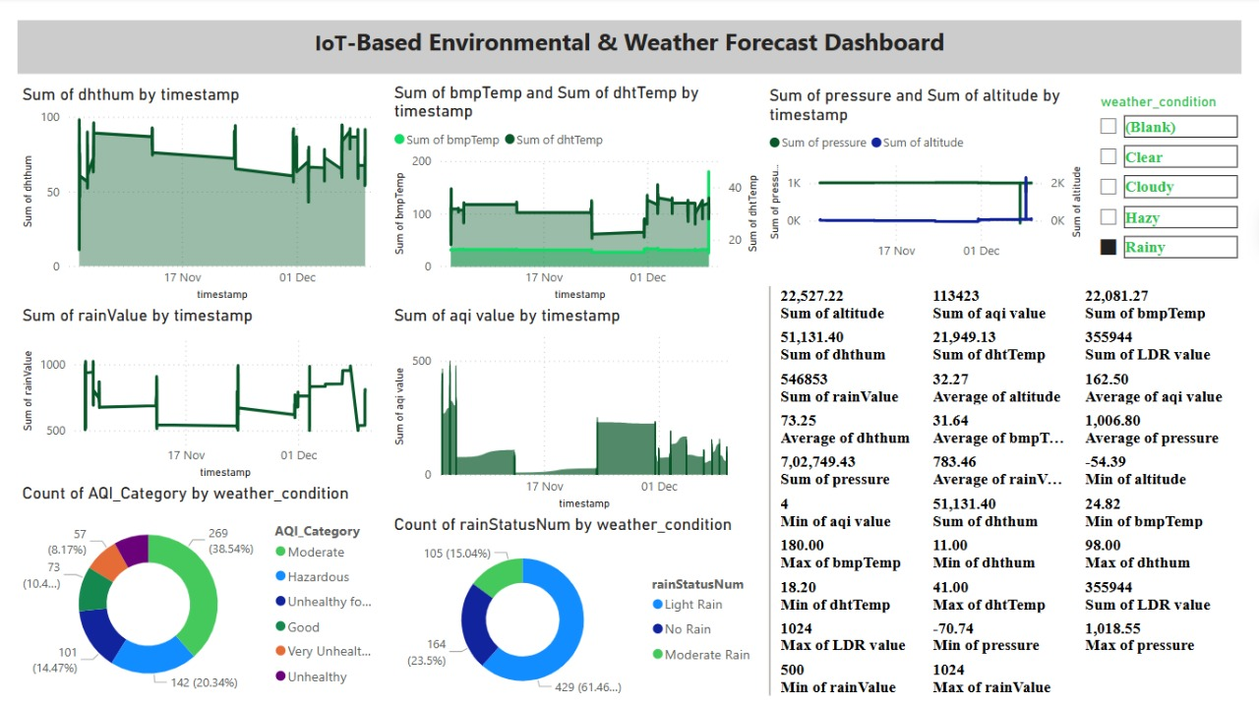
POWER BI VISUALISATION
⟮20⟯

Slide 22
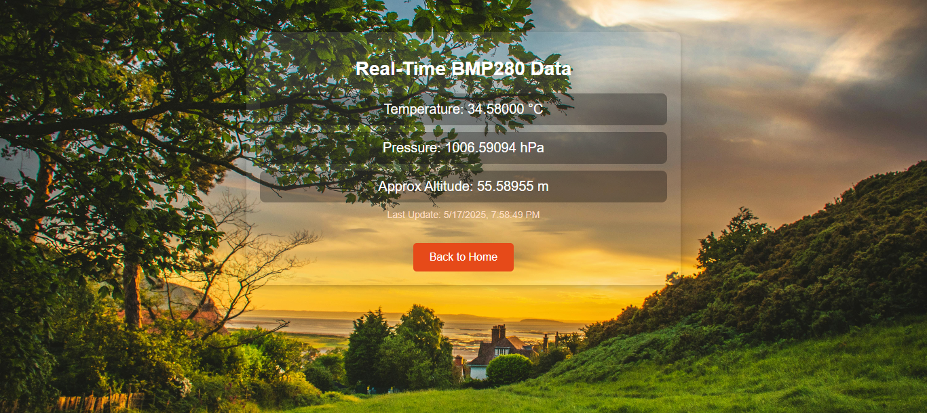
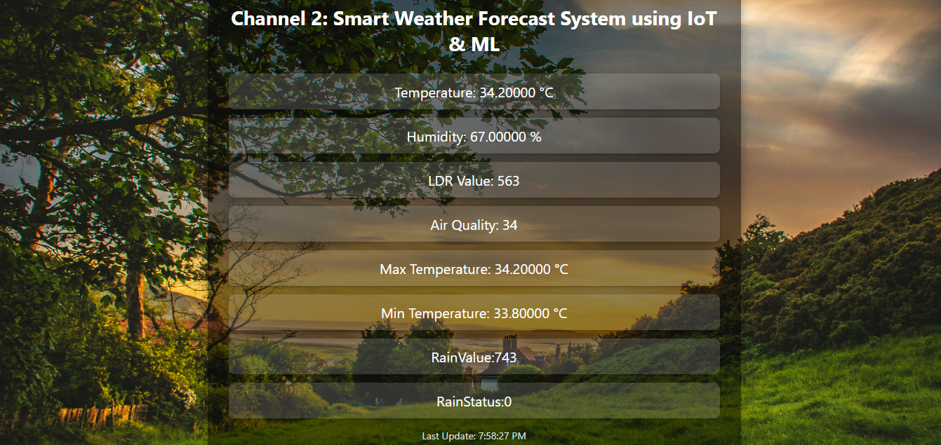
WEB SERVER VISUALISATION
Web Server Visualisation
⟮21⟯

Slide 23
ADDITIONAL FEATURES
Real–time Weather Data Collection : Continuously monitors parameters like temperature, humidity, pressure, and light intensity, providing up–to–date weather information.
Wireless Sensor Connectivity : Uses technologies like Wi–Fi, LoRa, Zigbee, or GSM to transmit data without physical connections, enabling remote deployment in any location.
Cloud–Based Data Storage : Collected data is sent to cloud platforms for secure storage, easy access, and long–term analysis from anywhere.
Alerts and Notifications : Sends SMS, email, or app notifications when extreme or abnormal weather conditions are detected, helping in quick decision–making.
Machine Learning–Based Predictions : Applies ML algorithms to analyze patterns and forecast weather conditions with higher accuracy over time.
Low Power Consumption : Designed for energy efficiency, often powered by solar panels or long–life batteries, making it ideal for remote or outdoor use.
Web and Mobile Dashboard Access : Data visualization dashboards are available through web browsers or mobile apps for convenient monitoring and control.
Scalable and Modular Design : Easy to expand the system by adding more sensors or deploying in multiple locations without major changes to the setup.
⟮22⟯

Slide 24
APPLICATIONS
Smart Agriculture : Helps farmers monitor weather conditions in real time, aiding in irrigation scheduling, pest control, and crop planning.
Disaster Management and Early Warning : Provides timely alerts for natural disasters like storms, heavy rainfall, or extreme heat, improving public safety and preparedness.
Smart Cities : Integrates with urban systems to monitor microclimates, air quality, and support environmental planning and traffic management.
Academic and Research Purposes : Offers accurate, real–time data for climate studies, student projects, and scientific experiments in environmental sciences.
Coastal and Marine Monitoring : Monitors weather near coastal areas, ports, and seas, helping in fishing, shipping, and beach safety operations.
Industrial Safety and Monitoring : Ensures safe environmental conditions in factories, warehouses, and chemical plants by tracking temperature and humidity.
Home Automation Systems : Adjusts smart home devices like air conditioners, fans, and heating systems based on real–time weather data.
Remote and Rural Area Monitoring : Useful in inaccessible areas without nearby weather stations to ensure timely data for local planning and safety.
⟮23⟯

Slide 25
ADVANTAGES
Reduced Field Damaging Conditions : Real–time weather alerts help prevent crop or equipment damage by enabling timely action during extreme weather like heavy rain, frost, or heatwaves.
Improved Safety and Security : Early warnings and environmental monitoring ensure the safety of people and assets, especially in agriculture, industry, or disaster–prone zones.
High–Quality Receiving Data : Advanced sensors and continuous monitoring provide accurate, precise, and reliable weather data for decision–making and forecasting.
Less Power Consumption : Designed with energy–efficient components, the system can run on low power, often supported by solar or long–life battery sources.
High Accuracy : Integration of IoT and machine learning leads to better data analysis and highly accurate weather predictions over time.
Smart Way to Monitor Environment : Automation and remote access make it easier to observe environmental conditions without manual effort, reducing human error.
Low Cost and Less Effort Required : Once deployed, the system requires minimal maintenance and human intervention, offering a cost–effective solution in the long term.
⟮24⟯

Slide 26
CHALLENGES & LIMITATIONS
Data quality and reliability : Inaccurate or missing data can affect decision–making.
High computational requirements : ML and analytics need strong processing power.
Data privacy and security : Risk of data breaches during wireless/cloud transmission.
High initial cost and maintenance : Sensors, infrastructure, and upkeep can be costly.
Data heterogeneity and integration : Difficult to merge data from diverse sources/sensors.
Limited coverage in remote areas : Poor connectivity affects real–time monitoring.
Unpredictable weather patterns : Weather is naturally chaotic, hard to model precisely.
Overfitting and model generalisation : ML models may perform well on training data but poorly in real–world scenarios.
Energy consumption : Continuous data collection may drain batteries or power sources.
Latency and real–time constraints : Delays in data transmission can hinder timely alerts.
Limited training data for rare events : Extreme weather events occur infrequently, limiting ML accuracy.
Environmental impact on IoT devices : Harsh conditions can damage sensors or reduce their accuracy.
Regulatory and compliance issues : Must adhere to data laws and communication regulations.
Limited interpretability of ML models : Complex models are hard to understand and trust.
Dependence on cloud and Internet connectivity : System fails or lags without reliable internet.
⟮25⟯

Slide 27
CONCLUSION
The Real–Time IoT Weather Forecast System using Machine Learning and Power BI Dashboard successfully integrates sensor–based data acquisition, real–time monitoring, intelligent forecasting, and interactive visualization to deliver a comprehensive weather prediction platform.
By utilizing IoT devices such as DHT sensors, BMP280, LDR, and rain sensors, the system captures key environmental parameters with high accuracy. The application of machine learning algorithms enables predictive insights such as future temperature trends, rainfall likelihood, and air quality classification.
The system's real–time visualization using Power BI ensures that users—from individuals to decision–makers—can easily interpret complex weather data and make informed choices.
This project not only demonstrates the potential of combining IoT and machine learning but also showcases how data analytics and business intelligence tools can transform raw data into actionable information.
In conclusion, the project addresses the growing need for accurate, accessible, and real–time weather forecasting. It offers scalable potential for smart agriculture, urban planning, disaster management, and environmental sustainability, making it a valuable contribution to the advancement of smart technologies in climate monitoring and prediction.
⟮26⟯

