Slide 1
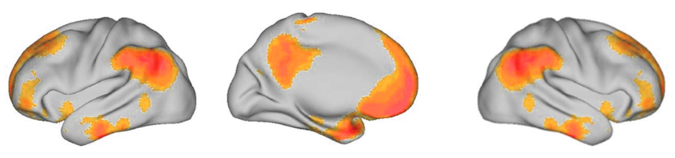
DMC: Global monitoring &
Information integration
vmPFC: Action consideration
OFC (BA10):
Stimulus-value
association
lTPJ: World semantics
OFC (BA11):
Reward
rTPJ: Predition error signaling
Hippocampus: memory,
space, & experience replay

