Slide 1
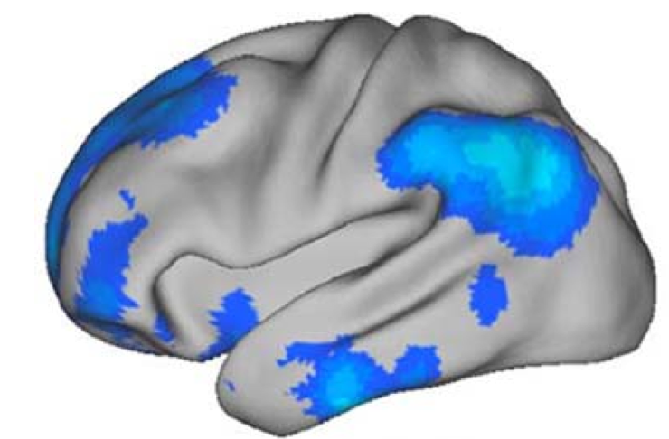
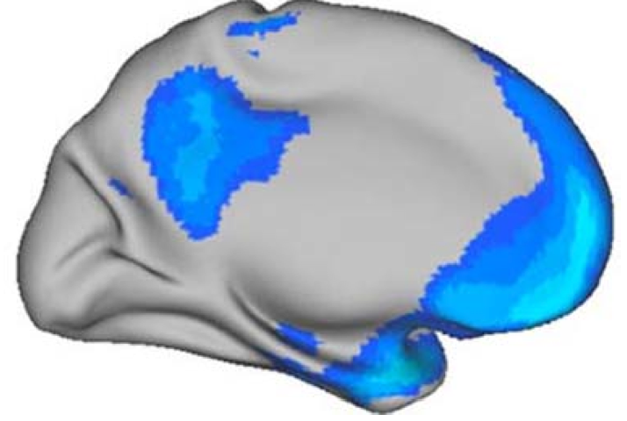
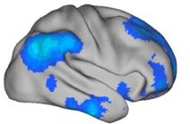


aversiveness
parameter update
Bellman equation
value function
world knowledge
reward
experience sampling
Predition error signaling

