Slide 1
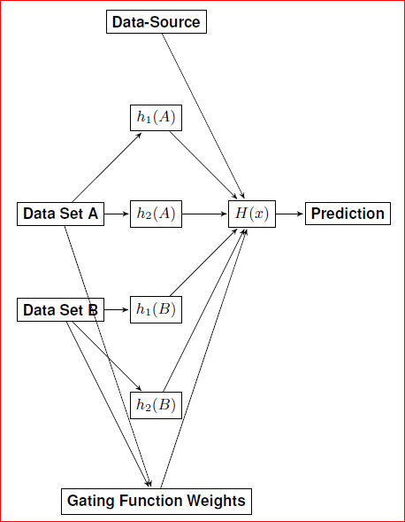
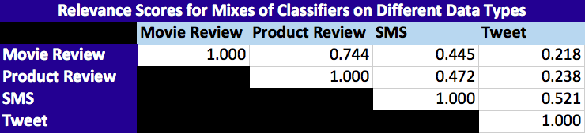
A Generalized 2-Layer Weighted Ensemble Classifier with Superior Text Sentiment Classification
For every dataset:
Partition into:
Training set
Validation set
Testing set
Train two classifiers per dataset
Calculate relevance on other datasets via difference in accuracy from testing on native data
Train 2nd layer on outputs of all 1st layer classifiers, data source, and gating function weights (relevance)

Slide 2
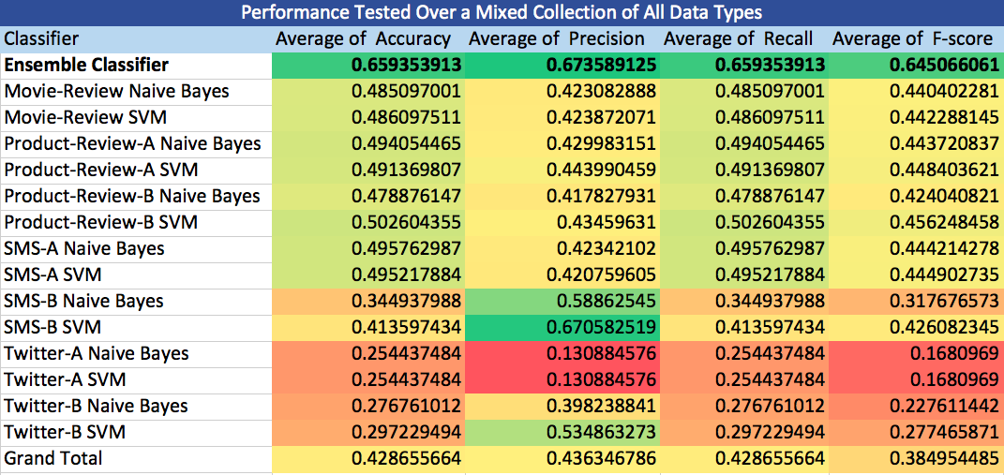
Averaged Accuracy, Precision, Recall & F-score

