Slide 1
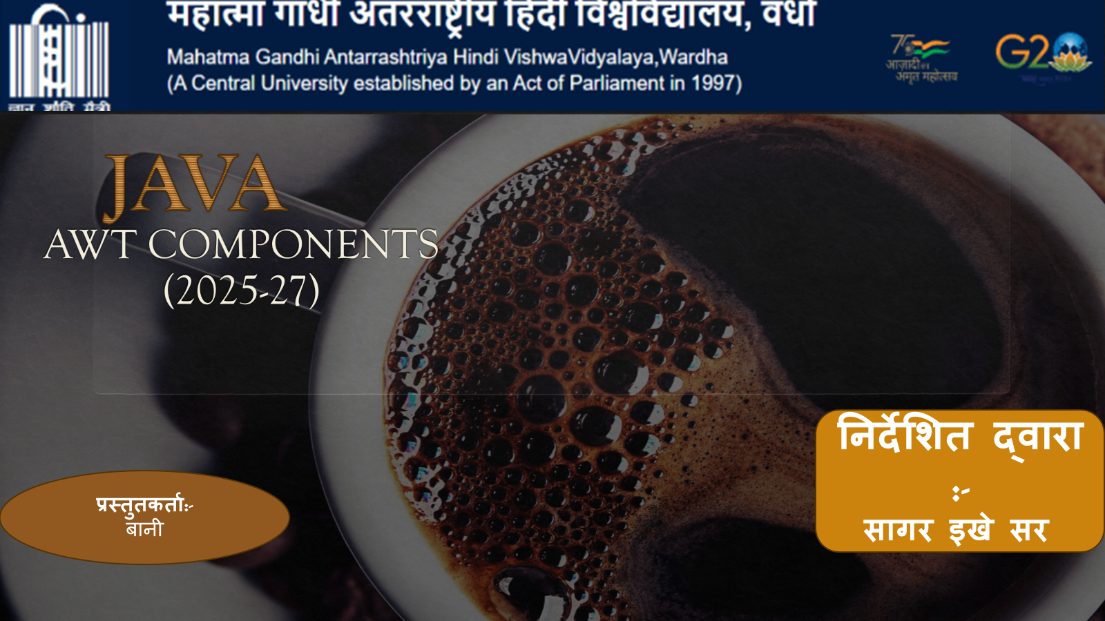

Slide 2

AWT Components
in Java
Abstract Window Toolkit — Building GUIs with Java’s Foundational Library

Slide 3
What is AWT?
The Abstract Window Toolkit — Java's original GUI framework
📦
Java Package —
Part of java.awt package, included in every JDK since Java 1.0
🖥️
Platform Dependent —
Uses native OS widgets — components look like native OS components
🔗
Heavy-Weight —
Each component has a native peer; directly tied to the OS windowing system
🏗️
Foundation —
Basis for Swing (javax.swing), which extends and improves upon AWT
📡
Event-Driven —
Uses delegation event model — listeners respond to user actions

Slide 4
AWT Class Hierarchy
Key classes and their inheritance relationships
Object
java.lang
Component
java.awt
Container
Button
Label
java.awt
java.awt
java.awt
Window
Panel
extends Container
extends Container
Frame
extends Window
AWT Component Hierarchy

Slide 5
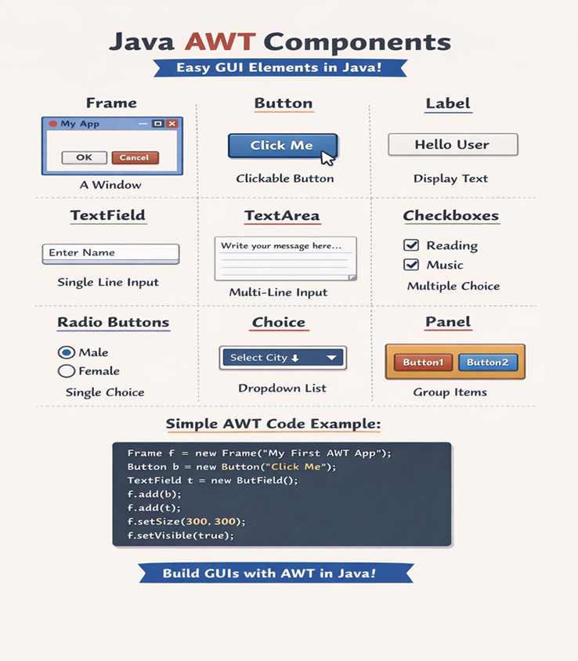

Slide 6
Container Components
Components that can hold other components
Frame
Panel
Top-level window with title bar and border. The primary container for AWT applications.
Generic container — no title bar. Used inside Frames to organize sub-components.
Frame f = new Frame("Title");
f.setSize(400, 300);
f.setVisible(true);
Panel p = new Panel();
p.setBackground(Color.GRAY);
frame.add(p);
Dialog
ScrollPane
Pop-up window for user interaction. Can be modal (blocks input) or non-modal.
Automatically adds scrollbars when content exceeds the viewport area.
Dialog d = new Dialog(frame,
"Info", true);
d.setSize(300, 150);
ScrollPane sp = new ScrollPane();
sp.add(largeComponent);

Slide 7
Button & Label
Basic interactive and display components
Button
Label
Clickable component that triggers actions
Generates ActionEvent on click
Supports setLabel() and getLabel()
Can be enabled / disabled via setEnabled()
Displays read-only, non-editable text
Supports LEFT, CENTER, RIGHT alignment
Can change text via setText() at runtime
Useful for form field labels and headings
Clickable component that triggers actions
Generates ActionEvent on click
Supports setLabel() and getLabel()
Can be enabled / disabled via setEnabled()
Displays read-only, non-editable text
Supports LEFT, CENTER, RIGHT alignment
Can change text via setText() at runtime
Useful for form field labels and headings
// Example
// Example
Button btn = new Button("Click Me");
btn.addActionListener(e -> {
System.out.println("Clicked!");
});
panel.add(btn);
Label lbl = new Label("Name:",
Label.RIGHT);
lbl.setFont(new Font("Arial",
Font.BOLD, 14));
frame.add(lbl);

Slide 8
Text Input Components
TextField, TextArea, and TextComponent
TextField
TextArea
TextComponent
Single-line text input
Multi-line text input
Abstract parent class
Single line of editable text
Multiple rows and columns
Base class for TextField & TextArea
setEchoChar() for password masking
SCROLLBARS_BOTH / VERTICAL / NONE
Common: getText(), setText()
addActionListener() on Enter key
append(), insert(), replaceRange()
select(), selectAll(), setEditable()
getText() / setText() methods
getCaretPosition() support
addTextListener() for changes
TextField tf = new TextField(20);
tf.setEchoChar('*'); // password
tf.addActionListener(e ->
process(tf.getText()));
TextArea ta = new TextArea(
"Default text", 5, 20,
TextArea.SCROLLBARS_VERTICAL);
ta.setEditable(true);
// TextComponent is abstract
// Common interface used by both:
component.setEditable(false);
component.selectAll();

Slide 9
Selection Components
Choice, List, Checkbox, and CheckboxGroup
▼ Choice (Dropdown)
☰ List
✓ Checkbox
A pop-up menu for single selection. Compact UI element.
Scrollable list. Supports single or multi-selection mode.
Toggle on/off. Use CheckboxGroup for radio-button behavior.
Choice c = new Choice();
c.add("Option A");
c.add("Option B");
c.addItemListener(e ->
use(c.getSelectedItem()));
List list = new List(4, true);
list.add("Item 1");
list.add("Item 2");
String[] sel =
list.getSelectedItems();
CheckboxGroup cg =
new CheckboxGroup();
Checkbox r1 = new Checkbox(
"Yes", cg, true);
Checkbox r2 = new Checkbox(
"No", cg, false);

Slide 10
AWT Layout Managers
How AWT arranges components automatically
FlowLayout
BorderLayout
GridLayout
Arranges left-to-right, wraps to next row. Default for Panel.
5 regions: NORTH, SOUTH, EAST, WEST, CENTER. Default for Frame.
Organizes in a grid of equal cells (rows × columns).
setLayout(new FlowLayout())
setLayout(new BorderLayout())
setLayout(new GridLayout())
CardLayout
GridBagLayout
null Layout
Stacks components like cards; show one at a time.
Flexible grid — cells can span multiple rows/columns.
Manual positioning using setBounds(x, y, w, h).
setLayout(new CardLayout())
setLayout(new GridBagLayout())
setLayout(new null Layout())

Slide 11
AWT Event Handling
Delegation Event Model — Events, Sources & Listeners
Event Source
(e.g., Button)
Event Object
(ActionEvent)
Event Listener
(ActionListener)
▶
▶
Common AWT Events & Listeners
Event Interface | Listener Method | Triggered By
ActionListener | actionPerformed() | Button click, menu select, Enter key
MouseListener | mouseClicked() / Pressed() | Mouse button press/release/click
KeyListener | keyPressed() / Released() | Keyboard key press or release
ItemListener | itemStateChanged() | Checkbox / Choice selection change
WindowListener | windowClosing() etc. | Window open, close, minimize events

Slide 12
Scrollbar & Canvas
Drawing, custom graphics, and scrollable ranges
🎨 Canvas
↕ Scrollbar
A blank rectangular area for custom drawing
VERTICAL or HORIZONTAL orientation
Override paint(Graphics g) to draw shapes, text, images
Range: minimum → maximum with block/unit increments
Supports Graphics methods: drawLine, drawRect, fillOval, drawImage
addAdjustmentListener() for value change events
Used as the base for animations and custom widgets
getValue() returns current scroll position
class MyCanvas extends Canvas {
public void paint(Graphics g) {
g.setColor(Color.RED);
g.fillOval(50, 50, 100, 100);
g.drawString("AWT!", 70, 110);
}
}
Scrollbar sb = new Scrollbar(
Scrollbar.VERTICAL,
0, // initial value
10, // visible amount
0, 100 // min, max
);
sb.addAdjustmentListener(e ->
use(sb.getValue()));

Slide 13
AWT vs Swing
Choosing the right GUI toolkit
Feature | AWT | Swing
Weight | Heavy-weight (native peers) | Light-weight (pure Java)
Look & Feel | Platform-native | Pluggable (Nimbus, Metal, etc.)
Components | Basic set (~20) | Rich set (JTable, JTree, JTabbedPane…)
Performance | Faster for simple UIs | More overhead, but more flexible
Portability | Minor rendering differences | Consistent across all platforms
MVC Support | Limited | Full Model-View-Controller
Status | Legacy / foundational | Preferred for desktop Java apps
💡 Swing extends AWT — understanding AWT is essential to mastering Swing

Slide 14
Key Takeaways
AWT Components in Java — Summary
🧱
Foundation
📦
Containers
AWT is the original Java GUI library — all Swing components build on it
Frame, Panel, Dialog & ScrollPane organize and host other components
🖱️
Basic UI
☑️
Selection
Button, Label, TextField, TextArea provide core user interactions
Choice, List, Checkbox, CheckboxGroup handle user selections
📐
Layouts
⚡
Events
Layout Managers (Flow, Border, Grid…) handle component positioning
Delegation model — Listeners on Sources handle user-triggered Events

Slide 15
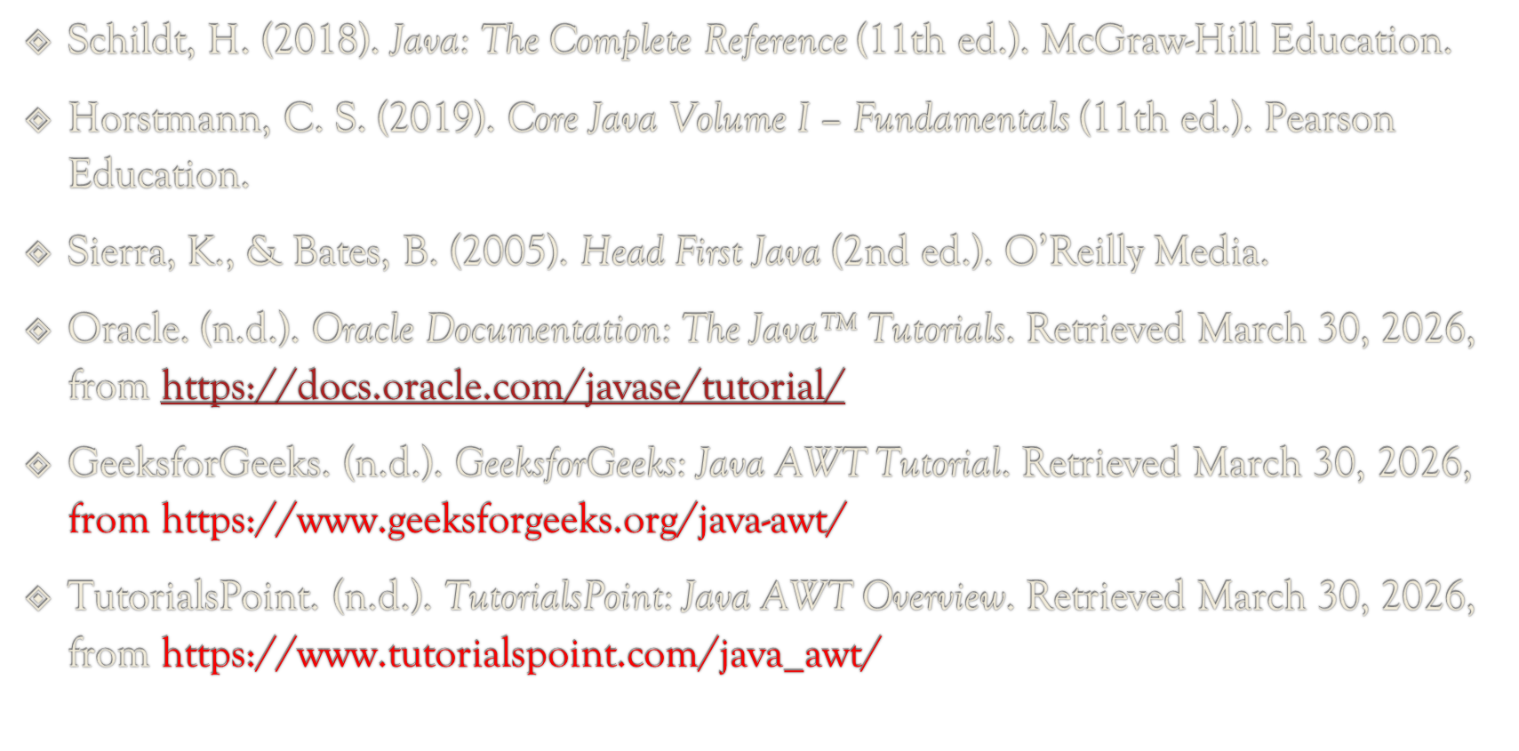
-:Refrences:-

Slide 16

This Photo by Unknown Author is licensed under CC BY

