Slide 1
DBSCAN Clustering Algorithm Machine Learning

Slide 2
Agenda
Introduction
DBSCAN
What is DBSCAN
Pictographical explanation
conclusion
Key Concepts:
How DBSCAN Works:

Slide 3

Banish J AI Developer, WEB Developer and APP Developer to know more about me check https://www.banish.in/

Slide 4
DENSITY BASED SPATIAL CLUSTERING APPLICATION
- DBSCAN

Slide 5
What is DBSCAN
DBSCAN - Density-Based Spatial Clustering of Applications with Noise
DBSCAN is a density-based clustering algorithm. It works by using two parameters:
Epsilon (ε):
The radius within which to search for points (measured in cm).
Minimum Points:
The minimum number of points required to form a cluster.

Slide 6
Key Concept:
Core Points:
A point is considered a core point if it has at least the specified number of points (Minimum Points) within the epsilon radius.
Border Points:
A point that does not have enough points within its epsilon radius to be a core point, but is within the epsilon radius of a core point.
Noise or Outliers:
Points that do not satisfy either of the above conditions.

Slide 7
How DBSCAN Works :
For each point in the dataset, draw a circle with a radius of epsilon.
Count the number of points inside the circle.
Classify the point as a core point, border point, or noise based on the count.
This method helps in identifying clusters of varying shapes and sizes and detecting noise in the dataset.

Slide 8
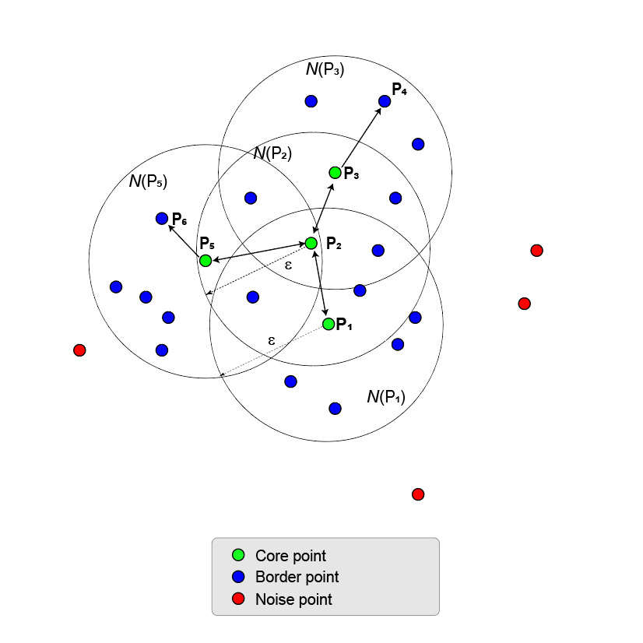
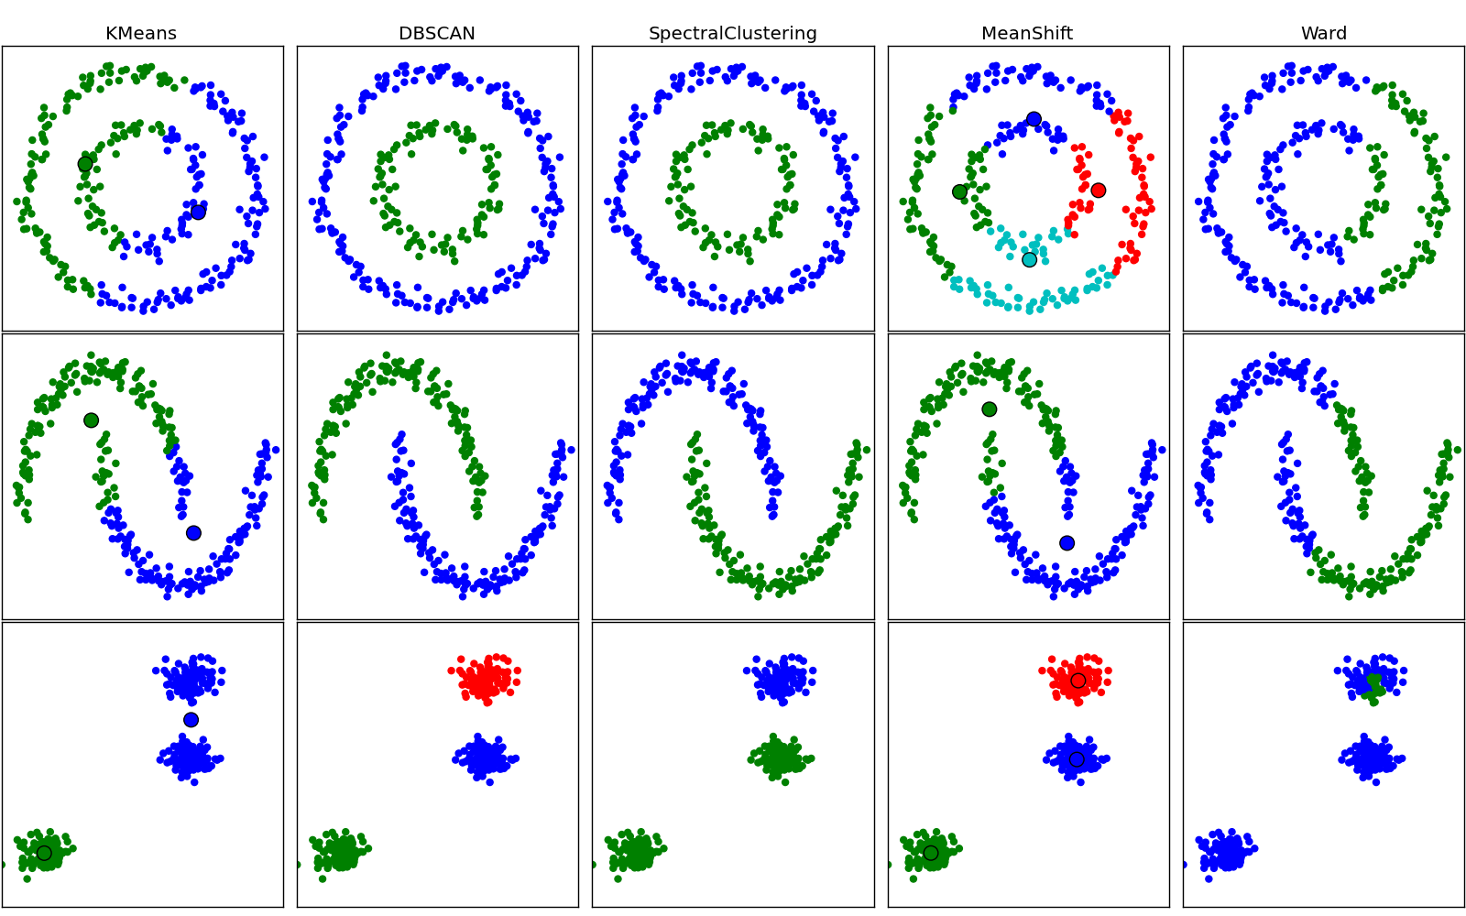
DBSCAN - Density Based Clustering Algorithm
D/B DBSCAN and other clustering algorithms

Slide 9
Thank you
Banish J
944-433-3914
mail@banish.in
www.banish.in

