Slide 1
HDBSCAN Clustering Algorithm Machine Learning

Slide 2
Agenda
Introduction
01
HDBSCAN
02
What is HDBSCAN
03
conclusion
06
Key Concepts:
04
How HDBSCAN Works:
05

Slide 3
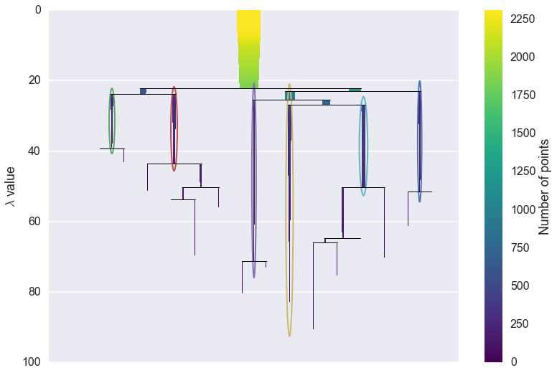
Hierarchical DENSITY BASED SPATIAL CLUSTERING APPLICATION
- HDBSCAN

Slide 4
What is HDBSCAN
HDBSCAN - Hierarchical Density-Based Spatial Clustering of Applications with Noise
HDBSCAN is a clustering algorithm that improves on DBSCAN by creating a hierarchy of clusters and doesn't need a fixed radius.
It uses two main parameters:
1. Minimum Cluster Size:
Minimum number of points needed to form a cluster.
2. Minimum Samples:
Minimum number of points to consider a point as dense enough.

Slide 5
Key Concept:
HDBSCAN finds clusters of different shapes and densities without needing a fixed search radius.
Core Distance:
The smallest distance at which a point is dense enough.
2. Mutual Reachability Distance:
A measure used to connect points into clusters.

Slide 6
How HDBSCAN Works :
Calculate Distances:
Measure how close points are to each other.
2. Build a Cluster Tree:
Create a tree structure showing how points group together at different distances.
3. Simplify the Tree:
Remove less important branches to focus on significant clusters.
4. Extract Clusters:
Identify clusters by finding stable groups in the simplified tree.

Slide 7

Thank You
Banish J
AI, WEB and APP Developer
☎️ 9444333914
📧 mail@banish.in
🌐 https://www.banish.in/

