Slide 1
OPTICS Clustering Algorithm Machine Learning

Slide 2
Agenda
Introduction
01
OPTICS
02
What is OPTICS
03
conclusion
06
Key Concepts:
04
How OPTICS Works:
05

Slide 3
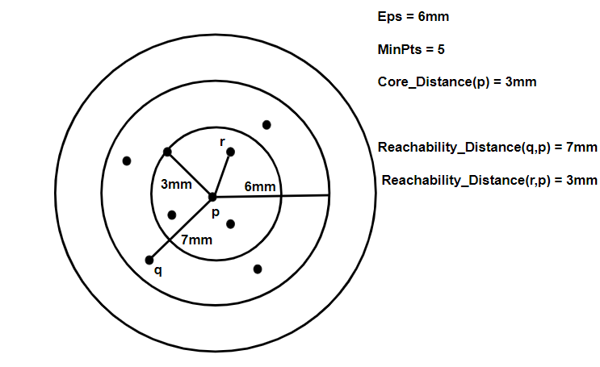
Ordering Points To Identify the Clustering Structure
- OPTICS

Slide 4
What is OPTICS
OPTICS - Ordering Points To Identify the Clustering Structure
OPTICS is a density-based clustering algorithm similar to DBSCAN but more versatile in detecting clusters with varying densities. It uses two main parameters:
1. Epsilon (ε):
Maximum radius to consider for clustering.
2. Minimum Points:
Minimum number of points to form a cluster.

Slide 5
Key Concept:
OPTICS finds clusters of different shapes and densities without needing a fixed search radius.
Core Distance: The smallest distance at which a point is a core point.
Reachability Distance: Distance used to reach a point from another point.

Slide 6
How OPTICS Works :
1. For each point, determine the core distance
(distance to the ε-nearest neighbor that makes the point a core point).
2. Order the points based on their reachability distances.
3. Extract clusters by analyzing the reachability plot, where valleys represent clusters.
This algorithm effectively identifies clusters of varying densities and structures within the data.

Slide 7

Thank You
Banish J
AI, WEB and APP Developer
☎️ 9444333914
📧 mail@banish.in
🌐 https://www.banish.in/

