Slide 1
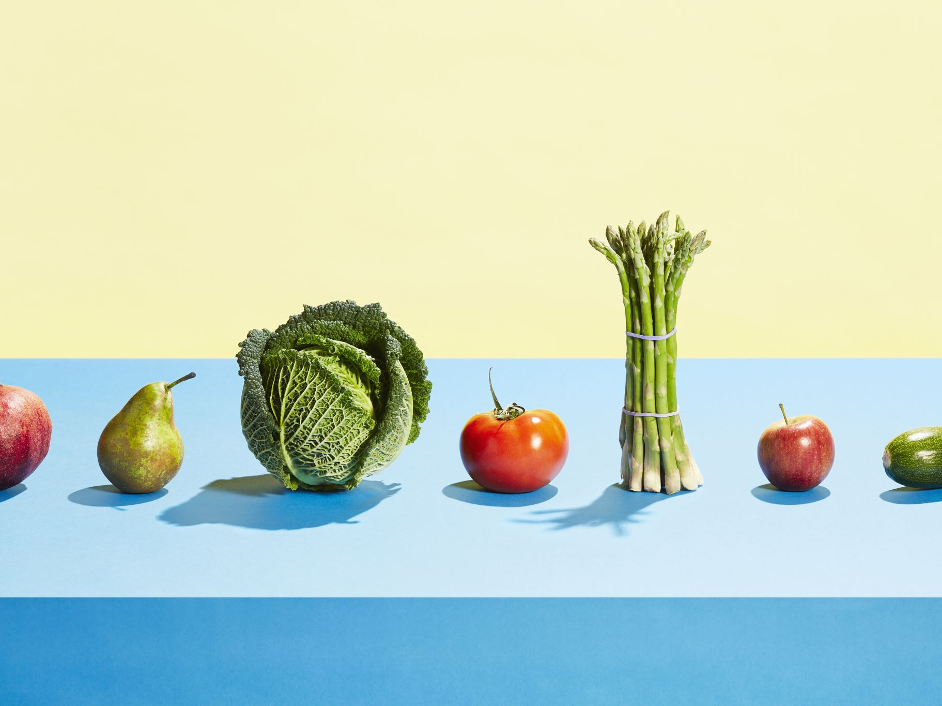
Scan For Vegetarian Diet
Project Presentation
Presented by: Mahesh Baniya

Slide 2

Application Architecture
Front-End: AngularJS
Back-End: FastAPI
Database: MongoDB or SQL
Data Flow:
- Front-End ➔ Back-End ➔ Database

Slide 3
Core Features of Scan For Vegetarian Diet
- Ingredient Scanning
- Vegetarian Verification
- User-Friendly Interface

Slide 4
Technical Implementation
1. Vegetarian-checking Algorithm:
def is_vegetarian(ingredient):
vegetarian_ingredients = ["carrot", "potato", "broccoli"]
return ingredient.lower() in vegetarian_ingredients
2. FastAPI Endpoint:
@app.get("/check_ingredient")
def check_ingredient(name: str):
result = db.get_ingredient_status(name)
return {"ingredient": name, "is_vegetarian": result}
3. Database Structure:
{
"ingredient": "carrot",
"category": "vegetarian"
}

Slide 5
User Interface and UX Principles
- Clean and intuitive interface
- Simplified design for easy navigation
- Accessible display of ingredient status
Feedback from one-on-one meeting:
- Improved results display for clarity

Slide 6
Conclusion and Future Improvements
Summary:
- *Scan For Vegetarian Diet* aims to make dietary choices easier for vegetarians.
Future Updates:
- Add more dietary options (vegan, gluten-free)
- Enhance ingredient recognition
Thank you!

