Slide 1

RESTful APIs
How are REST principles applied to APIs?

Slide 2
What is a RESTful API?
Applies REST architecture principles to API design.
Client-Server: User interface and data storage are separated.
Stateless: Requests from the client must contain all information necessary to understand the request. Requests cannot use context that might be stored on the server.
Cacheable: Implicitly or explicitly label response data as cacheable or non-cacheable. Clients are allowed to reuse cached data for other later requests
Layered: REST architecture has layers with hierarchy. Components can only see what’s in the layer they’re interacting with.
Uniform Interface: The software engineering principle of generality makes the architecture simple and interactions visible
Code on Demand: Enhance client functionality with scripts or applets. This is optional.

Slide 3
What’s so great about RESTful APIs?
Use HTTP methods, so nothing new has to be created. HTTP methods are also descriptive, making it easier to tell what’s happening.
Breaks the API down into components, allowing updates or expansions without refactoring the whole API.
Modularity allows developers to work on specific pieces of the API. This could make development or deployment faster.
RESTful APIs generally use less bandwidth than SOAP (a competing design standard), making them ideal for web applications.
RESTful APIs can return data in many formats, such as JSON, XML, plain text, and many others.
Can also be applied to developing cloud based applications.

Slide 4
And what’s not so great about them?
There isn’t a standardized set of rules dictating exactly what makes a RESTful API.
REST’s design constraints mean it simply can’t meet some design needs.
Complicated APIs have a lot of components, which can be difficult to maintain and troubleshoot.
There is a definite learning curve associated with creating RESTful APIs. Development might be slow at first.
RESTful APIs should only use HTTP methods. This may limit what the API can do.
Even some HTTP methods are unevenly supported. It’s important to be aware of users’ software and its capabilities.

Slide 5
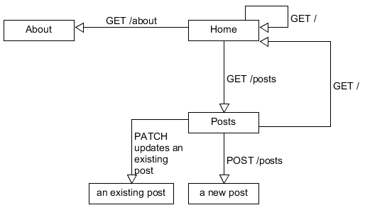
How do you communicate with a website?

Slide 6
Can you explain that diagram?
The HTTP GET method is used to load the home page.
The HTTP GET method is used to load posts.
The HTTP GET method is used to load the about page.
The HTTP POST method is used to create a new post.
The HTTP PATCH method is used to edit an existing post.
The HTTP GET method is used to navigate from posts back to home.

Slide 7
What are the best choices for HTTP methods?
To get data, use GET.
To create something new, use PUT.
To modify an existing resource, use POST.
To delete a resource, use DELETE.
PATCH can be used to partially update a resource. Patch can be more efficient, but it’s less evenly supported.
There are no strict rules defining which HTTP methods RESTful APIs must use.

Slide 8
How do you use a RESTful API?
RESTful APIs work by breaking transactions down into components called modules.
A module only handles a small part of the transaction.
Each information request is part of the transaction.
RESTful APIs have taken over the web because they use less bandwidth than SOAP.
Cloud applications also use RESTful APIs for similar reasons.
Modularity allows for flexible, fast development and deployment.

Slide 9
What’s a URI? What’s a URL?
All URLs are URIs. Not all URIs are URLs.
URLs are a subset of URIs.
A URI is a Uniform Resource Identifier.
A URI is just the name of the resource.
A URL is a Uniform Resource Locator.
A URL tell a client how to get to the resource.
If a URI tells the client how to reach the resource, it’s also a URL.

Slide 10
Where did you get this information?
https://restfulapi.net/
https://www.mulesoft.com/resources/api/restful-api
https://www.restapitutorial.com/lessons/httpmethods.html

