Slide 1

JSON APIs
JavaScript Object Notation Application Programming Interface

Slide 2
requires use of the JSON:API media type (application/vnd.api+json)
requires use of the JSON:API media type (application/vnd.api+json)
What is a JSON API?
JSON is referred to as a lightweight format to store and transport data.
JSON is written in plain text.
JSON API defines how a client requests information from a server and how the server responds.
Is designed to provide an efficient and standard (optimized) means by which the clients and servers communicate.
Clients and servers send JSON API data in request documents with the same header.
Requires the use of media type (application/vnd.api+json)
JSON API is backwards compatible.

Slide 3
What are JSON API Benefits?
Compund Documents – Allows servers to send related resources with the primary resources requested.
Decreases number of HTTP requests.
Sparse Fieldsets – Allows clients to request data from only specific fields.
Optionality – Many JSON API features are optional and can be turned on/off.
Optimization Features – Example of server side options are sorting and pagination.
Caching – Ability to utilize this feature built into HTTP.

Slide 4
How is JSON Similar to SOAP?
Both are programming language independent.
Both facilitate standardized communication between client and server.
Both have a specific format that must be used to structure data exchange.
Both have mandatory and optional information.
JSON uses key value pairs to store data. SOAP uses XML tags.

Slide 5
How is SOAP Different From JSON?
SOAP formatting requirements are more stringent than JSON.
SOAP requires more bandwidth than JSON due to its data structure specificity.
SOAP messages are larger in size.
JSON offers styling that SOAP does not.
SOAP can be used for XML messaging, exchanging documents, and message broadcasting; JSON cannot.
SOAP’s structure references an envelope, JSON contains a body.

Slide 6
What is a JSON Request Header?
All JSON API data sent from the client must be sent with the header Content-Type: application/vnd.api+json
The request shouldn’t include any media type parameters
There are specific HTTP status codes the server will respond with for incorrect or malformed header information (4XX)
Media parameters will cause the server to respond with an error, unless the header includes at least one instance with no parameters.
These errors allow the client to see what went wrong with the header formatting.
Different problems with the header will result in different error codes, making issues easy to diagnose.

Slide 7
What is a JSON Request Body?
The client sends a JSON request to the server
The request body must contain data, errors, or meta.
The request body can’t contain both errors and data.
Data represents the information being requested from the server.
Errors is an array of error objects, representing what went wrong.
Meta is an object that contains other information related to the request
The body may also optionally include jsonapi, links, and included

Slide 8
What is a JSON Response Body?
The server responds to a request with a response
Responses are very similar to requests, but they contain the information requested, or if something goes wrong, errors.
As with requests, data and errors can’t both be present.
The response body may contain jsonapi, links, and included, just like the request.
Jsonapi explains the server implementation.
Links is an object containing links related to the main data of the response.

Slide 9
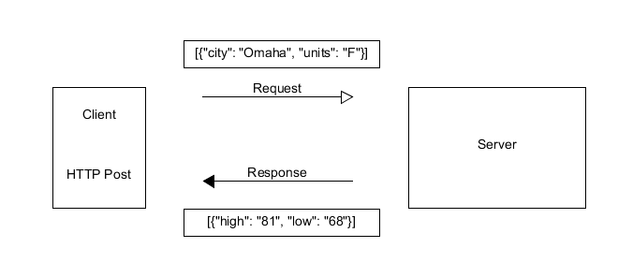
JSON API Data Flow Example (end-to-end)

Slide 10
Where did you get this information?
https://www.w3schools.com/js/js_json_intro.asp
https://nordicapis.com/the-benefits-of-using-json-api/
https://jsonapi.org/format/#introduction
https://www.educba.com/json-vs-soap/

