Slide 1

Open Authentication OAuth

Slide 2
What is OAuth?
Stands for Open Authentication
There are two versions: OAuth 1.0 and OAuth 2.0
Not an API or service
An open protocol/framework for authorization that applications (REST/APIs) can use for client applications with “secure delegated access” [2]
More secure than client-server authentication model because you do not have to reveal credentials (username/password)
A client requests access to a resource utilizing credentials that are different than the resource owner’s credentials

Slide 3
How does OAuth Work?
Access token based. Tokens contain/specify:
Scope
Lifetime
Access attributes
Works over HTTPS
Overview [2]:
Application requests user authorization
User authorizes/delivers proof
App provides proof of authorization to server to obtain a token
Token is restricted to access what the user is authorized for within the application

Slide 4
History of OAuth?
Started ~ November 2006 during Twitter OpenID implementation
April 2007: Google group created to write proposal for open protocol
July 2007: Initial specification drafted
October 3, 2007: OAuth Core 1.0 final draft released
From the beginning, OAuth has had strong backing from some very popular businesses:
Twitter
Google
OAuth Popularity Today: Amazon, Facebook, Instagram, LinkedIn, Microsoft, Netflix, Paypal

Slide 5
OAuth 1.0?
Cannot be used with OAuth 2.0
Grew out of work done by Flickr (FlickrAuth) and Google (AuthSub).
Works best for web applications and may provide a less than ideal experience for other applications, including mobile.
Two part access strings: public string and private string.
Four roles: Consumer, User, Authorization Server, and Service Provider.
May not be easy to scale due to generating credentials that are unused and the need for multiple state management steps across several different servers.

Slide 6
OAuth 2.0?
Not backwards compatible with OAuth 1.0
Creation discussions included discussion with many different companies including Salesforce, Google, Facebook, Intuit, Mozilla, Twitter, Microsoft, and Mozilla.
Built to work with many different implementations, including mobile devices, IoT, SPAs, and more.
Separates responsibility for authorization policy and authentication.
Issues credentials only when the application gets authorization from the user.
Only uses access tokens for API calls.
Servers don’t need to know anything about the client credentials; all they care about is the token.
Better scaling due to difference in credential creation and decoupling.

Slide 7
Why is OAuth Popular?
Workflows for many common situations.
Already widely adopted, so finding a service provider is simple.
Developed by a wide variety of industry leaders, creating a standard that’s useful across a broad range of implementations.
Works well with RESTful API design.
Easy to scale individual components to meet needs.
OAuth is extensible. PKCE helps OAuth 2.0 work with applications that don’t use a client secret. OpenID Connect is built on OAuth 2.0.

Slide 8
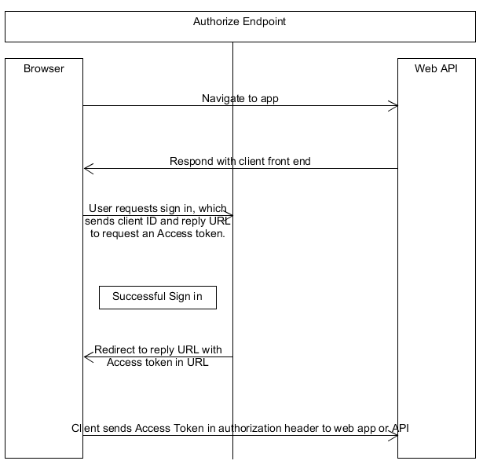
Data Flow API Example [1]?
Notes:
Replication of diagram contained within [2] https://developer.okta.com/blog/2017/06/21/what-the-heck-is-oauth

Slide 9
Example Explained?
App within browser initiates authorization request
User approves request
Service redirects back to the application
Application exchanges auth code for an access token
Authorization is granted or denied
If error is determined, error response may occur during authorization

Slide 10
Where did you get this information?
https://www.csoonline.com/article/3216404/what-is-oauth-how-the-open-authorization-framework-works.html
https://developer.okta.com/blog/2017/06/21/what-the-heck-is-oauth
https://www.oauth.com/oauth2-servers/server-side-apps/example-flow/
https://oauth.net/1/
https://oauth.net/2/
https://oauth.net/about/introduction/#:~:text=OAuth%20started%20around%20November%202006,Twitter%20API%20to%20delegate%20authentication.
https://tools.ietf.org/html/rfc5849
https://tools.ietf.org/html/rfc6749

