Slide 1

SOAP
Simple Object Access Protocol

Slide 2
What is SOAP?
SOAP is an acronym for Simple Object Access Protocol
Standardized XML based protocol for exchanging information
Standardized web service
SOAP encodes/decodes in a decentralized, distributed environment.
Standardizes the communication between servers.
SOAP is extendable and widely supported.
Since SOAP is posted over HTTP using request/response model, able to get past firewalls
SOAP client initiates the request to a SOAP server that then sends a response back to the client.

Slide 3
What is the history of SOAP?
XML (used in SOAP) was created in 1997
SOAP was created one short year later in 1998 as developers recognized a need for a more refined means of computers talking to each other, more than what XML offered.
Employees at Microsoft created SOAP.
XML-RPC (remote procedure call), a lightweight version of SOAP was released in April 1998, marking the creation of web services.
SOAP became a W3C Recommendation May 8, 2000 with Microsoft and IBM as its allies.
In 2000s, companies such as Salesforce, Yahoo, and eBay utilized SOAP which allowed any developer to connect to their website. At the same time, REST was coming out as a competitor to SOAP.

Slide 4
What are SOAP Envelopes?
A SOAP envelope is required and is what marks the XML as a SOAP message.
An envelope is marked by the opening and closing tags <soap:Envelope> Example SOAP envelope [4]
<?xml version="1.0"?> <soap:Envelope xmlns:soap="http://www.w3.org/2003/05/soap-envelope/" soap:encodingStyle="http://www.w3.org/2003/05/soap-encoding"> ... Message information goes here ... </soap:Envelope>
Attribute ”xmlns:soap namespace” always contains the same link "http://www.w3.org/2003/05/soap-envelope/".
Attribute “encodingStyle” defines the document data types.
All additional elements follow the body of the message.

Slide 5
What are SOAP Headers?
A SOAP header is optional.
XML element directly after the SOAP envelope.
Contains application specific information or add new functionality.
Payment
Authentication
Data expiration information
Attribute Actor specifies recipient of the SOAP header.
Attribute MustUnderstand states whether a header is optional or mandatory.
Attribute encodingStyle defines all of the data types used in the document.

Slide 6
What are SOAP Faults?
Optional element that returns error messages for SOAP messages.
Contains errors and status information.
If present, is a child element of Body element; however, can only appear once.
Possible sub elements:
<faultcode> - class of errors in the form of a code
<faultstring> - text that explains the error
<faultfactor> - who caused the fault
<detail> - application specific error messages
SOAP fault linked to 500-599 status code.

Slide 7
Do you have some fault code examples?
Codes that provide additional information about the fault.
Fault codes must be placed within the <faultcode> element
SOAP-ENV:VersionMismatch – indicates an invalid namespace
SOAP-ENV: MustUnderstand – indicates that an immediate child element of Header was not understood if set to “1”
SOAP-ENV: Client – indicates there was a problem with how the message was written
SOAP-ENV: Server – indicates there was a problem with the server

Slide 8
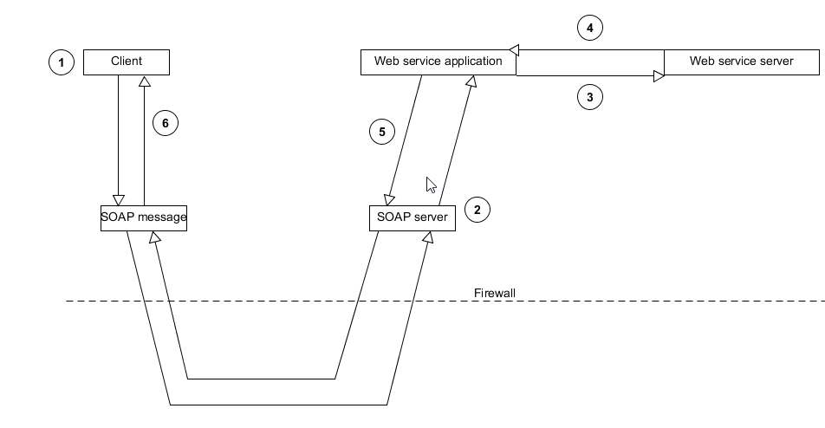
SOAP UI Data Flow Example

Slide 9
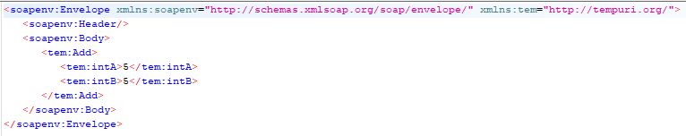
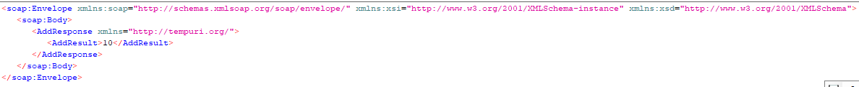
SOAP Example
Request:
Response:

Slide 10
Where did you get this information?
https://docs.oracle.com/cd/A97335_02/integrate.102/a90297/overview.htm
https://www.techrepublic.com/article/an-introduction-to-the-simple-object-access-protocol-soap/
https://thehistoryoftheweb.com/soap-rest-odds/
https://www.tutorialspoint.com/soap/soap_examples.htm
https://www.tutorialspoint.com/soap/soap_fault.htm
https://www.tutorialspoint.com/soap/soap_header.htm
https://www.w3schools.com/xml/xml_soap.asp
https://www.xml.com/pub/a/ws/2001/04/04/soap.html

