Slide 1
Women in the Workforce
Yihua Leng

Slide 2
What factors influenced women's working statuses over the past two decades?
Data source: General Social Survey
Demographic attitudes and living conditions of residents in United States since 1972
Face-to-face interview at the University of Chicago
Open to the public

Slide 3
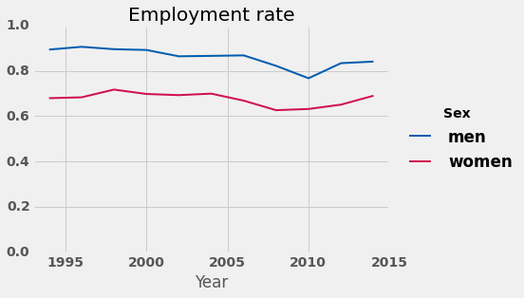
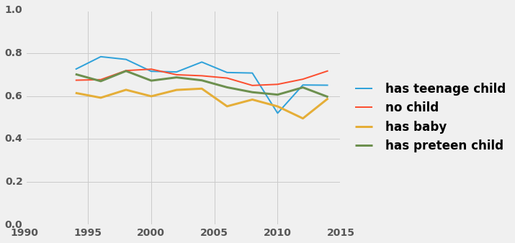
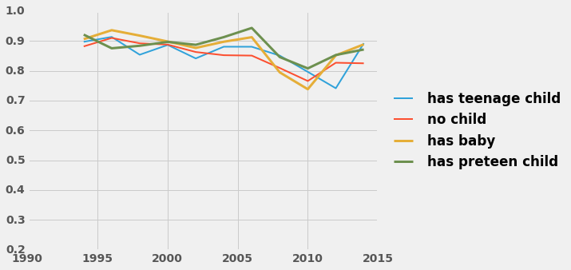
Female Employment Rates by Family Status
Men vs Women
Employment: 1994 ~ 2014
z-test
z-score: -32.78
p-value: 0.0

Slide 4
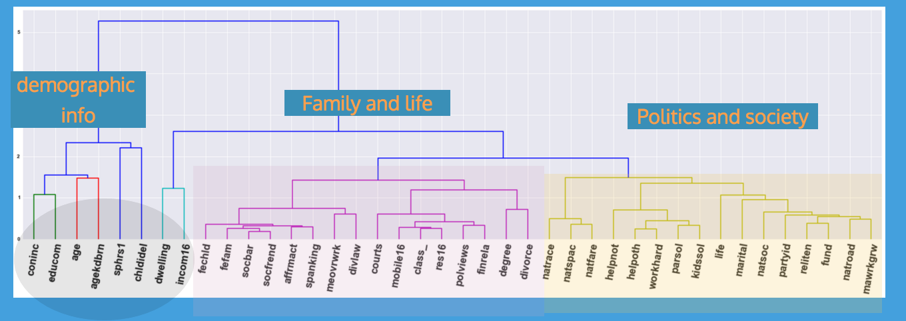
Among the women with children under thirteen, which ones are working?
General Social Survey data:
160 survey questions
40 Important questions
Random Forest
Classification Model
Target: Employment Status

Slide 5
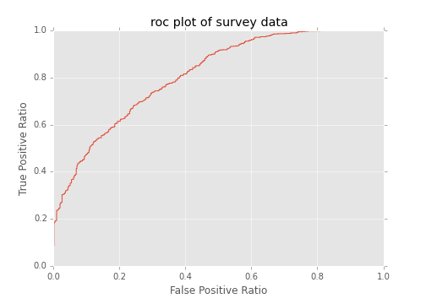
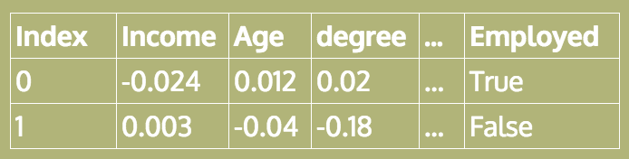
Random Forest
40 Features
roc_auc_score
0.81
Feature Engineering
Grid Search
Tree Interpreter
Feature Contribution Matrix

Slide 6
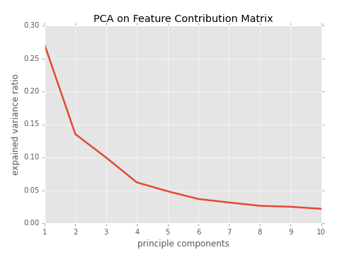
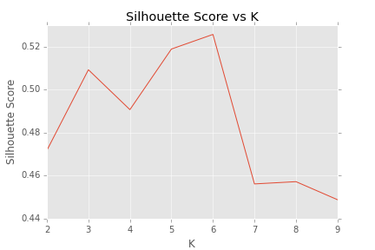
Decision Paths in Feature Contribution Matrix: Kmeans Clustering
Principle Component Analysis (PCA)
2. Kmeans
Three principle components
Number of cluster 6
Average Silhoutte score: 0.53

Slide 7
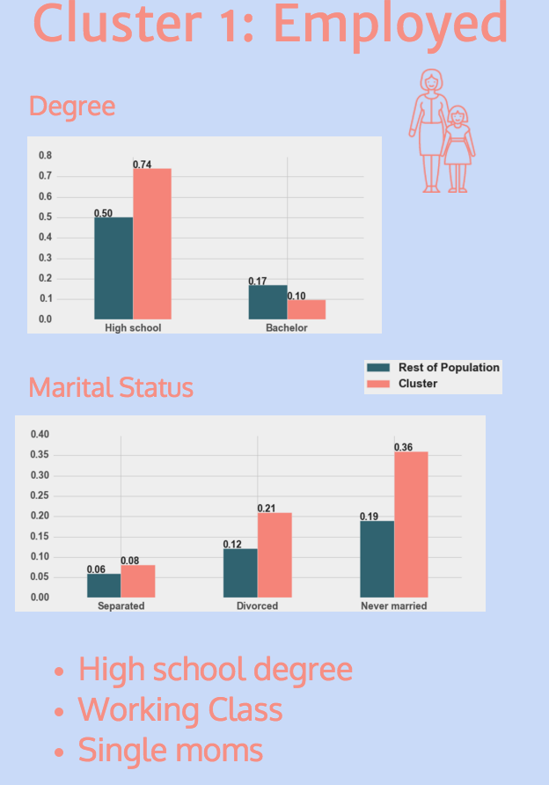
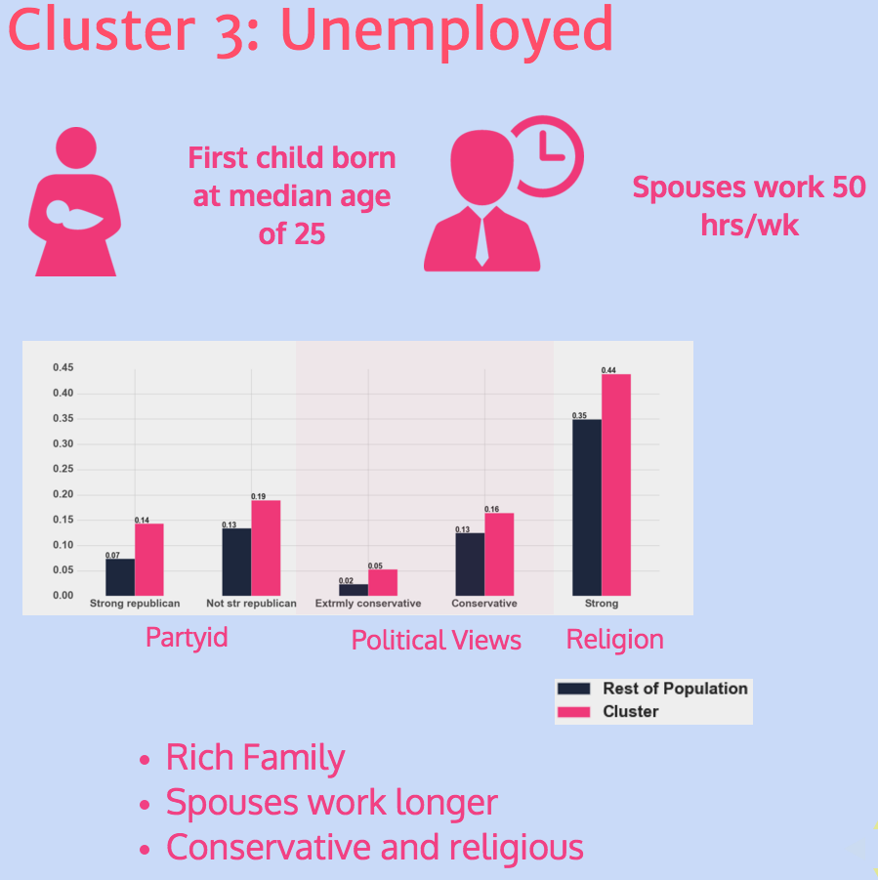
Cluster vs Rest of population

Slide 8
Results
Unemployed
Cluster 1: have children early, poor education, lower class
Cluster 2: have children late, rich family, spouses work over time
Cluster 3: High school degree, working class, spouses work full time
Employed
Cluster 4: have children early, less than high school education, blue-collar worker
Cluster 5: have children late, college degree or above, diverse political views
Cluster 6: High school degree, working class, single mom

Slide 9
Conclusions
Key Factors:
Highest degree earned
Spouse's working hours
Family's socioeconomic background
Age when having first child

Slide 10
Thank You
github.com/banjopickin/women_workforce
yihualeng@gmail.com

