Slide 1

Bank.Green for Engineers
Q1 2023

Slide 2
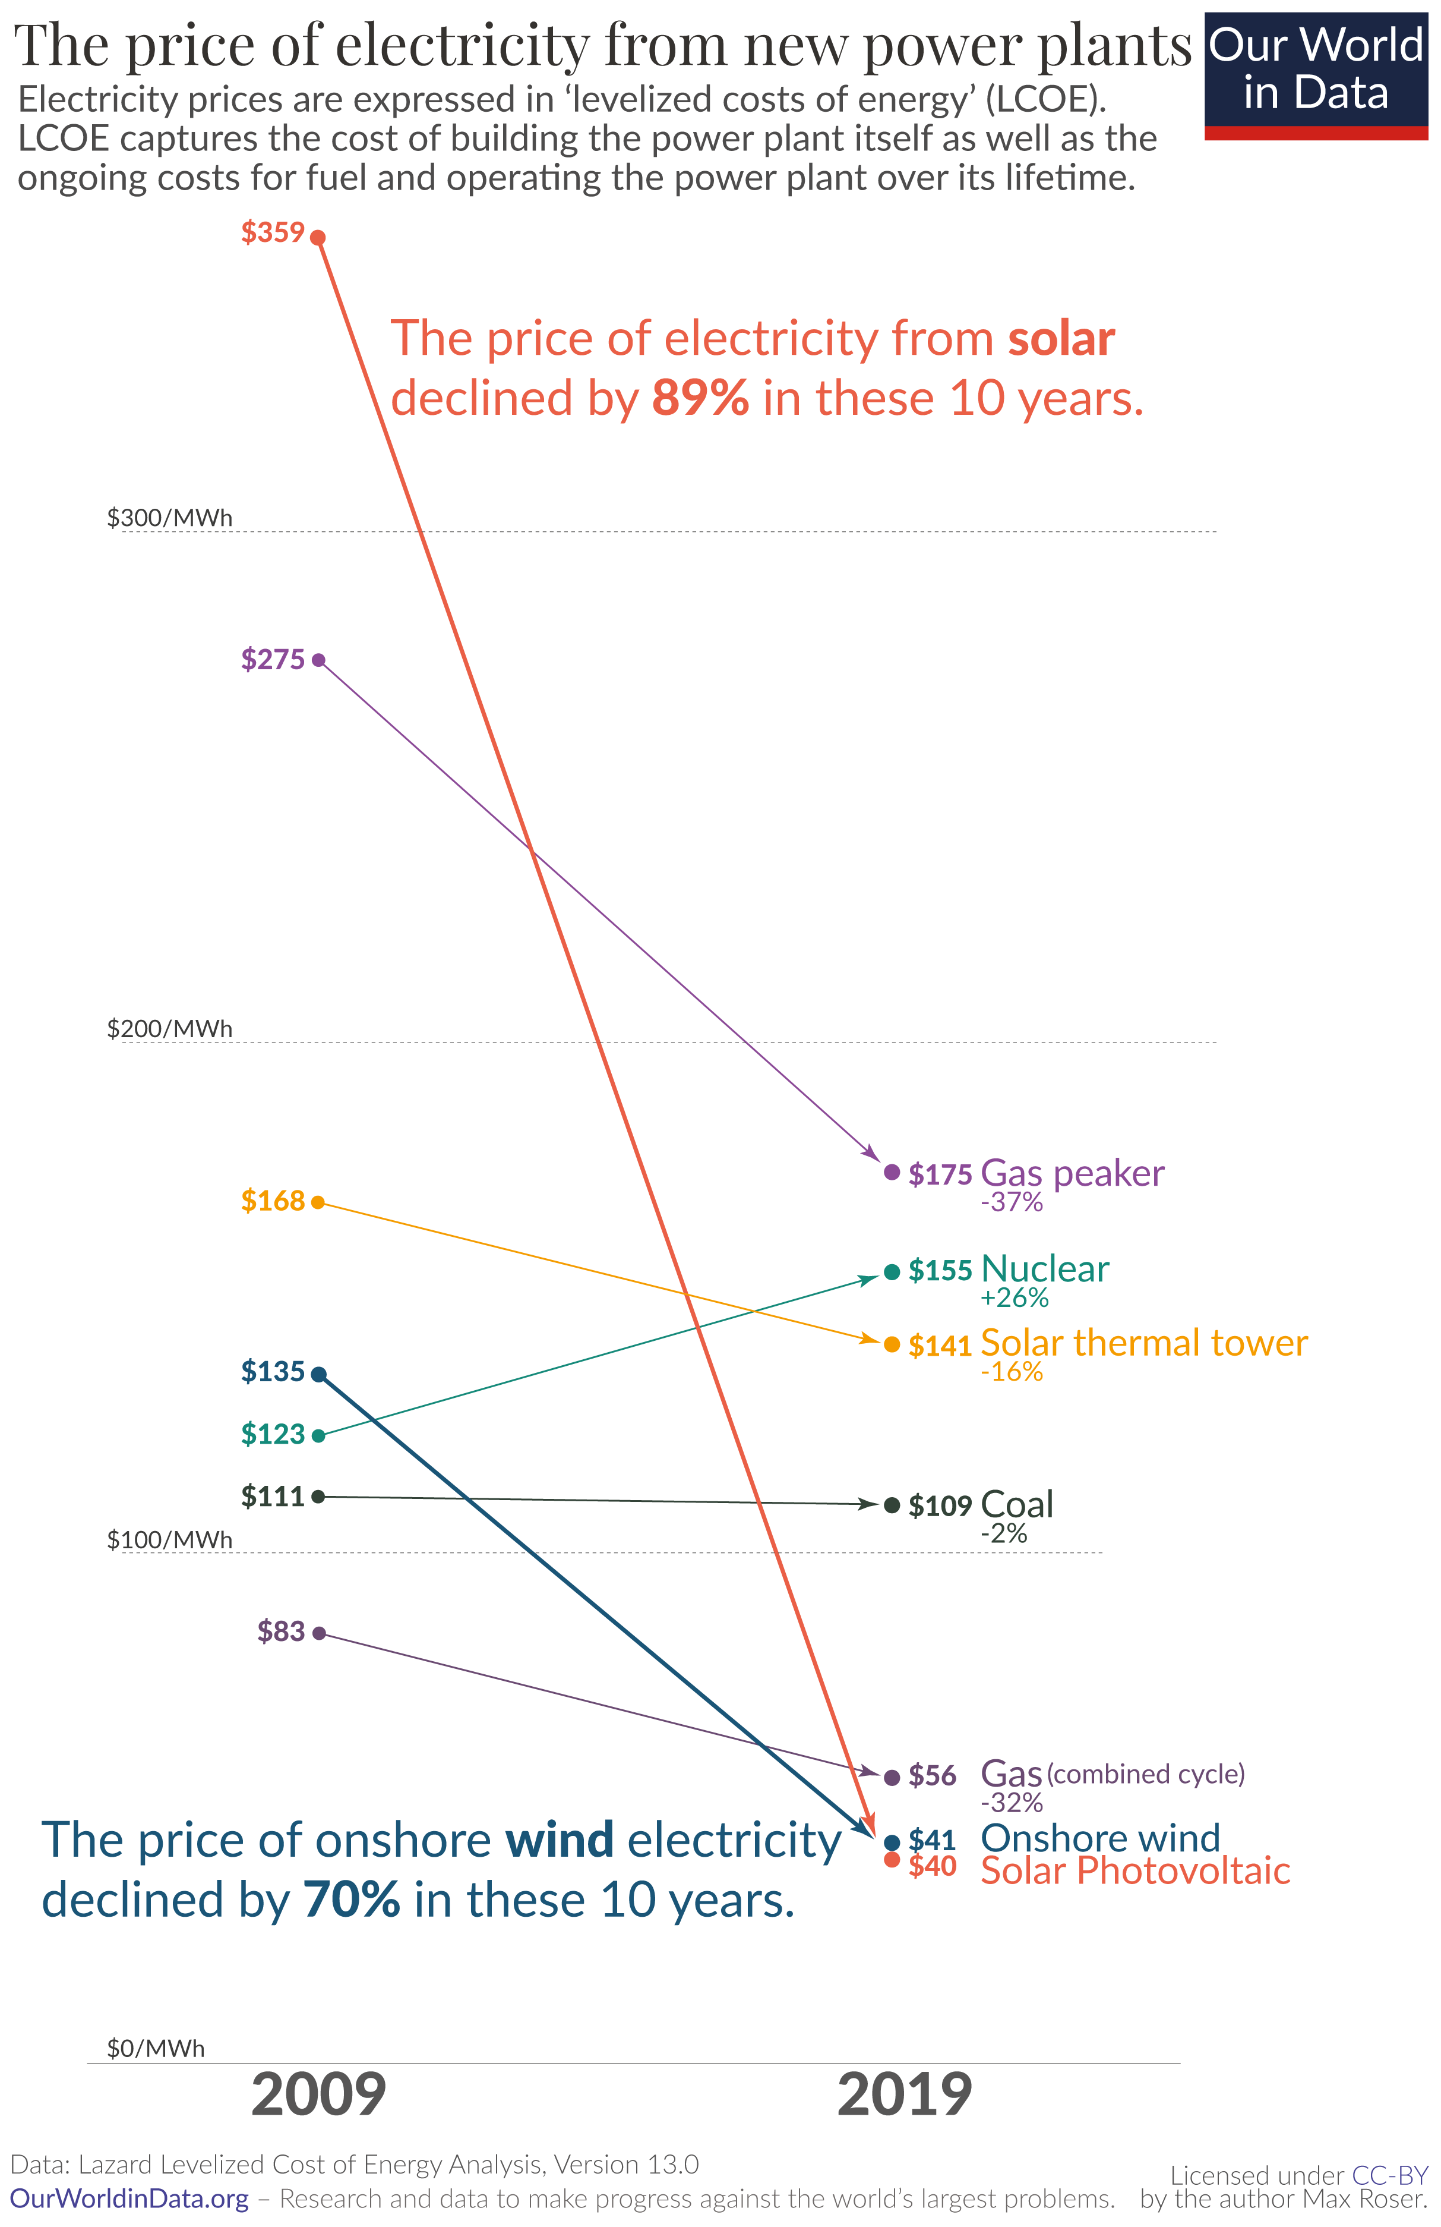
Bank.Green Vision
To accelerate the advent of a sustainable future by…
evaluating and promoting green banks and their products,
protecting consumers [from greenwashing], while
mobilising them to fight climate change by greening their finances
Defunding Fossil Fuels
Showing

Slide 3
Bank.Green Vision
To accelerate the advent of a sustainable future by…
evaluating and promoting green banks and their products,
protecting consumers [from greenwashing], while
mobilising them to fight climate change
By greening their finances
Tl;dr: Help people support these these by greening their finances*
* This chart is only for electricity, but also applies to other industries. What really matters for energy and other industries is the relative cost of polluting industries vs their sustainable counterparts.
Defunding Fossil Fuels
Showing

Slide 4

“to accelerating the advent of a sustainable future…” Starting with bank loans to the energy sector
Banks provide the majority of energy financing
True both for fossil fuels and sustainable energy
We want
More bank loans to sustainable energy
Fewer bank loans to fossil fuels
Defunding Fossil Fuels
Showing

Slide 5

How to achieve? (theory of change)
The obvious thing (doesn’t work): Consumer pressure from bank switching
Moving accounts is slow and difficult
Relatively few people will do it
Banks’ marketing departments sometimes care. Their finance departments do not.
The non-obvious solution: Demonstrating business feasibility
Big banks lend to fossil fuels because they feel that they need to for profitability
Bank.Green needs to demonstrate that it’s more profitable to lend sustainably
How to demonstrate business feasibility
Verify when “green” finance is truly green
Fossil free certification for banks
Exclude and ostracize greenwashing
Facilitate green lending
Show that green finance wins customers
Publish and publicize results
Defunding Fossil Fuels
Showing

Slide 6

Typical tech volunteering at non-technical nonprofits
Requests by day:
“Fix the printer”
“Fix Excel macros”
“Make an app encouraging 5000 people to spontaneously organise”
Hack the CIA
No In-between
Many non-technical collaborators imagine that you think, look, smell, and will act like this 🙁 ->

Slide 7


Bank.Green Tech Volunteering
Use your hard skills
See your impact
Learn new skills & technologies
Most effective use of your effort

Slide 8

Tech Setup
Bi-Weekly Plannings
Backend: Python Django + SQLite
Frontend: Vue.js + Nuxt
Groomed Backlog
GraphQL API
Open-Source Repos, Open Data
Notes:
The codebase is not a dumpster fire. There are no excel macros. This is a place where you could probably do some good without pulling your hair out.

Slide 9

Upcoming Initiatives
Testimonials
Better Bank Ratings
Bank Customizability

Slide 10

Testimonials
Users tell us about their bank switching experience
From what bank to what bank?
Why switch?
Pain points of switching
How is the new bank?
Bank.Green shares data with banks on…
Customers leaving/joining for environmental reasons
Products their customers wish they had (Fossil Free Alliance banks only)
About their user experience (Fossil Free Alliance banks only)
Tech Work:
Mostly frontend (vue.js) with typeform integrations

Slide 11
Testimonials (Tech Details)
Data collection via typeform (embed if possible)
Various ways to enter typeform
Bottom of ”great” rated bank pages
Contact us section
Etc
Mostly vue.js work

Slide 12

Better Bank Ratings
Updated system for rating banks
What organizations control lending with customer deposits?
Who do they lend to?
How environmental is their lending criteria?
Bank.Green displays some of data on its website
Tech Work:
Finance & Admin: Devising systems to collect
Backend: Assigning ratings

Slide 13
Bank Ratings (Tech Details)
Much work depends on how the ratings are designed (in progress)
Some data will need to be collected from the outside world. In the backend, this likely means:
Additional record attributes
Improved tools for merging and associating records
Repetitive jobs will likely be required to collect and associate data
Displaying this data on the frontend (Vue.js)
This will bleed somewhat into the next initiative. Some data should still be displayed in this initiative though

Slide 14

Bank Customizability
Allow editors to add custom information on more discoverable bank subpages
Highlight positive or negative actions
Highlight unique services that green banks offer
Highlight accredidations (i.e. B-Impact)
Easier editing via headless CMS
Tweaks for bots
Tech Work:
Frontend: Tighter integration (vue.js) with prismic CMS
Frontend: Higher lighthouse scores for bank pages (vue.js + nuxt.js)
Backend: Communication between Django and headless CMS (prismic.io)

Slide 15
Bank Customizability (Tech Details)
Two pieces of work:
connecting the python-django backend with prismic.io headless CMS
A design framework for what may need to be added to bank pages
Some loadtime and lighthouse score improvements are included here, but can be moved to other initiatives if necessary

Slide 16

Bank.Green Engineering Team
Challenges
Guidelines
Vision

Slide 17
Unique challenges of volunteer-driven tech
Low bus factor, high bus incidence
Contributors often dissapear, leaving unresolved technical issues behind
Lack of expertise
Many nonprofits simply don’t understand tech
Lack of showcaseable products
Resume driven development

Slide 18
Bank.Green Guidelines for Engineering Culture
Delivery includes collaboration and explanation
Explaining your work to at least one colleague
Embrace ignorance
Ask questions frequently in Slack
Mark them resolved as necessary
Err on the side of over-asking
Teach
Share what you learned, even if it’s redundant
Repeat yourself
Err on the side of repetition and redundancy
Technically present large changes to colleagues
Communicate frequently
Request and offer help/calls when possible
Prioritize synchronous communication when possible
Be proud of your work
Feel free to add yourself to the Bank.Green team page,
link to your profile/website, and
link your profile/website to Bank.Green
Choose well- known technologies
Boring and bulletproof > cutting-edge future abandonware
Use Bank.Green as an opportunity to learn proven but new-to-you tech
Say when you will respond
Promise less. Deliver more
undelivered promises have negative value
Keep your promises manageable and deliver more if possible.

Slide 19
Engineering Team Vision
Staffing
2-3 high-availability devs
2-3 more limited availability devs
1 product owner to help with productization and prioritization
1 UX designer (high availability, low hours)
Technology
Continue with Vue.js-Nuxt, Python-Django, SQLite, and Prismic.io CMS
Potential for additional data ingestion and processing for financial ratings
Rituals
Review + Sprint planning 2x per month (recommended attendance)
Retro 1x per month (recommended attendance)
Collaboration
Active and friendly Slack
Easy to ask questions of high-availabiliy devs
Video and voice call

Slide 20
Developer Availability & Expectations
 | Inactive Dev | Limited Availability Dev | High Availability Dev
Responsibilities | 0-2 hr /week answer dev questions on areas of expertise | 2-8 hours / week initially: completing low-priority non-blocking tickets later: completing higher priority and potentially blocking tickets, possibly owning low-priority projects | 8-20 hours / week initially: populating backog, planning sprints, completing high priority and potentially-blocking tickets later: owning high priority projects
Tooling & Access
Github | Write Access | Write Access expectation: push branches, open PR’s | Maintain Access expectation: all of the previous review, merge into main, and deploy
Slack | Member | Member expectation: respond to DM’s and and when tagged read and react (using emojis) to channel messages | Member expectation: all of the previous read, react, and respond to channel messages
Linear | No Access | Member expectation: own tickets | Admin expectation: all of the previous own projects
Meetings
Retros | optional | optional expectation: proactively communicate issues impacting you to high availability devs before meeting | recommended but not required expectation: proactively communicate issues impacting you and other developers to someone attending the meeting or in the meeting directly
Planning + Refinement | optional | optional expectation: communicate and commit to velocity/availability before planning Add unrefined tickets to backlog | required expectation: Add refined tickets to backlog participate in engineering discussion actively refine tickets in owned projects

