Slide 1
Linear Regression

Slide 2
An Example
Study time (min) | Score out of 100
16 | 50
34 | 61
8 | 45
38 | 60
39 | 60
40 | 67
54 | 65
21 | 59
16 | 57
67 | 73
40 | 68
43 | 71
47 | 75
56 | 71
60 | 88
80 | 94
Does study hours have
influence on exam score?

Slide 3
Scatterplot

Slide 4
What can we say?
From the plot it appears that:
Study hours and exam score are positively related. That means, the more time someone spends studying the more score they will get.
We want to derive a linear mathematical equation that can be used to predict exam score if study time is given.

Slide 5
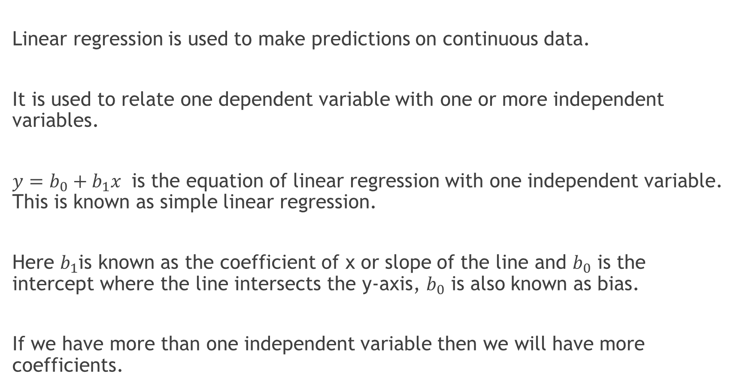
Formal Definition
Linear regression is used to make predictions on continuous data.
It is used to relate one dependent variable with one or more independent variables.
$y=b_{0}+b_{1}x$ is the equation of linear regression with one independent variable. This is known as simple linear regression.
Here $b_{1}$is known as the coefficient of x or slope of the line and $b_{0}$ is the intercept where the line intersects the y-axis, $b_{0}$ is also known as bias.
If we have more than one independent variable then we will have more coefficients.

Slide 6
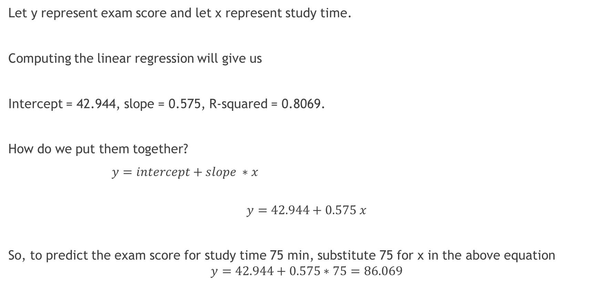
What’s the equation?
Let y represent exam score and let x represent study time.
Computing the linear regression will give us
Intercept = 42.944, slope = 0.575, R-squared = 0.8069.
How do we put them together?
$y=intercept+slope ∗x$
$$y=42.944+0.575 x$$
So, to predict the exam score for study time 75 min, substitute 75 for x in the above equation
$$y=42.944+0.575∗75=86.069$$

Slide 7
Can we fit the line?

Slide 8
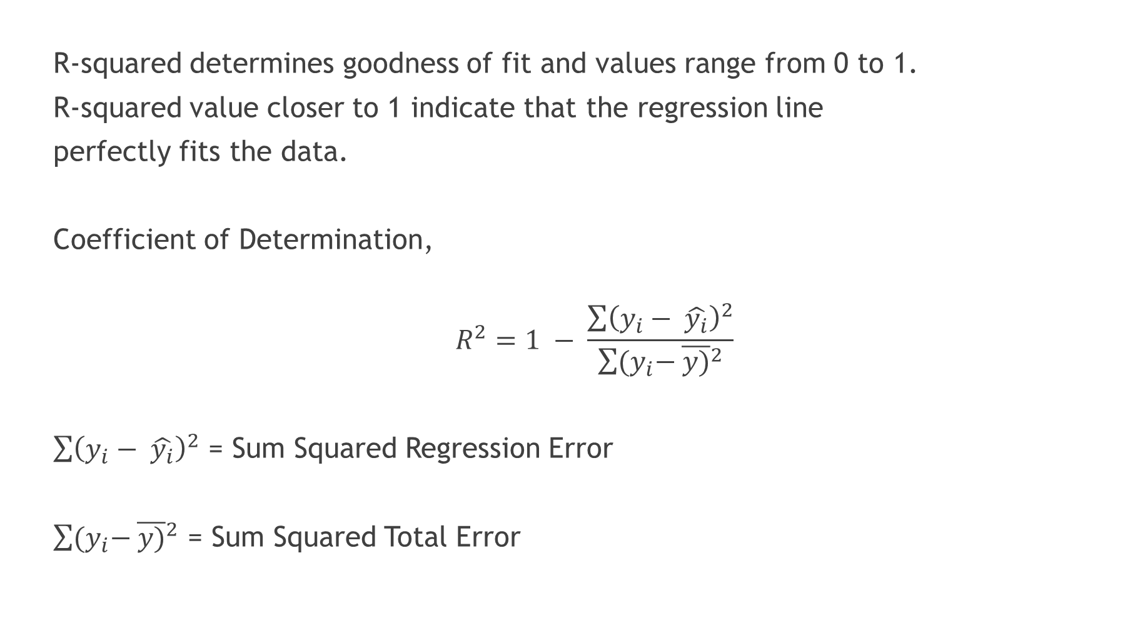
What is R-squared?
R-squared determines goodness of fit and values range from 0 to 1.
R-squared value closer to 1 indicate that the regression line
perfectly fits the data.
Coefficient of Determination,
$$R^{2}=1 − \frac{\sum{{\left(y_{i}− \hat{y_{i}}\right)}^{2}}}{\sum{{(y}_{i}− {\overline{y)}}^{2}}}$$
$\sum{{\left(y_{i}− \hat{y_{i}}\right)}^{2}}$ = Sum Squared Regression Error
$\sum{{(y}_{i}− {\overline{y)}}^{2}}$ = Sum Squared Total Error

Slide 9
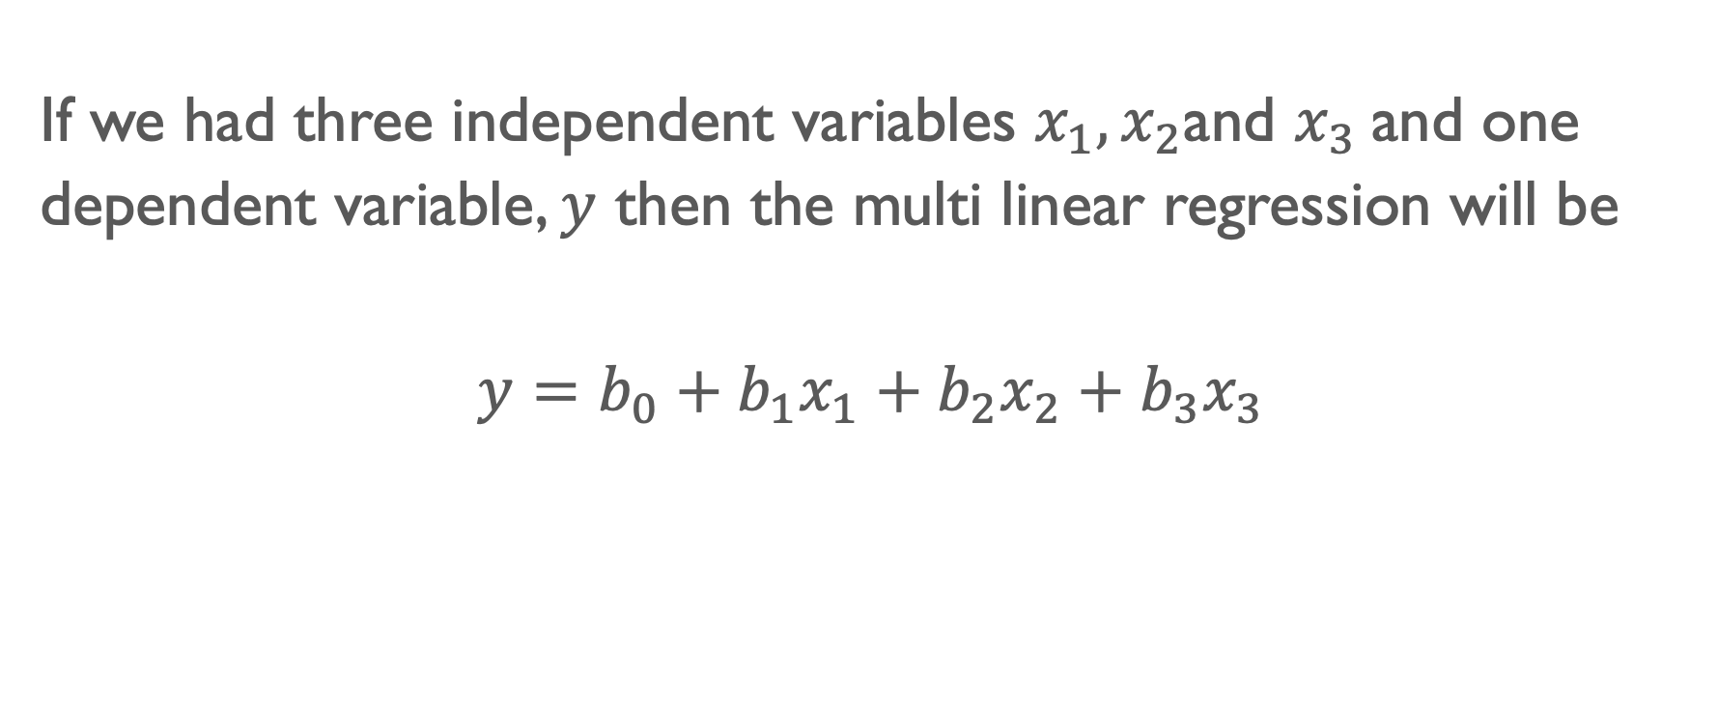
Multi Linear Regression
If we had three independent variables $x_{1},x_{2}$and $x_{3}$and one dependent variable, $y$ then the multi linear regression will be
$$y=b_{0}+b_{1}x_{1}+b_{2}x_{2}+b_{3}x_{3}$$

Slide 10
reference
Links
https://machinelearningmastery.com/linear-regression-for-machine-learning/
https://scikit-learn.org/stable/modules/generated/sklearn.linear_model.LinearRegression.html

