Slide 1
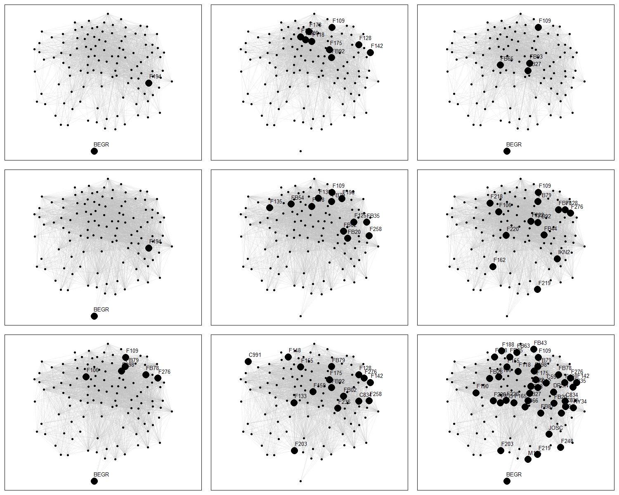
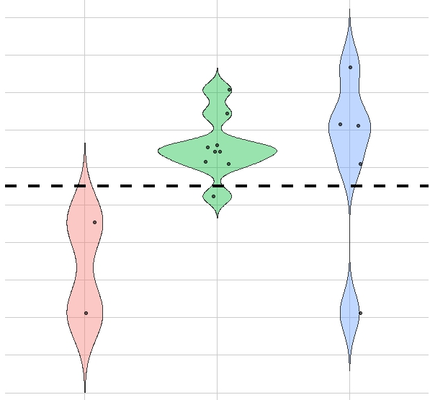
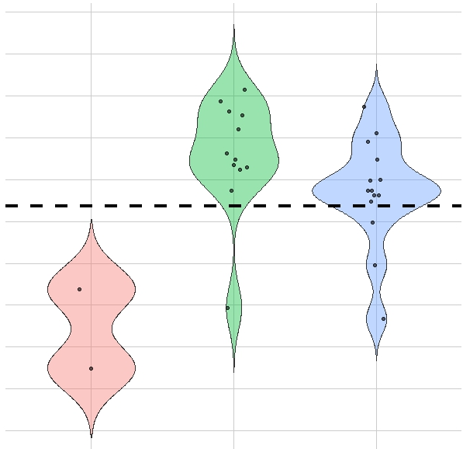
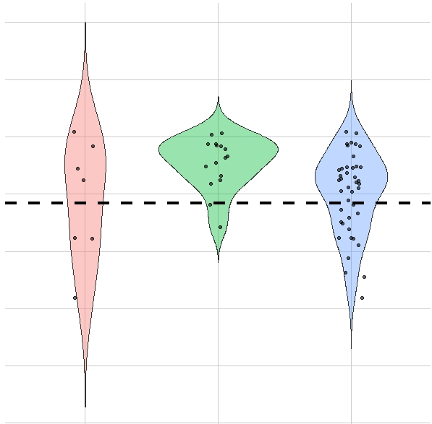
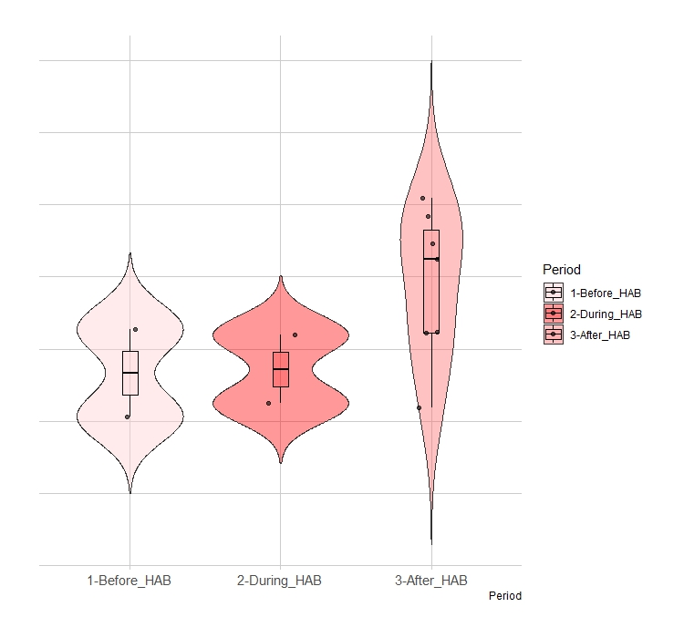
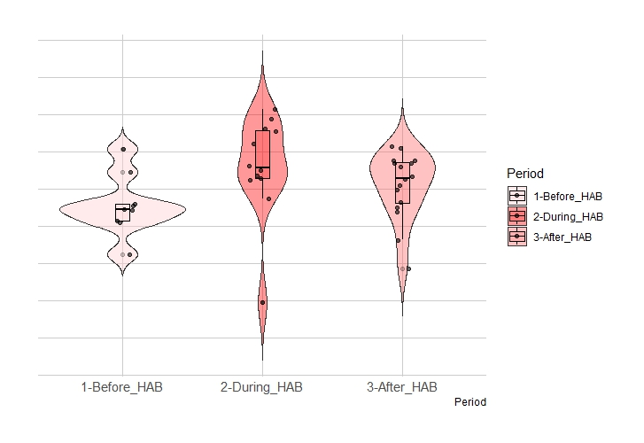
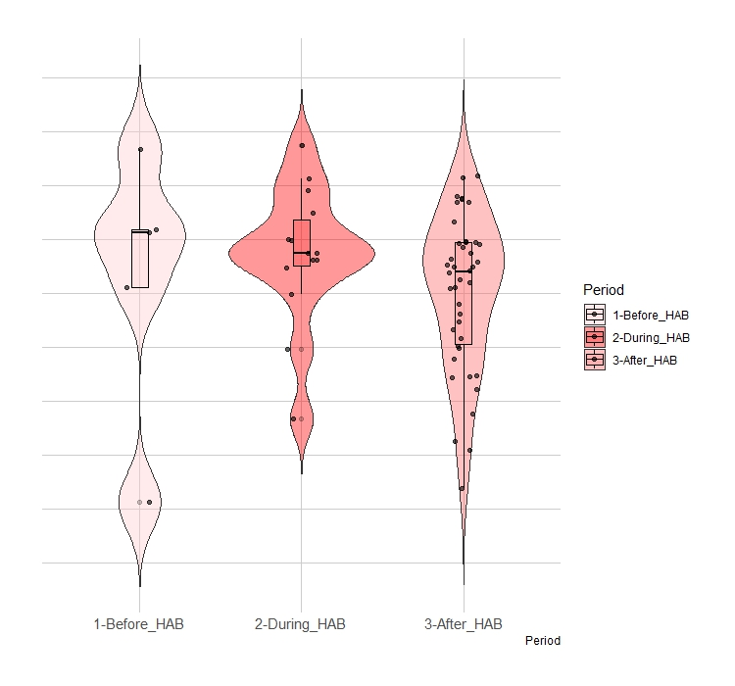
Beggars/Provisioners
Fixed gear foragers
Scavengers/Depredators
Before
During
After

Slide 2
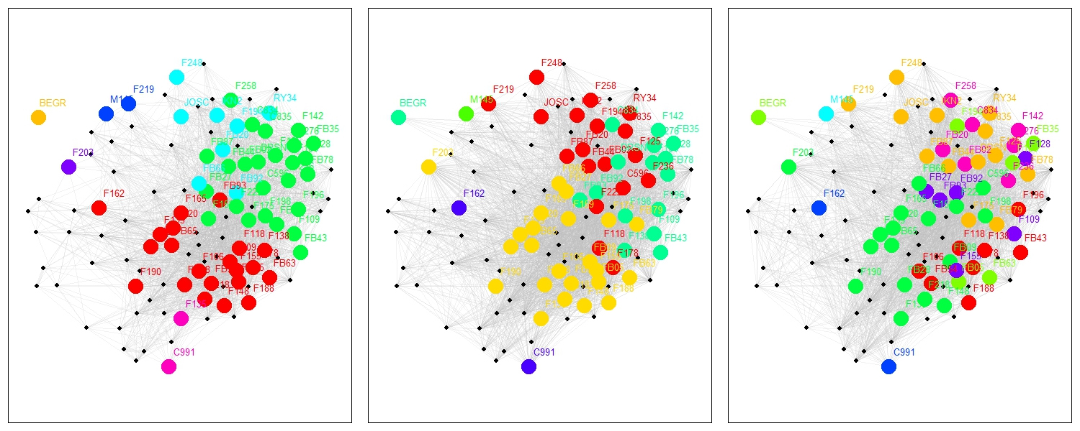
Before
During
After
Number of Total Clusters = 8
Number of HC Clusters = 7
Number of Total Clusters = 7
Number of HC Clusters = 4
Number of Total Clusters = 8
Number of HC Clusters = 8

