Slide 1
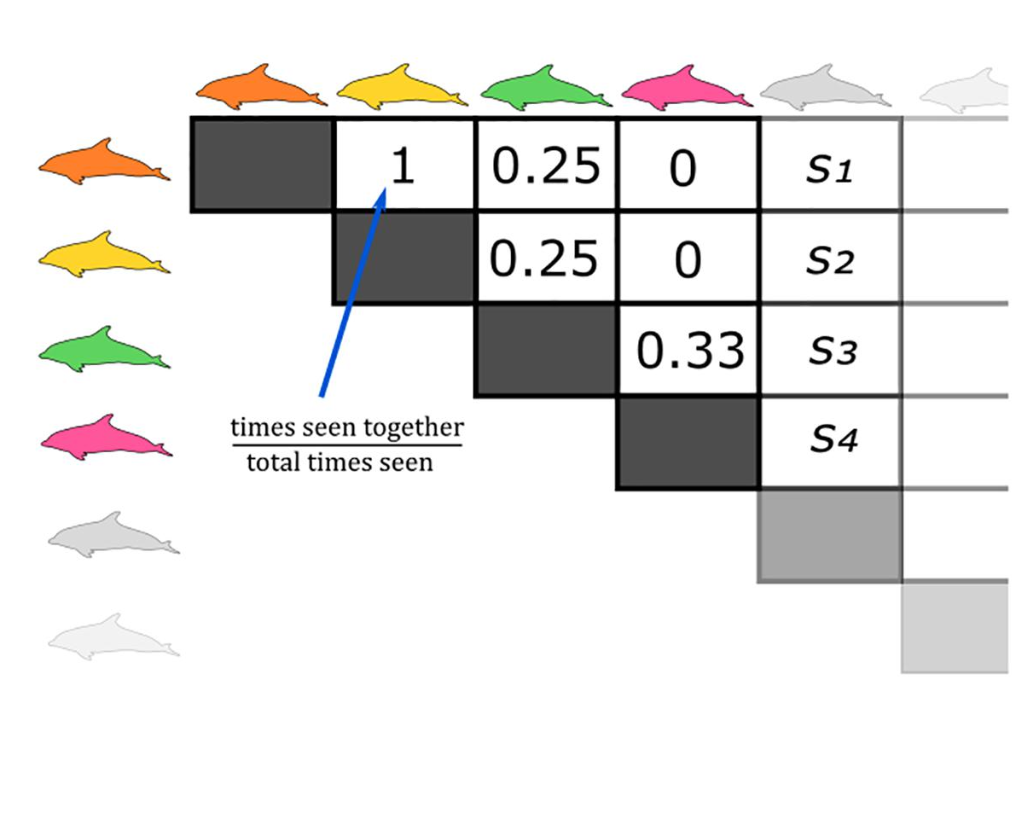
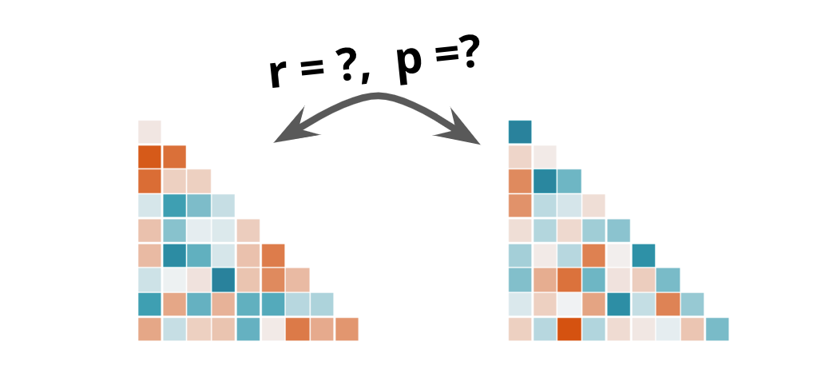
Two Period Resolution
0, Low
~
+
*
HAB =
1, High
Age + Sex Similarity +
Home range overlap +
Genetic Relatedness
Human-centric foraging tactic engagement similarity (BG + FG + SD)
Change of human-centric effects between HAB periods
Association Index (SRI)
Biological and Ecological Dyadic Similarities
Human-centric Effects on Assortativity

Slide 2
Three Period Resolution
0, Other
During HAB =
1, During
~
+
*
0, Other
After HAB =
Age + Sex Similarity +
Home range overlap +
Genetic Relatedness
Human-centric foraging tactic engagement similarity (BG + FG + SD)
1, After
Change of human-centric effects between HAB periods
Association Index (SRI)
Biological and Ecological Dyadic Similarities
Human-centric Effects on Assortativity

Slide 3

$${SRI}_{i,j, p} \sim$$
$(u_{i}+u_{j})$ +
$β_{sex}x_{sex[i,j]}+$ $β_{age}x_{age[i,j]}+β_{hro}x_{hro[i,j]}+β_{gr}x_{gr[i,j]}+$
$β_{HAB_BP}x_{BP[i,j, p]}∗x_{HAB}+$ $β_{HAB_FG}x_{FG[i,j,p]}∗x_{HAB}+$ $β_{HAB_SD}x_{SD[i,j,p]}∗x_{HAB}$
170 Individuals
170 x 170 x 2
57,800 observations
Association Matrix
Random Intercept
Biological and Ecological Dyadic Similarities
Absent
Change of human-centric effects between HAB periods

Slide 4
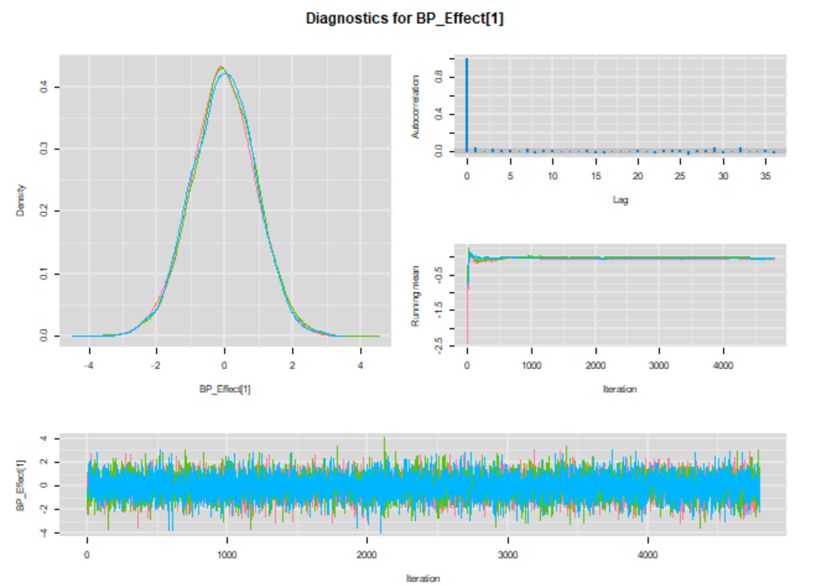
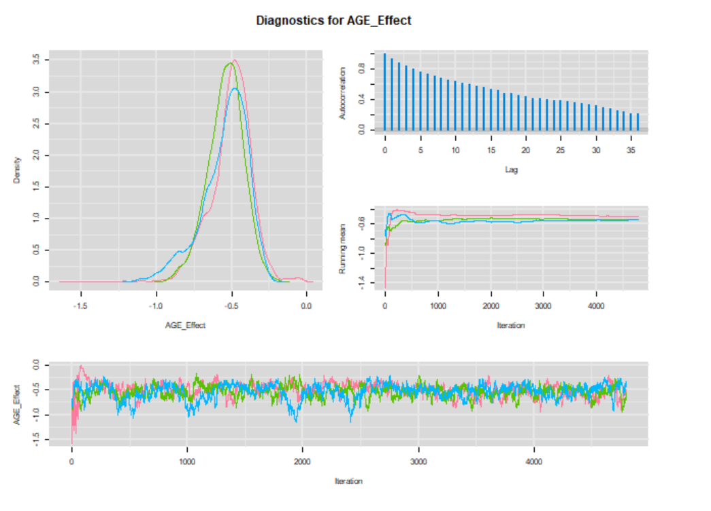
MCMC Plots
Setting | #
Iterations | 50,000
Thinning | 10
Burn-in | 2,000
Chains | 3

Slide 5
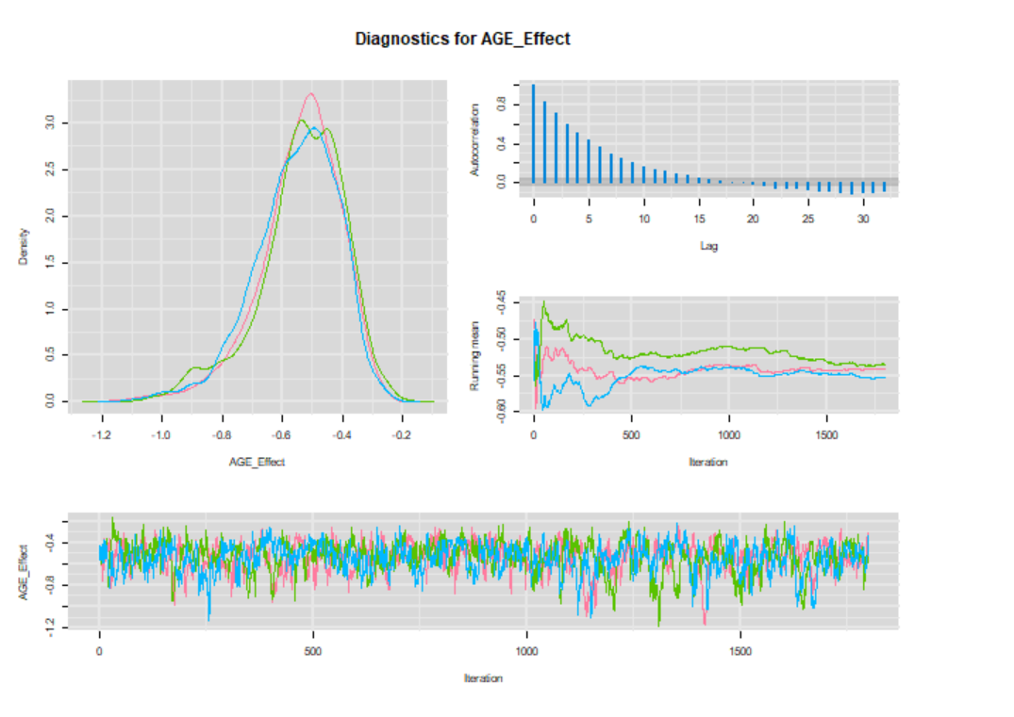
Adjusted Settings
Setting | #
Iterations | 100,000
Thinning | 50
Burn-in | 10,000
Chains | 3

