Slide 1
bet9ja 2.54
sportybet
1.76
1st half corners o/u 5.5
arbitrage
1.0396
Arbibet — a cross-bookmaker data platform
FIVE BOOKS.
ONE HONEST NUMBER.
From a Go odds collector to a Snowflake warehouse and a Streamlit dashboard — and what went silently wrong on the way.
[YOUR NAME]
[IRONHACK DE COHORT]
[DATE]
ACT 1 · WHY · 1:00
1 / 29
Notes:
Open on the odds board top-right: two real prices from two real books that add up to a guaranteed 3.96% return on first-half corners. That is one of exactly four true surebets this platform found in 6.9 million payloads. Tell them the deck is about how we got to a number we can trust, and everything that tried to stop us. ~1 min.

Slide 2
WHY THIS, WHY NOW
THE WORLD IS BETTING
$125B
44%
$326B
global sports betting market, 2026 — up from $119B in 2025
of that market is Europe; North America is the fastest-growing region
projected by 2035 — an 11% compound growth rate from 2026
Legalisation, smartphones and digital payments are the drivers cited across every report — the same three things that make Nigeria the case study two slides on.
Sources: The Business Research Company, Sports Betting Global Market Report 2026 · Precedence Research, to 2035 · Grand View Research
ACT 1 · WHY · 1:15
2 / 29
Notes:
Keep it brisk — three numbers, one sentence each. The point is not the size, it is the direction. Market-size estimates differ by a few billion between houses; say 'roughly' and move on. ~1:15.

Slide 3
WHY THIS, WHY NOW
ODDS BECAME A MARKET OF THEIR OWN
$44.8B
WHAT THAT MEANS FOR US
A price on an outcome is now a traded, public number.
Disagreement between prices is the product — not a bug.
Whoever reconciles prices fastest and most honestly wins.
combined monthly volume on Kalshi + Polymarket, June 2026
That is more than triple the ~$14B average monthly handle of every legal US sportsbook in 2025. Nine months earlier it was under $5B a month.
Sources: Pew Research Center, May 2026 · TRM Labs, 2026 · KuCoin: combined 2025 volume > $44B
ACT 1 · WHY · 1:15
3 / 29
Notes:
The bridge slide. Prediction markets prove that a probability is a tradeable asset. Arbibet treats bookmaker prices the same way: five independent estimates of the same event, and the gaps between them are the signal. ~1:15.

Slide 4
WHY THIS, WHY NOW
NIGERIA: A FOOTBALL-BETTING NATION
54%
~$590M
75–80%
of Nigerians surveyed placed a bet in the past 12 months (GeoPoll, July 2026)
sports-betting revenue in 2025, growing ~4.6% a year
of handle is football; ~9 in 10 bets are placed on a phone
Five of the books in this platform — sportybet, msport, ilotbet, bet9ja, livescorebet — are the ones on those phones. The booking-slip culture ("copy my code") is the behaviour the AI layer studies.
Sources: GeoPoll, Betting in Africa 2026 · News Agency of Nigeria, 2026 · iGaming Afrika, Nigeria market overview
ACT 1 · WHY · 1:30
4 / 29
Notes:
This is the 'why these five books' slide. Headline participation figures for Nigeria vary wildly by source — one widely-repeated figure exceeds the adult population — so this deck uses GeoPoll's survey rate and the revenue estimate only. If asked, say exactly that: the honest number is the surveyed one. ~1:30.

Slide 5
WHY THIS, WHY NOW
WORLD CUP 2026: THE BIGGEST BETTING EVENT EVER
$3.3B
$50–60B
10×
legal US handle on the tournament (Deutsche Bank); estimates ran to $4.3B — ~9× Qatar 2022
wagered worldwide (Macquarie / H2 Gambling Capital), up from ~$35B in 2022
"ten Super Bowls" — how FOX Sports summarised the tournament's total handle
The platform was collecting through the tournament. The slips punters copied, and the prices five books put on them, are the data in this deck.
Sources: CNBC, June 2026 · Yogonet, July 2026 · FOX Sports recap · Casino.org
ACT 1 · WHY · 1:00
5 / 29
Notes:
One minute. Land the scale, then pivot: 'and every one of those wagers is a data point somebody had to reconcile.' ~1:00.

Slide 6
THE BUSINESS QUESTION
PEOPLE ALREADY PAY FOR RECONCILED ODDS
ODDSJAM — THE PROOF OF DEMAND
ARBIBET'S TWO QUESTIONS
Scans 50+ sportsbooks for positive-EV and arbitrage bets.
Subscriptions from $39 to $199 a month (top tiers to $999).
Founded 2020; still independent and growing.
Sport is a data business already: every commentary line is a statistic — possession, xG, corners, form. The bet is just the price attached to it.
Across five Nigerian and international books, do the prices ever disagree enough to matter?
When thousands of people copy a betting slip, does it actually make sense?
Both need the same thing: every book's prices on one taxonomy, joined to what actually happened.
Sources: OddsJam subscription packages · XCLSV, OddsJam review 2026
ACT 1 · WHY · 1:30
6 / 29
Notes:
Frame the whole project as answering two questions, and promise the answers come in Act 3: the first is 'almost never, and here are the four times it did'; the second is 'usually not, and here is the arithmetic.' ~1:30.

Slide 7
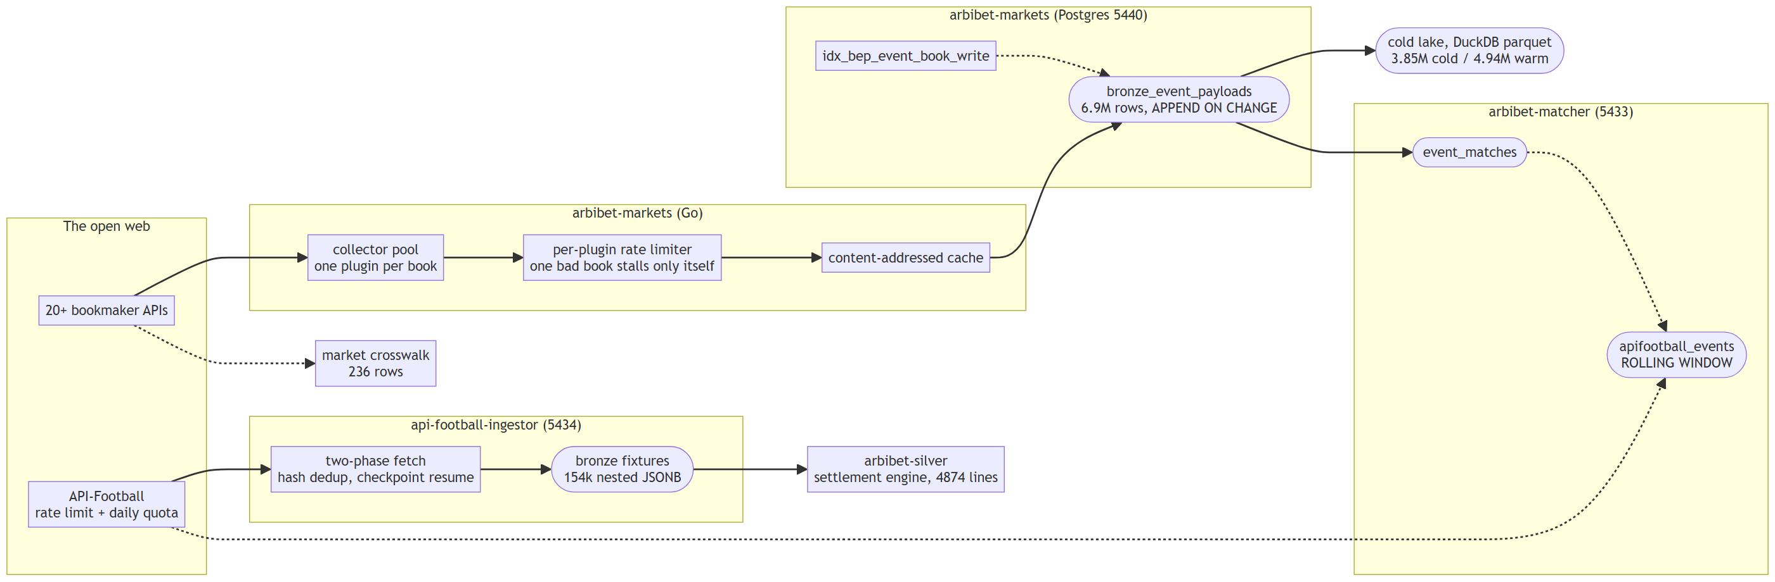
THE PLATFORM, PART 1 OF 2
WHERE THE DATA COMES FROM
ACT 2 · WHAT I BUILT · 1:15
7 / 29
Notes:
Left to right, and none of this is the capstone -- it is the platform the capstone plugs into. A Go collector per book, writing bronze only when a response actually changes, which is why bronze doubles as a tick store later. The matcher decides which entries across books are the same fixture; API-Football is the record of what happened; silver knows how to settle a market. Point at ROLLING WINDOW on apifootball_events -- that is the biggest bug in the deck, and it is coming. ~1:15.

Slide 8
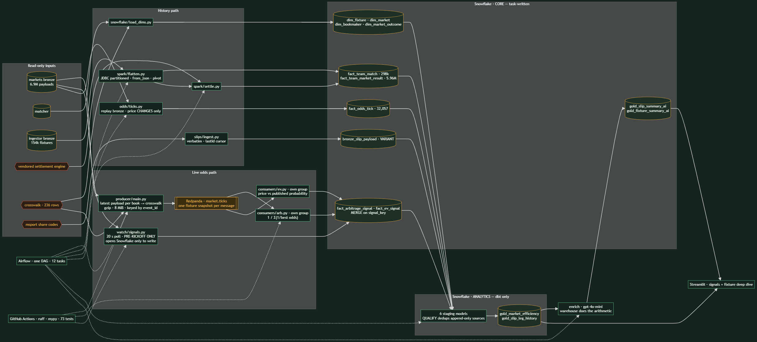
THE PLATFORM, PART 2 OF 2
THE CAPSTONE PIPELINE
ACT 2 · WHAT I BUILT · 1:30
8 / 29
Notes:
Everything here is new. Two paths out of the same bronze: a live one through Redpanda to two detectors in their own consumer groups, and a batch one through Spark. The watcher is the freshness path added later -- same code as the consumers, MERGEd on the same key, so the two converge instead of duplicating. CORE is task-written and ANALYTICS is dbt's, so a full-refresh can never drop something a task paid an API call for. Then: 'each of the next twelve slides is one box on this chart.' ~1:30.

Slide 9
LAYER 1 · COLLECTION
THE GO COLLECTOR
WHAT IT DOES
TOOLING
A pool of HTTP collectors hits 20+ bookmaker APIs on a per-plugin schedule — one plugin per book, so one broken book never stalls the rest.
Validates, deduplicates with a content-addressed cache, persists to Postgres.
Inherited a v1 and re-platformed it. My changes: the MongoDB → Postgres migration, team-ID extraction, and the event-ID collision fix. The plugin architecture predates me.
Go
Postgres
Kafka-instrumented
per-plugin rate limits
SILENTLY WRONG
Two different fixtures sharing one event id looked like one fixture with twice the prices. Nothing errored; the collision fix was found from the data, not a log.
ACT 2 · WHAT I BUILT · 1:15
9 / 29
Notes:
Attribution matters here and the panel will respect it. Say plainly what you inherited and what you changed. The three contributions are concrete and yours. ~1:15.

Slide 10
LAYER 2 · BRONZE
MARKETS BRONZE: KEEP EVERYTHING, VERBATIM
WHAT IT DOES
TOOLING
6.9 million payloads from ~14 books, stored as the exact bytes each book returned — with payload_sha256, parser_version and run_id on every row.
Append on change: a row is written only when a book's response differs from the last one. Bronze never updates.
Byte fidelity is the contract: a malformed body fails in the parser, where the failure has a reason, never on the way in.
Postgres
BYTEA
medallion
hash dedup
SILENTLY WRONG
"Append on change" means a book whose price has not moved contributes an hours-old leg to a "snapshot". An arbitrage across a fresh leg and a stale one is an artefact. The spread is now recorded on every signal — observed up to 30 hours.
ACT 2 · WHAT I BUILT · 1:30
10 / 29
Notes:
The single most important property of the whole platform is 'append on change, verbatim'. Everything downstream can be rebuilt from it — including the odds tick store in the capstone, which nobody planned but bronze already was. ~1:30.

Slide 11
LAYER 2B · COLD STORAGE
THE PARQUET LAKE ATTEMPT
8.8M
TWO TIERS, BUILT WITH DUCKDB
TIER | ROWS | SIZE | ROW GROUPS
cold | 3,853,417 | 16.5 GB | 377
warm | 4,936,610 | 26.4 GB | 483
bronze rows exported to parquet
43 GB
Same 12 columns as bronze — event, bookmaker, fire/ingest/write time, HTTP status, payload, sha256, parser version, run id — so it is a faithful mirror, not a summary.
on local disk, D:\arbibet-cold
[YOUR INPUT] why two tiers, what worked, why it paused
ACT 2 · WHAT I BUILT · 1:15
11 / 29
Notes:
The numbers are real and read straight from the parquet metadata. Fill in the intent: was cold = older than N days? Was the goal to free Postgres, or to query with DuckDB? What stopped it — disk, time, or the capstone deadline? ~1:15.

Slide 12
LAYER 3 · IDENTITY & RECORD
MATCHER + API-FOOTBALL INGESTOR
WHAT IT DOES
TOOLING
Matcher: Man Utd, Manchester Utd, Manchester United FC are one club to a human and three strings to a database. It decides which entries across books are the same fixture and persists a canonical match graph.
Ingestor: the record of what actually happened — 154k fixtures as nested JSONB, with a two-phase fetch to live inside a per-minute rate limit and a daily quota, hash dedup, and idempotent resume from checkpoint.
Built from scratch as a disciplined rebuild of an earlier monolith.
Python
Postgres · JSONB
one-shot Docker
checkpoint resume
SILENTLY WRONG
The matcher's API-Football projection is a rolling window. A fixture that resolved to team ids last week resolves to NULL today — and a plain MERGE wrote those NULLs over ids the warehouse already had. 3,226 fixtures blanked; nothing errored.
ACT 2 · WHAT I BUILT · 1:30
12 / 29
Notes:
Two repos, one slide, because together they are 'identity and truth'. The rolling-window bug is the biggest one in the deck — it comes back in Act 3. Plant it here. ~1:30.

Slide 13
LAYER 4 · SETTLEMENT
THE SILVER SETTLEMENT ENGINE
WHAT IT DOES
TOOLING
4,874 lines of resolvers that take a market, an outcome and a final score, and say won / lost / void — for every betradar market the books price.
Period-resolved scores (1st half, 2nd half, match), a per-team form grain, and one rule that cost a debate: "full" = regulation + extra time, never penalties.
Vendored into the capstone and run at scale: 5.96M settled team-market rows.
Python
pure functions
vendored
LOUDLY WRONG — THE CHEAP KIND
The engine wants ft/aet; the ingestor stores FT/AET. It refused all 87,600 rows as unknown_status. Annoying, obvious, fixed in minutes. Compare that to the slide before.
ACT 2 · WHAT I BUILT · 1:15
13 / 29
Notes:
The deck's first green chip. Make the contrast explicit: a loud failure is a gift. The engine also insists side_or_line='home' means 'this team', not 'the home team' — which is why two teams' histories cannot always be pooled. ~1:15.

Slide 14
LAYER 5 · STREAMING
KAFKA FAN-OUT: ONE SNAPSHOT, TWO DETECTORS
WHAT IT DOES
TOOLING
The producer reads each book's latest payload, parses it through the market crosswalk (bet9ja and livescorebet speak their own dialects; three books are betradar-native) and publishes one fixture snapshot per message, keyed by event id.
Two consumers in separate consumer groups: arbitrage (1 / Σ(1 / best odds)) and positive-EV (price vs a published probability).
At-least-once: offsets commit after the write, and a MERGE on signal_key absorbs any replay.
Redpanda
confluent-kafka
pandas crosswalk
MERGE
SILENTLY WRONG
Measure a parser fix against messages produced before the fix and you measure the old parser. Three investigations were misled in one session. Rule: change parser → delete topic → delete groups → re-produce → then measure.
ACT 2 · WHAT I BUILT · 1:30
14 / 29
Notes:
Why a broker at all: the snapshot is expensive to build and TWO detectors need it, so a topic means building it once -- and a third detector later just subscribes, touching nothing upstream. Offsets are a rewind button after a bug fix. Why Redpanda: it speaks the Kafka API, so this is ordinary Kafka code that could point at managed Kafka tomorrow with one config change -- no lock-in; one binary, no ZooKeeper and no JVM, so one container instead of three; it fits in the one core and 1 GB of RAM the compose file gives it; the same broker in development as a real deployment; and free, when the whole project cost twenty cents. Say the counterpoint before they do: at this volume a queue is not strictly required, and the watcher on the next slide deliberately skips it. Kafka is here for the SHAPE -- fan-out -- not the throughput. If the panel asks why Kafka at all for a daily batch: the producer and consumers make one pass and exit, which is what lets them sit in a batch DAG — but the shape is the real-time shape, and the next slide is where it becomes real-time. ~1:30.

Slide 15
LAYER 5B · FRESHNESS
THE WATCHER: RECOMPUTE THE MOMENT PRICES LAND
WHAT IT DOES
TOOLING
Polls bronze every 20 s for the newest write per upcoming fixture; any fixture whose prices moved is re-run through the same snapshot → arbitrage/EV code the consumers use, and MERGEd on the same key — so the two paths converge.
Pre-kickoff only. A bet must still be placeable, and an in-play match is a payload storm.
Snowflake is touched only to write. No opportunity, no statement, no credits.
Python loop
Postgres · indexed poll
Snowflake MERGE
NEARLY WRONG, CAUGHT IN THE LOG
First run: a 3-day window = 1,368 fixtures, and the poll became a 40-second seq scan of the 6.9M-row table. A 6-hour window and an indexed key: under a second. Then it primed a baseline instead of recomputing 1,300 fixtures the DAG already covered.
ACT 2 · WHAT I BUILT · 1:30
15 / 29
Notes:
This is how the legacy system worked and it was rebuilt on request in an afternoon because every piece already existed as a tested function. Verified live: new signals landed within one poll. ~1:30.

Slide 16
LAYER 6 · BATCH
FLATTEN WITH SPARK, SETTLE IN PYTHON
WHAT IT DOES
TOOLING
flatten: 154k nested-JSONB fixtures → 298k wide team-match rows: period scores, xG, shots, corners, possession, passes. JDBC partitioned reads, from_json with a partial schema, pivot, self-join.
settle: every team-match row × every market the books price, through the vendored engine → 5.96M results. Not a Spark job -- the input is already flat, so it is a Python loop over Snowflake.
Incremental in the DAG (FLATTEN_SINCE_DAYS=3); the full backfill is an 80-minute, 505 MB scan.
PySpark 4.2
JDK 17
settle: plain Python
runs in the Airflow image
LOUDLY WRONG — BUT EXPENSIVELY
One fixture in 153,386 had no score. A NOT NULL failed the write — after 80 minutes. Two such runs were lost. Rule now: prove a long job on a 3,000-row bound before running it whole.
ACT 2 · WHAT I BUILT · 1:30
16 / 29
Notes:
The Spark code in one breath. flatten.py is the ONLY real Spark job. read_payloads does a JDBC partitioned read -- eight partitions keyed on the bronze id, so eight workers pull in parallel instead of one connection dragging 505 MB. parse applies from_json with a PARTIAL schema: declare only the fields you want and Spark discards the rest, which is how nested JSONB becomes columns with no manual traversal. latest_per_fixture is a window dedup; team_statistics is an explode-then-pivot rather than a UDF, because the stat labels are known and a pivot stays in the JVM; team_rows makes the two team-rows per fixture and self-joins to attach the OPPONENT's xG. The DataFrame is cached because three branches read it -- both sides and the pivot -- and without that the 505 MB parse runs three times. settle.py is NOT Spark and its docstring says so: the input is already-flattened fact_team_match in Snowflake, and the work is a nested loop in Python over ~225 (market, side) combinations per fixture calling the vendored settle() and team_perspective(). If asked why it lives in spark/: naming it honestly matters more than a tidy folder. Windows gotcha for the panel: spark.jars.packages needs a Hadoop temp dir Windows cannot provide without winutils.exe, so Spark runs inside the Airflow image. Then --env-file .env passed the HOST's JAVA_HOME into the Linux container and the JVM never started. Both in the troubleshooting slide. ~1:30.

Slide 17
LAYER 7 · WAREHOUSE
SNOWFLAKE: A MEDALLION WITH TWO OWNERS
WHAT IT DOES
TOOLING
CORE is task-written (consumers, Spark, the LLM tasks); ANALYTICS is dbt-written. A dbt full-refresh can never drop something a task paid an API call for.
Snowflake enforces NOT NULL and nothing else — PRIMARY KEY is documentation. So every write is a MERGE on a natural key, and re-running anything converges.
Loads stage through write_pandas + one MERGE after a row-at-a-time loader died at 446 of 4,527 rows and left the table silently partial.
Snowflake
MERGE
write_pandas
TIMESTAMP_TZ
SILENTLY WRONG
Session TIMEZONE defaults to America/Los_Angeles, and TIMESTAMP_TZ keeps the writer's offset forever. Every instant was correct; every kick-off printed nine hours early. An evening Ligue 1 match at 11:45.
ACT 2 · WHAT I BUILT · 1:30
17 / 29
Notes:
The timezone one is a good teaching moment because the data was never wrong — only the rendering. Fix was three lines: pin the session to Europe/Berlin in the connector and dbt, and cast to TIMESTAMP_LTZ where it is displayed. ~1:30.

Slide 18
LAYER 8 · TRANSFORMATION
DBT: THE MODELS, AND THE TESTS THAT EARN THEIR KEEP
WHAT IT DOES
TOOLING
8 models: staging views over the facts, gold tables for market efficiency and slip-leg history, an observed-outcome-label model built from what the books themselves publish.
30 tests, four of them singular and written after a bug: arbitrage is physically plausible, slip legs are unique, odds are real prices, gold is not empty.
on-run-start pins the session timezone; QUALIFY dedups every append-only source before it is joined.
dbt-snowflake
singular tests
macros
SILENTLY WRONG
bronze_slip_payload is keyed on payload hash, so a slip re-fetched after losing a leg is stored again. 598 rows for 409 slips → 2,247 duplicated legs, fed to the LLM with repeats. Fix: read the table by the key it actually has.
ACT 2 · WHAT I BUILT · 1:30
18 / 29
Notes:
What dbt is doing here. Everything upstream WRITES facts; dbt only ever READS them and shapes them for the dashboard. That split is enforced by schema: tasks own CORE, dbt owns ANALYTICS, and dbt has no write path into CORE at all -- so a full-refresh cannot drop a table a task paid an API call for. dbt run builds 8 models in dependency order, working out that order itself from the ref() and source() calls -- nobody maintains a list. Six staging models are VIEWS: they rename and lightly filter facts the pipeline already wrote, so a table would just be a second copy that can go stale. The two gold models are TABLES, because the dashboard reads them on every page load and a view would re-scan five million settled rows each time someone opens the URL. Last run: 8 of 8 OK, about 12 seconds. dbt test then runs 31 assertions against what was just built -- 26 generic ones declared in YAML (not_null, unique, accepted_values, and relationships for foreign keys) plus 5 singular tests, which are just SQL that must return zero rows. The generic ones catch schema drift. The singular ones are the interesting half, because every one of them was written the day a bug got past everything else: arbitrage_is_physically_plausible exists because the first run reported a 7.83x arbitrage; slip_legs_are_unique because two joins were fanning legs out; odds_are_real_prices because a book publishes 0.00 for a suspended outcome; slip_rates_are_proportions because pooling two teams' histories produced a rate above 1; gold_is_not_empty because an empty table passes every column test ever written. Order matters in the DAG: dbt_run, then dbt_test, then the LLM tasks -- the model is the one step that costs money per run, and paying for a verdict on data that failed its own tests is the wrong order. And one test taught its own lesson: a relationships test on market_base_id used to FAIL the run, but dim_market is the crosswalk and native books legitimately price outside it, so it is warn-severity now. A test encodes an assumption; if the assumption is wrong the test is too. The point to make about dbt: generic tests catch schema drift; the singular tests here each encode a bug that a plausible number got past. 'Arbitrage physically plausible' exists because the first run reported a 7.83× arbitrage. ~1:30.

Slide 19
LAYER 9 · AI
AN LLM THAT MAY USE NOTHING BUT OUR DATA
WHAT IT DOES
TOOLING
Slip verdicts: every copied booking slip, leg by leg, with the price and how often that exact market has landed for that side. Opens with a bold sentence: "a 1-in-232 shot."
Fixture briefs: three paragraphs — what the market thought, what both sides had been doing, where they disagree.
All arithmetic in the warehouse. The model is handed finished numbers and forbidden from computing, from outside knowledge, and from reading "copied by 8,462" as a probability.
The cache key hashes the evidence, not just the subject.
OpenAI gpt-4o-mini
Cortex — blocked on trial
signature cache
SILENTLY WRONG, TWICE
A verdict said "recent form of 90%" beside a table reading "no history" — legs unchanged, evidence gone, cache key unchanged. Later, round(1.19)=1 produced "1 in 1 … extremely rare" for an 84%-likely slip. Both fixed in SQL, not in the prompt.
ACT 2 · WHAT I BUILT · 1:45
19 / 29
Notes:
Snowflake Cortex was the plan and would have been free; it refuses AI functions on trial accounts, verified in the console. Moving to an orchestrated OpenAI task put the LLM behind a swappable boundary. Emphasise the design rule: the model narrates numbers it did not compute. ~1:45.

Slide 20
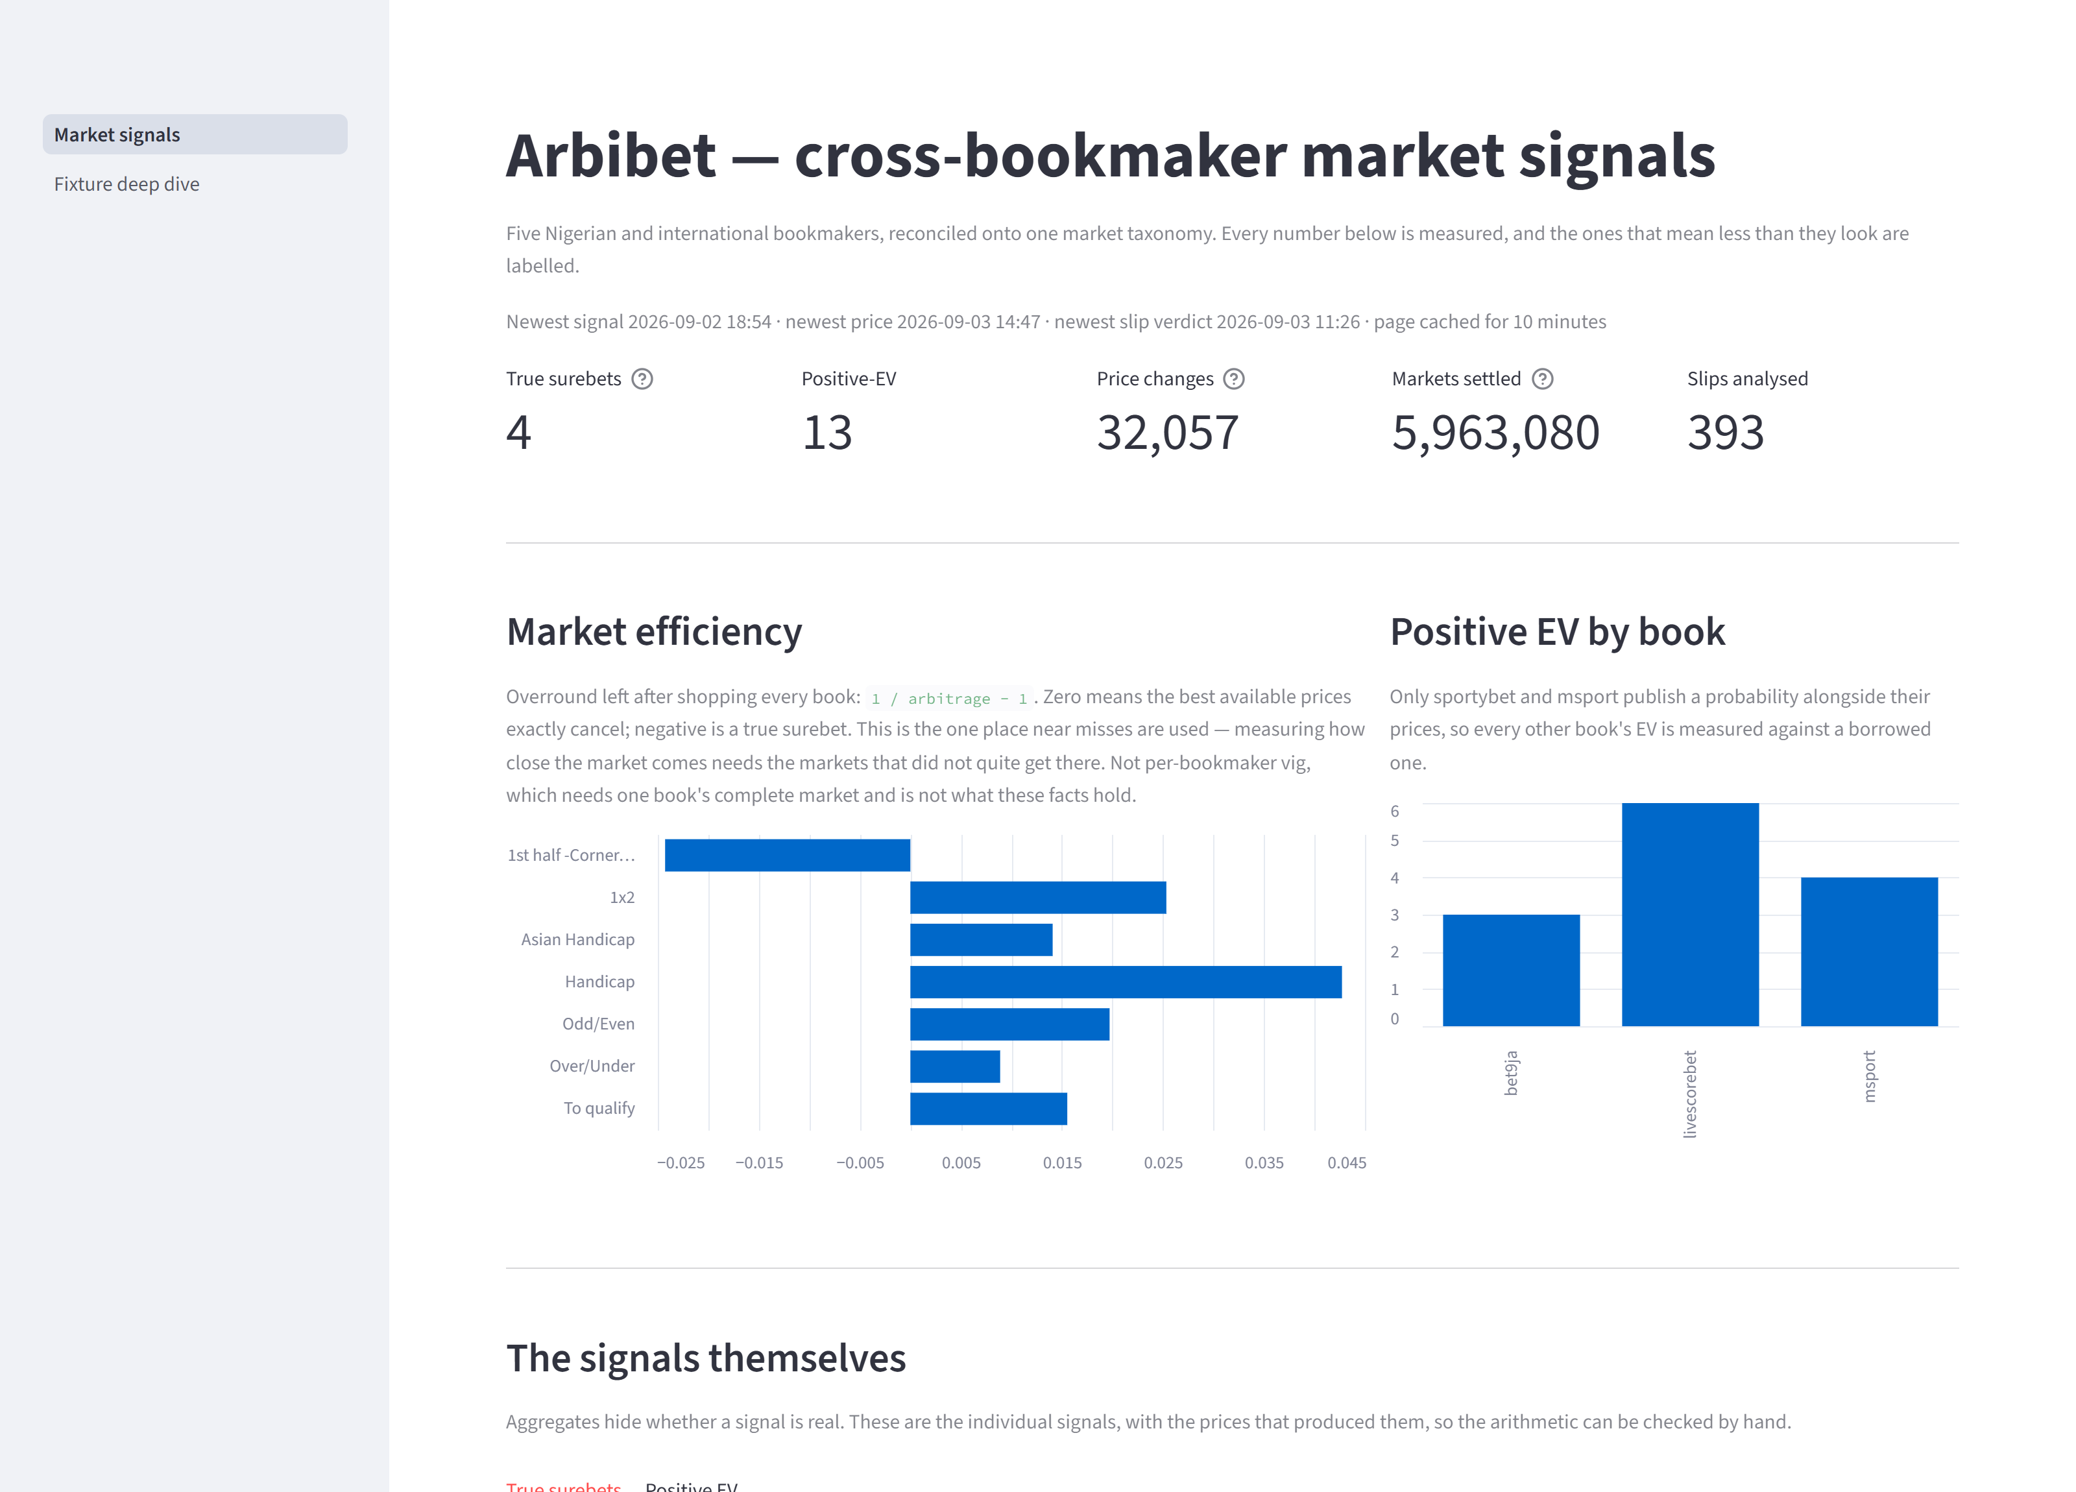
LAYER 10 · SERVING & ORCHESTRATION
STREAMLIT AND AIRFLOW
STREAMLIT
Two pages: market signals, and a deep dive per fixture with the LLM brief, every book's price over time, and both sides' record.
Queries cached 10 min because Snowflake auto-suspends at 5 — an uncached load would bill a minute of credit for a page nobody is reading.
Standalone: imports no pipeline code, so Community Cloud installs from a 5-line requirements.txt.
AIRFLOW
One DAG, 12 tasks, LocalExecutor. Every task is a BashOperator against a separate pipeline venv — the DAG file imports nothing from the project.
Never backfills: every task reads the current state of bronze, not a partition.
ACT 2 · WHAT I BUILT · 1:30
20 / 29
Notes:
If there is time, this is the live-demo cue: open the dashboard, click a deep dive, show the price chart with the kick-off line. Otherwise the screenshot carries it. ~1:30.

Slide 21
LAYER 11 · PERFORMANCE
INDEXES: THE ONE QUERY SHAPE YOU NEVER WRITE
THE INDEX THAT HOLDS BRONZE UP
MEASURED, NOT ASSUMED
idx_bep_event_book_write
(event_id, bookmaker, write_time DESC)
POLL SHAPE | FIXTURES | TIME
event_id = ANY(…), 3-day window | 1,368 | ≈ 40 s
event_id = ANY(…), 6-hour window | 100 | < 1 s
Every read drives on event_id — the leading column. "Latest per book" is one ordered walk.
Never filter on bookmaker or write_time alone: no index leads with them, so the planner falls back to a sequential scan over the BYTEA payload bodies. That is the query that froze the production host mid-tournament.
Same index, same query. A large enough array tips the planner into scanning the table anyway. Bound the key set and the index serves it.
In Snowflake the equivalent discipline is the MERGE key: every write matches on a natural key so re-runs converge instead of duplicate.
ACT 2 · WHAT I BUILT · 1:30
21 / 29
Notes:
Two concrete stories, both measured this week. The panel will like that the 40s → <1s figure came from the watcher's own log, not a benchmark. ~1:30.

Slide 22
RESULTS
WHAT THE PIPELINE ACTUALLY FOUND
4
5.96M
393
true surebets in 6.9M payloads. First run said 174 — every extra one was a crosswalk defect.
settled team-market results; 32,057 price changes replayed with 0 unparseable payloads
booking slips judged; 86% of legs reach a settled history
Arbitrage is approximately zero — and that is the answer. The best surebet, 1.0396, is on first-half corners: the obscure market where soft books pay least attention.
Popularity and soundness are unrelated. 5,739 people copied a slip with a 1-in-411,956 chance. The most-copied slip on the same fetch was a sane 1-in-13.
ACT 3 · WHAT I LEARNED · 1:30
22 / 29
Notes:
Answer the two questions from Act 1 here, explicitly. 72 unit tests, 30 dbt tests, ruff and mypy clean — say it once. ~1:30.

Slide 23
THE THESIS
SILENT WRONGNESS BEATS LOUD FAILURE — AND IT IS WORSE
WHAT IT LOOKED LIKE | WHAT IT WAS | WHAT CAUGHT IT
174 arbitrages, best 7.83× | O/U ladder collapsed into one market; asian handicap not normalised; suspended prices read as live | "Is 783% of stake physically possible?"
Slip cards: "0 with history" | Rolling-window NULLs MERGEd over 3,226 fixtures' team ids | The dashboard put a claim beside its evidence
Kick-off 11:45 | Session timezone America/Los_Angeles; TIMESTAMP_TZ keeps the offset | "Ligue 1 does not kick off at lunch"
"Won 0/10" for every side | Compared RESULT to "win"; the column holds "W" | Reading the rendered page
"1 in 1 … extremely rare" | round(1.19)=1; model invented a frequency from the copy count | Reading the rendered sentence
"outcome 12" | Taxonomy names only what it can settle; id 12 is over in one market and 1-2 in another | Refusing to guess; using the book's own label
A price collapsing to 0.00 | One book emits 0.00 for suspended outcomes; in the engine 1/0=∞ and the market is never flagged | A chart axis reaching zero when told not to
published=73 failed=0, exit 0 | Broker advertised localhost, so the containerised producer connected to itself; delivery reports ignored | The topic's high-water mark had not moved
"arbitrage 0.9897" on 2 legs | Both legs were the SAME book -- its own overround, admitted by the 0.98 threshold | A dbt relationships test failed on the orphan market
THE PATTERN
Every one produced a plausible number. None raised an error, failed a test, or changed a row count. The loud failures — unknown_status, the NOT NULL at write — were the cheap ones. Put claims next to their evidence, and ask "is this physically possible?" before "does it run?".
ACT 3 · WHAT I LEARNED · 2:30
23 / 29
Notes:
Give this slide the most time. Walk two or three rows, not all seven. End on the last sentence of the chip — it is the one line you want the panel to repeat back. ~2:30.

Slide 24
TROUBLESHOOTING THE TOOLCHAIN
WHAT EACH TOOL TAUGHT ME, THE HARD WAY
KAFKA / REDPANDA
AIRFLOW
SNOWFLAKE
Two detectors need two consumer groups, or one gets every message and the other none -- silently.
produce() only QUEUES. Check the delivery report and flush()'s return, or a dead broker looks like success.
The ADVERTISED address is what clients reconnect to; one listener cannot serve host and container.
message.max.bytes is enforced client-side. Raise it on producer, topic, cluster AND consumer together.
Reset the topic before measuring a parser change.
Keep the pipeline venv separate from Airflow's own; the DAG file imports nothing from the project.
--env-file .env handed the host's JAVA_HOME to a Linux container: the JVM never started.
A compose edit is not a running container -- the logs mount was declared but unapplied for days.
standalone does NOT respawn the webserver: a 120 s gunicorn timeout killed the UI for eight hours.
PRIMARY KEY is documentation; MERGE on natural keys.
Session timezone is LA by default; TIMESTAMP_TZ keeps the writer's offset.
Cortex AI functions refuse trial accounts.
DBT
Separate who writes what: CORE vs ANALYTICS. A full-refresh must never drop paid work.
A relationships test encodes an assumption -- dim_market is the crosswalk, so warn, do not fail.
QUALIFY every append-only source before joining it.
SPARK
GIT & SHELL
Windows has no Hadoop temp dir without winutils.exe -- run Spark in the image, never the host.
Bound a long job (3,000 rows) before the 80-minute run.
Piping tests through tail masked exit codes -- a broken build was committed. set -o pipefail.
Two sessions in one working tree commit each other's files.
ACT 3 · WHAT I LEARNED · 2:00
24 / 29
Notes:
Dense on purpose — this is the slide the panel will photograph. Do not read it. Pick the one story per column you tell best (JAVA_HOME, winutils, Cortex) and let the rest sit. ~2:00.

Slide 25
PRINCIPLES
FOUR ACRONYMS, APPLIED — NOT RECITED
YAGNI — YOU AREN'T GONNA NEED IT
DRY — DON'T REPEAT YOURSELF
A 16-hour phased crosswalk rebuild was proposed; the crosswalk CSV turned out to exist. Build for the case in front of you.
One MERGE builder for every write; one crosswalk parses both the live signals and the historical ticks, so a chart that disagrees with a signal is a real disagreement.
KISS — KEEP IT SIMPLE, STUPID
SOLID
The watcher is one polling loop composing four existing functions — no new queue, no new service. Spark was skipped for the tick extractor: 5,000 payloads is a for-loop.
Single responsibility · Open/closed · Liskov substitution · Interface segregation · Dependency inversion. The LLM sits behind a swappable boundary (Cortex → OpenAI was a one-file change). Prompt building is separate from the API call because the prompt is where the decisions are.
ACT 3 · WHAT I LEARNED · 1:30
25 / 29
Notes:
Say the acronyms out loud in full once — the brief asked for it — then give one example each. The crosswalk rebuild story is a good one because it was your correction: 'you overcomplicate things.' ~1:30.

Slide 26
METHOD & AUTHORSHIP
AI-ASSISTED DEVELOPMENT, HONESTLY
HOW THE WORK WAS DONE
WHAT IS MINE, REUSED, AND NEW
A spec-driven coordinator → implementor → verifier loop. I wrote the architecture, the specifications and the acceptance checks; AI implementors wrote much of the code against them; I reviewed and verified.
Used deliberately to improve a monolith I had already built — the API-Football ingestor's README calls itself "a disciplined rebuild of an earlier monolith".
Every finding, trap and convention is written down in a 900-line FINDINGS.md as part of the work, not after it.
Reused: the bronze collection layer, the matcher, the five parsers, the 236-row crosswalk, the arbitrage/EV engine, the 4,874-line settlement engine.
New in the capstone: producer, consumers, watcher, warehouse schema, Spark jobs, slip ingest, every dbt model, both LLM tasks, CI, the DAG, the dashboard.
Collector: inherited v1; my Mongo→Postgres migration, team-ID extraction, event-ID collision fix.
[WHICH REPO, WHAT AI CHANGED]
ACT 3 · WHAT I LEARNED · 1:45
26 / 29
Notes:
This slide protects you. Panels reward candour about AI use far more than they penalise it, and the reused/new split is exactly the README's honesty statement. Fill the monolith placeholder with the specific repo. ~1:45.

Slide 27
COSTS
WHAT IT COST TO RUN
COMPONENT | USAGE | COST
Snowflake | 9.27 credits over 3 active days · 0.05 GB stored | $0 — 30-day trial credit
OpenAI gpt-4o-mini | a few hundred calls (slip verdicts + fixture briefs) | ≈ $0.30 (estimate)
Redpanda, Airflow, Postgres, Spark | local containers | $0
Streamlit Community Cloud | — | $0
Cold parquet lake | 43 GB local disk | $0
LOCAL MACHINE POWER
[YOUR INPUT] kWh / average watts during the 80-minute Spark runs and the collection window; the tool you measured with
Snowflake Cortex would have been $0 and was the original plan; it is unavailable on trial accounts, so the LLM moved to OpenAI — which, as a side effect, made it swappable.
ACT 3 · WHAT I LEARNED · 1:00
27 / 29
Notes:
The Snowflake figure is read from ACCOUNT_USAGE, not estimated. If asked what 9.27 credits would cost off-trial: roughly tens of dollars at list pricing for an X-Small — do not quote a rate you cannot cite. ~1:00.

Slide 28
NEXT
WHAT I WOULD DO NEXT
KNOWN GAPS, DELIBERATELY RECORDED
ROADMAP
The 0.00-odds parser defect still reaches the arbitrage engine upstream — a false-negative source. Fix belongs in the markets repo beside the other four.
msport's parser likely shares sportybet's suspended-market bug; unchecked.
Bookmaker names are shown; a repo-wide scrub was built, reverted on request, and documented for re-use.
Postgres LISTEN/NOTIFY to make the watcher event-driven instead of 20-second polling.
Arbitrage-over-time: the as-of join that shows the line crossing 1.0.
Events, lineups and players from API-Football into the same medallion.
AWS, IaC, Iceberg, Great Expectations — absent by decision, not omission.
ACT 3 · WHAT I LEARNED · 1:00
28 / 29
Notes:
Keep it short; the panel's questions start here. The first bullet is a genuine open bug and saying so is stronger than hiding it. ~1:00.

Slide 29
Arbibet
ASK ME WHAT
WENT WRONG.
Every number in this deck is measured, and the ones that mean less than they look are labelled.
[DASHBOARD URL]
[REPO URL]
CLOSE · 0:30
29 / 29
Notes:
Invite questions on the failures specifically — you have better answers there than anyone expects. ~0:30. Total running time with the suggested timings is about 33 minutes; trim the Nigeria or World Cup slide to 45 seconds each to land at 30.

