Slide 1
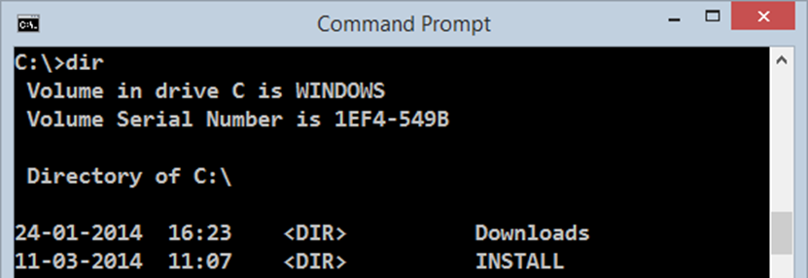
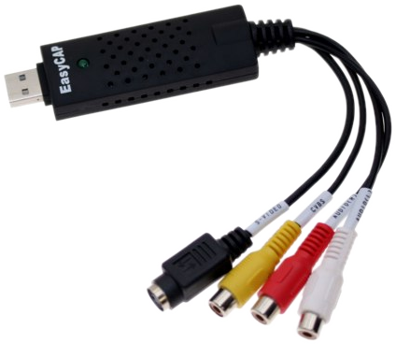


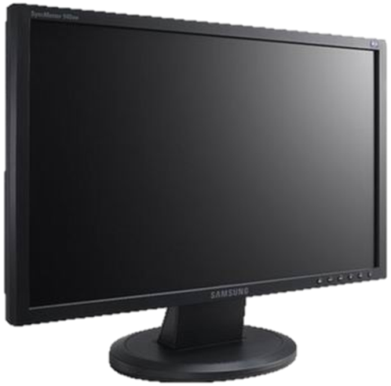
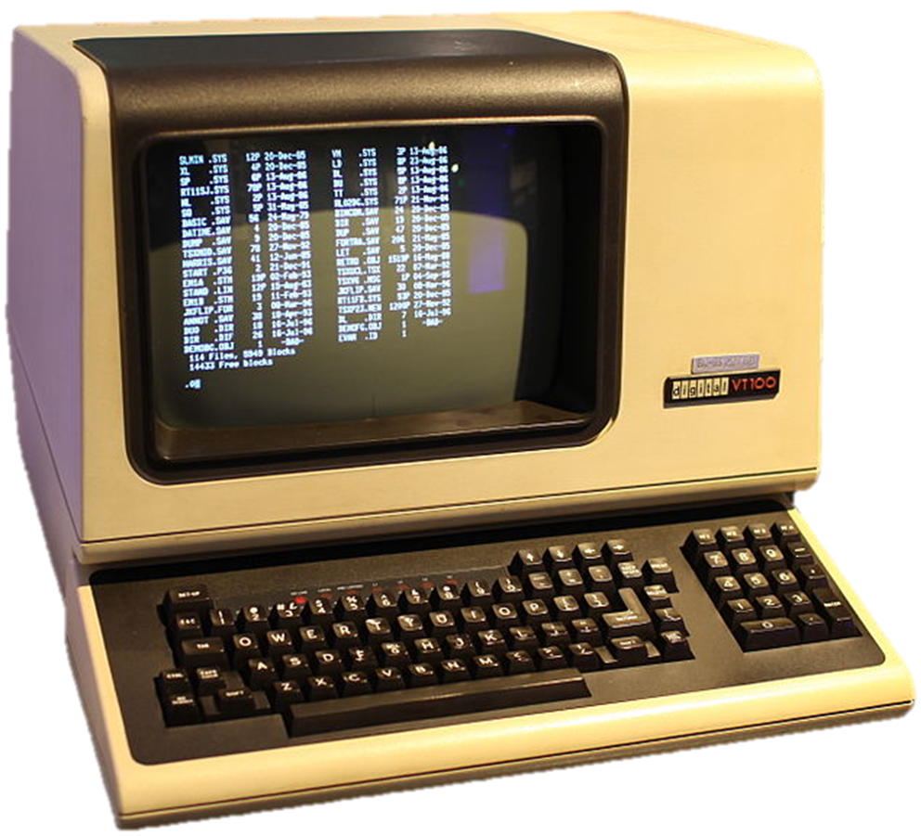

Console Input / Output
Reading and Writing to the Console
Svetlin Nakov
Technical Trainer
www.nakov.com
Software University
http://softuni.bg

Slide 2
Table of Contents
Printing to the Console
Printing Strings and Numbers
Reading from the Console
Reading Characters
Reading Strings
Parsing Strings to Numeral Types
Reading Numeral Types
Various Examples

Slide 3
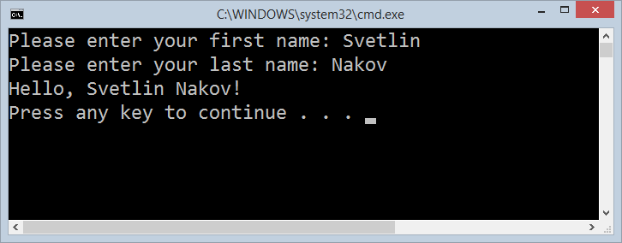
Printing to the Console
Printing Strings, Numeral Types and Expressions

Slide 4
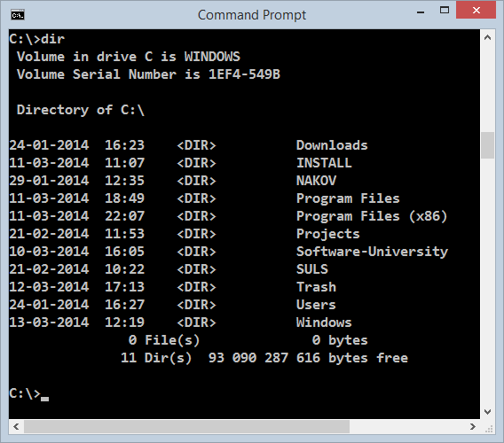
Printing to the Console
The console (terminal window) is used to read / display text-based information in a virtual terminal window
Learn more from Wikipedia: terminal emulator, virtual console
Can display different values:
Strings
Numeral types
All primitive data types
To print to the console use the Console class (System.Console)

Slide 5
The Console Class
Provides methods for console input and output
Input
Read(…) – reads a single character
ReadKey(…) – reads a combination of keys
ReadLine(…) – reads a single line of characters
Output
Write(…) – prints the specified argument on the console
WriteLine(…) – prints specified data to the console and moves to the next line

Slide 6
Console.Write(…)
Printing an integer variable:
Printing more than one variable using a formatting string:
int a = 15;
Console.Write(a); // 15
double a = 15.5;
int b = 14;
...
Console.Write("{0} + {1} = {2}", a, b, a + b);
// 15.5 + 14 = 29.5
The next print operation will start from the same line

Slide 7
Console.WriteLine(…)
Printing a string variable + new line (\r\n):
string str = "Hello C#!";
Console.WriteLine(str);
Printing more than one variable using a formatting string:
string name = "Marry";
int year = 1987;
...
Console.WriteLine("{0} was born in {1}.", name, year);
// Marry was born in 1987.
Next printing will start from the new line

Slide 8
Printing to the Console – Example
static void Main()
{
string name = "Peter";
int age = 18;
string town = "Sofia";
Console.Write("{0} is {1} years old from {2}.",
name, age, town);
// Result: Peter is 18 years old from Sofia.
Console.Write("This is on the same line!");
Console.WriteLine("Next sentence will be on a new line.");
Console.WriteLine("Bye, bye, {0} from {1}.", name, town);
}

Slide 9
Formatting Strings
{index[,alignment][:formatString]}
index
The zero-based index of the argument whose string representation is to be included at this position in the string
alignment
A signed integer that indicates the total length of the field into which the argument is inserted
a positive integer – right-aligned
a negative integer – left-aligned

Slide 10
Formatting Strings (2)
{index[,alignment][:formatString]}
formatString
Specifies the format of the corresponding argument's result string, e.g. "X", "C", "0.00", e.g.
static void Main()
{
double pi = 1.234;
Console.WriteLine("{0:0.000000}", pi);
// 1.234000
}

Slide 11
Formatting Strings – Examples
static void Main()
{
int a=2, b=3;
Console.Write("{0} + {1} =", a, b);
Console.WriteLine(" {0}", a+b);
// 2 + 3 = 5
Console.WriteLine("{0} * {1} = {2}", a, b, a*b);
// 2 * 3 = 6
float pi = 3.14159206;
Console.WriteLine("{0:F2}", pi); // 3,14 or 3.14
Console.WriteLine("Bye – Bye!");
}

Slide 12
Printing a Menu – Example
double colaPrice = 1.20;
string cola = "Coca Cola";
double fantaPrice = 1.20;
string fanta = "Fanta Dizzy";
double zagorkaPrice = 1.50;
string zagorka = "Zagorka";
Console.WriteLine("Menu:");
Console.WriteLine("1. {0} – {1}", cola, colaPrice);
Console.WriteLine("2. {0} – {1}", fanta, fantaPrice);
Console.WriteLine("3. {0} – {1}", zagorka, zagorkaPrice);
Console.WriteLine("Have a nice day!");

Slide 13

Printing to the Console
Live Demo

Slide 14

Reading from the Console
Reading Strings and Numeral Types

Slide 15
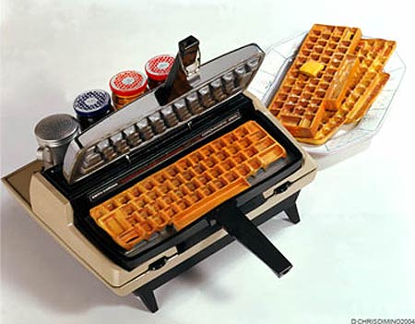
Reading from the Console
We use the console to read information from the command line
Usually the data is entered from the keyboard
We can read:
Characters
Strings
Numeral types (after conversion)
To read from the console we use the methods Console.Read() and Console.ReadLine()

Slide 16
Console.Read()
Gets a single character from the console (after [Enter] is pressed)
Returns a result of type int
Returns -1 if there aren’t more symbols
To get the actually read character we need to cast it to char
int i = Console.Read();
char ch = (char) i; // Cast the int to char
// Gets the code of the entered symbol
Console.WriteLine("The code of '{0}' is {1}.", ch, i);

Slide 17


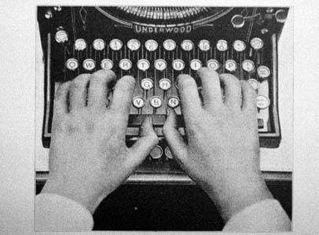
Reading Characters from the Console
Live Demo

Slide 18
Console.ReadKey()
Waits until a combination of keys is pressed
Reads a single character from console or a combination of keys
Returns a result of type ConsoleKeyInfo
KeyChar – holds the entered character
Modifiers – holds the state of [Ctrl], [Alt], …
ConsoleKeyInfo key = Console.ReadKey();
Console.WriteLine();
Console.WriteLine("Character entered: " + key.KeyChar);
Console.WriteLine("Special keys: " + key.Modifiers);

Slide 19
Reading Keys from the Console
Live Demo

Slide 20
Console.ReadLine()
Gets a line of characters
Returns a string value
Returns null if the end of the input is reached
Console.Write("Please enter your first name: ");
string firstName = Console.ReadLine();
Console.Write("Please enter your last name: ");
string lastName = Console.ReadLine();
Console.WriteLine("Hello, {0} {1}!", firstName, lastName);

Slide 21

Reading Strings from the Console
Live Demo

Slide 22
Reading Numeral Types
Numeral types can not be read directly from the console
To read a numeral type do the following:
Read a string value
Convert (parse) it to the required numeral type
int.Parse(string)
Parses (converts) a string to int
string str = Console.ReadLine()
int number = int.Parse(str);
Console.WriteLine("You entered: {0}", number);

Slide 23

Converting Strings to Numbers
Numeral types have a method Parse(…) for extracting the numeral value from a string
int.Parse(string) – string → int
long.Parse(string) – string → long
float.Parse(string) – string → float
Causes FormatException in case of error
string
int
string s = "123";
int i = int.Parse(s); // i = 123
long l = long.Parse(s); // l = 123L
string invalid = "xxx1845";
int value = int.Parse(invalid); // FormatException

Slide 24
Reading Numbers from the Console – Example
static void Main()
{
int a = int.Parse(Console.ReadLine());
int b = int.Parse(Console.ReadLine());
Console.WriteLine("{0} + {1} = {2}", a, b, a+b);
Console.WriteLine("{0} * {1} = {2}", a, b, a*b);
float f = float.Parse(Console.ReadLine());
Console.WriteLine("{0} * {1} / {2} = {3}", a, b, f, a*b/f);
}

Slide 25
Converting Strings to Numbers (2)
Converting can also be done through the Convert class
Convert.ToInt32(string[, base]) – string → int
Convert.ToSingle(string)– string → float
Convert.ToInt64(string)– string → long
It uses the parse methods of the numeral types
string s = "123";
int i = Convert.ToInt32(s); // i = 123
long l = Convert.ToInt64(s); // l = 123L
string invalid = "xxx1845";
int value = Convert.ToInt32(invalid); // FormatException

Slide 26

Reading Numbers from the Console
Live Demo

Slide 27
Error Handling when Parsing
Sometimes we want to handle the errors when parsing a number
Two options: use try-catch block or TryParse()
Parsing with TryParse():
string str = Console.ReadLine();
int number;
if (int.TryParse(str, out number))
{
Console.WriteLine("Valid number: {0}", number);
}
else
{
Console.WriteLine("Invalid number: {0}", str);
}

Slide 28

Parsing with TryParse()
Live Demo

Slide 29



Regional Settings
Printing and Reading Special Characters
Regional Settings and the Number Formatting

Slide 30
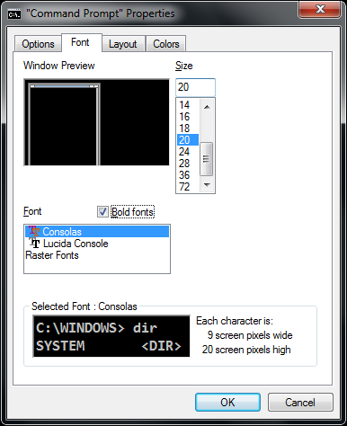
How to Print Special Characters on the Console?
Printing special characters on the console needs two steps:
Change the console properties to enable Unicode-friendly font
Enable Unicode for the Console by adjusting its output encoding
Prefer UTF8 (Unicode)
using System.Text;
…
Console.OutputEncoding = Encoding.UTF8;
Console.WriteLine("Това е кирилица: ☺");

Slide 31
Decimal Separator
The currency format and number formats are different in different countries
E.g. the decimal separator could be "." or ","
To ensure the decimal separator is "." use the following code:
using System.Threading;
using System.Globalization;
…
Thread.CurrentThread.CurrentCulture = CultureInfo.InvariantCulture;
Console.WriteLine(3.54); // 3.54
decimal value = decimal.Parse("1.33");

Slide 32

Regional Settings
Live Demo

Slide 33


Reading and Printing to the Console
Various Examples
Examples

Slide 34
Printing a Letter – Example
Console.Write("Enter person name: ");
string person = Console.ReadLine();
Console.Write("Enter company name: ");
string company = Console.ReadLine();
Console.WriteLine(" Dear {0},", person);
Console.WriteLine("We are pleased to tell you that " +
"{1} has accepted you to take part in the \"C# Basics\"" +
" course. {1} wishes you a good luck!", person, company);
Console.WriteLine(" Yours,");
Console.WriteLine(" {0}", company);

Slide 35

Printing a Letter
Live Demo

Slide 36
Calculating Area – Example
Console.WriteLine("This program calculates " +
"the area of a rectangle or a triangle");
Console.Write("Enter a and b (for rectangle) " +
" or a and h (for triangle): ");
int a = int.Parse(Console.ReadLine());
int b = int.Parse(Console.ReadLine());
Console.Write("Enter 1 for a rectangle or 2 for a triangle: ");
int choice = int.Parse(Console.ReadLine());
double area = (double) (a*b) / choice;
Console.WriteLine("The area of your figure is {0}", area);

Slide 37

Calculating Area
Live Demo

Slide 38

Summary
Basic input and output methods of the class Console
Write(…) and WriteLine(…)
Write values to the console
Read(…) and ReadLine(…)
Read values from the console
Parsing numbers to strings
int.Parse(…)
double.Parse(…)
…

Slide 39

Console Input / Output
http://softuni.bg/courses/csharp-basics/

Slide 40
License
This course (slides, examples, demos, videos, homework, etc.) is licensed under the "Creative Commons Attribution-NonCommercial-ShareAlike 4.0 International" license
Attribution: this work may contain portions from
"Fundamentals of Computer Programming with C#" book by Svetlin Nakov & Co. under CC-BY-SA license
"C# Part I" course by Telerik Academy under CC-BY-NC-SA license

Slide 41





Free Trainings @ Software University
Software University Foundation – softuni.org
Software University – High-Quality Education, Profession and Job for Software Developers
softuni.bg
Software University @ Facebook
facebook.com/SoftwareUniversity
Software University @ YouTube
youtube.com/SoftwareUniversity
Software University Forums – forum.softuni.bg

