Slide 1
Business Plan for the digital asset brokerage business Brooker Planner Co., Ltd.?
[Please insert the company’s logo]
Private & Confidential

Slide 2
Agenda and objectives
Company Profile
Business Plan
Business Operation and Policies

Slide 3
1. Overview of the company profile

Slide 4
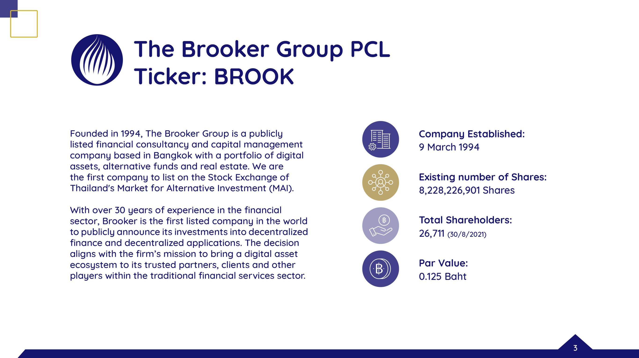

Slide 5
Introduction
In 2021, Brooker Group made a strategic direction towards digital assets and invested 1.2 billion baht in digital currencies and tokens.
For 2022, the company would like to build new business models involving digital assets. As a result, the company has setup a 100% owned subsidiary Brooker Planner Co., Ltd. to apply for Brokerage License.
Vision and strategy
To provide the best technology infrastructure to help customers access opportunities in global markets.
To provide liquidity for customers to construct their desired investment portfolio and risk appetite.
Notes:
[BM: Please add the relevant details. ]

Slide 6
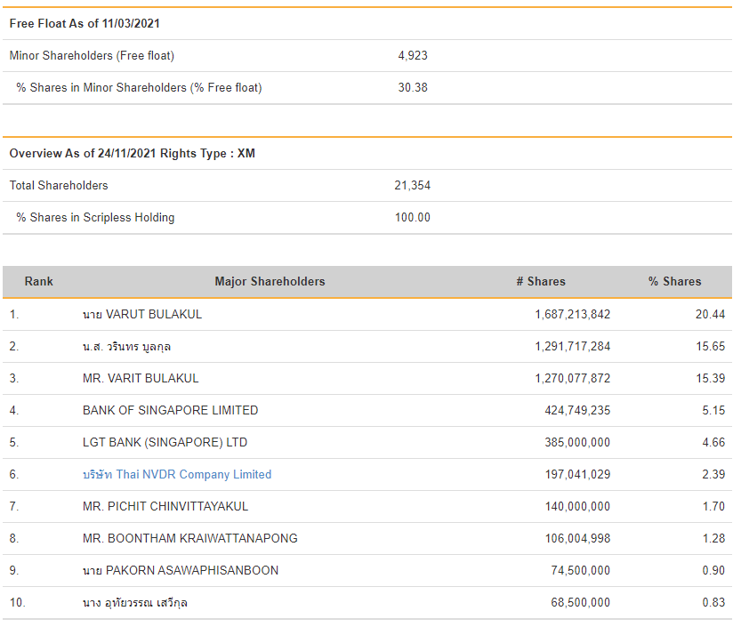
Shareholding structure
100% owned by BROOK

Slide 7
Organizational structure
[Please add the intended organizational structure chart of the entity that would be operating the digital asset business.]

Slide 8
Management/key officer’s work experience
[The management personnel should have relevant work experience in the digital asset business industry, finance, capital market or IT business.]
[The head of compliance department must have at least 2 years of work experience.]
Notes:
[BM: Please also consider providing the information of the directors for entirety purposes. Please note that the SEC will require the company to prepare the qualifications of the directors, persons with management power and major shareholders. It would be good to provide and prepare information on their experience within the investment, financial, or technology industry. Kindly note that the SEC prohibits a person being a director, persons with management power, and major shareholders of one digital asset business company to also be in another digital asset business company. This is to avoid conflict of interest.
The directors and management would also need to have qualifications of the following:
- หากสำเร็จการศึกษาระดับปริญญาตรีหรือเทียบเท่าที่สำนักงานคณะกรรมการข้าราชการพลเรือน (ก.พ.) รับรองจะต้องมีประสบการณ์การทำงานที่เกี่ยวข้องไม่น้อยกว่า 3 ปี หรือ หากสำเร็จการศึกษาตำกว่าระดับปริญญาตรี จะต้องมีประสบการณ์การทำงานที่เกี่ยวข้องไม่น้อยกว่า 5 ปี
- ไม่มีลักษณะต้องห้ามตามประกาศคณะกรรมการกำกับหลักทรัพย์และตลาดหลักทรัพย์]

Slide 9
2. Business plan and models

Slide 10
Business Plan
Economic value will be generated from wealth creation of customers who invested and have capital gains in digital currencies, tokens, or utility coins.
The strength of the company is the technology platform which is used and tested by millions of users.
The company will also provide low fees compared to existing players in the Thai market.
The company can will expand services to fit customer needs which may be similar to equities market. For example margin lending, private wealth, custodian, etc.
Product/service features
Customer Journey: Registration (Email/SMS)——>log in——>complete KYC(optional by Client)——>deposit fiat ( optional by Client) ——>deposit crypto currency—>trade
Target Group of Cusomters: Retail investors and High Net Worth.
[Please also consider preparing a high level on-boarding process (if any)]
Notes:
[BM: Please add the relevant details.]

Slide 11
KYC
3. Security process
(1) captcha test： Completely Automated Public Turing test to tell Computers and Humans Apart"
(2) Google 2F
(3) Anti-Phishing Code (optional)

Slide 12
Data and transaction flow
Data flow of the digital asset brokerage services
[Please provide the data flow of the end-to-end brokerage service.]
Transaction flow of digital asset brokerage services
[Please provide the transaction flow of the end-to-end brokerage service. This include how the company connect with the investor, how the company connect with exchange(s)? Are there any third parties providing the outsourcing service to the company?]
Notes:
[BM: This is an important part where the SEC will be able to have a great understanding on the business operator’s business.]

Slide 13
3. Business operations and policies

Slide 14
Digital Asset Brokerage Service
Best Execution Process
[Please explain how the company execute the trading order for investor on a “Best Execution” method to ensure that the investor could get the best order offered at such time. This includes the relevant details (e.g. Would the company open the omnibus account with the exchange to reflect the order on the platform? Are there any reserve that the company needs to provide to the exchange to ensure the order could be executed in a timely manner? ]
Selection of Digital Exchange Platform
[Please provide the company’s rules/criteria for selecting the partnering exchange. The requirements set under the regulations are provided to you in the summary of relevant requirements. The company may consider adding any criteria to ensure that the partnering exchange is secured and efficient.]
Selection of Digital Asset
[Please provide the company’s rules/criteria for selecting the digital assets to be made available for the investors.]
Notes:
[BM: This is an important part where the SEC will be able to have a great understanding on the business operator’s business.]

Slide 15
Outsourcing to third parties
[Please consider providing the following:
The intended policy, measure, and guideline for outsourcing to third parties;
The intended third parties that would be providing the outsourcing service to the company; and
The intended services to be outsourced by third parties.
This must ensure compliance with relevant regulations and requirements.]

Slide 16
Asset Safekeeping
[Please consider providing the following:
The method and process for (i) fiat and (ii) digital asset keeping;
The criteria in selecting a third-party digital asset custodian;
The intended third-party custodian that the company intends to use;
The custody plan regarding to the company holding one key and still requiring two out of three keys.
This must ensure compliance with relevant regulations and requirements.]

Slide 17
IT systems and IT risk management
[Please consider providing the following:
The key information on IT system used in providing the services.
IT security policies/measures
Systems and measure to ensure the availability and continuity of the services.]
Notes:
[BM: Please add the relevant details.]

Slide 18
Risk Management
Risk management and risk assessment
[Please consider providing a high-level explanation of risk management, risk management procedures, responsible department, authorized person for approval, period for review of risk, method for risk assessment, risk appetite covering all the important aspects (i.e. business risk, IT and cyber risk, operational risk, financial risk, market risk, anti-money laundering, legal and compliance risk.]
Risk monitoring and review
Business Continuity Management (BCM)
[Please consider providing a summary of business continuity management policy, business continuity plan, disaster recovery plan covering critical business function.]
Notes:
[BM: Please add the relevant details.]

Slide 19
Questions and answers

