Slide 1
Haldane’s Model for Recombination
A model to determine how many recombination events happen in a genomic window

Slide 2
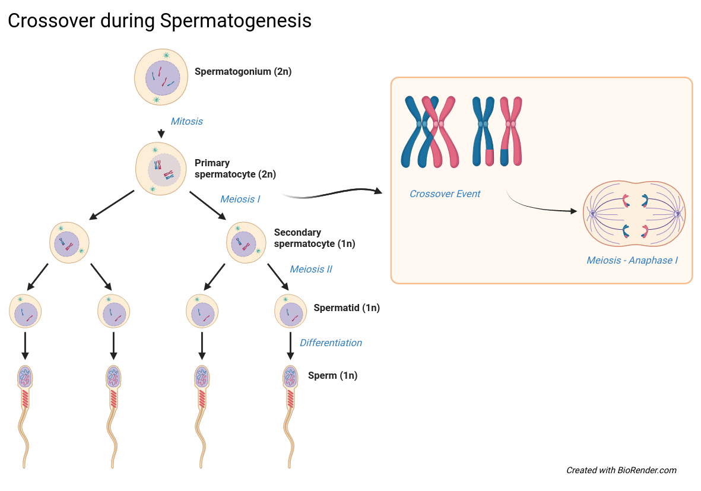
Notes:
Crossovers are the events in which genetic recombination happens. They happen between two homologous chromosomes during meiosis. These chromosomes can exchange genetic material during the alignment of the chromosomes before meiosis I. The number and distribution of crossover events over the chromosomes can be influenced by the physical structure of the chromosomes, recombination hotspots and regulatory mechanisms.

Slide 3
Crossovers
Exchange of DNA segments between homologous chromosomes
Important role in evolution as it shuffles genetic material
Notes:
Genetic recombination through crossovers is an important mechanism for evolution. The recombination shuffles genes into new combinations, which leads to a bigger diversity in the offspring generation.

Slide 4
Searching for anomalies
Where are more recombination events than expected?
Where are less recombination events than expected?
Notes:
To understand crossovers, we might be interested where in the genome they occur more frequent than on average or less frequent than on average. This could provide us with the sites we might dig into to look for special composition or physical structure of the chromosome.

Slide 5
Expected location of crossovers
Assumption: between every base the likelihood of a crossover event is the same, implies:
Uniform chromosomal structure
Independent crossover events
Steady recombination rate
-> Binomial Model
Notes:
How are we able to make a prediction of how many crossovers there should be in each genomic region?
We can assume that it is exactly equally likely to get a crossover between any nucleotide in the whole genome.
This implies these three points:
Uniform chromosomal structure: At any point of the chromosome the recombination rate is equal
Independent crossover events: The occurrence of one crossover event does not increase or decrease the probability of another crossover event within the same window
Steady recombination rate: The rate of recombination is the same for unit length of DNA.
This leaves us with a Binomial model, where the probability for a certain number of successes is defined by the amount of tries and the probability of success in each try. In our case that would leave us with the number of nucleotides in the window and the per base recombination probability.

Slide 6
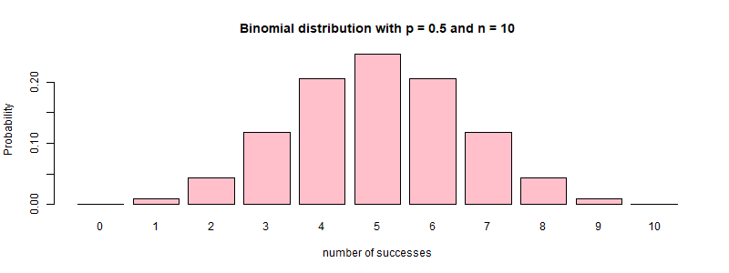
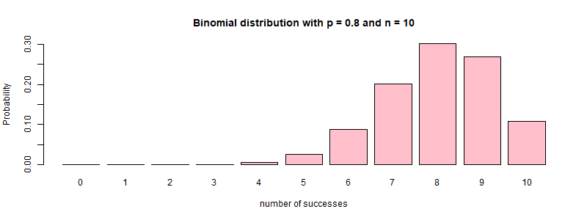
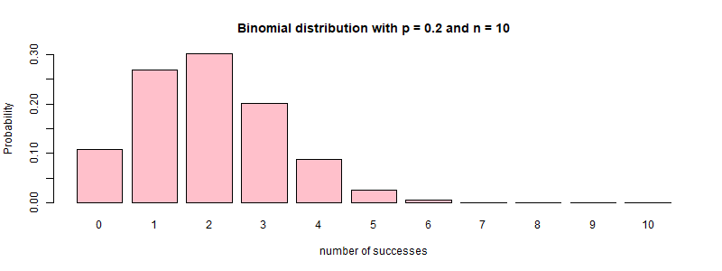
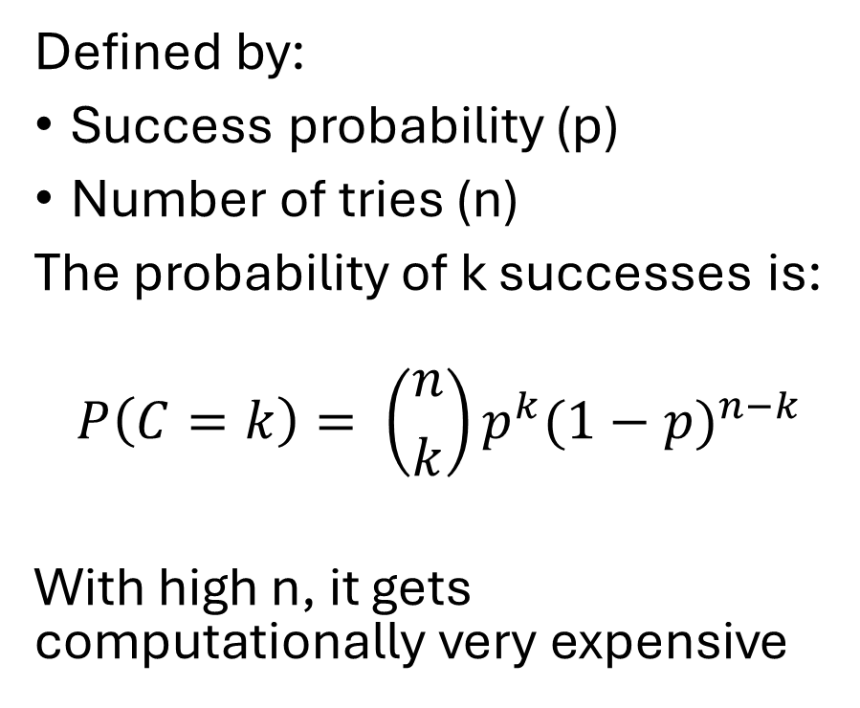
Binomial Model
Defined by:
Success probability (p)
Number of tries (n)
The probability of k successes is:
$$P\left(C=k\right)= \left({n \atop k}\right)p^{k}{(1−p)}^{n−k}$$
With high n, it gets computationally very expensive

Slide 7
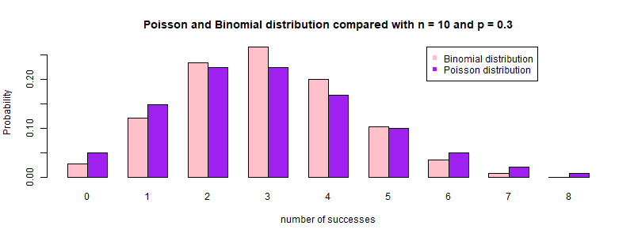
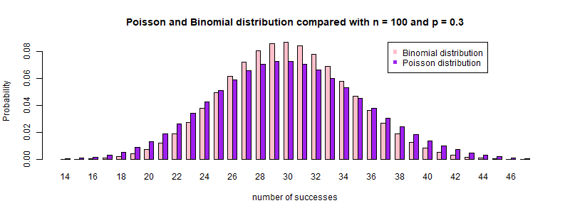
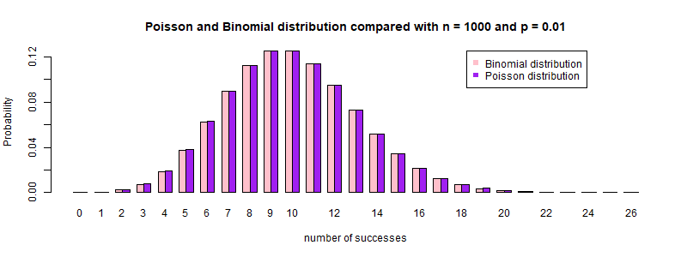
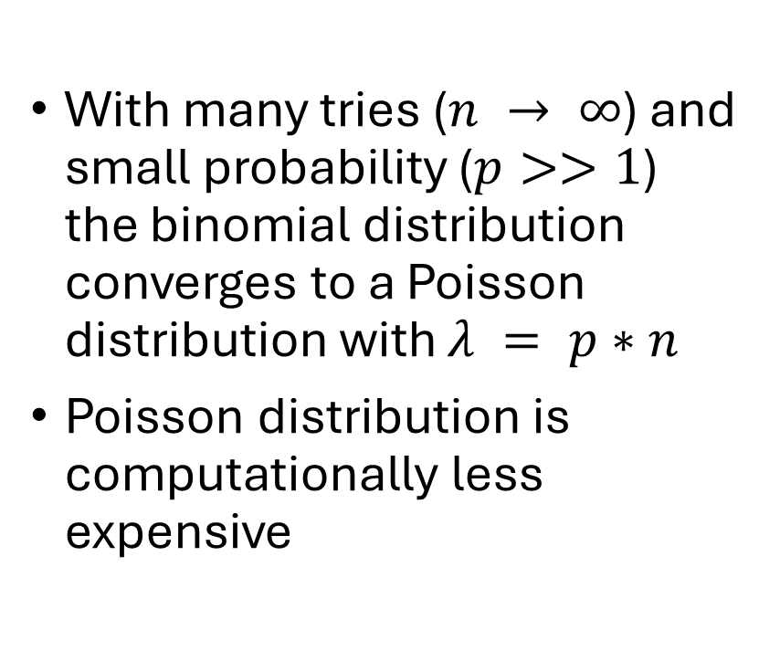
Binomial distribution converges to Poisson distribution
With many tries ($n → ∞$) and small probability ($p>>1$) the binomial distribution converges to a Poisson distribution with $λ = p∗n$
Poisson distribution is computationally less expensive

Slide 8
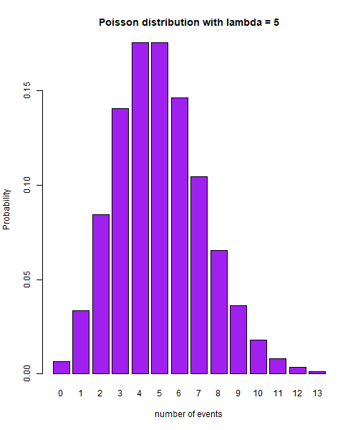
Poisson distribution
Used to describe probability for a certain number of events in a certain timeframe
Similar to binomial model as it models numbers of events (≈ successes = k) during a certain frame
The tries in the Poisson distribution are continuous and can therefore approximate very big amounts of tries

Slide 9
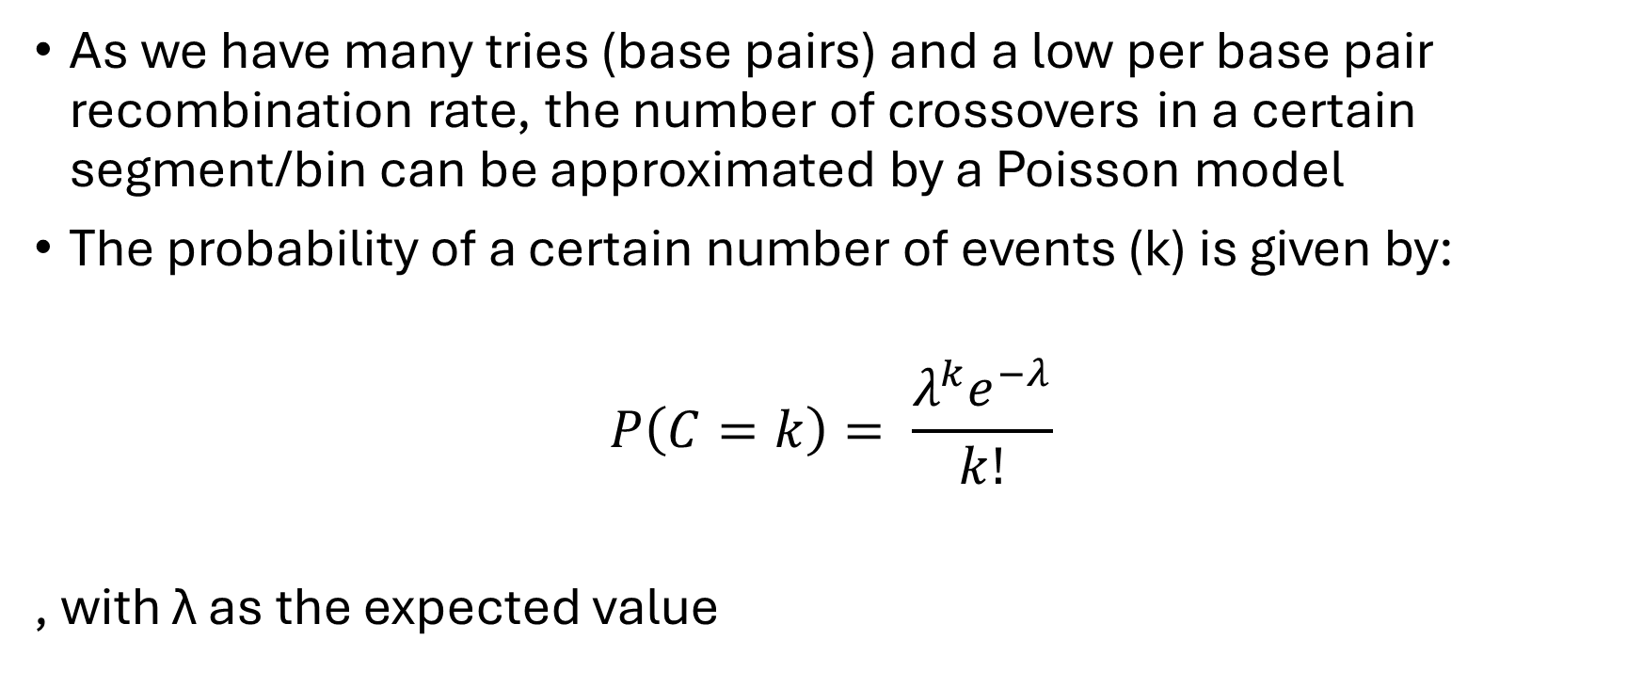
Poisson model applies for crossovers
As we have many tries (base pairs) and a low per base pair recombination rate, the number of crossovers in a certain segment/bin can be approximated by a Poisson model
The probability of a certain number of events (k) is given by:
$$P\left(C=k\right)= \frac{λ^{k}e^{−λ}}{k!}$$
, with λ as the expected value

Slide 10
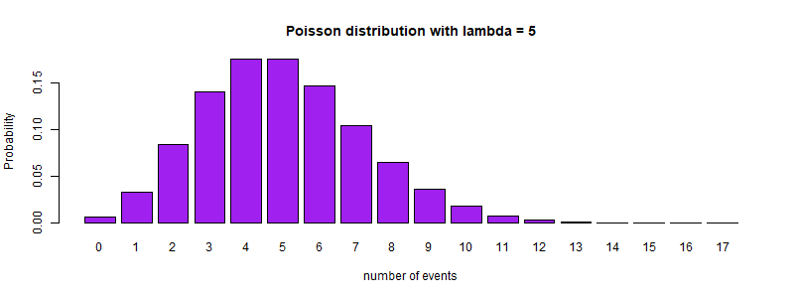
Recombination hotspots
To see whether a genomic region is a recombination hotspot, we can compare the amount of recombination with the probability distribution
Define a threshold (α) for how improbable the value is which you count as a hotspot.
α = 0.05
α = 0.01
α = 0.001

Slide 11
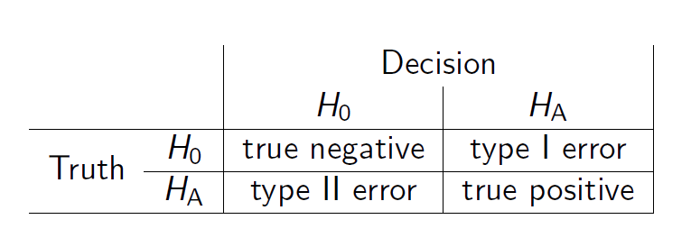

False discovery rate (FDR) Proportion of false positives among positives
FDR tries to identify the proportion of type I errors (Truth =$H_{0 }$& Decision = $H_{A}$) among all positive test results (Decision = $H_{A}$)
$FDR =$ $\frac{type I error}{type I error+true positive}$

Slide 12
True positives
Influenced by effect size and power of the test

