Slide 1

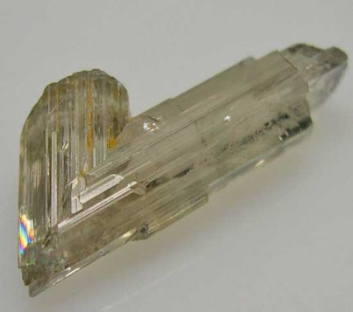

Diaspore

Slide 2
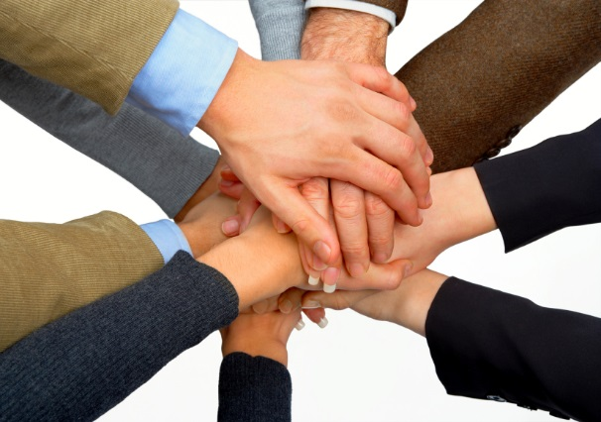
Team members
bankoff , bgotov, nina.krusteva, Ivan.Dimitrov.b, evgenitochev
Nina Markova
Borislav Gotov
Evgeni Tochev
Ivan Dimitrov
Yordan Bankov

Slide 3
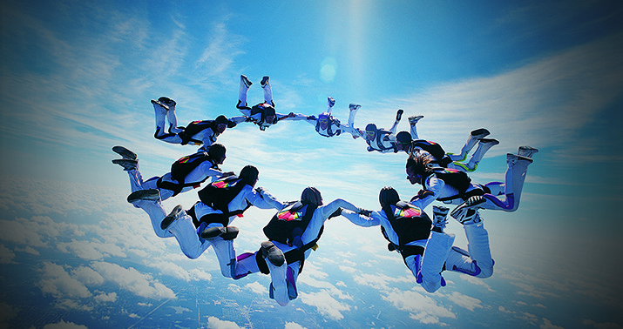
We began with a brilliant start

Slide 4
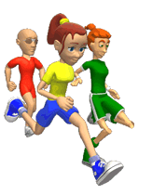
Initial Ideas
Тo create a program that presents statistics of past events in athletics
With a lot of screens to create coaches, athletes, tournaments and disciplines
Implement images in the program
To create different color themes on the screen that the user can choose
Goal: Show moving objects
in our project

Slide 5
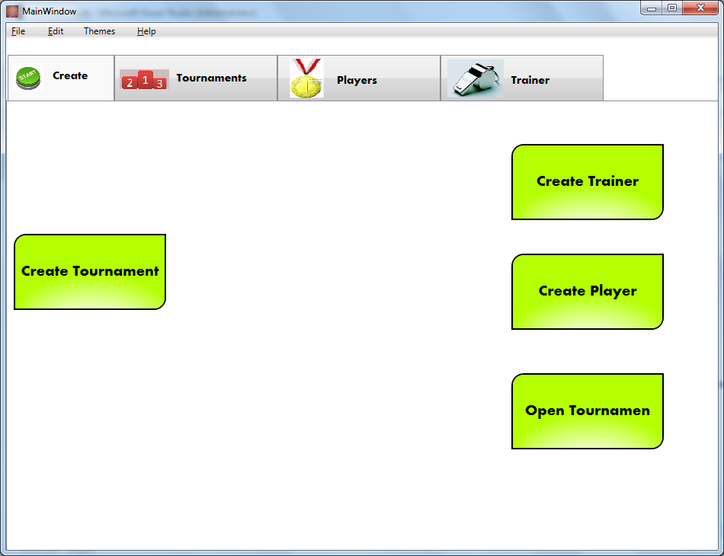
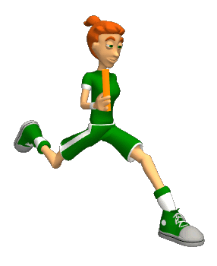
Project:
Athletics Guide

Slide 6
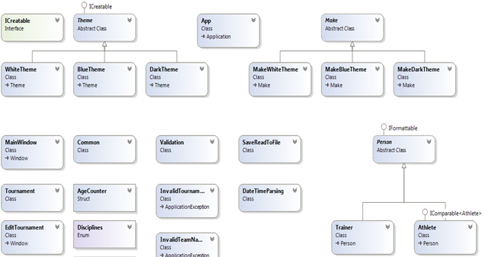
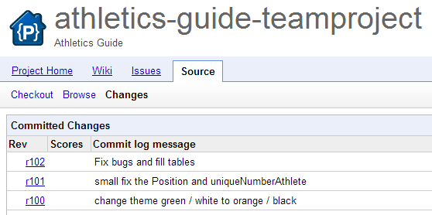
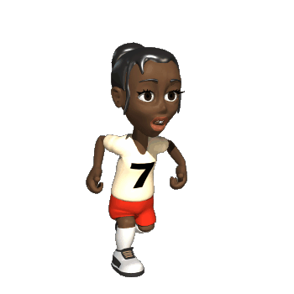
The best thing,
that boosted our teamwork was everybody`s contribution

Slide 7
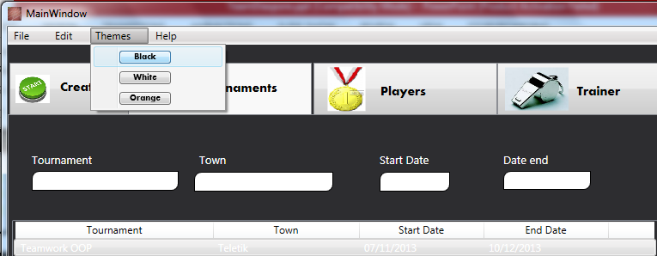
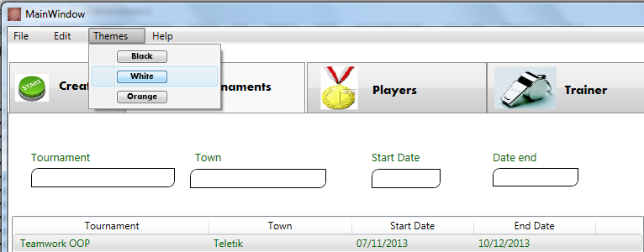
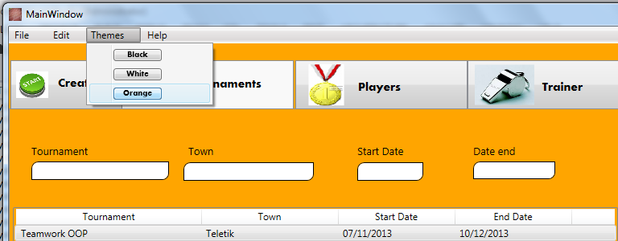

Persistency of all
team members
achieved
excellent
results

Slide 8
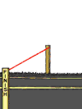
Thank you for your attention!

