Slide 1




Slide 2
bankoff
themagicis
ralitsa.radeva
valentin.genev
Yordan Bankov
Nikola Nikolov
Ralitza Radeva
Valentin Genev
Yordan Bankov - bankoff
Nikola Nikolov - themagicis
Ralitza Radeva - ralitsa.radeva
Valentin Genev - valentin.genev
Team members

Slide 3
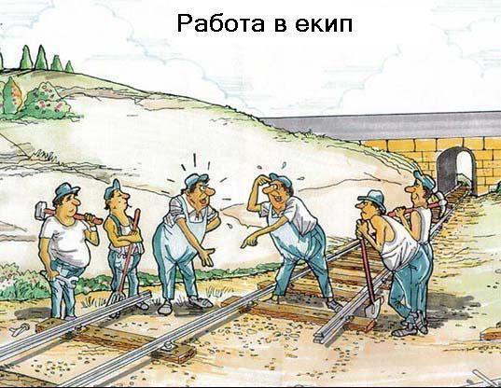
Initial expectations about what could have happened

Slide 4
Initial Ideas
To create logical game
With several levels
To implement movements on the screen of the console
To implement movement of text
Goal: To show, that our team can implement animation in console game

Slide 5
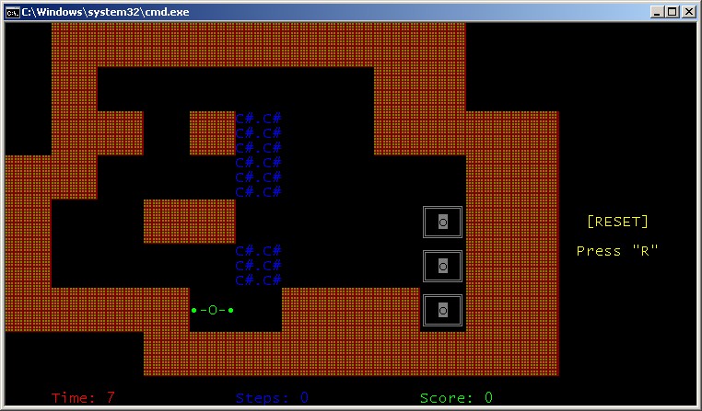
Project: PushIt! Game

Slide 6
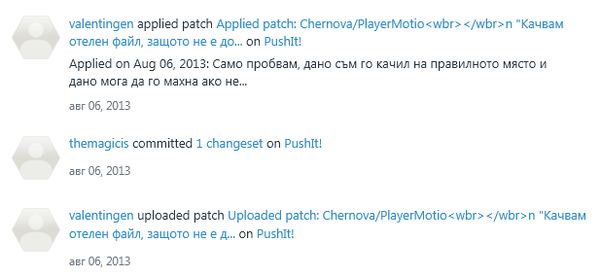
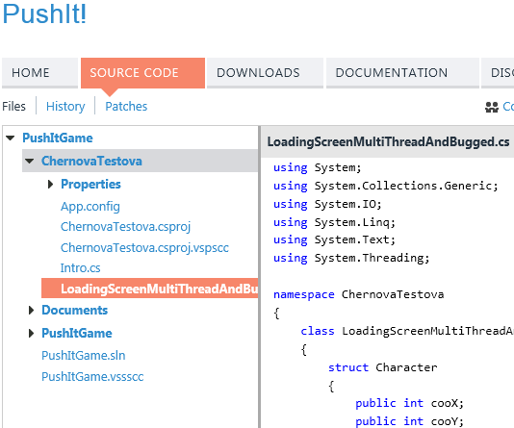
Generation of separate project for ideas
The best thing, that boosted our teamwork and assisted in everybody`s contribution

Slide 7
Thank you for your attention!

