Slide 1


Team Kobra

Slide 2

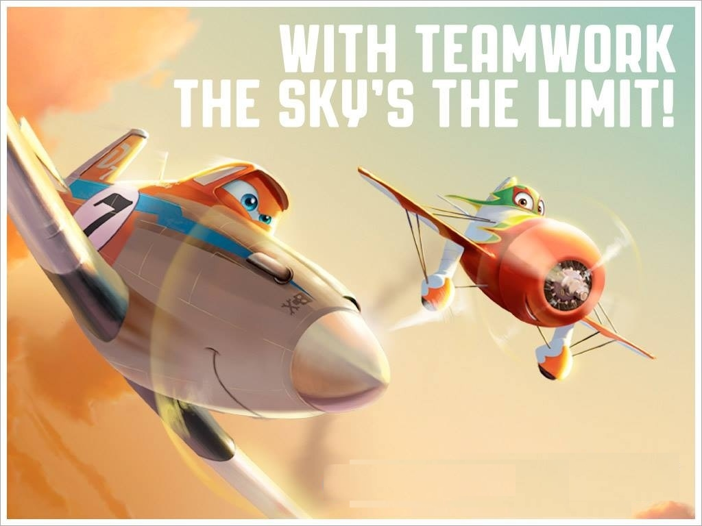
Team members
smile7 , dimitar.mitev.7374, Antoni.Dikov, stefanN, bankoff
Silvena Miteva
Dimitar Mitev
Antoni Dikov
Stefan Naumov
Yordan Bankov

Slide 3
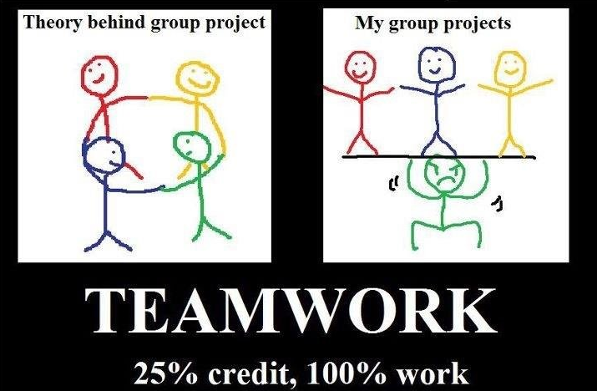
Initial expectations
about what could have happened

Slide 4
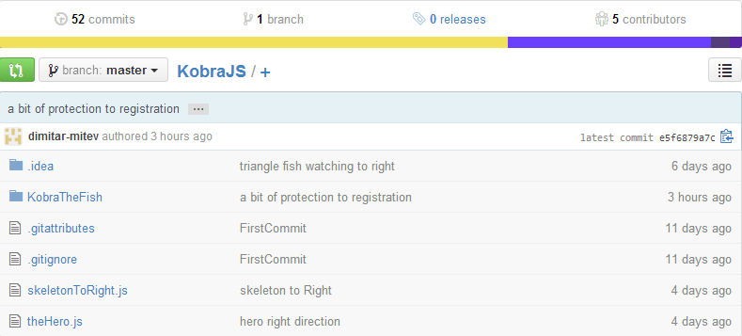
https://github.com/smile7/KobraJS

Slide 5
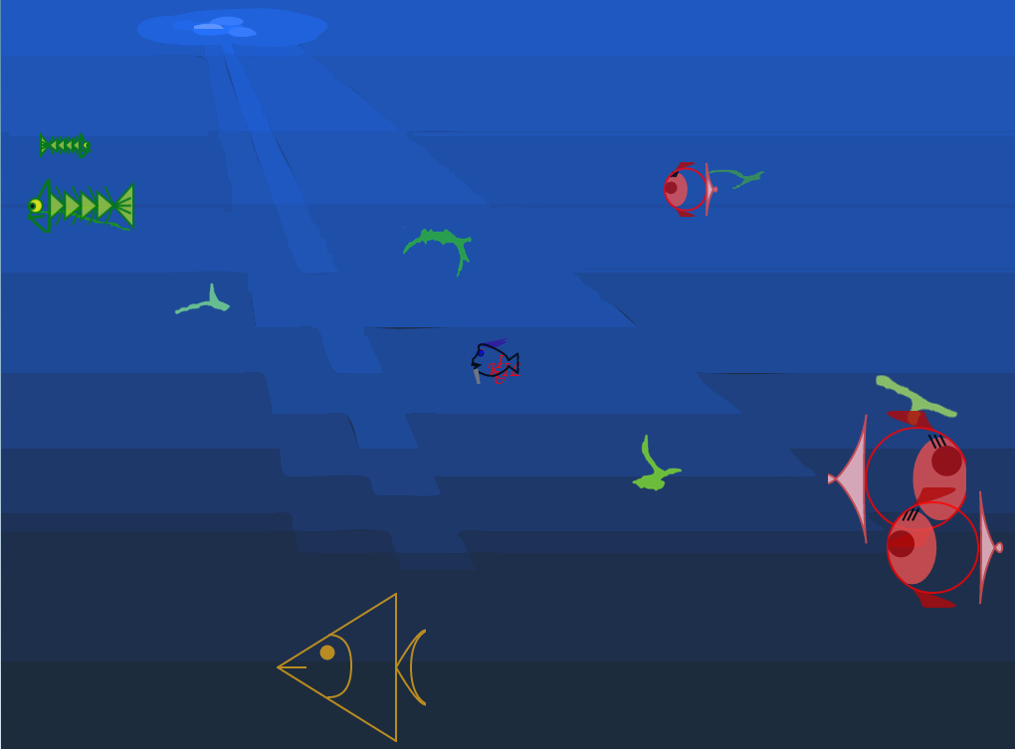
Kobra the Fish is a web application with entertainment purposes (game).

Slide 6
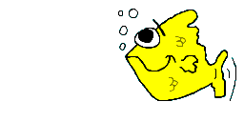
Project:
Kobra the Fish
used libraries:
kinetic.js
jQuery
inheritance.js
server side: VBScript:
mainincludes.asp: includes needed files to all pages
logIn.asp: provides interface to the client to log in or register
game.asp: provides interface for playing the game and
register.asp: executes script for registering user
saveScore.asp: executes script for saving the player score onto the server
client side:
userScore.js: contains AJAX functions for communicating with the server for handling user information, as well as functions saving and loading from browser local storage.
Game.js: the main game engine
gameObjects.js : base class for the scripts generating the game objects.
XXX.js: scripts visualizing game objects.

Slide 7

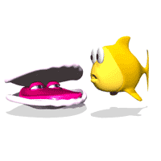
allocation of jobs
Silvena Miteva, Stefan Naumov, Yordan Bankov
SVG, Canvas, DOM
Dimitar Mitev
server side
Antoni Dikov
collision detection

Slide 8
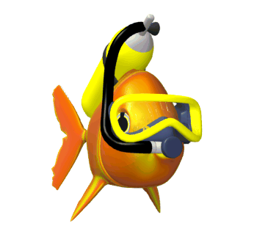
Thank you for your attention!

